Slide 1
Graph-based SLAM and Occupancy Grid Mapping for Robot Simulation
Yixing Lin

Slide 2
Simultaneous Localization and Mapping
SLAM refers to Simultaneous Localization and Mapping.
Mapping refers to build a map to describe an unknown environment using different kinds of sensors.
localization is to estimate the location of a mobile robot in that map.
Both of localization and mapping should exist and solve simultaneously.
Challenge:
SLAM is a chicken-and-egg problem, since localization depends on a given map and the mapping requires the robot location.

Slide 3
The Task of the Project Work
Implement and integrate the Graph-based SLAM into a simulator, called sobot-rimulator.
Compare the Graph-based SLAM with the previously integrated SLAM algorithms.
Add noises to sensors and motors.
Implement and integrate the Occupancy Grid Mapping algorithm.

Slide 4
The Task of the Project Work
Modifications of the simulator:
Feature-based map containing large rectangular obstacles (more realistic).
Map used in the previous project
Map used in new project

Slide 5
The Task of the Project Work
Modifications of the simulator:
Visualization of the occupancy grid mapping.

Slide 6
SLAM Problem
Online SLAM Problem
e.g. EKF SLAM and FastSLAM
SLAM Problem
Full SLAM Problem
e.g. Graph-based SLAM

Slide 7
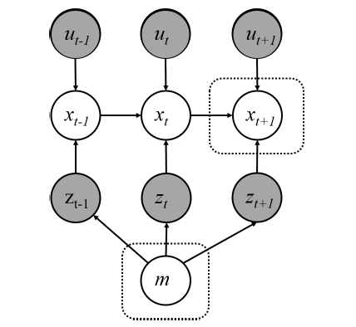
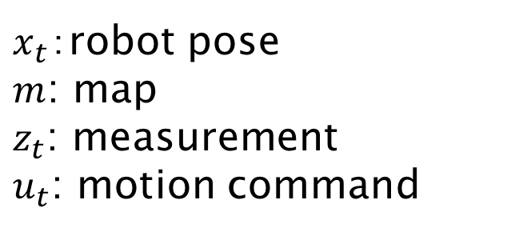
Online SLAM Problem
$x_{t}$：robot pose
$m$: map
$z_{t}$: measurement
$u_{t}$: motion command
Algorithms: e.g. EKF SLAM, FastSLAM.
Dynamic Bayesian Network

Slide 8
SLAM Problem
Online SLAM Problem
e.g. EKF SLAM and FastSLAM
SLAM Problem
Full SLAM Problem
e.g. Graph-based SLAM

Slide 9
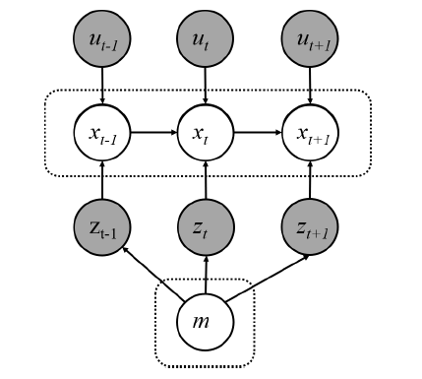
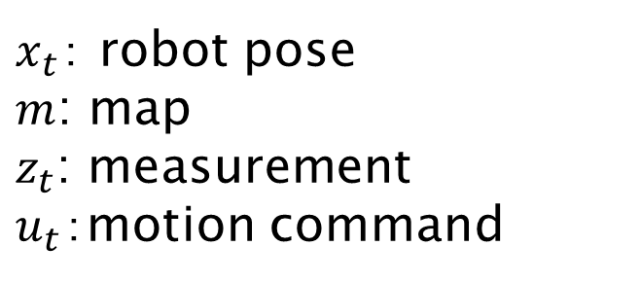
Full SLAM Problem
$x_{t}$： robot pose
$m$: map
$z_{t}$: measurement
$u_{t}$：motion command
Graph-based SLAM algorithm:
A state-of-the-art method to solve the full SLAM problem.
Dynamic Bayesian Network

Slide 10
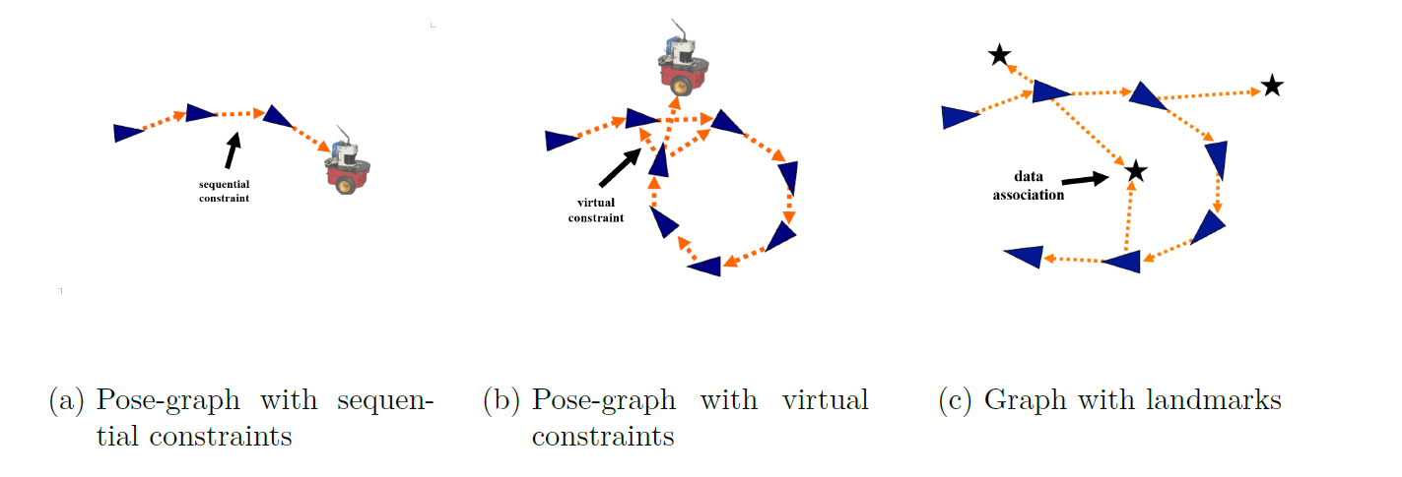
Full SLAM Problem – Graph-based SLAM
Representation of the SLAM problem:
The full SLAM problem is represented by a graph,
A vertices represents either a robot poses or landmark,
An Edge represents a spatial constraint between neighboring vertices.
http://ais.informatik.uni-freiburg.de/teaching/ws17/mapping/pdf/slam15-ls-slam.pdf
http://ais.informatik.uni-freiburg.de/teaching/current-ws/mapping/pdf/slam17-ls-landmarks.pdf

Slide 11
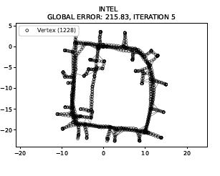
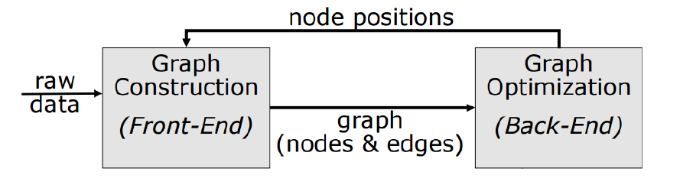
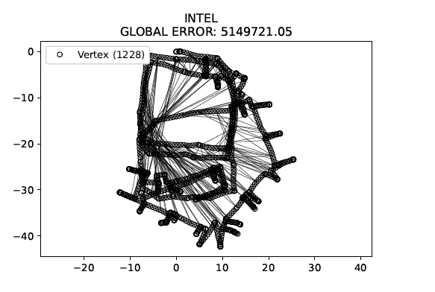
Full SLAM Problem – Graph-based SLAM
Structure of the Graph-based SLAM problem：
http://ais.informatik.uni-freiburg.de/teaching/ws17/mapping/pdf/slam15-ls-slam.pdf

Slide 12
Full SLAM Problem – Graph-based SLAM
Structure of the Graph-based SLAM problem：

Slide 13
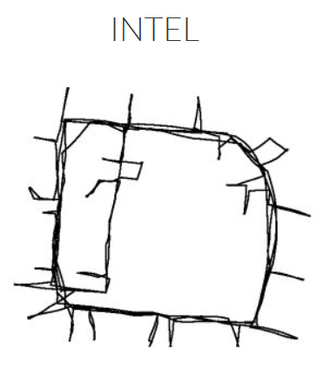
Full SLAM Problem – Graph-based SLAM
Front-End:
Predict the trajectory and landmark positions based on incoming raw data from sensors and odometry.
There exists errors, so the predicted trajectory may be unreasonable.
The map of the Intel Research Lab in Seattle
The graph constructed based on raw data acquired at the Intel Research Lab in Seattle.
Big difference from the ground-truth!
https://lucacarlone.mit.edu/datasets/

Slide 14



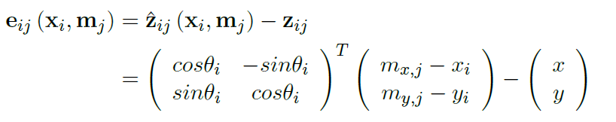
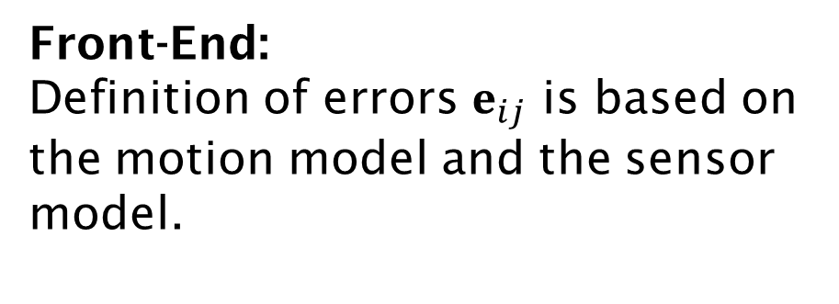
Full SLAM Problem – Graph-based SLAM
Actual measurement:
Front-End:
Definition of errors $e_{ij}$ is based on the motion model and the sensor model.
Landmark position:
Example:
The error vector of a X-Y sensor model is given by:
Robot pose:

Slide 15
Full SLAM Problem – Graph-based SLAM
Structure of the Graph-based SLAM problem：

Slide 16
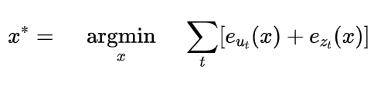

Full SLAM Problem – Graph-based SLAM
Back-End:
Bayes rule
Markov assumption
logarithm
Gaussian assumption
Estimate the SLAM Posterior
Maximum Likelihood Estimation
Least Squares Minimization
sum of the quadratic errors of the odometry and sensor measurements
sensor model
motion model
Least squares problem!
$x_{t}$： robot pose, $m$: map, $z_{t}$: measurement, $u_{t}$motion command， $x_{0}$： initial robot pose.

Slide 17
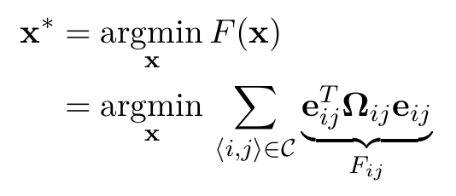
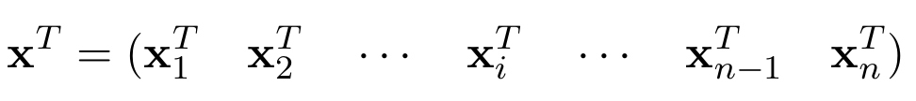
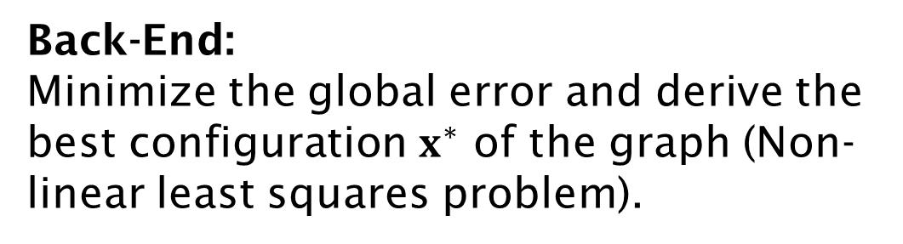
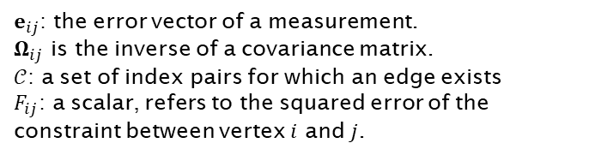
Full SLAM Problem – Graph-based SLAM
Back-End:
Minimize the global error and derive the best configuration $x^{∗}$ of the graph (Non-linear least squares problem).
Equivalent to the estimate the posterior of the full SLAM problem.
Linearizing the error,
Calculating the linear system,
Solving the linear system,
Update the graph
Repeating the process until the graph converges.
Gauss-Newton minimization algorithm
$e_{ij}$: the error vector of a measurement.
$Ω_{ij}$ is the inverse of a covariance matrix.
$𝒞$: a set of index pairs for which an edge exists
$F_{ij}$: a scalar, refers to the squared error of the constraint between vertex $i$ and $j$.

Slide 18
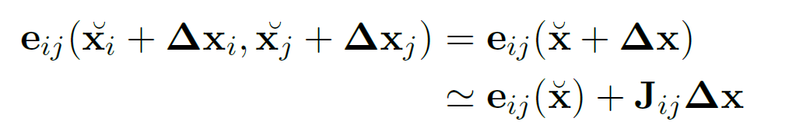

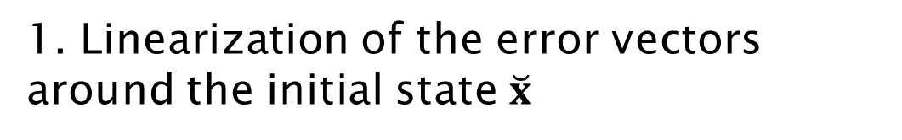
Gauss-Newton Minimization
1. Linearization of the error vectors around the initial state $\breve{x}$
First-order Taylor Expansion
Note: $Δx$is a long state vector that contains all vertices of the graph.

Slide 19
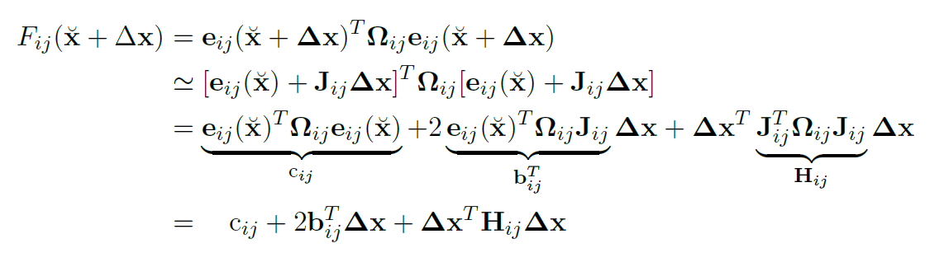
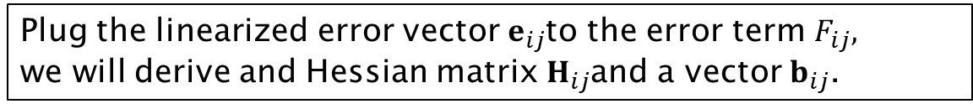
Gauss-Newton Minimization
2. Calculate the linear system.
Plug the linearized error vector $e_{ij}$to the error term $F_{ij},$
we will derive and Hessian matrix $H_{ij}$and a vector $b_{ij}$.

Slide 20
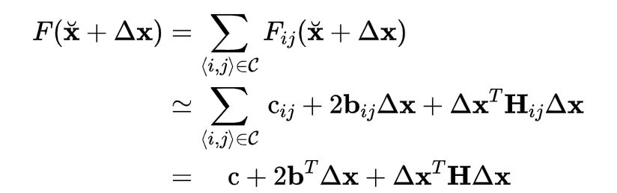
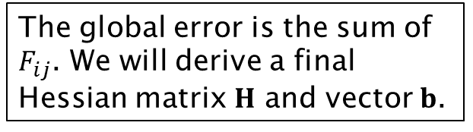
Gauss-Newton Minimization
2. Calculate the linear system.
The global error is the sum of $F_{ij}$. We will derive a final Hessian matrix $H$ and vector $b$.

Slide 21


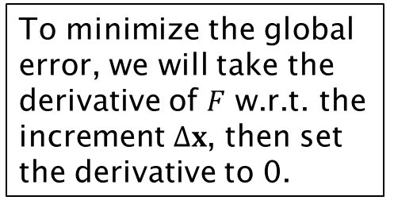
Gauss-Newton Minimization
2. Calculate the linear system.
To minimize the global error, we will take the derivative of $F$ w.r.t. the increment $Δx$, then set the derivative to 0.
We will derive a linear system.

Slide 22
Gauss-Newton Minimization
3. Solve the linear system
Matrix H is a very sparse matrix that leads to a sparse linear system.
Matrix H is symmetric.
Efficient solvers:
e.g. Cholesky decomposition and QR decomposition
The graph and Hessian matrix were generated from the sobot-rimulator.

Slide 23
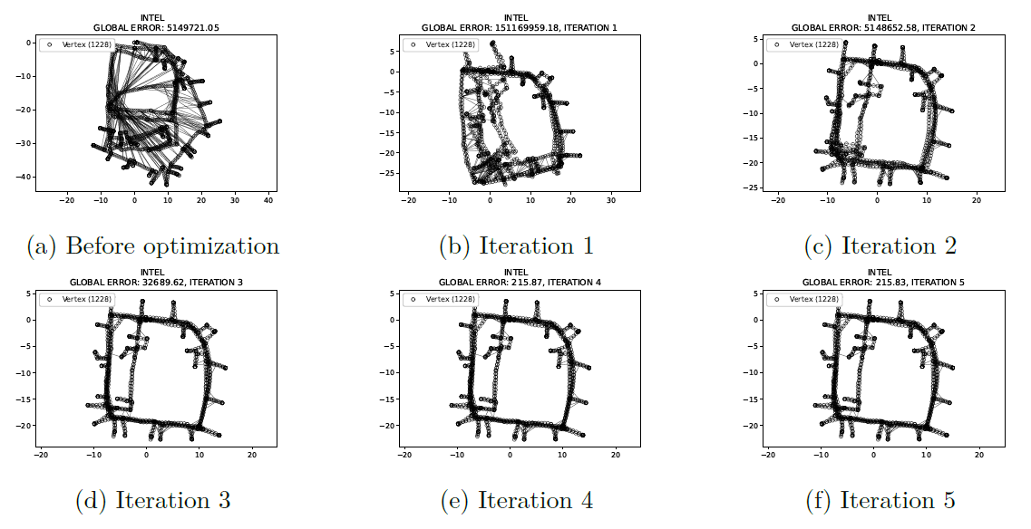

Gauss-Newton Minimization
4. Update the graph
Graph-optimization based on the INTEL dataset
https://lucacarlone.mit.edu/datasets/

Slide 24
Full SLAM Problem – Graph-based SLAM
Challenge:
Data Association and Loop Closure Problems
Data association: the robot can associate the measurement to a specified landmark.
Loop closure: the robot can determine whether it has seen a previously seen object.

Slide 25
Full SLAM Problem – Graph-based SLAM
Challenge:
Data Association and Loop Closure Problems
Both are key problems in the Graph-based SLAM!
True-positive data association and loop closure can dramatically improve the accuracy of estimation,
False-positive data association and loop closure has a risk to destroy the graph estimation.
Open-loop optimization will enhance the errors.
Reason: Least squares method is sensitive to outliers.

Slide 26
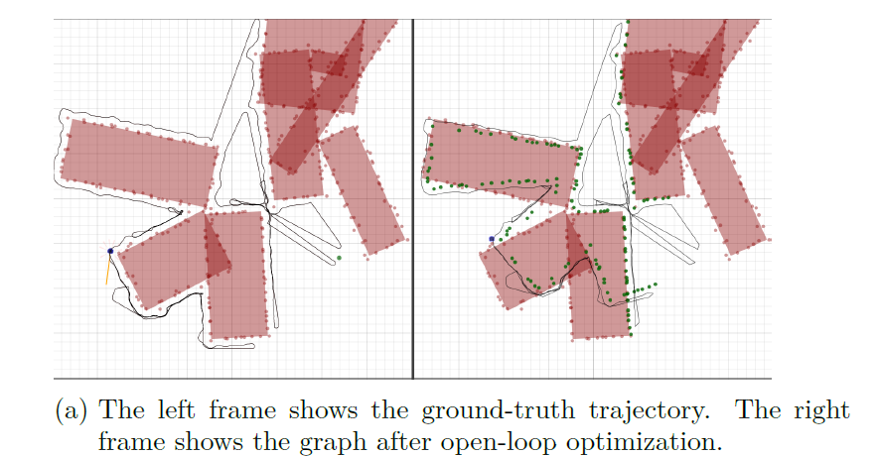
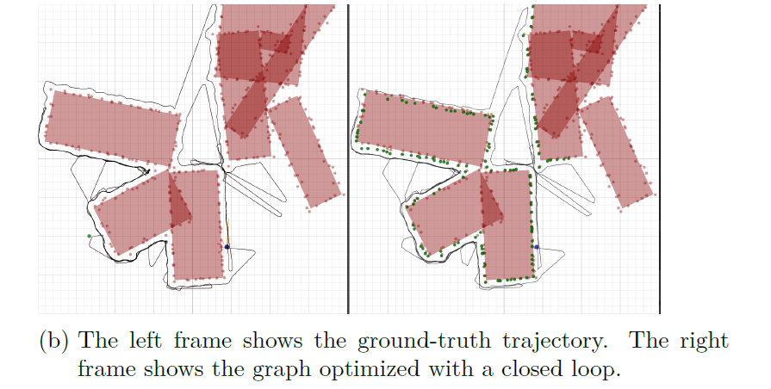
Full SLAM Problem – Graph-based SLAM
Challenge:
Data Association and Loop Closure Problems
Both are key problems in the Graph-based SLAM!
True-positive data association and loop closure can dramatically improve the accuracy of estimation,
False-positive data association and loop closure has a risk to destroy the graph estimation.

Slide 27
Full SLAM Problem – Graph-based SLAM
My solution to avoid false-positive data association and loop closure.
Give each landmark an identifier, and assume the robot knows their identifiers.
id:1
id:3
id:2

Slide 28
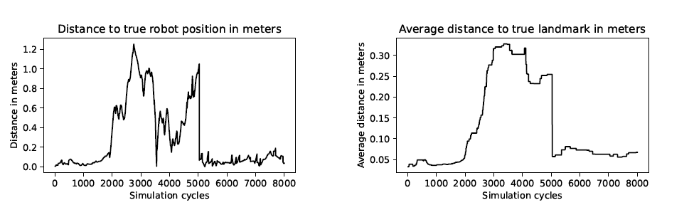
Full SLAM Problem – Graph-based SLAM
Test of Graph-based SLAM estimation during a simulation in the sobot-rimulator
That implies, loop closure detection is very important!
Open-loop optimization:
Error increases sharply.
Optimization after a loop closure:
Error decreases sharply.

Slide 29
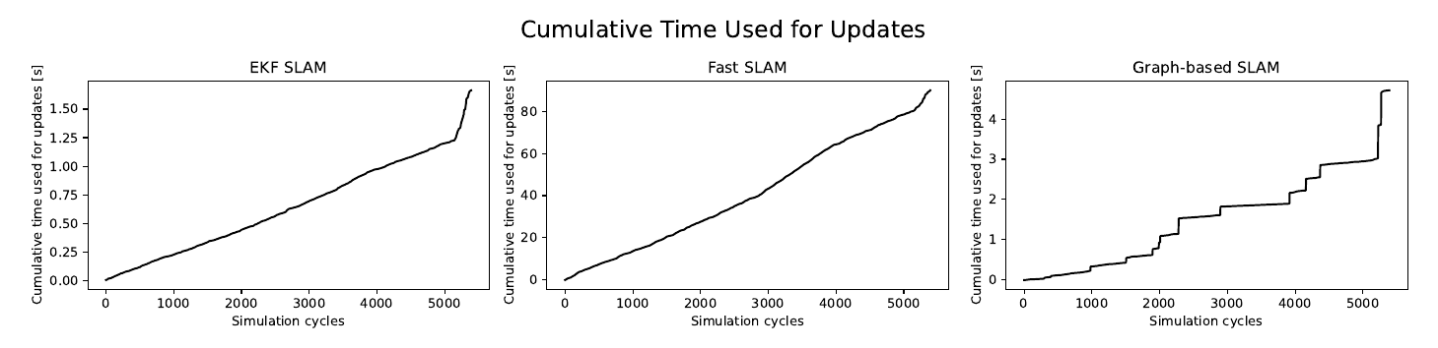
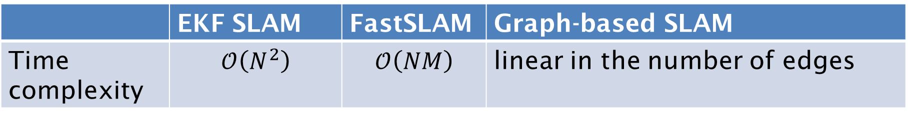
Full SLAM Problem – Graph-based SLAM
Comparison of all SLAM Implementations:
 | EKF SLAM | FastSLAM | Graph-based SLAM
Time complexity | $$𝒪\left(N^{2}\right)$$ | $$𝒪\left(NM\right)$$ | linear in the number of edges
N: the number of landmarks, M: the number of particles.
EKF SLAM is fastest,
FastSLAM is slowest. Reasons?
Graph-based SLAM is an offline algorithm, we can even reduce the frequency of the optimization, such that less time will be spent during SLAM updates (but be careful of a reasonable initial configuration).
Evaluation of time complexity

Slide 30
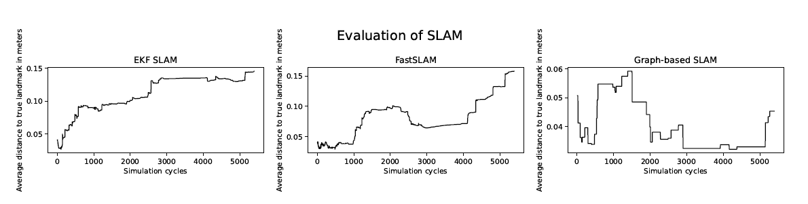
Full SLAM Problem – Graph-based SLAM
Comparison of all SLAM Implementations:
Graph-based SLAM evaluation (with known data association) are usually more accuracy and robust than the other two showed by many experimental results.
Evaluation of accuracy

Slide 31
Full SLAM Problem – Graph-based SLAM
Conclusion of the Graph-based SLAM implementation
Advantages:
SLAM problem can be efficiently solved with Gauss-Newton minimization algorithm.
The sparse linear system can be efficiently solved with Cholesky decomposition.
Relinearizing the nonlinear model, i.e. linearization errors are changeable.
Faster than the FastSLAM algorithm,
Robuster and more accurate than the EKF SLAM and FastSLAM algorithm.

Slide 32
Full SLAM Problem – Graph-based SLAM
Conclusion of the Graph-based SLAM implementation
Disadvantages:
Sensitive to false-positive data association and loop closure.
No algorithms to evaluate data association and loop closure based on the available sensors of the sobot-rimulator.
No hierarchical structure to optimize the increasingly larger graph (optimize the core of the graph, instead of the whole graph).

Slide 33
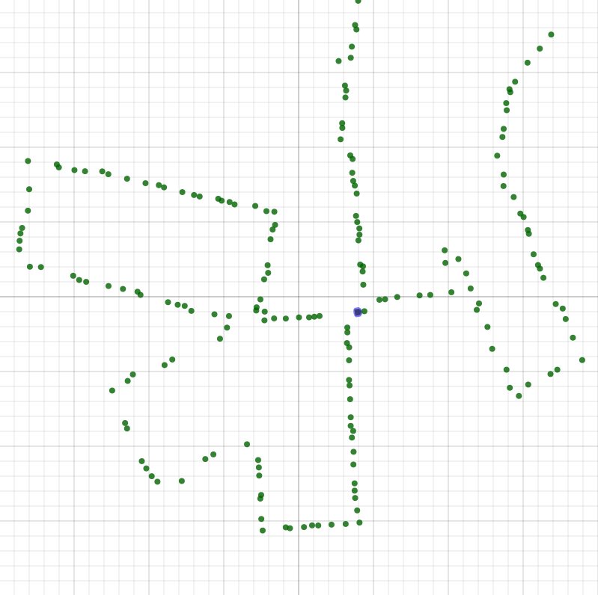
Occupancy Grid Mapping
Motivation:
Point-like feature-based maps are not suitable for path planning.
Occupancy grid map is considerable for navigation task.
Suitable for navigation
A point-like feature-based map
A two-dimensional occupancy grid map [1]
[1] Sebastian Thrun, Wolfram Burgard, and Dieter Fox. Probalistic robotics. Kybernetes, 2006

Slide 34
Occupancy Grid Mapping
Introduction:
Introduced by Moravec and Elfes in 1985
Occupancy grid maps discretize the space into independent cells.
Illustration of a two-dimensional occupancy grid map. Each value refers to the occupancy probability of a grid cell. The space is discretized into independent cells.
[1] Sebastian Thrun, Wolfram Burgard, and Dieter Fox. Probalistic robotics. Kybernetes, 2006

Slide 35
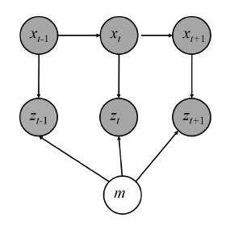
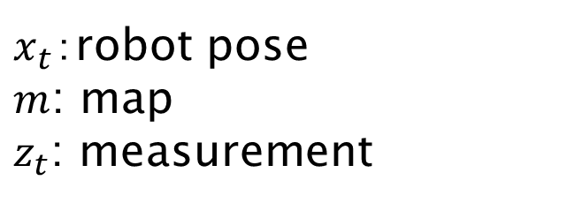
Occupancy Grid Mapping
Estimate a occupancy grid map based on given sensor measurements and known robot poses.
$x_{t}$：robot pose
$m$: map
$z_{t}$: measurement
Dynamic Bayesian Network

Slide 36

Occupancy Grid Mapping
Assumptions:
A grid cell is either free or occupied, denoted by
The world is assumed to be static.
Each cell (or random variables) is independent of each other.
Illustration of a two-dimensional occupancy grid map. Each value refers to the occupancy probability of a grid cell. The space is discretized into independent cells.
Based on the three assumptions, we will derive an efficient static state binary Bayes filter, the update rule of the Occupancy Grid Mapping algorithm

Slide 37
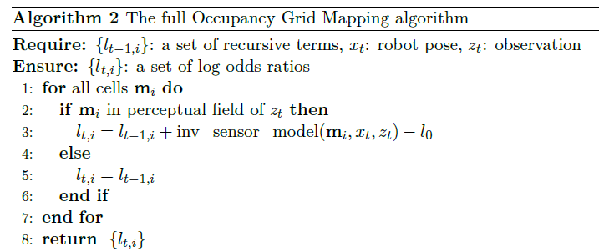
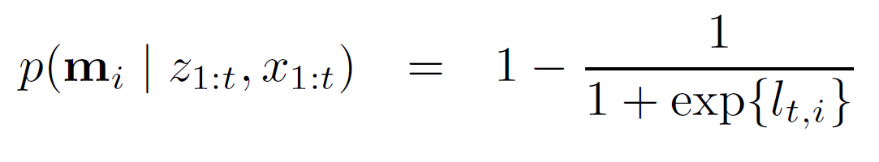

Occupancy Grid Mapping
Update rule of the occupancy grid mapping:
Graphical model of the occupancy grid mapping problem
An occupancy probability of a grid cell can be calculated by:
Calculate the belief of the whole map

Slide 38
Occupancy Grid Mapping
Screenshot of the Implementations:
Occupancy grid mapping
A* path planning
Graph-based SLAM

Slide 39
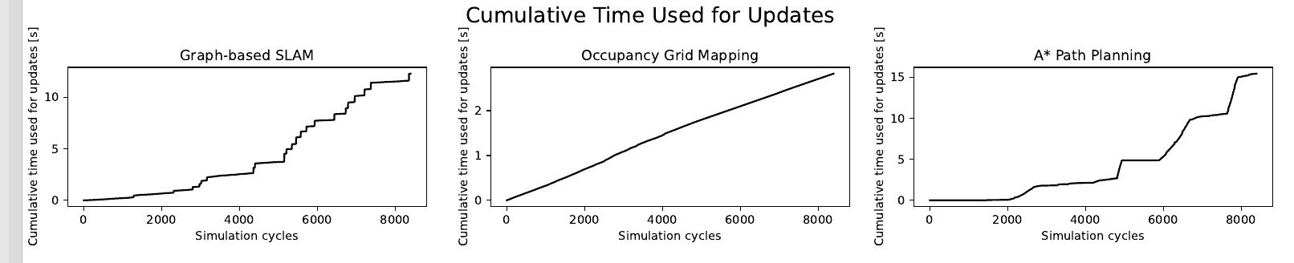
Occupancy Grid Mapping
Screenshot of the Implementations:
Occupancy grid mapping (≈2.7s)
A* path planning (≈15.1s)
Grap-based SLAM (≈11.5s)
Occupancy Grid Mapping algorithm is the fastest
in 8000 simulation cycles.
Evaluation of time complexity

Slide 40
Occupancy Grid Mapping
Advantages:
Very efficient,
Better representation of the environment,
Allows path planning.
Problem:
The Occupancy Grid Mapping algorithm is strongly based on a set of
known robot poses, which are produced by the SLAM algorithms.
Therefore, the accuracy of the mapping highly depends on how precise the robot poses that the SLAM algorithms can evaluate.

Slide 41
Improvements
Plan a safer path.
Enable a path-following behavior.
Estimate data association for the Graph-based SLAM algorithm.
Hierarchical structure of the Graph-based SLAM algorithm.

Slide 42
Thank you for your attention!

