Slide 1
Python as a tool to build large-scale geoscience systems - An example on a hydrologic data assimilation system
Yixin Mao
Feb 6, 2018
Python for Geosciences Seminar Series

Slide 2
A little about me and my work…
PhD student in the Computational Hydrology Lab @ CEE
Thesis project: hydrologic data assimilation
Other research interests:
Data science applications
Hydrologic model development
Drought, climate change impacts, …

Slide 3
A little about science… Introduction of the data assimilation system

Slide 4


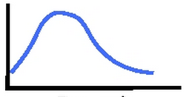
Goal: improve short-term streamflow forecast Approach: assimilate soil moisture measurements
Soil moisture measurements
Precipitation
correct via
ensemble Kalman filter
Hydrologic model
Antecedent
soil moisture
Runoff prediction

Slide 5
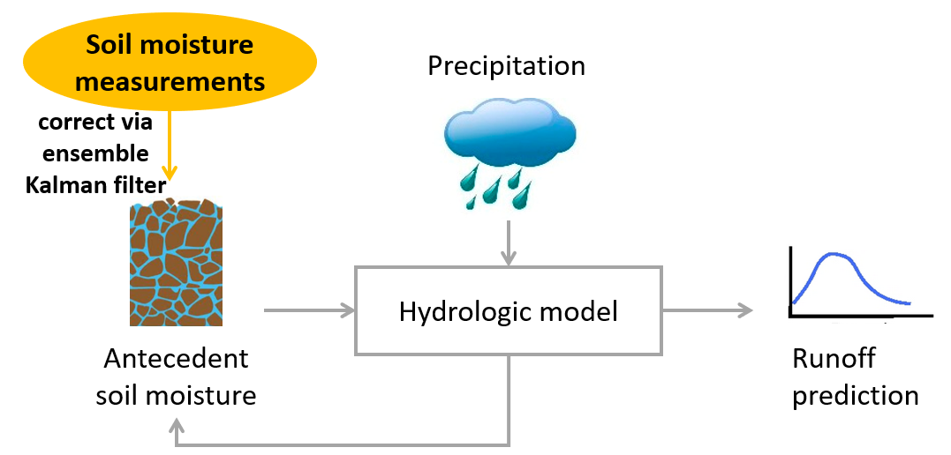
Soil moisture assimilation Ensemble Kalman filter (EnKF) method
Day 1
SM state ensemble

Slide 6
Soil moisture assimilation Ensemble Kalman filter (EnKF) method
Run hydrologic model (VIC)
with perturbation on meteorological forcings and SM states
Day 1
Day 2
SM state ensemble

Slide 7
Soil moisture assimilation Ensemble Kalman filter (EnKF) method
Run hydrologic model (VIC)
with perturbation on meteorological forcings and SM states
Day 1
Day 2
SM state ensemble
Update SM states
Measured surface SM

Slide 8
Soil moisture assimilation Ensemble Kalman filter (EnKF) method
Run hydrologic model (VIC)
with perturbation on meteorological forcings and SM states
Day 1
Day 2
Day 3
SM state ensemble
Update SM states
Measured surface SM

Slide 9
Soil moisture assimilation Ensemble Kalman filter (EnKF) method
Run hydrologic model (VIC)
with perturbation on meteorological forcings and SM states
Day 1
Day 2
Day 3
SM state ensemble
Update SM states
Update SM states
… …
Measured surface SM
Measured surface SM

Slide 10
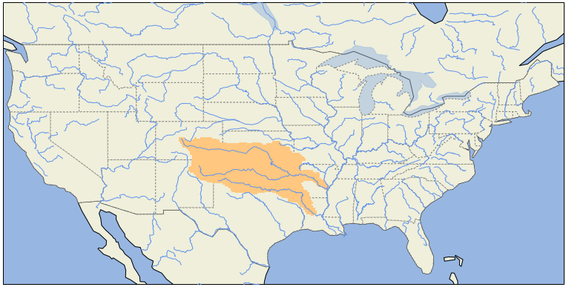
Soil moisture assimilation Ensemble Kalman filter (EnKF) method
Run hydrologic model (VIC)
with perturbation on meteorological forcings and SM states
Day 1
Day 2
Day 3
SM state ensemble
Update SM states
Update SM states
~4000 grid cells (1/8º)
10-year simulation
32 ensemble members
… …
Measured surface SM
Measured surface SM

Slide 11
Structure of the system

Slide 12
Perturb initial states
States
Run the VIC model for 1 day
States
Pre-processing data
Met. forcings
Satellite soil moisture
Post-processing results
Calculate metrics
Make plots
…
Calculate Kalman gain K
Gain K
Update each ensemble
member
States
Perturb each ensemble
member
States

Slide 13
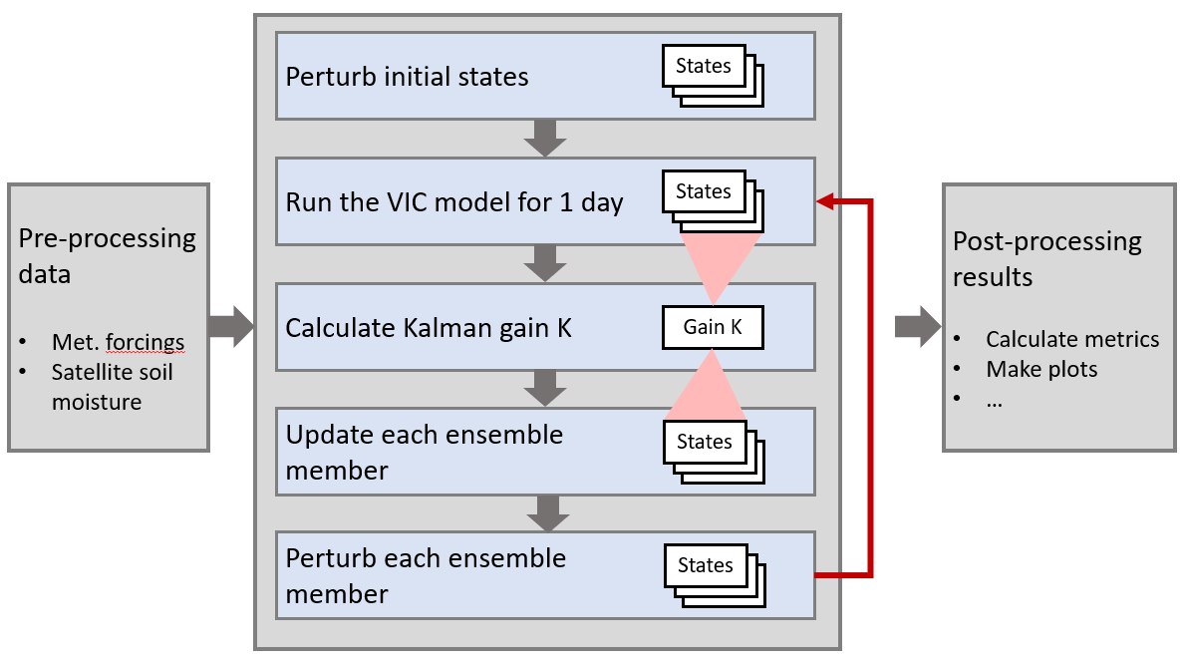
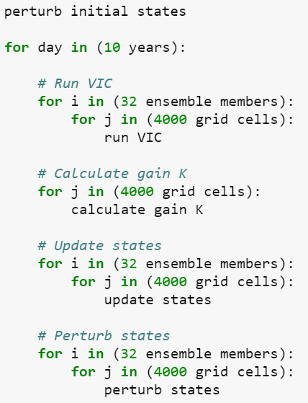

Slide 14
Advantages of using Python to link all the pieces:
Many handy packages for data processing/computation
xarray: N-dimensional labeled data array
pandas
Numpy
scipy
…
Directly run command line arguments
Support parallel computing
Multiprocessing package

Slide 15
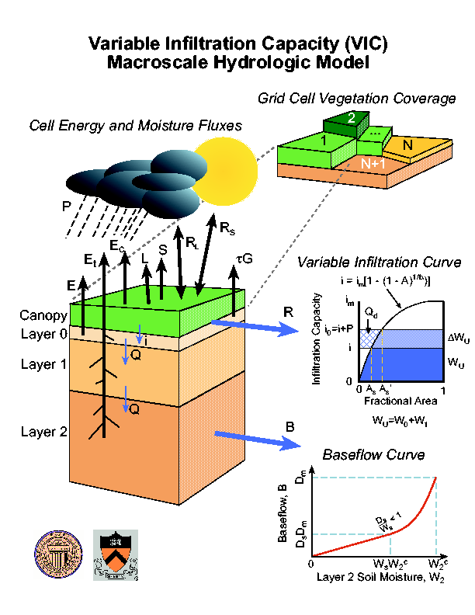
Challenge 1 (that is easy to solve): Running a stand-alone model within Python
VIC is a stand-alone model
Written in C
VIC version 5 has built-in parallelization functionality (using MPI)
Running VIC using command line:
(e.g. parallelize grid cells on 30 processors)
$ mpiexec –np 30 vic.exe –g global_control_file.txt

Slide 16
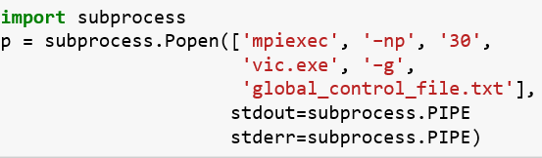
Challenge 1: Running a stand-alone model within Python
In Python:

Slide 17
Challenge 2: the code is too slow – how to speed up?
There are many time steps, ensemble members and grid cells → a lot of computation
General philosophy:
Pinpoint bottlenecks first!
Try strategies from easy to complex
Avoid loops
Parallel computing

Slide 18
The code is too slow. How to speed up?

Slide 19
Thank you!
yixinmao@uw.edu

