Slide 1
Git

Slide 2
Motivation – Common programming practices and some quick fixes

Slide 3
Version Control – one developer
One developer saving work at different snapshots in time
One developer saving work from different locations – laptop or desktop
One developer backing up work to the cloud
Reverting fatally flawed code
A log of change histories would make this easy

Slide 4
Version Control – multiple developers
Two developers working on different features in the project
One could write code that affects a feature on the other person’s feature
E.g. cleaning an upstream variable that a collaborator uses downstream
Two developers working on the same feature in the project
You would need to keep a log of who is making what change so edits can be merged together

Slide 5
Luckily there is something that does this automatically
Git

Slide 6
Terminology
Repository
A local or remote store of the versions
Working Copy
A local, editable copy of our project that we can work on
File
A single file in our project
Version/revision
A record of the contents of our project at a point in time
Change/diff
The difference between two versions
Head
The current version

Slide 7
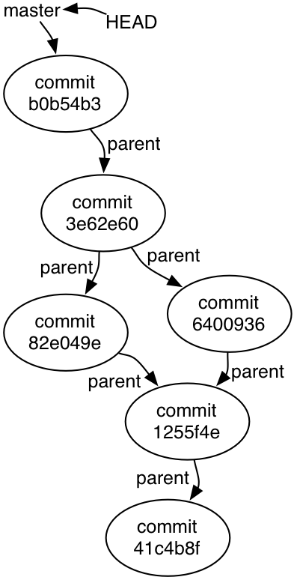
The object graph (Directed Acyclic Graph)

Slide 8
Copy the object graph on your local machine
Every repository comes with an object graph
On github these start up in the remote repository and it must be copied to your local machine
This is done through cloning the repository on your local machine
git clone https://www.github.com/username/url/to/your/repository

Slide 9
Adding a commit to the object graph
git add .
This will add the changes to a staging area
It is essentially a proto-commit where we build up a snapshot of the commit
git commit
This sets in stone the commit as it is added to the object graph

Slide 10
Pushing and pulling
Once we commit, we have now added to the commit graph on our local history. However, this doesn’t end up in our remote history unless we push it up there

Slide 11
Merging

Slide 12
Branching

