Slide 1
Spatial Data in R

Slide 2
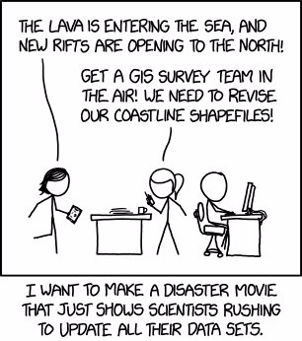
Why We Need Spatial Data

Slide 3
What is Spatial Data?
Spatial data are either discrete locations (roads, countries, oceans) or continuous fields (elevation, air quality, land type). They are represented in 2 ways
Vector Data – points, lines and polygons composed by coordinate pairs
Raster Data – represents continuous variables by dividing the world into grids/pixels, with each pixel representing an average value for the area it covers

Slide 4
Coordinate Reference System
To represent the location and shape of an object you need 2 pieces of information:
Coordinates
Reference system for how the coordinates relate to the shape of the Earth.
Coordinate Reference system (CRS): a geometric model of the shape of the Earth, which identifies the origin and orientation of the coordinate axes on the ellipsoid and the units of measurement.
Notes:
There are two types of CRSs: geographic and projected.
Geographic reference systems represent points on an globe, using units of degrees longitude and latitude that correspond to angles measured from the center of the Earth as calculated using the given ellipsoid.
A projected reference system uses a geometric model to project a 3-dimensional ellipsoid onto a 2-dimensional plane. A projection is necessary to create any 2-dimensional map, but it results in distortions of aspects of the Earth’s surface. Despite the necessary distortion, projected reference systems are useful for geographic analysis, because they use linear units of measurement such as meters instead of degrees.

Slide 5
Vector Data in R
sp (spatial polygons)
sf (simple features)
defines classes to represent spatial data. It is an S4 object, where objects store spatial geometries separately from associated attribute data, matching by order
stored as a native R dataframe, where the geometries are in a list-column. It implements the “simple features standard” that is also used in PostGIS, GeoJSON, and ArcGIS, while sp predates industry standards
Notes:
S4 objects are made up of slots that store different types of well-defined data. The slots can be accessed with the @ symbol in the form of object@slot. The foundational sp class is the Spatial class, which has ten subclasses differentiated by the slots they contain.
Essentially, sf objects can be treated as data frames that also contain spatial data, as opposed to spatial data that may or may not also contain data frames. This enables sf objects to fit within the tidyverse workflow, making it possible to manipulate them with dplyr commands. The tidy nature of sf objects also means that they can can be plotted with ggplot2, though currently this capability is only possible with the development version of ggplot2.

Slide 6
Objects in the spatial features package

Slide 7
sfg: geometry
geometry of a single feature
vector, matrix, or list of matrices of coordinates with defined dimension and type of geometry
seven main geometry types

Slide 8
sfc: geospatial geometry
list of sfg objects
coordinate reference system through crs attribute
seven subclasses based on geometries

Slide 9
sf: geospatial geometry with attributes
data frame housing attributes
geometry column of class sfc

