Slide 1
Git
By Nadia Lucas
EPIC Orientation 2018

Slide 2
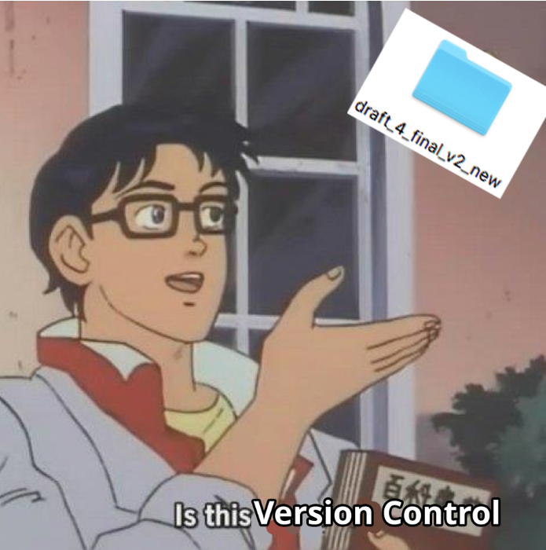
Version Control

Slide 3
Motivation
Common Programming Practices and some Quick Fixes

Slide 4
Version Control – one developer
One developer saving work at different snapshots in time
One developer saving work from different locations – laptop or desktop
One developer backing up work to the cloud
Reverting fatally flawed code
A log of change histories would make this easy

Slide 5
Version Control – multiple developers
Two developers working on different features in the project
One could write code that affects a feature on the other person’s feature
E.g. cleaning an upstream variable that a collaborator uses downstream
Two developers working on the same feature in the project
You would need to keep a log of who is making what change so edits can be merged together

Slide 6
Luckily there is something that does this automatically
Git

Slide 7
Terminology
Repository
A local or remote store of the versions
Working Copy
A local, editable copy of our project that we can work on
File
A single file in our project
Version/revision
A record of the contents of our project at a point in time
Change/diff
The difference between two versions
Head
The current version

Slide 8
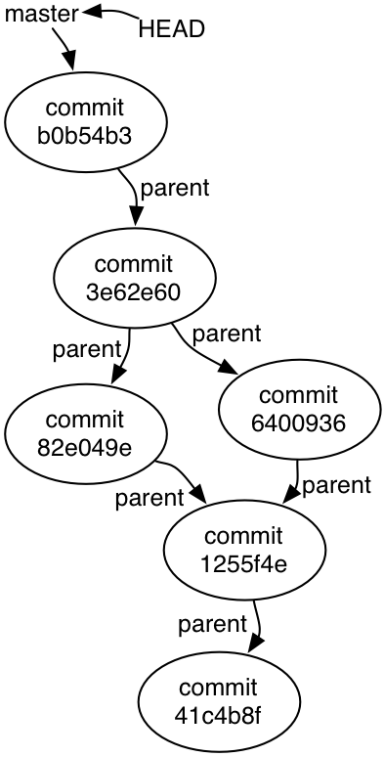
The object graph (Directed Acyclic Graph)

Slide 9
Copy the object graph on your local machine
Every repository comes with an object graph
On github these start up in the remote repository and it must be copied to your local machine
This is done through cloning the repository on your local machine
git clone https://www.github.com/username/url/to/your/repository

Slide 10
Adding a commit to the object graph
git add .
This will add the changes to a staging area
It is essentially a proto-commit where we build up a snapshot of the commit
git commit
This sets in stone the commit as it is added to the object graph

Slide 11
Pushing
Once we commit, we have now added to the commit graph on our local history. However, this doesn't end up in our remote history unless we push it up there
git push origin branch-name
Once we push, the remote commit graph now matches the local commit graph on our computer

Slide 12
Pulling (Merging)
Sometimes if you work on a branch in parallel with another developer, you may need to pull work from the remote object graph down to your own local machine
git pull origin branch-name
Why do you have to update the object graph manually?
You want your local copy of the object graph to be a work in progress and if you sent stuff up to the remote object graph

Slide 13
Branching
Oftentimes when you work on a project with multiple developers, you may not want

Slide 14
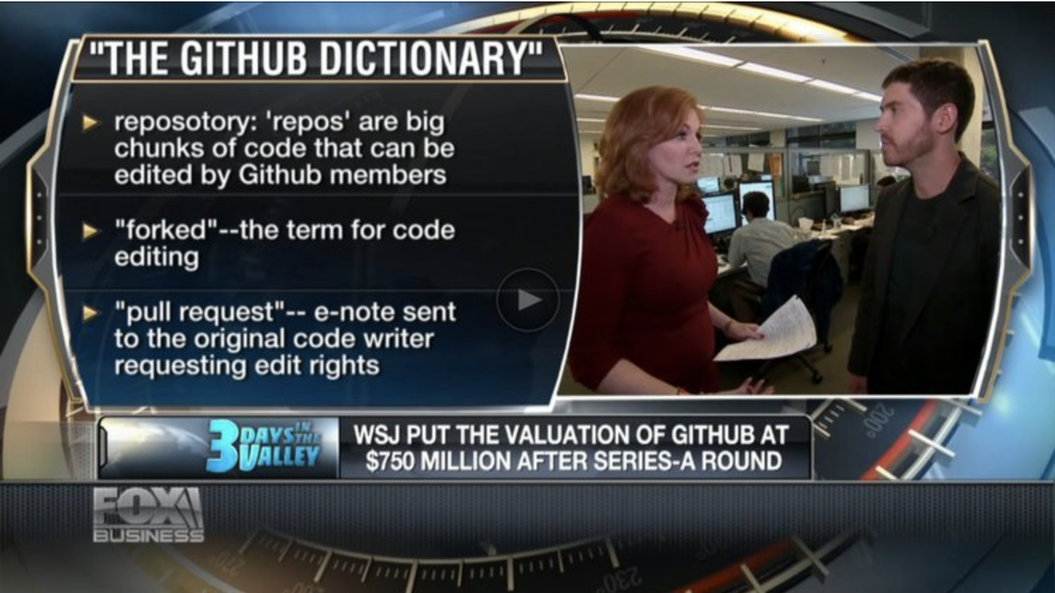
Now you’re smarter than Fox News!

Slide 15
Merging Branches

Slide 16
Log

Slide 17
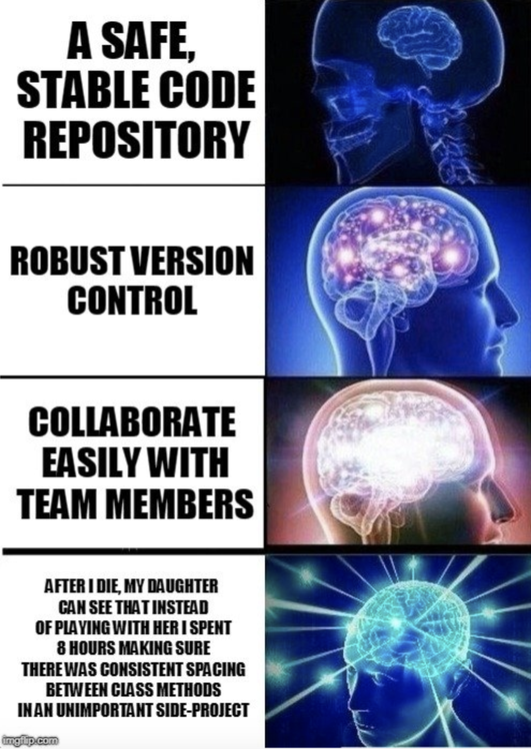
Why Github?

