Slide 1
Forecast Evaluation and Uncertainty Communication
--introduction of a useful tool
Yi Xu
FRAM Software Meeting
Olympia, Washington
December 9, 2026

Slide 2
Challenges we face as forecasters:
Our forecast is not accurate.
We don’t think our model is wrong, but data are messy.
It’s hard to compare our forecast with others because we are using different models.
The uncertainty is so high that the forecast is not helpful.
Folks are questioning about our forecast, it’s hard to explain to them.

Slide 3
Introduction
A tool that can help:
  Diagnose data/model issues
  Compare all models for a single stock
  Compare models across different stocks
  Demonstrate uncertainties
  Communicate to non-experts

Slide 4
Taylor Diagram
Taylor (2001)
Google citations: 9,972 (last checked, 2026/12/9)
Be widely used by many science communities (weather, oceanography, other fisheries)
Ready to use in multiple languages
  R (plotrix), Python (VCS), Matlab (taylordiag)

Slide 5
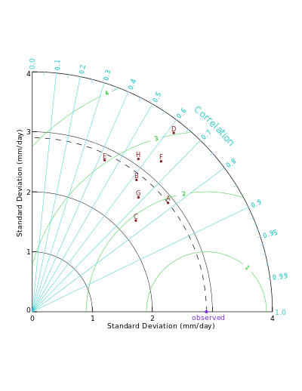
Taylor Diagram
Inputs:
Observation
Prediction
3-metrics-in-1-plot
Correlation
SD
RMSE
D
E
Standard Deviation
C
A
B
RMSE
F
Standard Deviation
Taylor (2001)

Slide 6
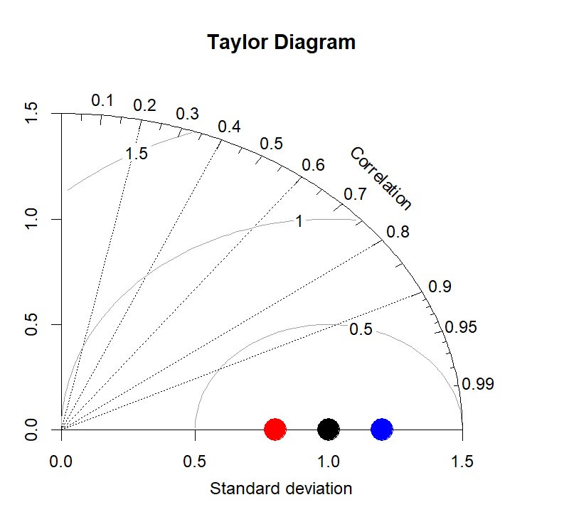
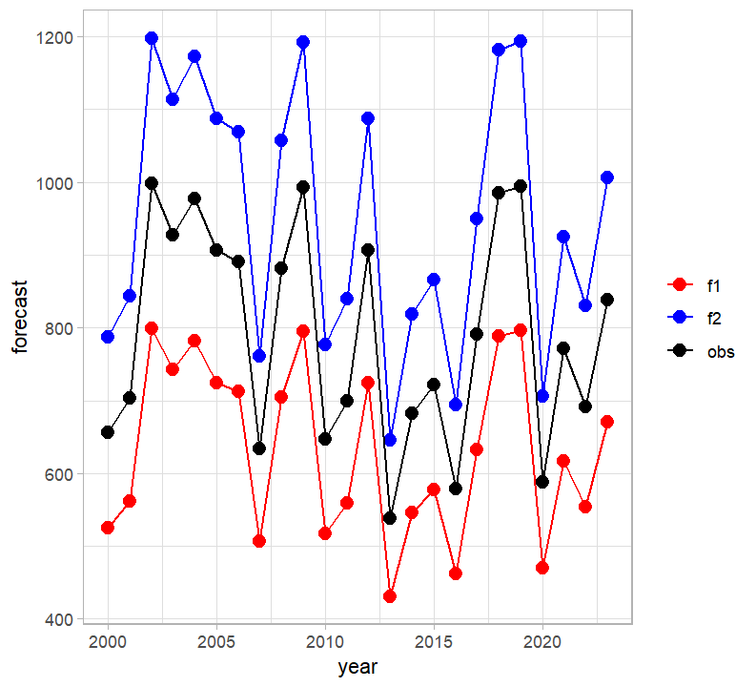
Taylor Diagram - correlation
0
1.00

Slide 7
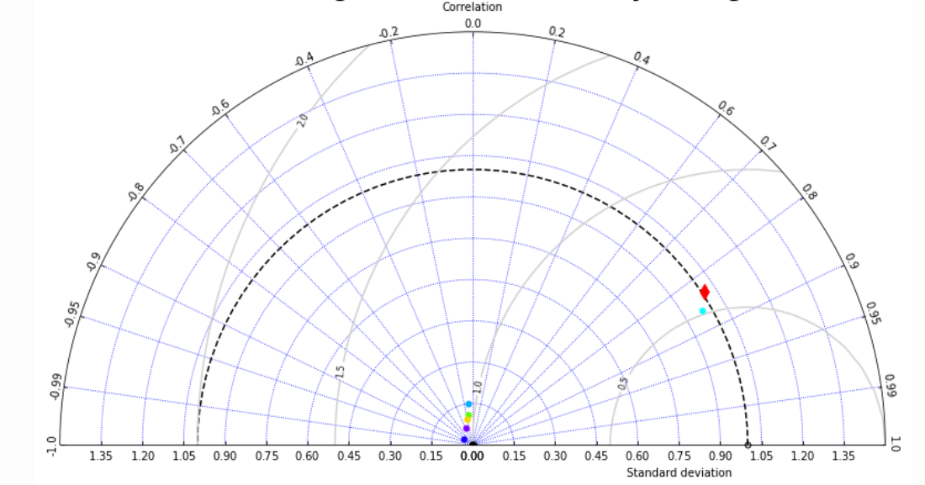
Taylor Diagram - correlation
F
F
F

Slide 8
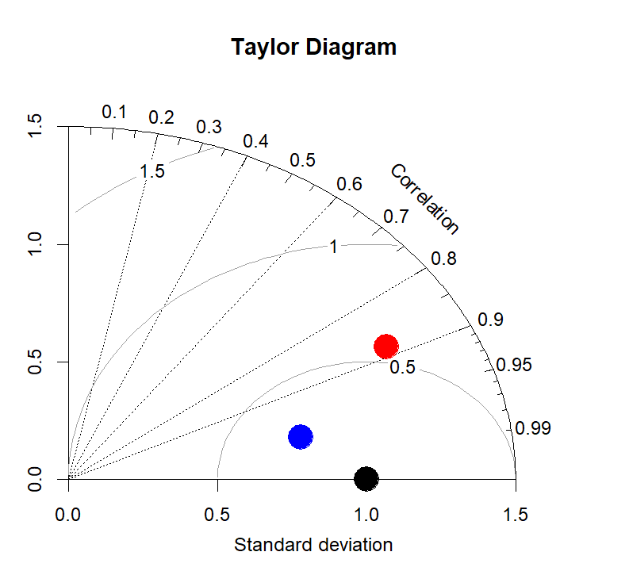
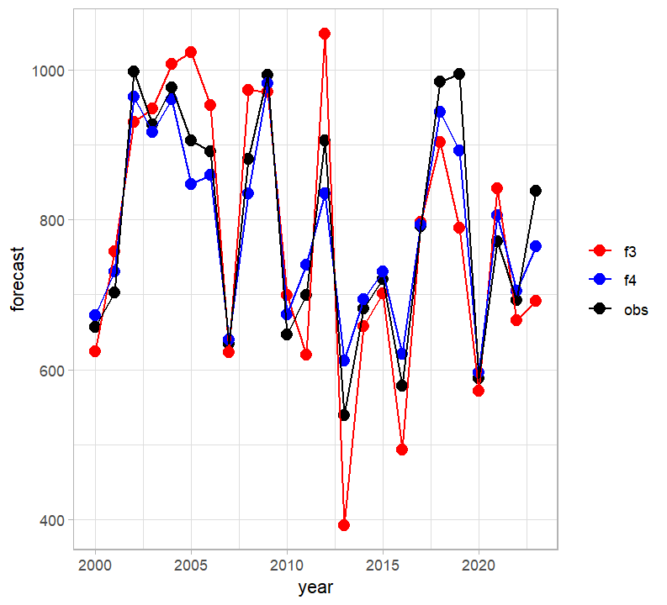
Taylor Diagram – standard deviation

Slide 9
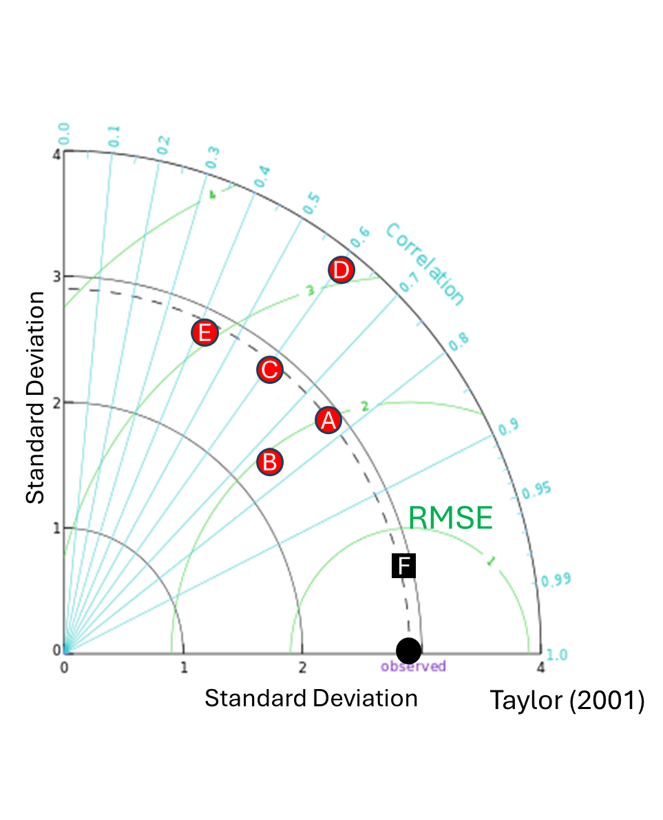
Taylor Diagram - RMSE
Other metrics:
  MAE
  MRE
  MAPE
Good model:
  High correlation
  Similar SD
  Small RMSE
  => Close to observation

Slide 10
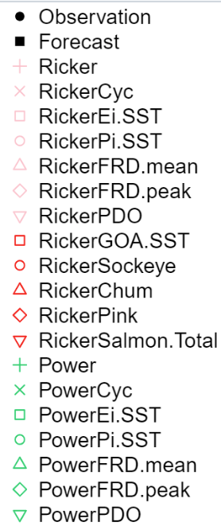
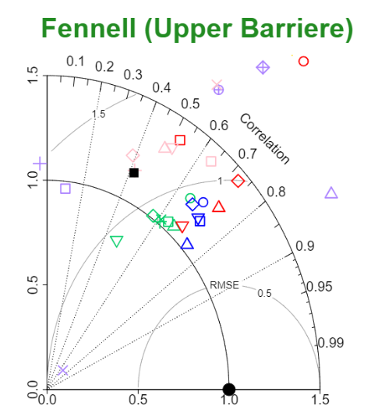
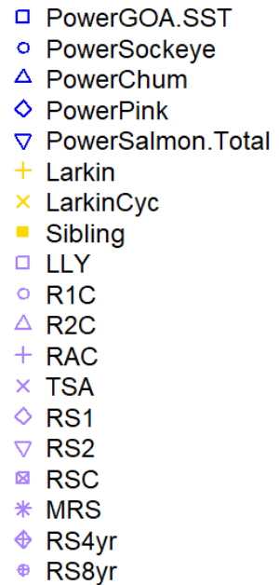
Case study: Fraser sockeye

Slide 11
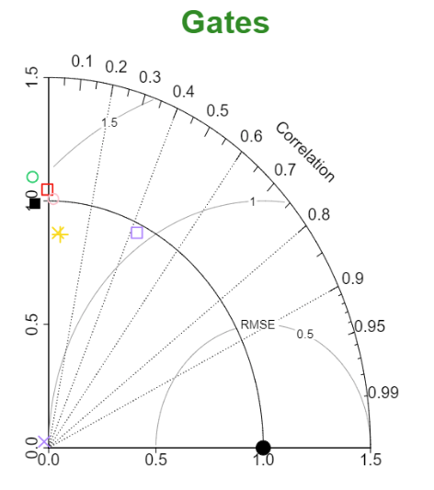
Case study: Fraser sockeye

Slide 12
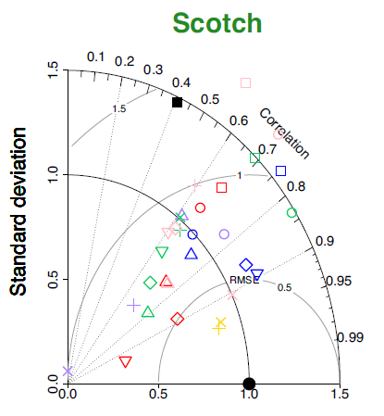
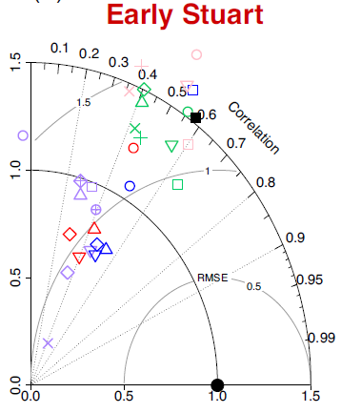
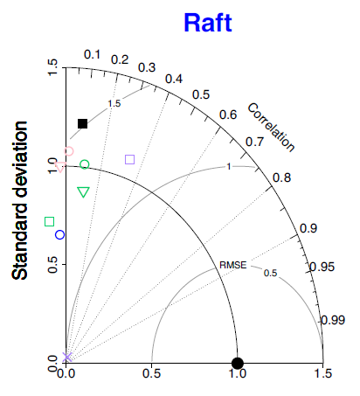
Identify work priorities
• Model Selection • Develop new models • QA/QC data

Slide 13
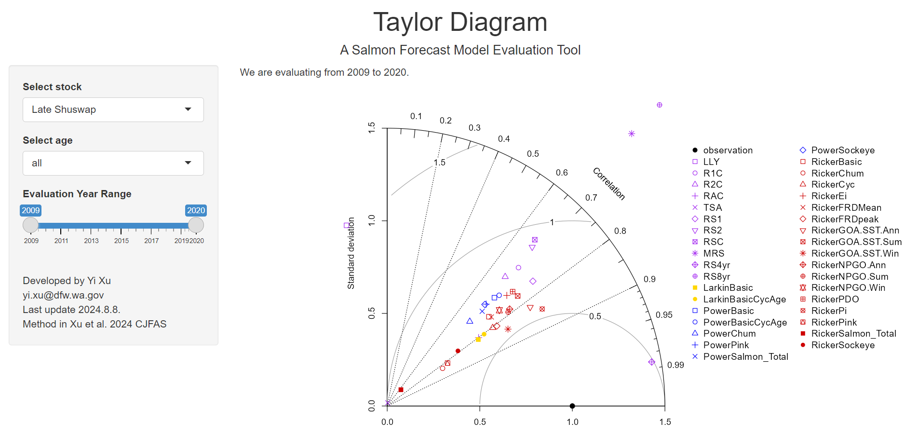
Shiny app
R Code:
library(plotrix)
taylor.diagram(observation, model, …)

Slide 14
Fraser forecast vs return in recent years
Year | Forecast | Return | Percentage | Source
2021 | 1,330,000 | 2,549,000 | +92% | (DFO,2022)
2022 | 9,775,000 | 6,777,000 | -31% | (PSC,2022)
2023 | 1,564,000 | 1,670,000 | +7% | (PSC,2023)
2024 | 567,000 |  |  | (DFO,2024)

Slide 15
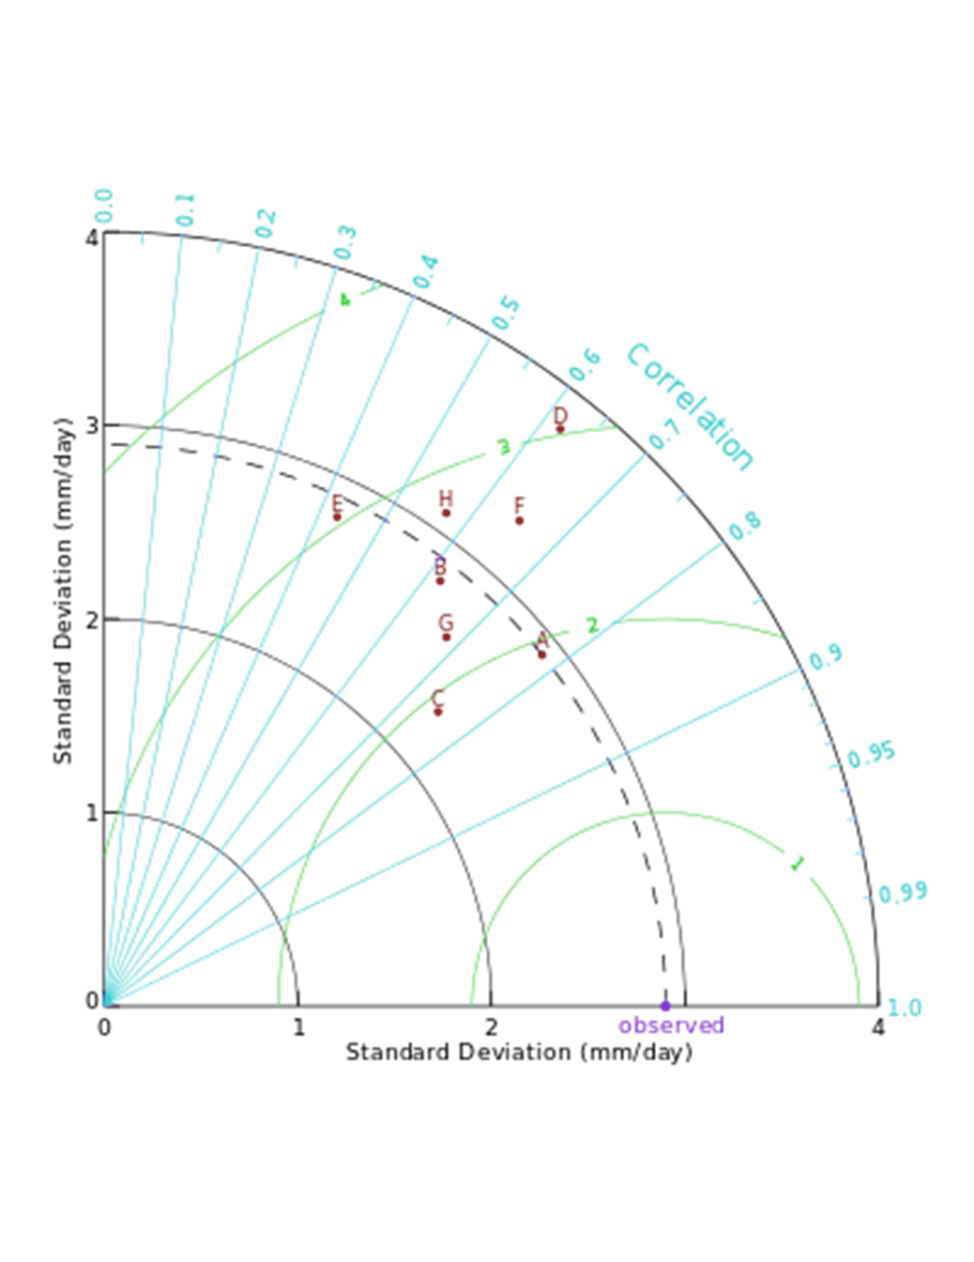
Future development
Dynamic Taylor
Automated process
Forecast evaluation standard – “best available science”
D
E
C
n
A
B
m
M
H

Slide 16
Summary
Introduce a tool ---Taylor Diagram that can potentially help:
  forecasters to improve their forecast by identify data/model issues, evaluate model performance more effectively within and across stocks
  managers to identify work priorities, better communicate results to non-experts
All data/method are published and accessible.
  Data weblink: https://waves-vagues.dfo-mpo.gc.ca/library-bibliotheque/41227153.pdf
  Analyses weblink: https://github.com/yi-xu/Sockeye_paper (Xu et al., 2024, CJFAS)
  Paper weblink: https://agupubs.onlinelibrary.wiley.com/doi/10.1029/2000JD900719
  Shiny app weblink: https://github.com/yi-xu-dfw/ForecastEvaluation
This tool can be further developed and may become a more powerful standard tool for the salmon fisheries/forecast society.
Reference: Taylor, K. E. (2001), Summarizing multiple aspects of model performance in a single diagram, J. Geophys. Res., 106(D7), 7183–7192, doi:10.1029/2000JD900719.

Slide 17


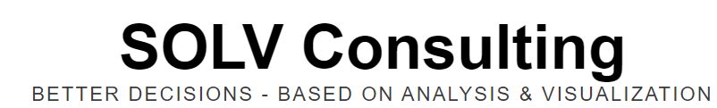
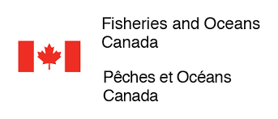





Acknowledgements
Questions? Contact Yi
yi.xu@dfw.wa.gov
WDFW&NWIFC:
FRAM Team
Mark Sorel
Matt Bogaard
Mickey Agha
Marisa Litz
Gordon Rose
DFO:
100+ colleagues
Tulalip Tribe:
Diego Holmgren
Stillaguamish Tribe:
Robert Roose
PSC: Catherine Michielsens
PSF: Brian Riddell
OSU: James Peterson
SOLV: Gottfried Pestal
Angler’s Altas: Sean Simmons

