Slide 1
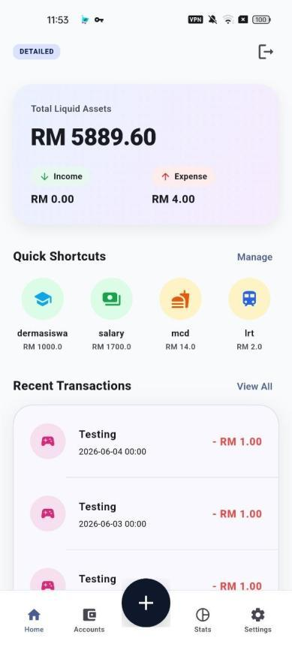
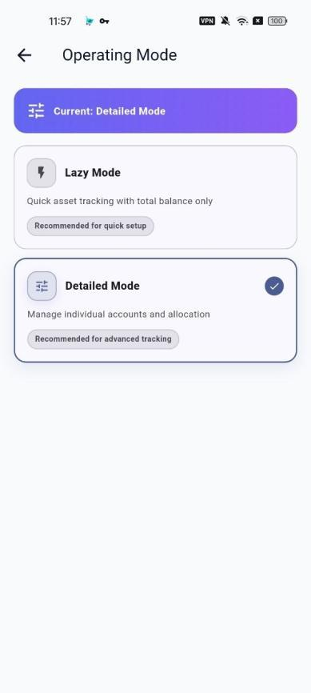

SMART POCKET
FYP PRODUCT DEMO
SMART
POCKET
Track. Plan. Grow.
A multi-modal personal finance app that reduces recording friction while improving financial awareness.
Operating Mode
Dashboard

Slide 2
THE PROBLEM
FYP PRODUCT DEMO
The Personal Finance Dilemma
Young adults do not only need to record money. They need a recording method they can sustain.
Rigidity Gap
Behavioral Gap
Manual tracking asks for too many details, so users delay recording or abandon the habit.
Cashless spending happens quickly, but awareness comes too late when data is incomplete.
Smart Pocket addresses both gaps by offering flexible tracking depth and immediate feedback.

Slide 3
PRODUCT SOLUTION
FYP PRODUCT DEMO
Closing the Gap with Smart Pocket
The app combines fast capture, mode flexibility and visual financial feedback in one mobile workflow.
Frictionless Entry
Multi-Mode Engine
Shortcuts and simplified forms reduce repeated manual input.
Users can choose simple Lazy Mode or controlled Detailed Mode.
Goal-Oriented Insight
Reliable Data Flow
Analytics, budgets and allocation goals turn records into awareness.
Accounts, transactions, recurring plans and reports stay connected.
Main dashboard

Slide 4
DEMO MAP
FYP PRODUCT DEMO
Presentation Flow for the Live Demo
Each segment shows one user problem, then immediately demonstrates how Smart Pocket solves it.
1
Start & Onboard
2
Choose Tracking Depth
3
Set Up Accounts
Login, Smart Survey and security setup.
Lazy Mode vs Detailed Mode.
Assets, account creation and allocation tags.
4
Record Daily Spending
5
Automate Repeats
6
Review Impact
Shortcut and Lazy transaction entry.
Recurring transactions and monthly budget.
Analytics, PDF report and validation results.

Slide 5
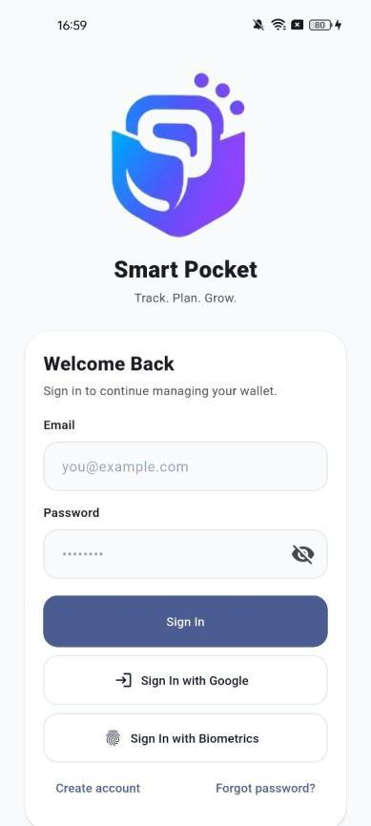
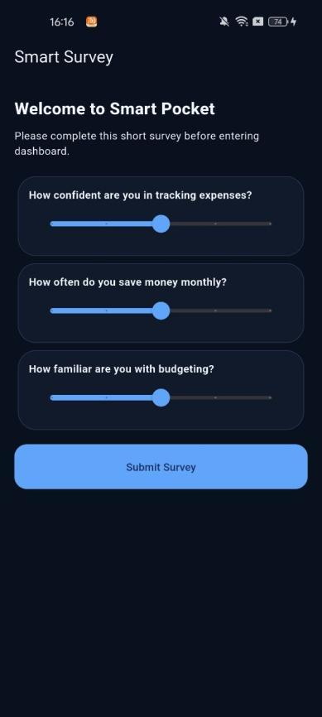
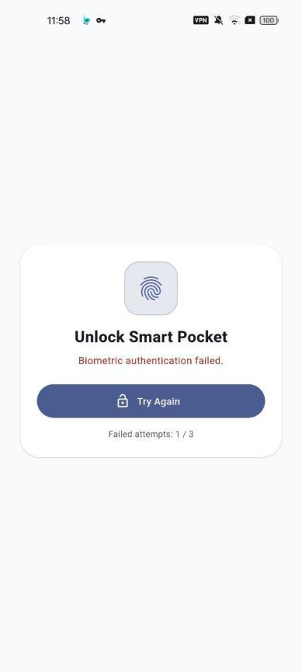
ONBOARDING
FYP PRODUCT DEMO
Onboarding and Secure Access
Users can enter quickly, answer a short survey and protect the app with device-level biometric authentication.
Demo Cue
Show login/register, then explain that Smart Survey supports onboarding and user habit understanding.
Safe Claim
Biometric access uses the Android device's supported biometric prompt, not custom face or fingerprint recognition.
Welcome
Smart Survey
Biometric unlock

Slide 6
CORE INNOVATION
FYP PRODUCT DEMO
Dual-Mode Architecture
Smart Pocket adapts to different tracking habits instead of forcing every user into the same workflow.
Lazy Mode
Detailed Mode
Design: Simple
Speed: Fast setup
Advantage: Lower friction
Design: Advanced
Speed: Full control
Advantage: Higher accuracy
For users who want quick daily capture and a simple overview.
For users who want account-level control and detailed records.
Operating Mode

Slide 7
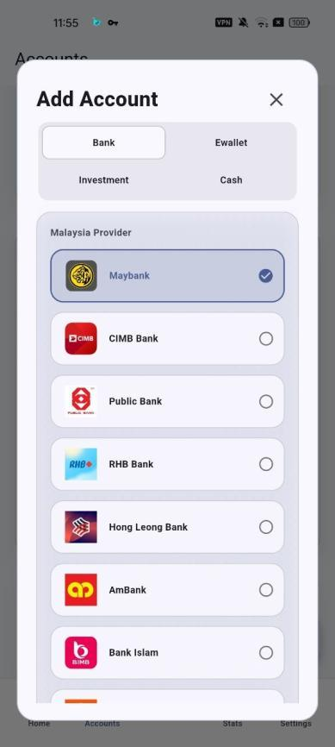
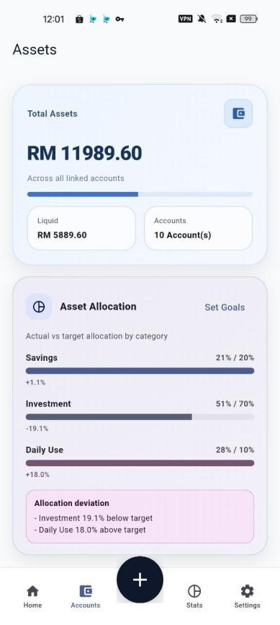
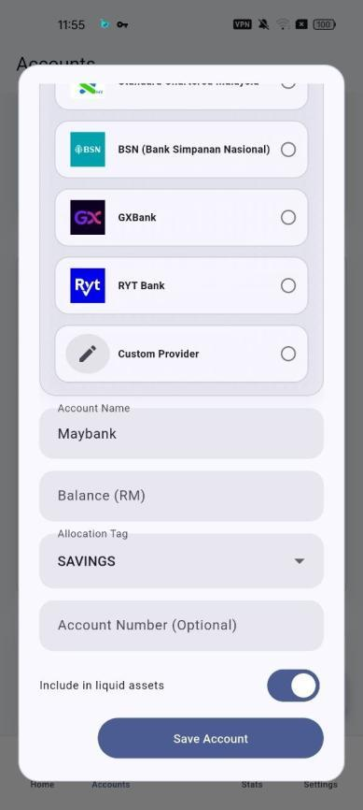
KEY DIFFERENTIATOR
FYP PRODUCT DEMO
Two Different Paths into Lazy Mode
This is the most important logic to explain during the demo: Lazy Mode is simple, but it is not always entered the same way.
First-Time Lazy User
Detailed to Lazy
Starts with functional pools such as Daily Use, Savings and Investment. The setup is intentionally light to reduce first-use friction.
Existing detailed accounts are grouped by allocation tag. Data is preserved; only the viewing depth becomes simpler.
simple setup
tag aggregation
Add account
Lazy assets
Detailed accounts
Demo line: Lazy Mode can either reduce setup for beginners or reduce fatigue for detailed users.

Slide 8
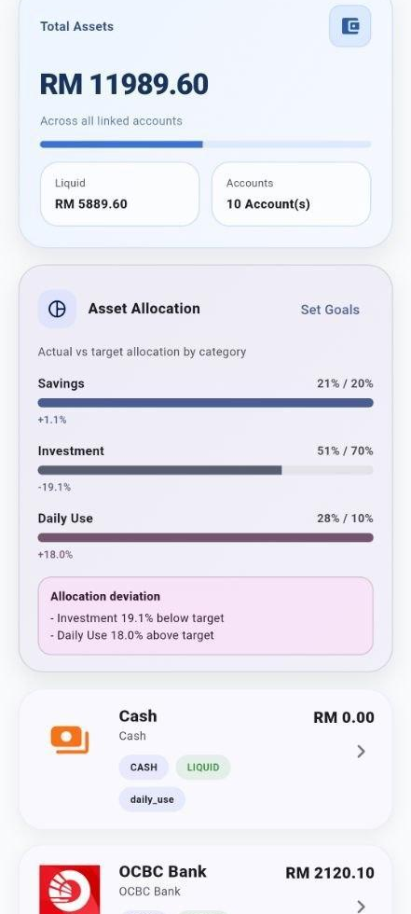
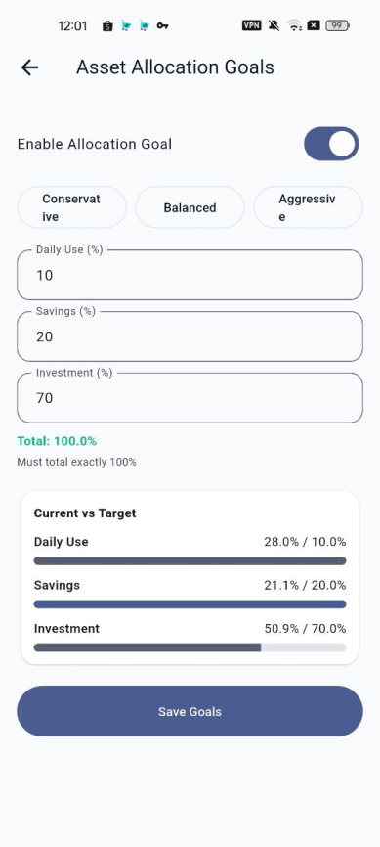
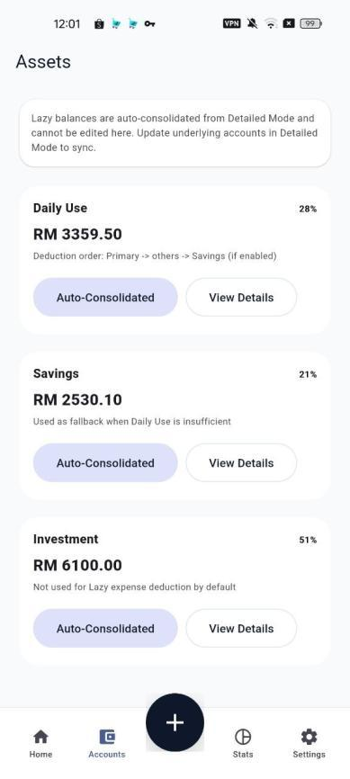
ACCOUNTS & ASSETS
FYP PRODUCT DEMO
Goal-Oriented Account Setup
Accounts support allocation goals and meaningful views of daily use, savings and investment.
What to Demo
Open Accounts, add or edit an account, then show allocation goals and suggested tags.
Why It Matters
This turns fragmented accounts into purpose-based financial guidance.
Accounts
Allocation goals
Assets

Slide 9
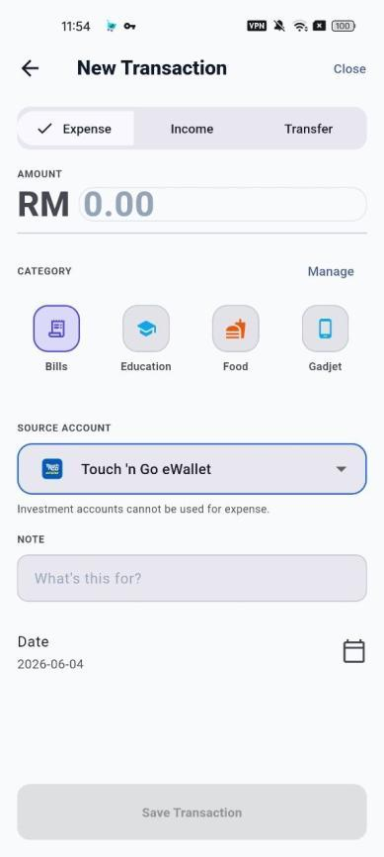
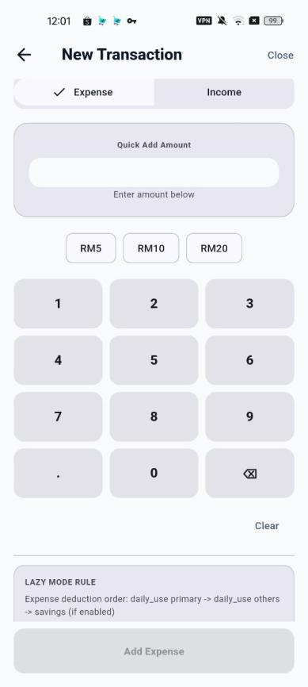
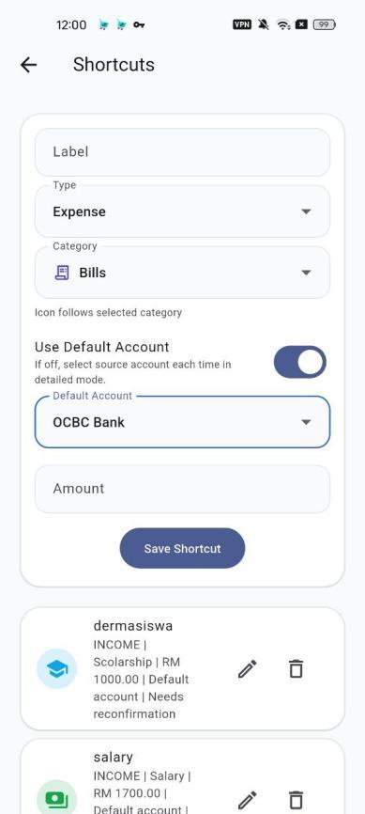
DAILY CAPTURE
FYP PRODUCT DEMO
Faster Daily Recording
Smart Pocket reduces capture friction through simplified entry, category selection and reusable one-tap shortcuts.
Shortcut Logic
Frequently repeated expenses can be saved once and recorded again with fewer steps.
Lazy Logic
The transaction form focuses on essential fields so users can record before they forget.
Expense entry
Lazy entry
Shortcuts

Slide 10
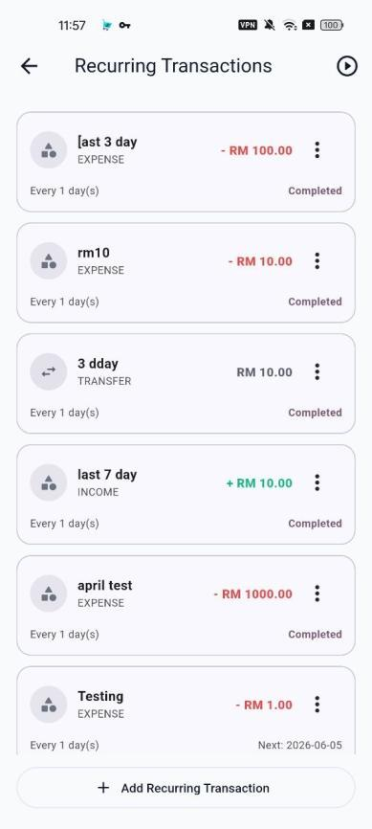
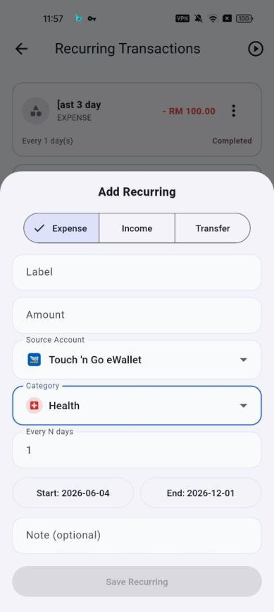
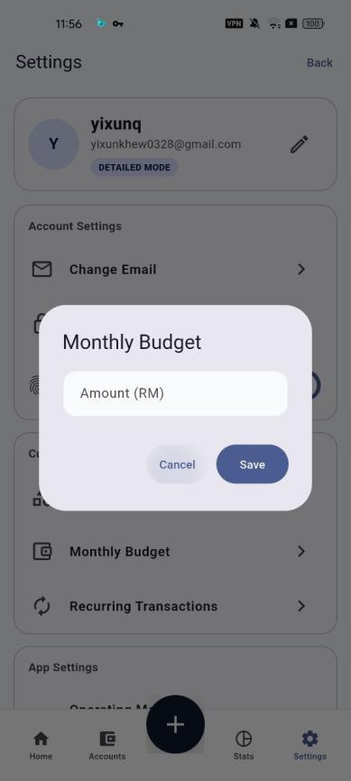
AUTOMATION
FYP PRODUCT DEMO
Automation for Sustainable Habits
Recurring plans and budget controls reduce repetitive work while keeping financial records complete.
Recurring Transactions
Useful for salary, subscriptions and fixed bills that repeat every month.
Budget Management
Monthly budget feedback helps users connect spending records with control.
Recurring list
Add recurring
Monthly budget

Slide 11
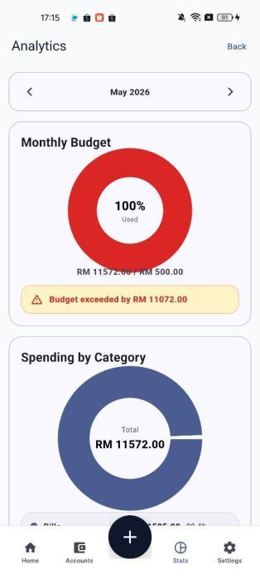
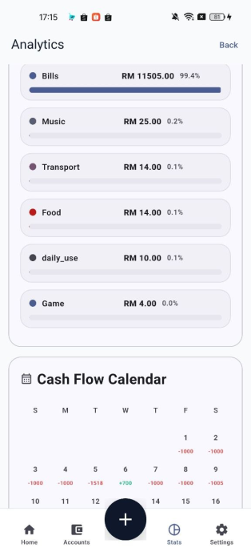
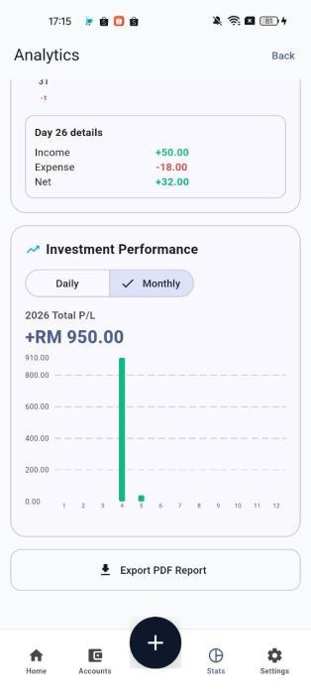
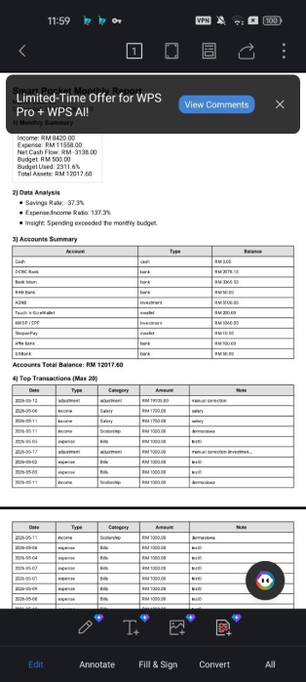
ANALYTICS & REPORTS
FYP PRODUCT DEMO
From Records to Awareness
Smart Pocket converts entries into budget, category, cash flow and PDF summaries.
Demo Cue
Open Stats, show analytics cards, then export or preview the PDF report.
User Value
Reports make spending patterns easier to review and explain.
Budget & category
Cash flow
Investment
PDF report

Slide 12
VALIDATION
FYP PRODUCT DEMO
Validation and Impact
Testing results show that the app is functional, usable and positively received by target users.
100%
90.6%
Functional pass rate across 56 test cases
Overall user satisfaction positive feedback
93.8%
81.2%
Recommendation positive feedback
One-Tap Shortcuts save time positive feedback

Slide 13
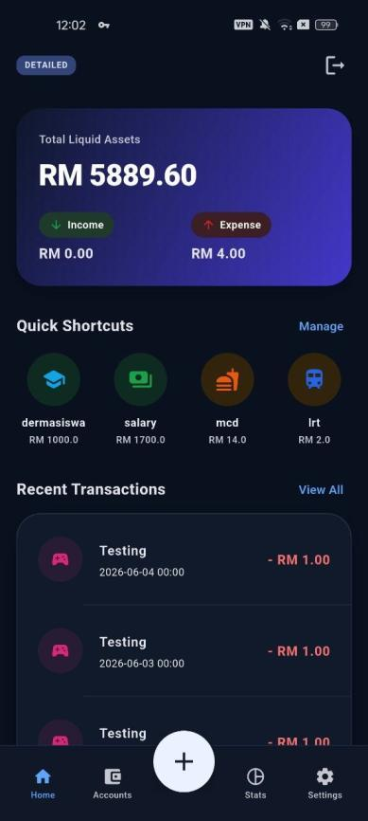
CONCLUSION
FYP PRODUCT DEMO
The Future of Personal Finance
Smart Pocket's value is not only more features. It is an adaptive tracking experience that different users can actually continue using.
Problem Solved
Key Innovation
Reduced recording friction through shortcuts, recurring plans and Lazy Mode.
Multi-mode architecture bridges fast entry and detailed account control.
User Impact
Future Potential
Analytics, reports and allocation views improve financial awareness.
Scalable foundation for OCR receipt capture, bank integration and predictive analytics.
Dark mode dashboard
Closing line: Smart Pocket adapts to the user, so the user does not have to abandon tracking.

