Slide 1
Capstone Project: Battle of the Neighborhoods --- Which place should I choose?
by Yiyao Ma

Slide 2
Table of Contents
A. Introduction/Business Problem
B. Data
C. Method
D. Results
E. Discussion
F. Conclusion

Slide 3
A. Introduction/Business Problem
Jack Lee is currently living in Flushing, Queens, New York City. He needs to rent a studio in a neighborhood in Manhattan.
He has two requirements:
(1) similar neighborhoods/venues and facilities as Flushing
(2) lowest average rent price for studio among the similar neighborhoods.

Slide 4
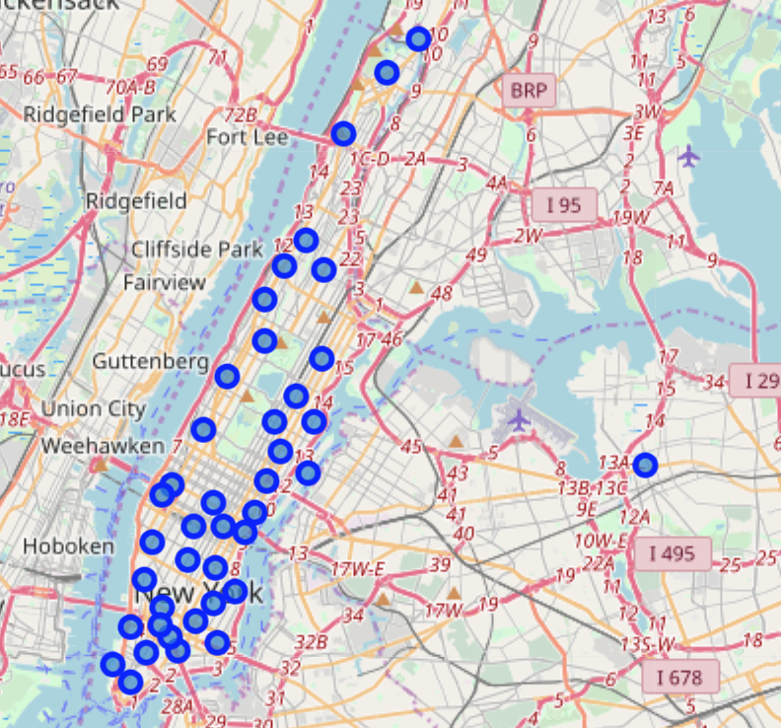
A. Introduction/Business Problem
So, the problem is --- Which neighborhood in Manhattan is similar to Flushing, Queens and has the lowest average rent for a studio?
Manhattan
Flushing, Queens

Slide 5
B. Data
1. Geographic Data
['Borough', 'Neighborhood', 'Latitude', 'Longitude’]
2. Foursquare Location Data
[‘Neighborhood', ‘Neighborhood Latitude', ‘Neighborhood Longitude', ‘Venue’, ‘Venue Latitude', ‘Venue Longitude', ‘Venue Category’]
3. Rent Data
[‘Neighborhood', 'Studio Rent’]

Slide 6
C. Methodology
We will leverage the Foursquare location data to explore or compare Flushing, Queens, NYC and the neighborhoods of Manhattan, use the k-means clustering algorithm to find the similar neighborhood(s), use the Folium library to visualize the neighborhoods and their emerging clusters, and finally apply Beautifulsoup library to extract the average rent data in Manhattan by neighborhood from online sources to find the similar neighborhoods in Manhattan that has the lowest average rent for a studio.

Slide 7
C. Methodology
What Machine Learning were used and why?
We use k-means clustering method. K-means is vastly used for clustering in many data science applications, especially useful if you need to quickly discover insights from unlabeled data.

Slide 8
C. Methodology
1. Download and Explore Dataset
2. Explore Neighborhoods in New York City
3. Analyze Each Neighborhood
4. Cluster Neighborhoods --- K-means clustering
5. Examine Clusters and Find Similar Neighborhoods in Manhattan
6. Rank the Similar Neighborhoods by Studio Rent Price

Slide 9
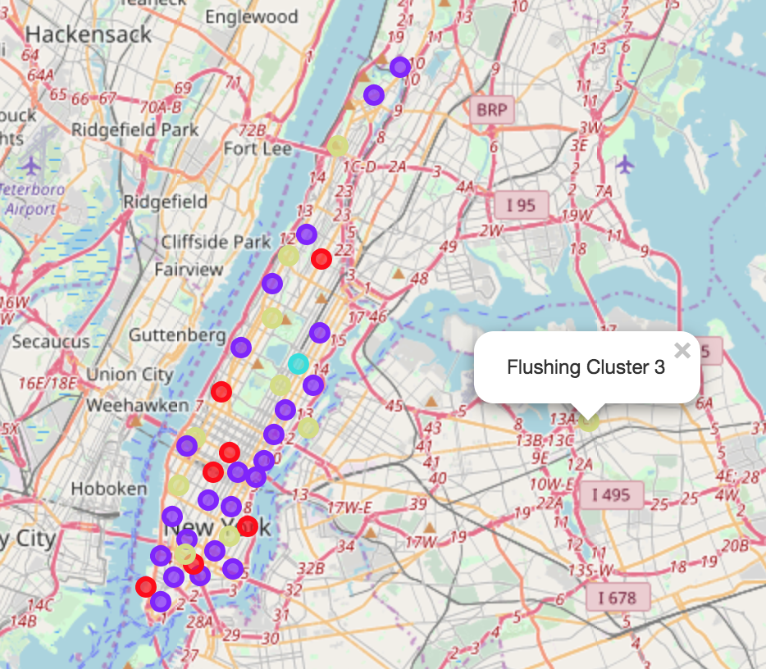
D. Results
1. Here is the clustering map of Flushing and Manhattan after running k-means clustering.

Slide 10
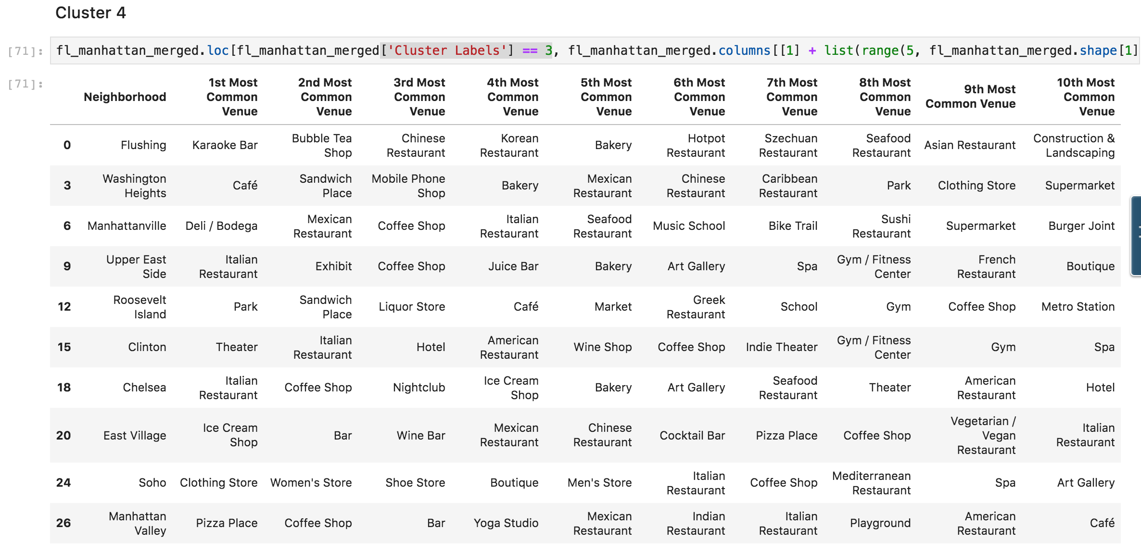
D. Results
2. Examining each cluster, we can see that Flushing, Queens is in Cluster 4 (['Cluster Labels'] == 3)

Slide 11
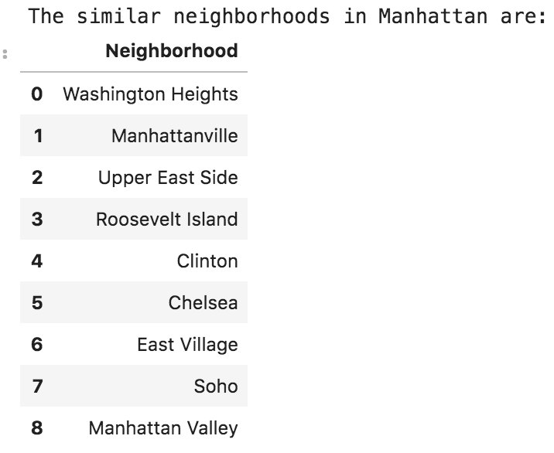
D. Results
3. Let's create a dataframe that includes all the neighborhoods in Manhattan in Cluster 4.

Slide 12
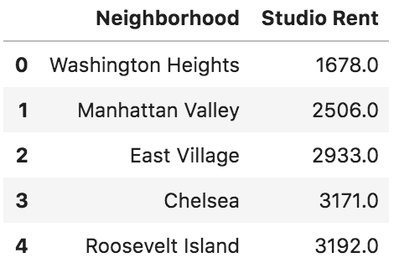
D. Results
4. Let's check the average Studio Rent of similar neighborhoods ranking in ascending order.
We can see that Washington Heights has the lowest Studio Rent in the Cluster 4.
Note: Because the rent dataset doesn't include the rent data of all the neighborhoods, some neighborhoods such as Manhattanville, Upper East Side, Clinton do not have rent data for analysis. To simplify the process, we simply delete those neighborhoods which means that Jack Lee won't choose from those neighborhoods.

Slide 13
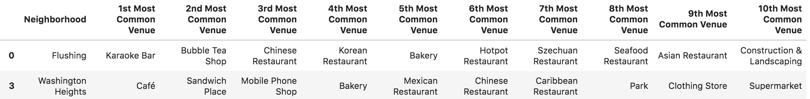
E. Discussion
As we can see from the results above:
From the Cluster 4 table as shown below, we can see that both Washington Heights and Flushing have many various kinds of restaurants such as Chinese restaurant, Asian restaurant, Bakeries and etc. And probably the main reason that Jack Lee enjoys living in Flushing is due to such many diversified restaurants especially Chinese restaurants as he was originally from China, which makes a lot of sense.
In the meantime, as Jack just graduated and has to pay back student loans, he needs to be frugal about his living expenses. Therefore he needs to rent a studio in a neighborhood that has the lowest average rental price.

Slide 14
F. Conclusion
Conclusion:
Based on the analysis and results shown above, we conclude that the similar neighborhood in Manhattan as Flushing with Lowest Studio Rental price is Washington Heights with studio rent of 1678 USD.
Therefore, we recommend Jack Lee to rent a studio in Washington Heights because it meets his two requirements:
(1) Washington Heights has the similar neighborhoods/venues and facilities as Flushing, and
(2) Washington Heights has the lowest average rent price for studio among the similar neighborhoods.

Slide 15
F. Conclusion
Further Possible Developments:
Due to some limitations, there are several areas that could be developed or improved in the future research:
(1) Use DBSCAN (Density-based spatial clustering of applications with noise) as the machine learning method to cluster neighborhoods for further studies.
(2) Find more completed rent dataset that includes the average rental costs of all neighborhoods.

Slide 16
Thanks!
Capstone Project: Battle of the Neighborhoods --- Which place should I choose?

