Slide 1
Machine Problem 7
By Yiyin (Sophia) Shen & Ruobin (Ruby) Wang

Slide 2
ABC Puzzle
Input Sample: 9,17,22,26,4,A,7,C,18,C,19,C,32
1 | 2 | 3 | 4 | 5 | 6
7 | 8 | 9 | 10 | 11 | 12
13 | 14 | 15 | 16 | 17 | 18
19 | 20 | 21 | 22 | 23 | 24
25 | 26 | 27 | 28 | 29 | 30
31 | 32 | 33 | 34 | 35 | 36
A |  | @
 |  |  |  | @ | C
C |  |  | @
 | @
 | C
A | A | @
 |  |  | C | @ | C
C | C |  | @
 | @
 | C
A | @ | B | C
B | A | C | @
C | B | @ | A
@ | C | A | B
Output
Grid #1 Grid #2 Grid #3

Slide 3
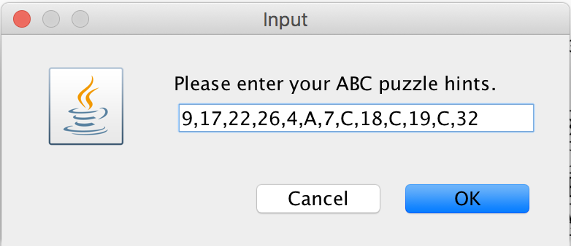
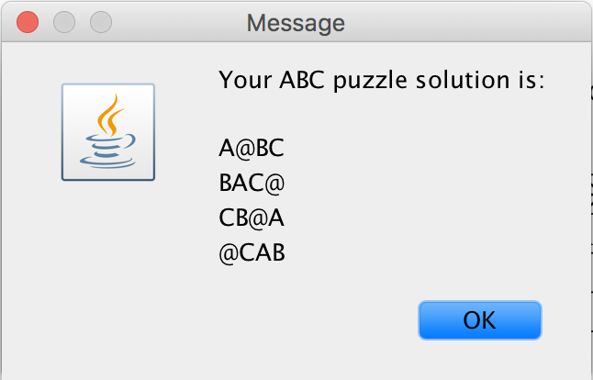
puzzleRunner Class Input and output
Java JOptionPane
showInputDialog
Java JOptionPane
showMessageDialog

Slide 4
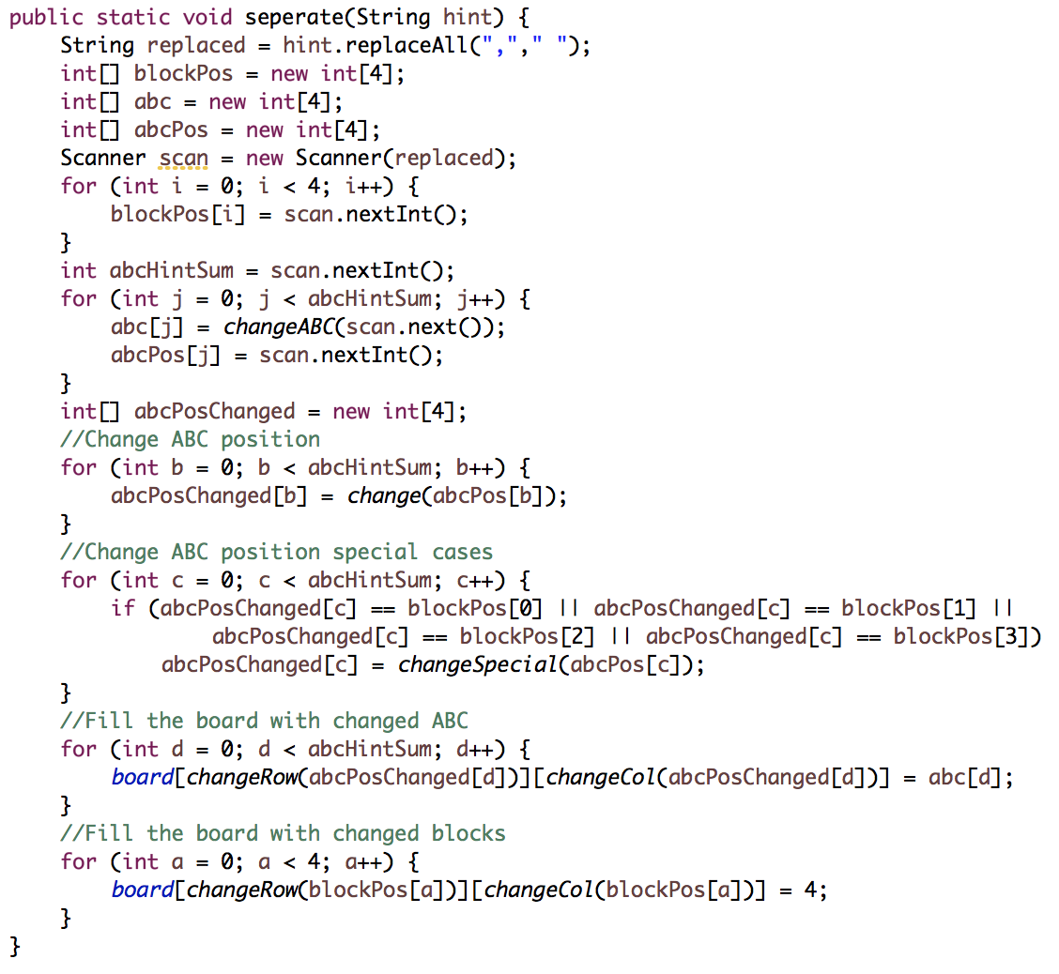
Puzzle Class ABC Assignment
A | A | @
 |  |  | C | @ | C
C | C |  | @
 | @
 | C

Slide 5
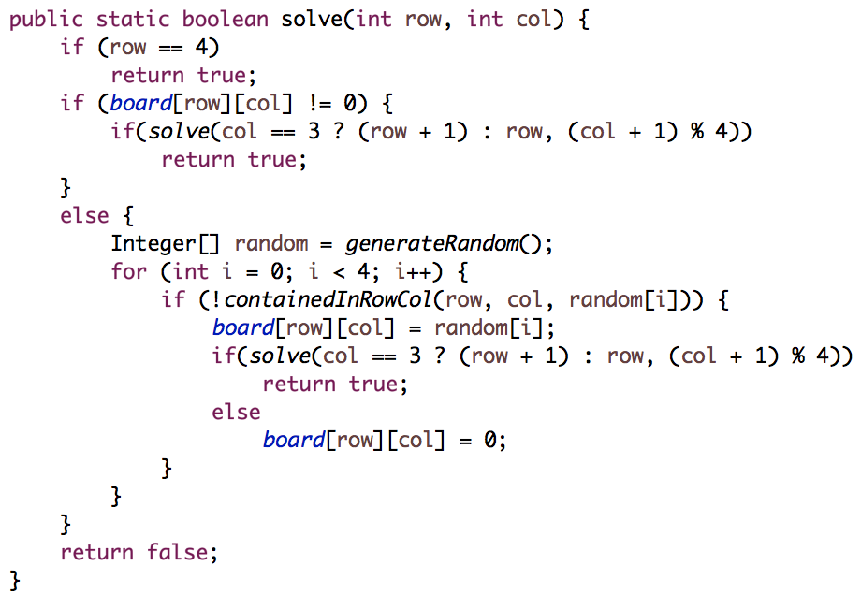
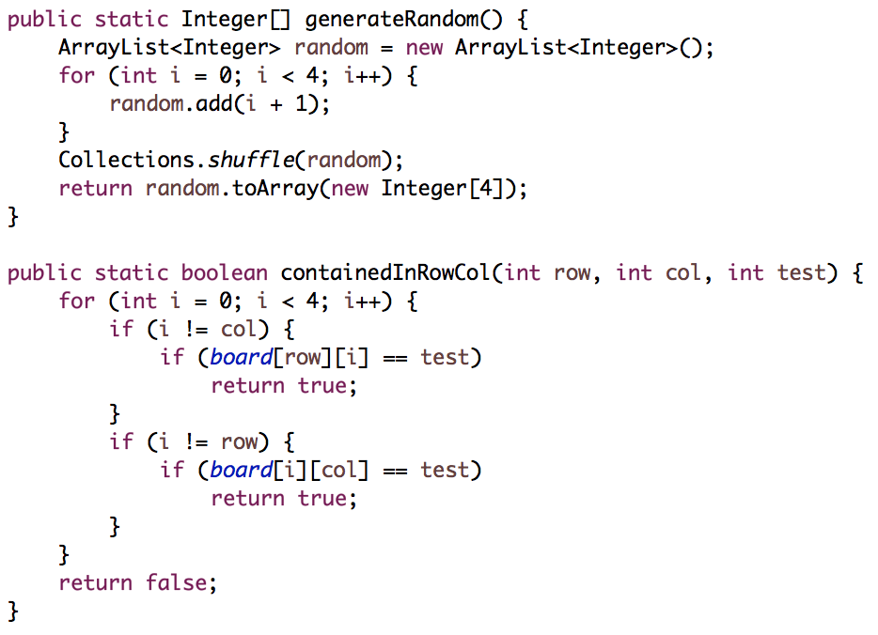
Puzzle Class Puzzle Solver

Slide 6
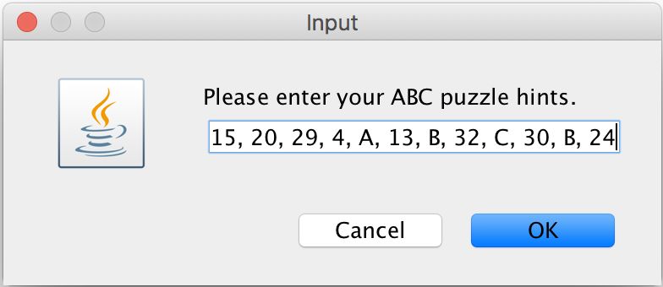
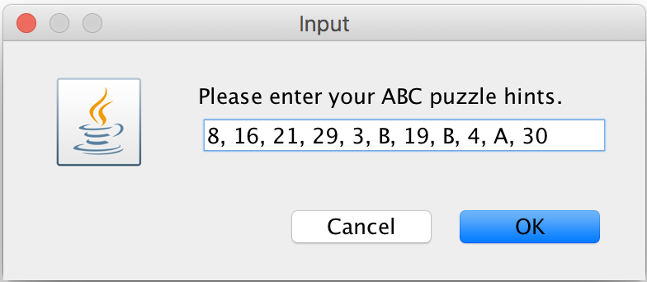

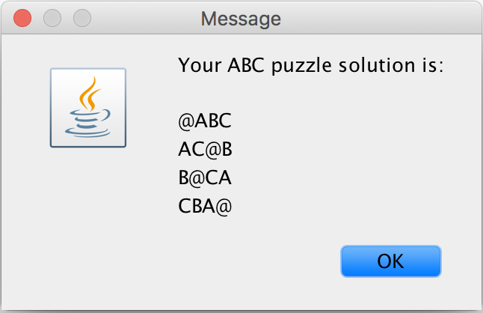
Other Test case

Slide 7
Thank You For Watching

