Slide 1

Note: The data and information in this document is reflective of a hypothetical situation and client. This document is to be used for KPMG Virtual Internship purposes only.
Sprocket Central Pty Ltd
Data analytics approach
[Division Name] - [Engagement Manager], [Senior Consultant], [Junior Consultant]

Slide 2
Note: The data and information in this document is reflective of a hypothetical situation and client. This document is to be used for KPMG Virtual Internship purposes only.
Agenda
Introduction
Data Exploration
Model Development
Interpretation

Slide 3
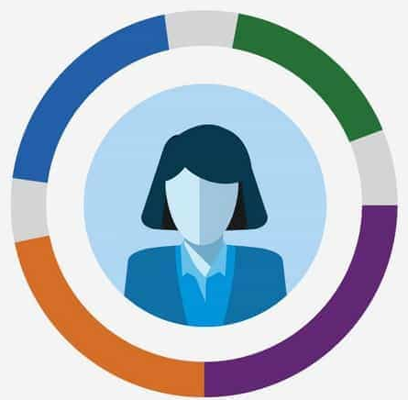

Note: The data and information in this document is reflective of a hypothetical situation and client. This document is to be used for KPMG Virtual Internship purposes only.
Introduction
Main Directions of Data Analysis
Customer Profile
Product Profile

Slide 4
Note: The data and information in this document is reflective of a hypothetical situation and client. This document is to be used for KPMG Virtual Internship purposes only.
Introduction
Customer Profile
Age and Gender and Sales
Customer Income and Sales
Job Category
Product Profile
Product Class , Product Line and Sales
Brand and Sales
Online Order

Slide 5
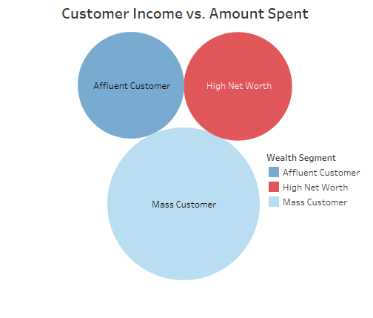
Note: The data and information in this document is reflective of a hypothetical situation and client. This document is to be used for KPMG Virtual Internship purposes only.
Data Exploration
Customer Income
Mass Customer: 2000 person
High Net Worth: 1021 person
Affluent Customer: 979 person
Mass customer is the most populous category among all the income level, thus we should adjust our strategy to target mass customers.

Slide 6
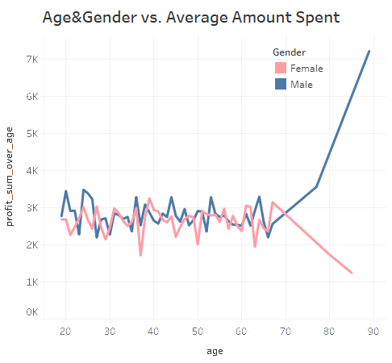
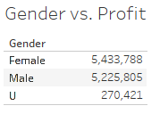
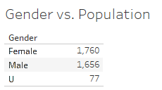
Note: The data and information in this document is reflective of a hypothetical situation and client. This document is to be used for KPMG Virtual Internship purposes only.
Model Development
Age and Gender vs. Profit
For most age groups, female and male customers’ consummation shows an even pattern on average
For more elderly age groups, male customers spend significantly more than female customers, but this may be due to the uneven population between female and male customers
Overall, female customers are more populous and tend to spend more

Slide 7
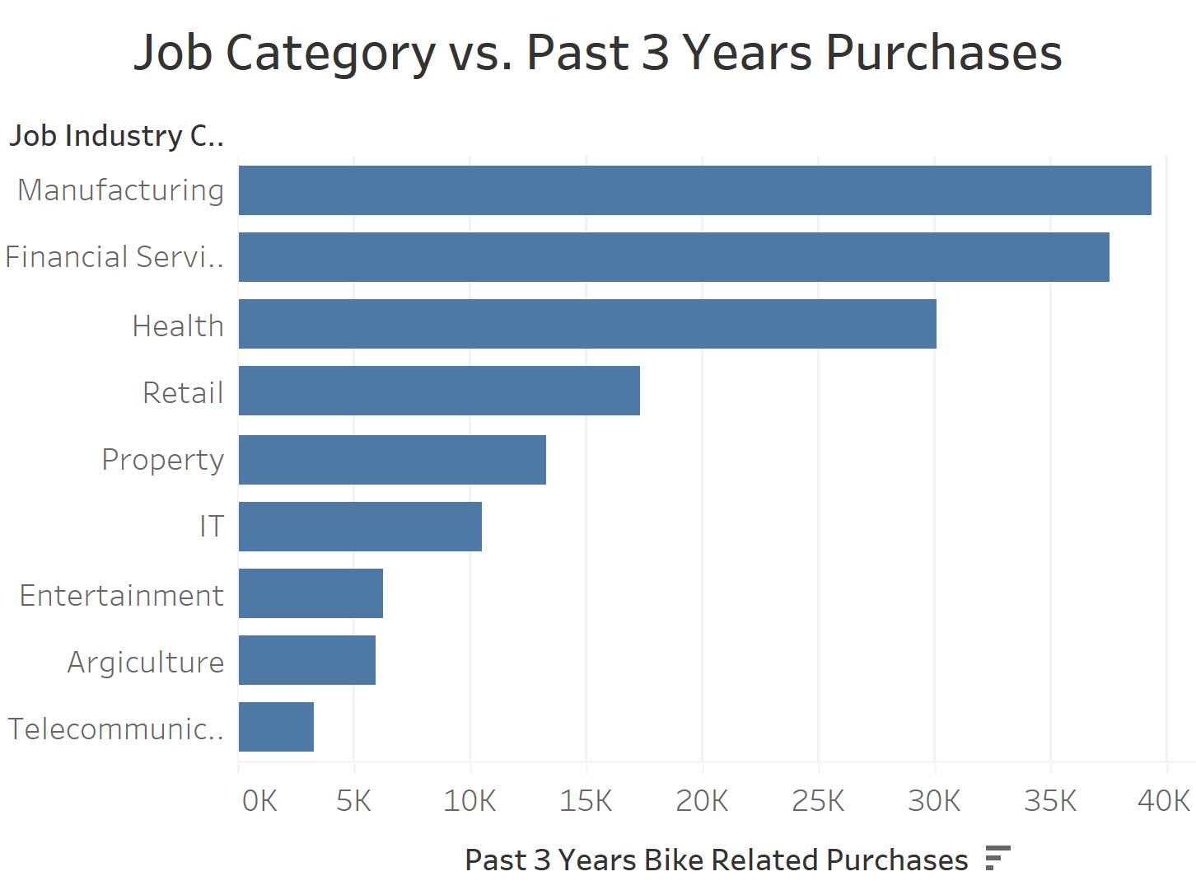
Note: The data and information in this document is reflective of a hypothetical situation and client. This document is to be used for KPMG Virtual Internship purposes only.
Model Development
Job Category vs. Consumption Frequency
Manufacturing, Financial Service, Health and Retail Industry are the most loyal customers’ job categories
We can attract more customers from property and IT industry for future business growth while maintaining the current customer distribution.

Slide 8
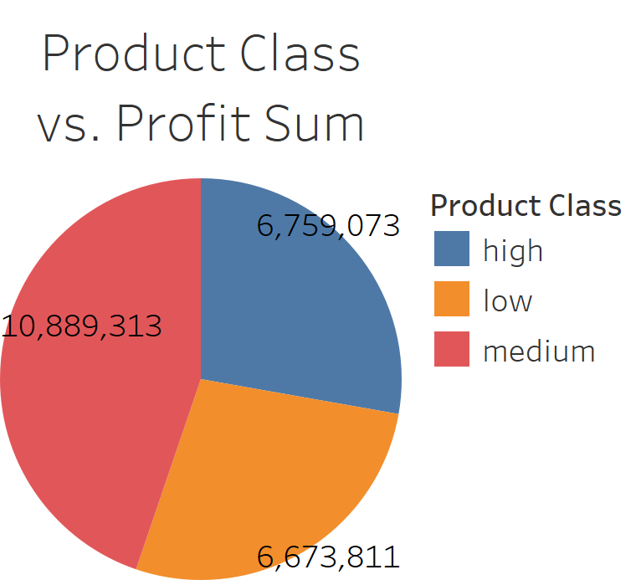
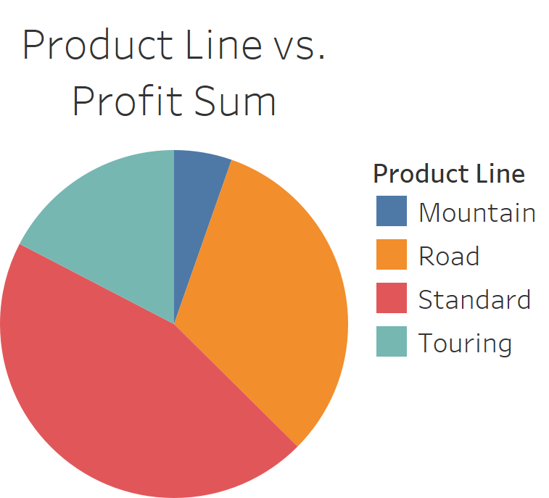
Note: The data and information in this document is reflective of a hypothetical situation and client. This document is to be used for KPMG Virtual Internship purposes only.
Data Exploration
Product Class and Line vs. Profit Sum
Medium class products are the most profitable product class
Standard line products are the most profitable product line

Slide 9
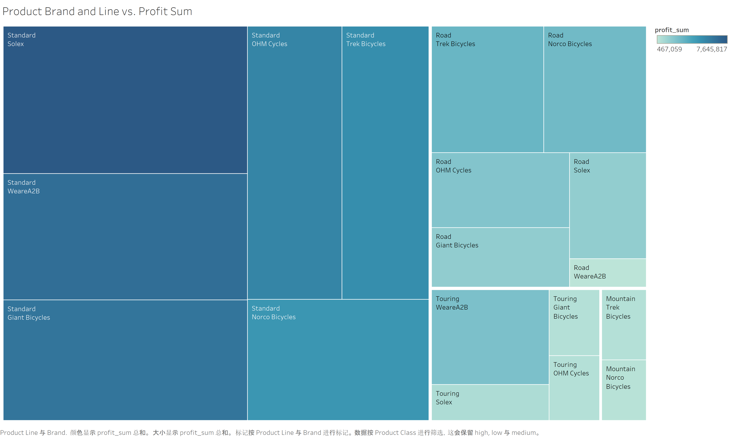

Slide 10
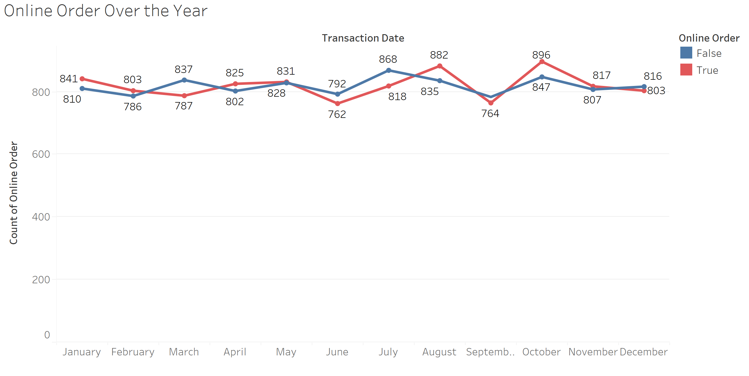
Note: The data and information in this document is reflective of a hypothetical situation and client. This document is to be used for KPMG Virtual Internship purposes only.
Model Development
Online Order
October is the month with most online order
July is the month with most instore order

Slide 11
Note: The data and information in this document is reflective of a hypothetical situation and client. This document is to be used for KPMG Virtual Internship purposes only.
Interpretation
Conclusion
The company's audience is mainly ordinary consumers looking for affordable products
Maintain current customers profile and adjust our strategy to expand to target higher income female customers, as well as customers from property and IT industry
Expand online business for facing the COVID-19 situation

Slide 12
Note: The data and information in this document is reflective of a hypothetical situation and client. This document is to be used for KPMG Virtual Internship purposes only.
Appendix

Slide 13
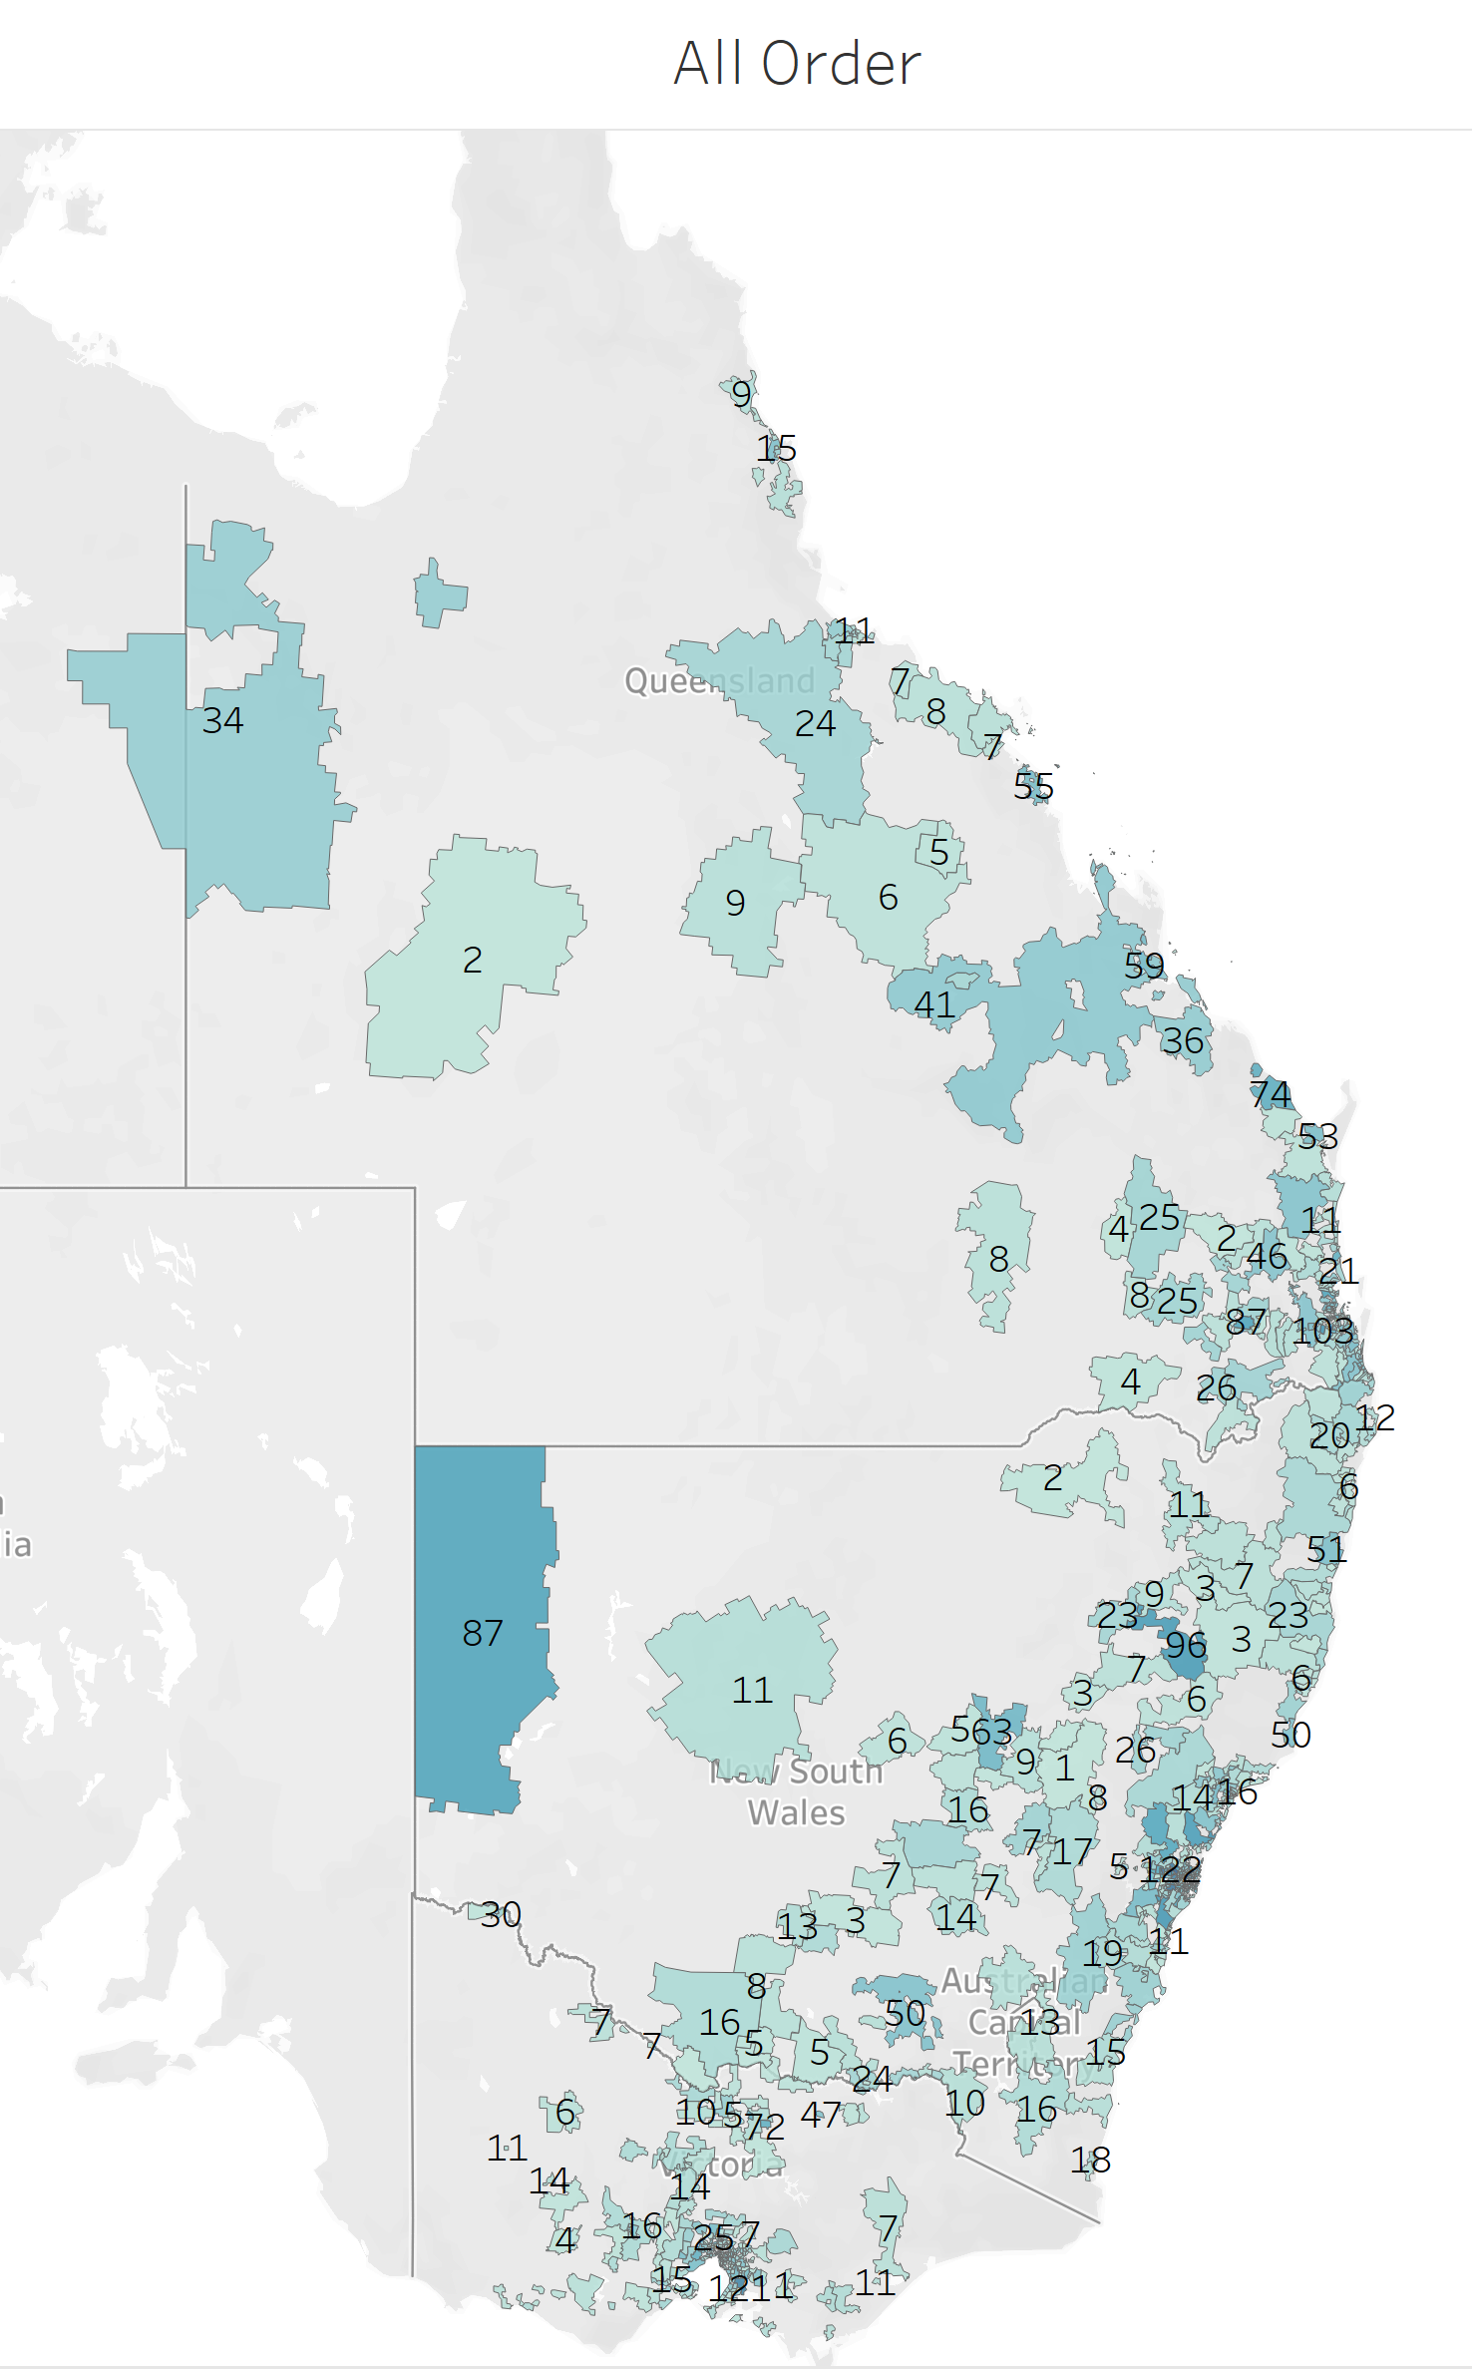
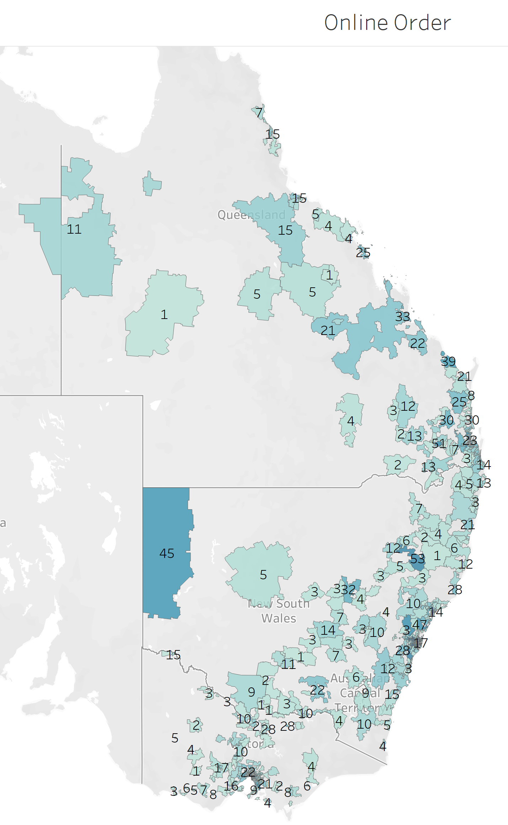
Note: The data and information in this document is reflective of a hypothetical situation and client. This document is to be used for KPMG Virtual Internship purposes only.
Appendix A. Geographical Distribution of Online Order vs. All Order

