Slide 1
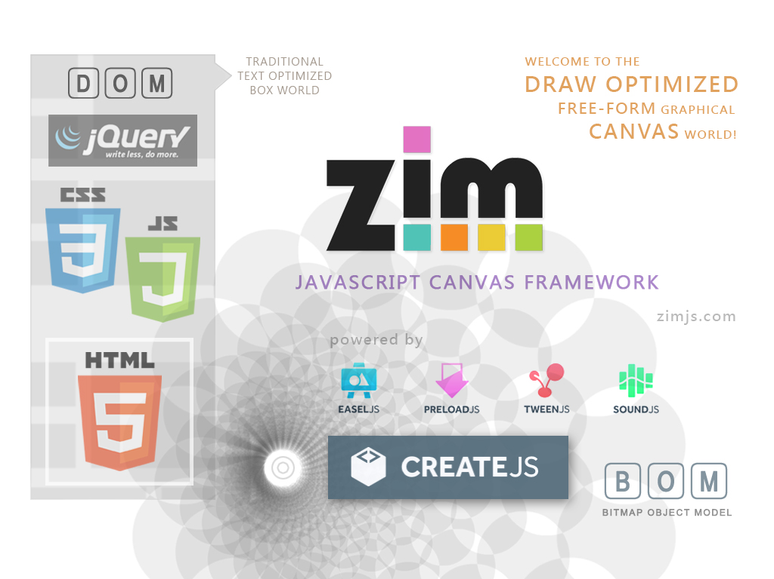
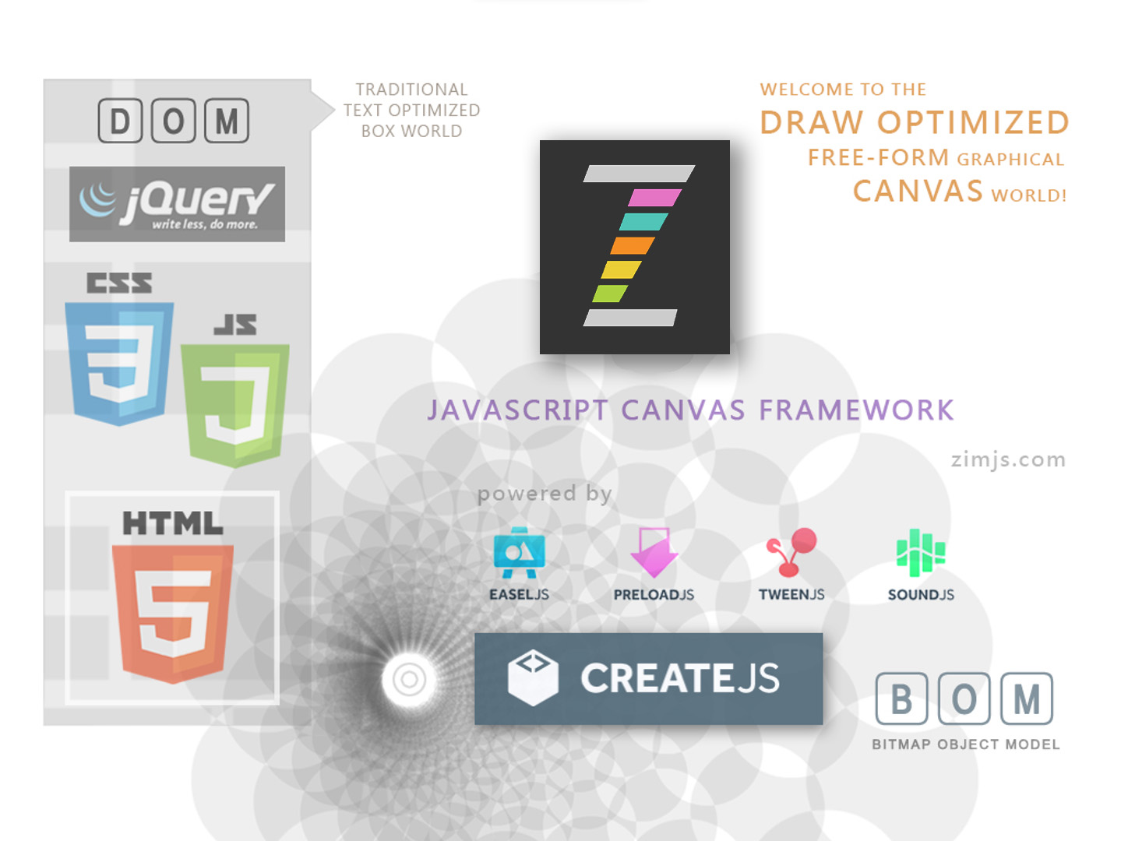

Slide 2

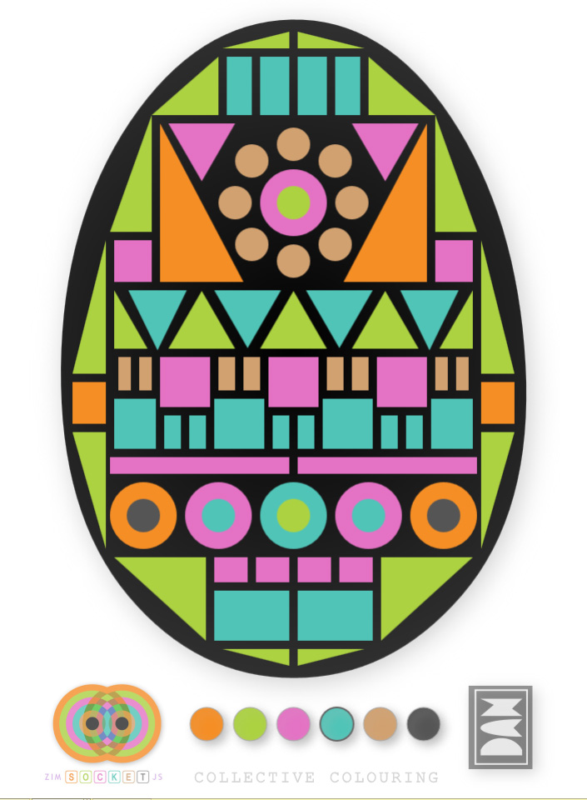
EXAMPLES
Make Interactive Media beyond Navigation
COLORING APPS
EASY SHAPES AND COLORS
MULTIUSER OPTION

Slide 3
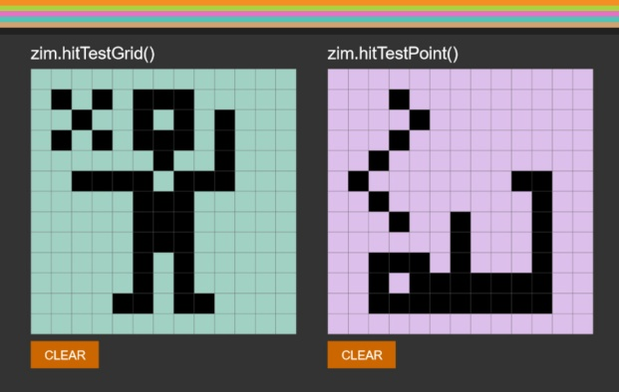
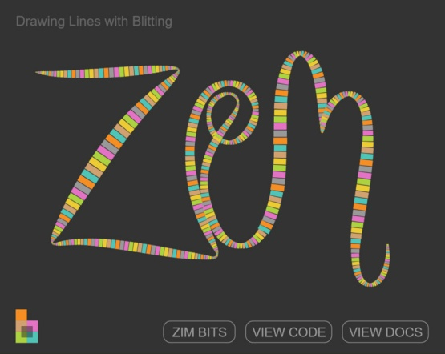
EXAMPLES
Make Interactive Media beyond Navigation
DYNAMIC DRAWING
from PIXEL ART APPS
to SMOOTH RIBBONS with DAMPING

Slide 4
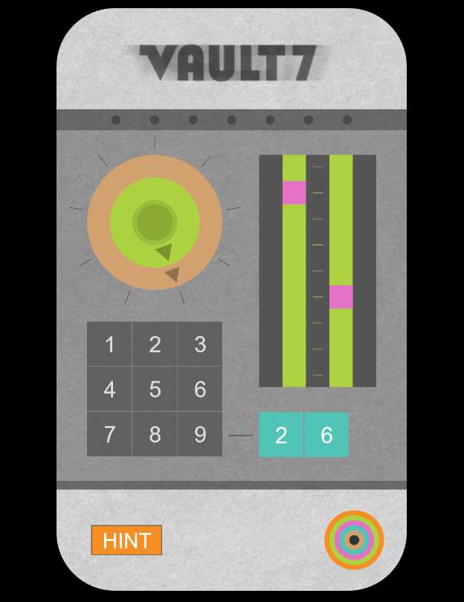
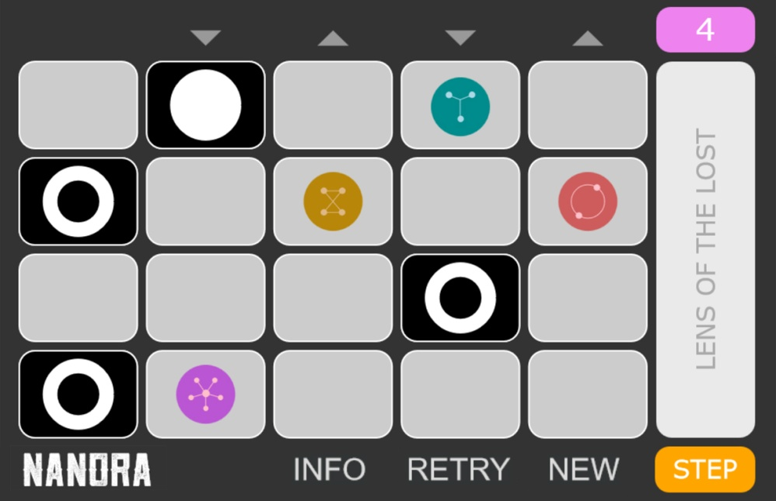
EXAMPLES
Make Interactive Media beyond Navigation
PUZZLES
BUTTON, DIAL, SLIDER, etc. COMPONENTS
DRAG, DROP and HIT TESTS
Meta Monks

Slide 5
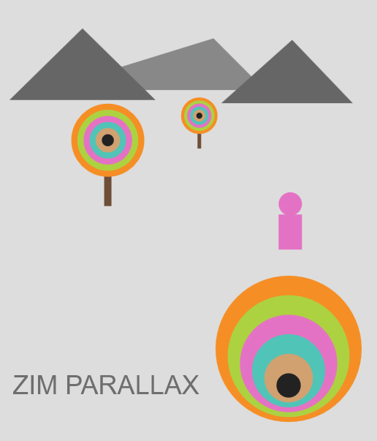
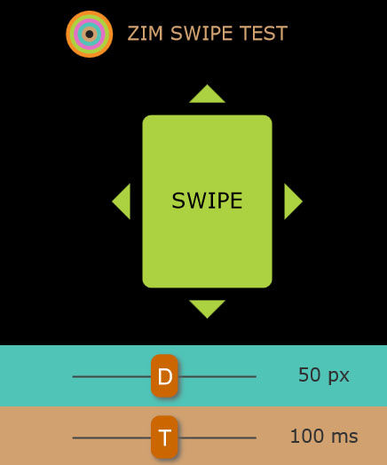

EXAMPLES
Make Interactive Media beyond Navigation
SWIPES & PARALLAX
PAGES with RESPONSIVE LAYOUTS
MOUSE MOVEMENT or SCROLL PARALLAX

Slide 6
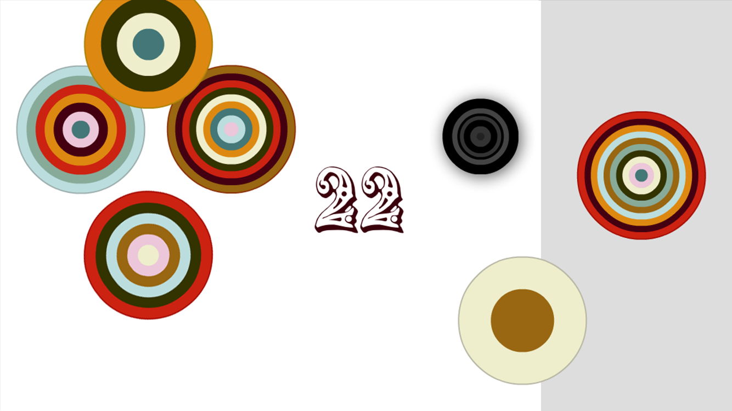
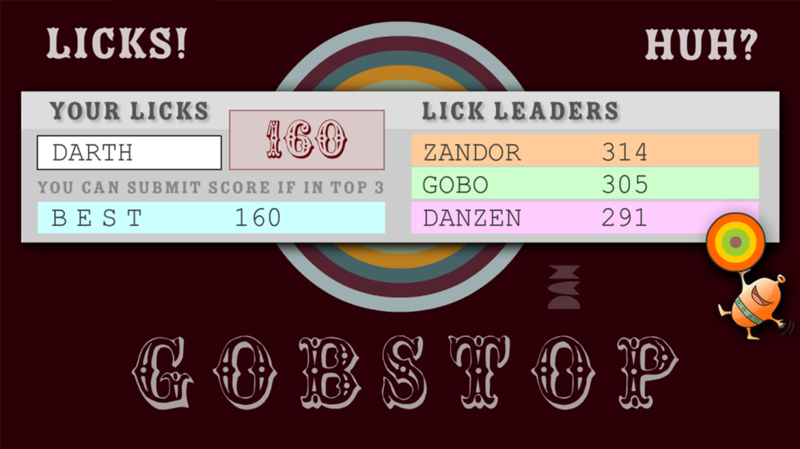
EXAMPLES
Make Interactive Media beyond Navigation
GAMES
MOBILE or DESKTOP
ANIMATION, SOUND, DATA

Slide 7
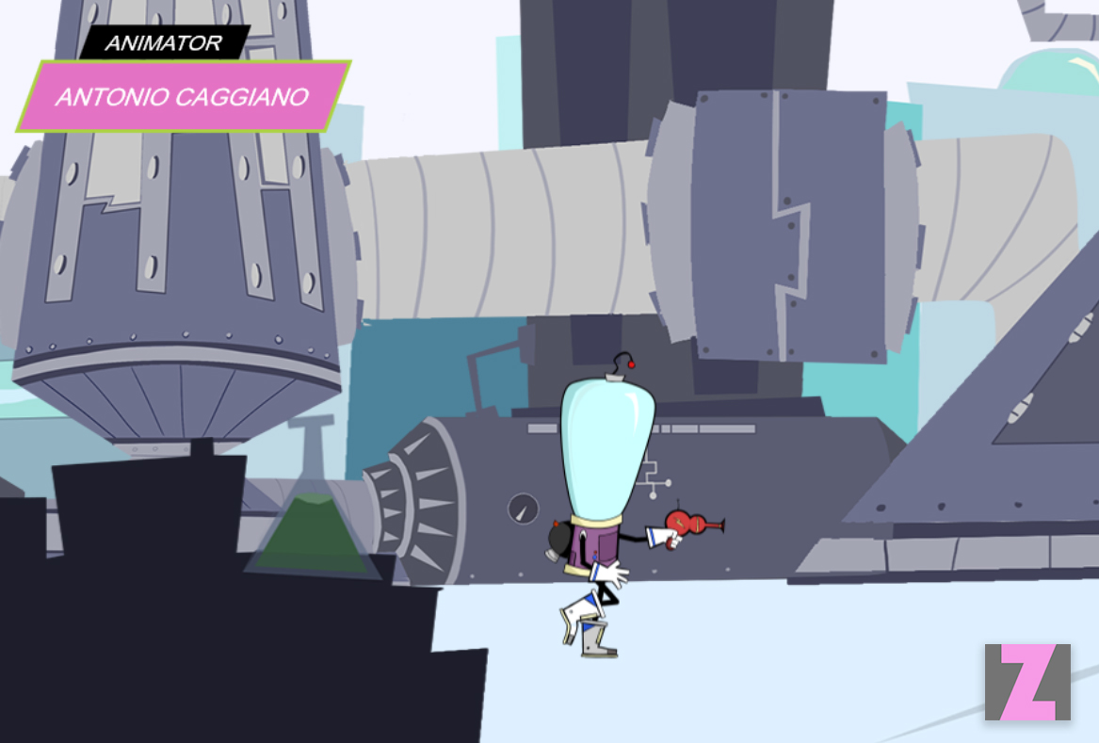
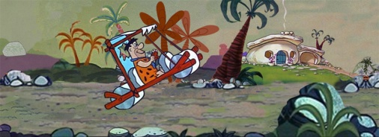
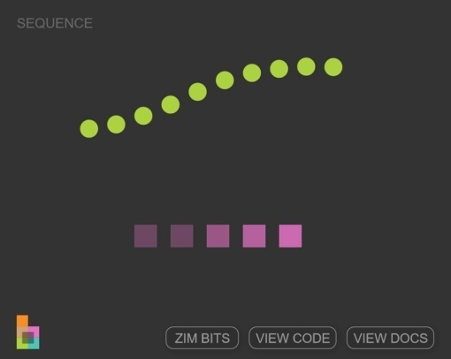
EXAMPLES
Make Interactive Media beyond Navigation
ANIMATIONS
TWEENS, SEQUENCES, SPRITE SHEETS and MOVING BACKGROUNDS

Slide 8
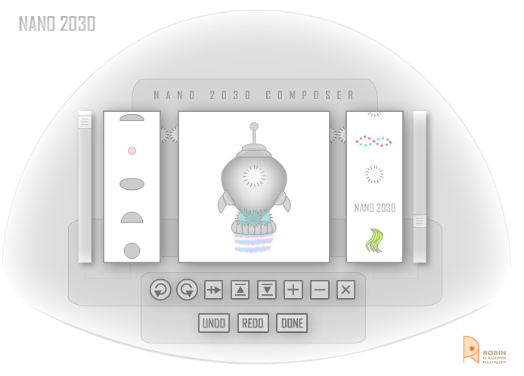
EXAMPLES
Make Interactive Media beyond Navigation
CONFIGURATORS
SPECIFICATIONS, AVATARS, COLLAGES...

Slide 9
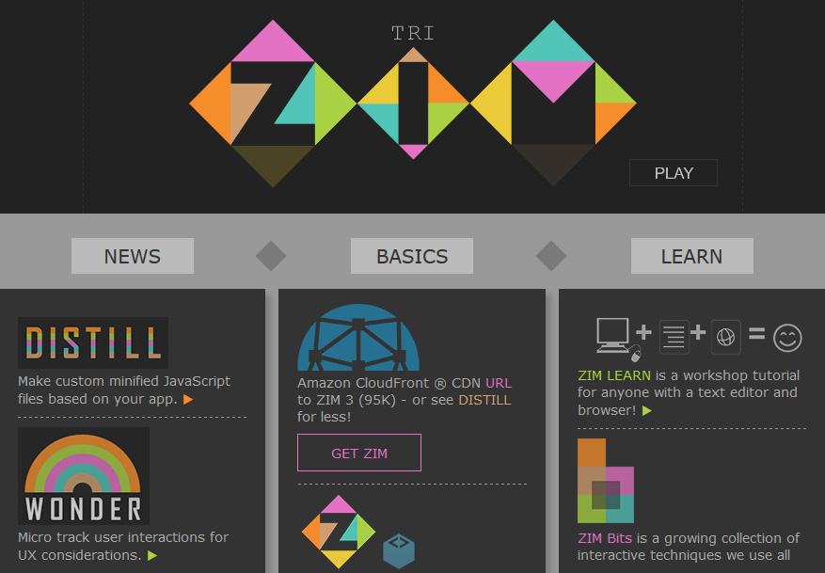
EXAMPLES
Make Interactive Media beyond Navigation
INTERACTIVE LOGOS & ADS
ANIMATED
SNAPPABLE &
TRACKABLE
ZIM SITE LOGO
COLLAGE &
ENGAGING AD
DISTILLED
TO 14K

Slide 10
CONTEXT
Taxonomy of Interactive Media – generalized / simplified
INFORMATION
SOCIAL
EDUCATION
PLAY
ART
SIMULATION
WHY
SITE
APP
GAME
WHAT
BROCHURE
INTERACTIVE
SERVICE
PRODUCT
TEXT
2D
3D
Unity
WEB
MOBILE
PHYSICAL
AR
MR
VR
WHERE
TEXT OPTIMIZED
DOM
DRAW OPTIMIZED
BOM
HOW
HTML
JS
CSS
jQuery
CANVAS
JS
CreateJS
ZIM
ASSETS : Fluid Text, Images, Forms, Tags,
Audio, Video (less integrated)
ACTIONS: Navigate (Press, Swipe),
Hide / Show, Animate, Submit
ASSETS : Fluid Images, Text, Components,
Containers, Sound, Animation
ACTIONS: Drag and Drop, Hit Tests, Scale, Rotate, Animate,
Navigate (Press, Swipe, Key), Add / Remove, Cache, Mask
AR – Augmented Reality, MR – Mixed Reality, VR – Virtual Reality, DOM – Document Object Model, BOM – Bitmap Object Model

Slide 11
METRICS
1000 CONDITIONALS
100 LOOPS
200 RETURNS
tasks and build times
100 FUNCTIONS
2000 { } BLOCKS
100 ADDCHILD ( )
ADOBE FLASH
BENCH MARK
DISTILL FOR LESS
TRADITIONAL BASIS FOR INTERACTIVE MEDIA
JAVASCRIPT
CREATE JS
ZIM
ZIM
APP
var
conditional
loop
function
array
object
canvas
fill & stroke
line & rect
curve & arc
stage
container
shape
bitmap
text
sound
events
tween
hit test
filters
buttons
pane & label
slider & dial
picker & pad
tab & grid
drag & drop
hit tests
animate
shapes
frame
pages
layout
hotspots
swiping
damping
async
proportion
scaling
scrolling
parallax
creativity
UI & UX
sketch
assets
steps & logic
custom class
module
refactor
debug
test & launch
BUILD TIME WITH JS
+
BUILD TIME WITH CREATE JS
BUILD TIME WITH ZIM
CASE STUDY : ZIM saved over 200 lines of code on a 1500 line puzzle application (Nanora)

Slide 12
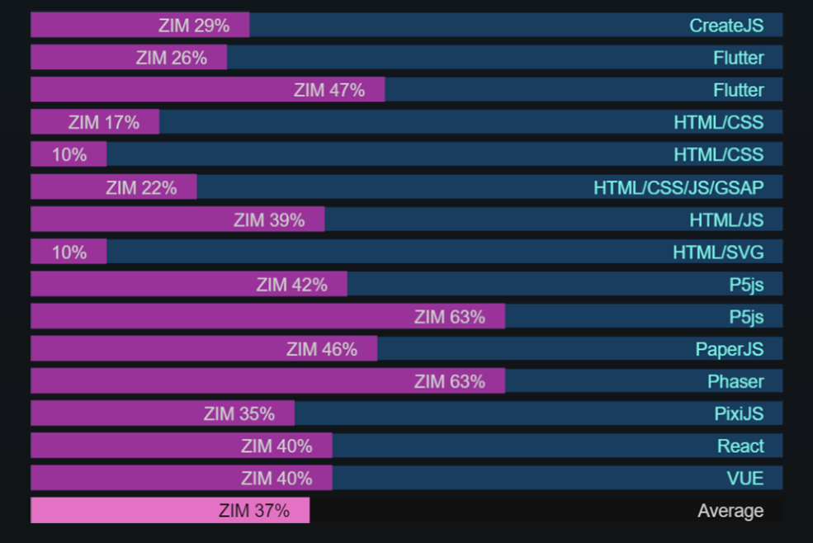
METRICS
comparison to other frameworks

Slide 13
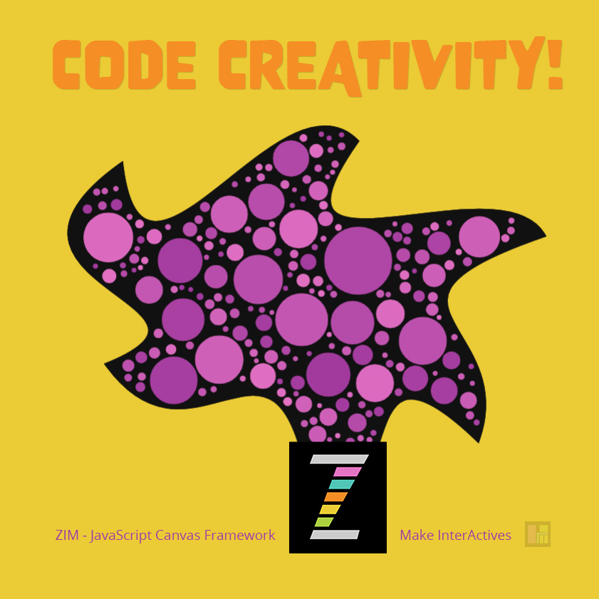
GET CODING!
go to https://zimjs.com

