Slide 2
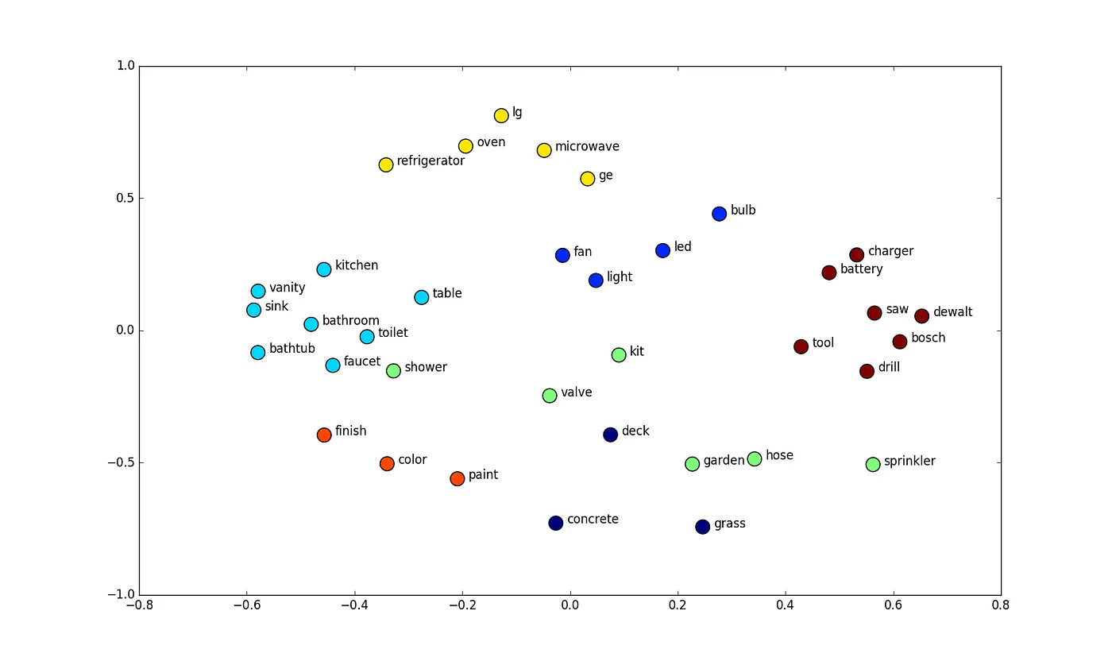

Word Embedding: Machine Learning-Based Vector Representation of Text
Machine Learning
Datasets
ex: Wikipedia
2-D word vector space

Slide 3
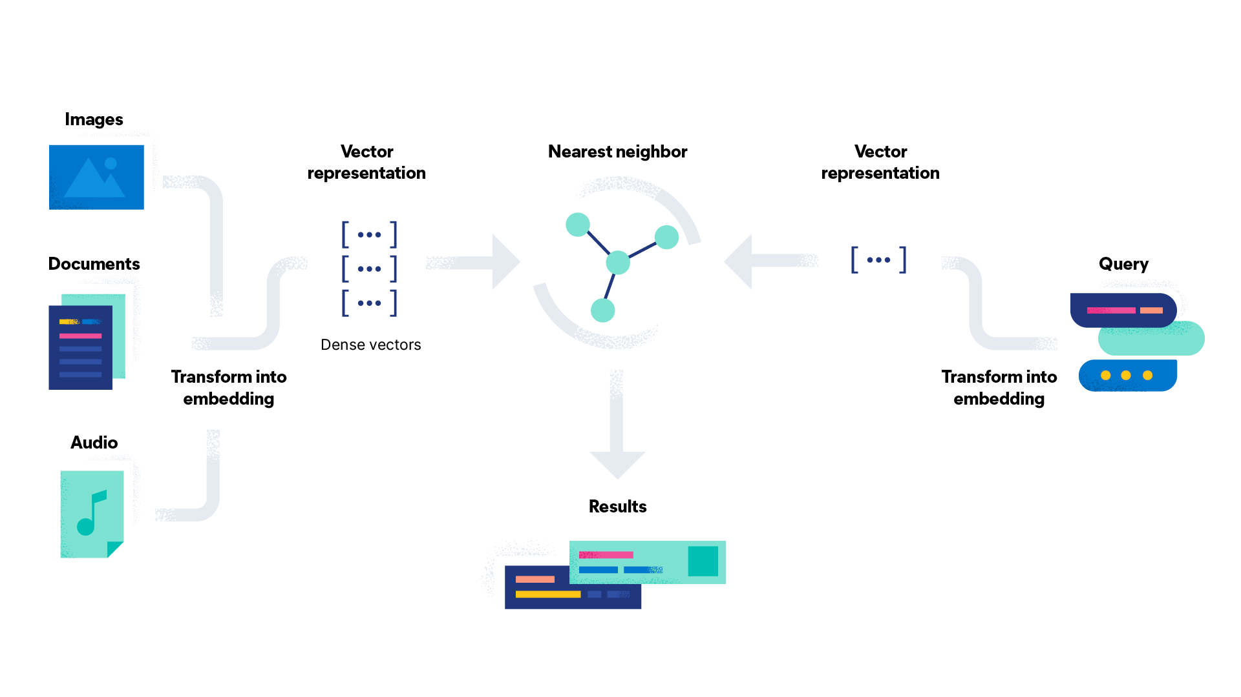
How does semantic search work?
https://www.elastic.co/what-is/semantic-search

Slide 4
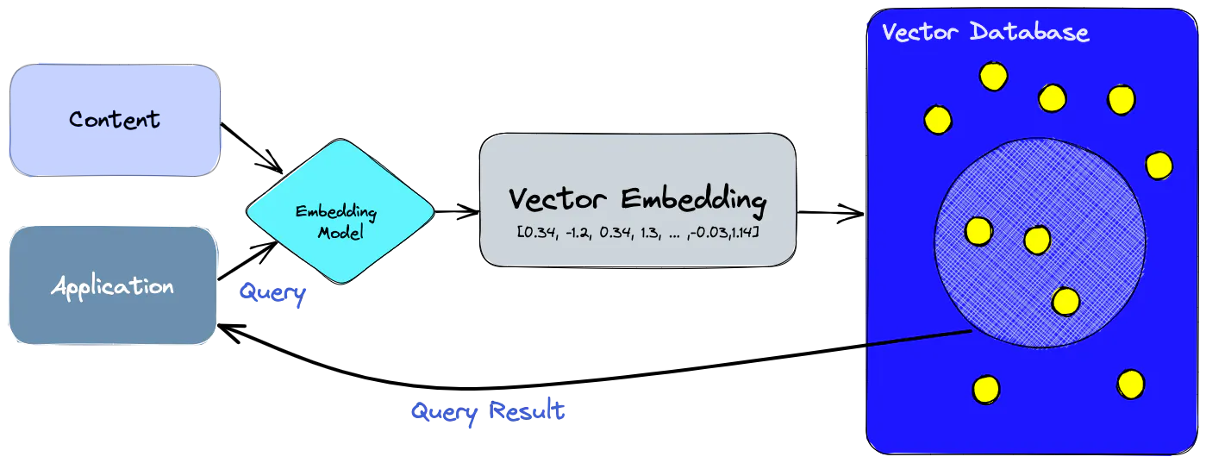
Vector DB: A Database for Storing and Quickly Retrieving Similar Vectors
Unstructured data
Vector databases enable businesses to manage unstructured data more efficiently and improve internal knowledge retrieval

Slide 5
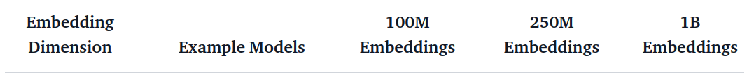
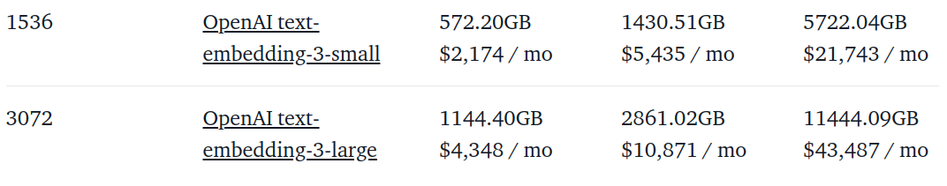
Challenges in Scaling Embedding Storage on Cloud-Based Vector Databases
AWS: $3.8 per GB/month
For storing embeddings in a vector database on a cloud virtual machine:"

Slide 6
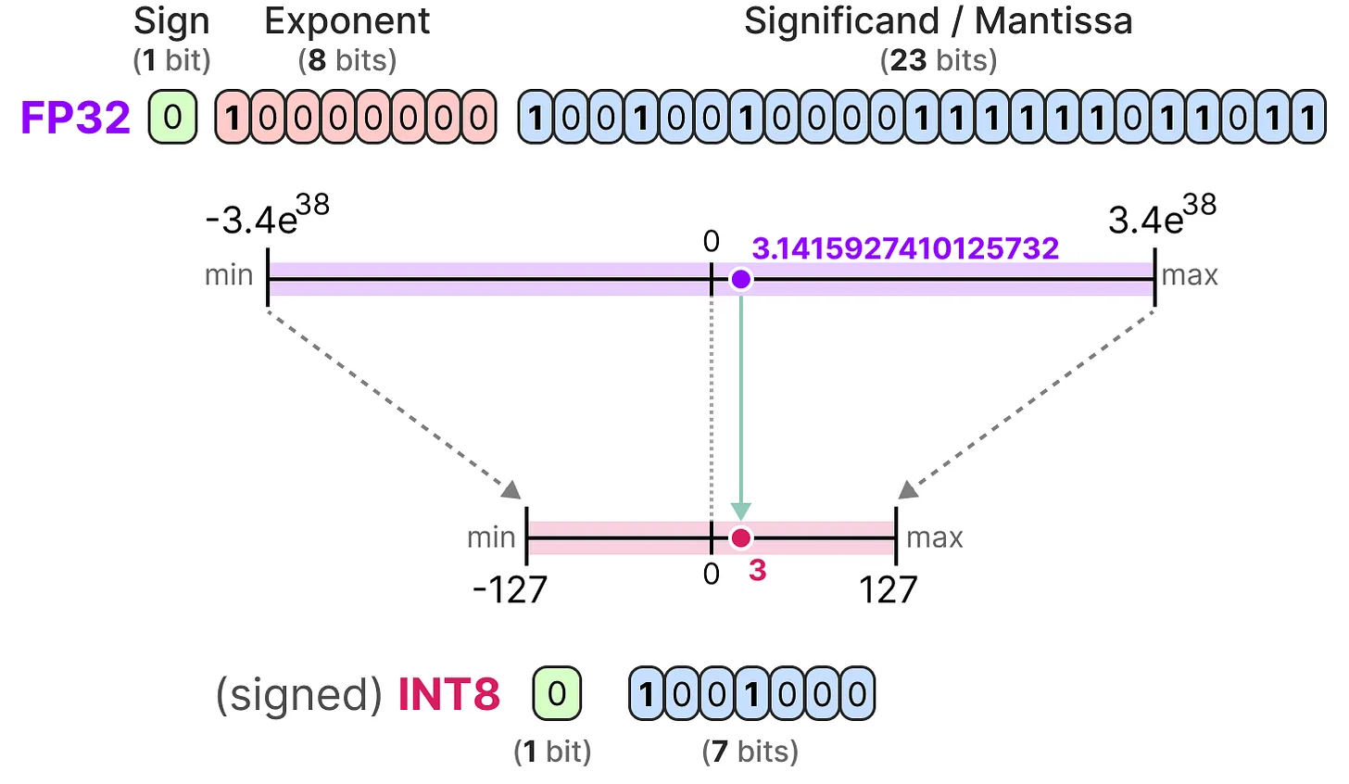
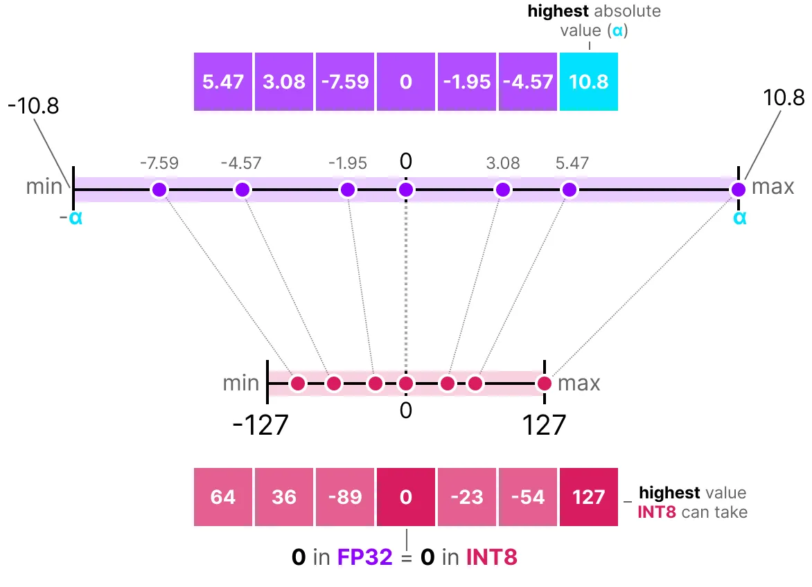
Quantization is a solution

Slide 7
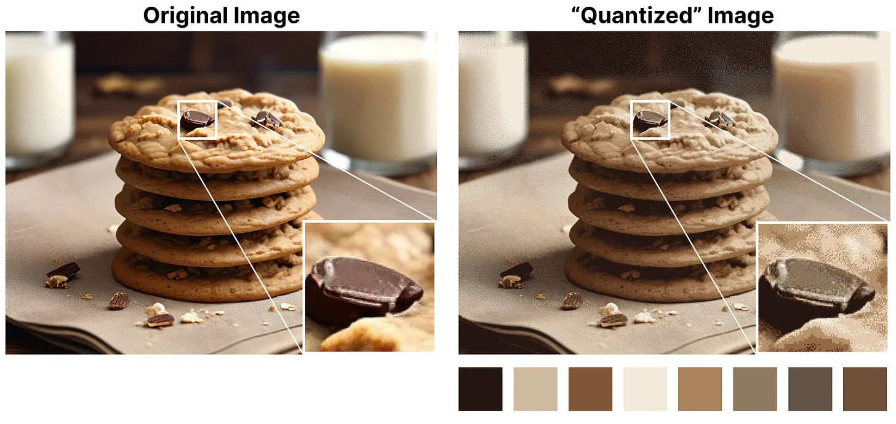
Quantization: an example

Slide 8
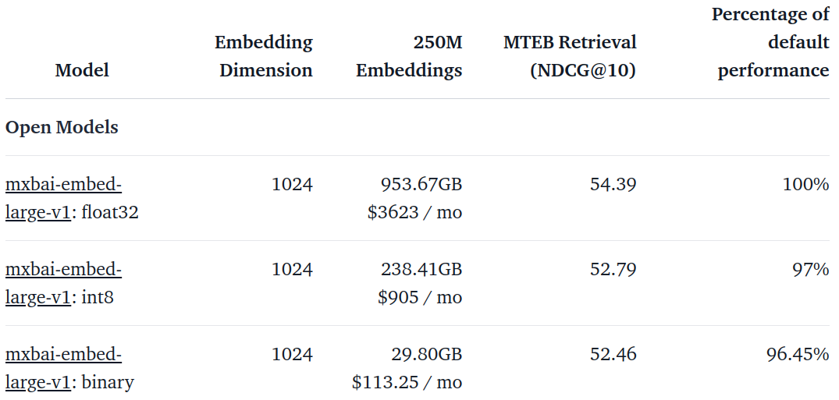
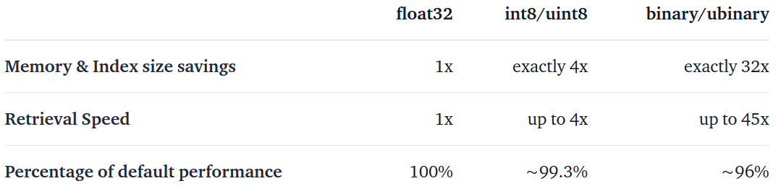
Improvement

