Slide 1

Can LLMs do security code review?
Exploring their capabilities and limitations in detecting vulnerabilities.

Slide 2

LLM Security Code Review Experiments
From ad-hoc scans to rule-backed, measurable detection
Repository
Benchmark Scale
cursor-security-code-review-rules
9–10 bundles · ~900–1,000 files
7,674–8,001 ground-truth vulnerable lines
Core Framing
An engineering experiment measuring what changed when we changed the process, not just the model

Slide 3





Agenda
Benchmark & Metrics
Simple Review
Guided Review
How we define and score detection quality
What we tried, model variance, and fundamental limits
Five versions — what worked and what failed
Results Trend
Failures, Lesson Learned & Future Direction
v1.0 → v1.4 objective improvement data
Open gaps and recommended roadmap

Slide 4

The Question We Asked: Can we make LLM security code review repeatable, reliable, and trustworthy?
Approach | Input | Hypothesis
Simple Review | Source code only | Model security priors* are enough (Organic LLM)
Guided Review | Source + Cursor rules + workflow | Process + patterns improve recall without killing precision (LLM + human)
security priors means the model has learned things like:
malware is bad, credential leakage is risky, privilege escalation is dangerous …
In ML/LLM language, “priors” often means:
built-in tendencies, learned patterns, default assumptions, pre-trained guardrails …

Slide 5
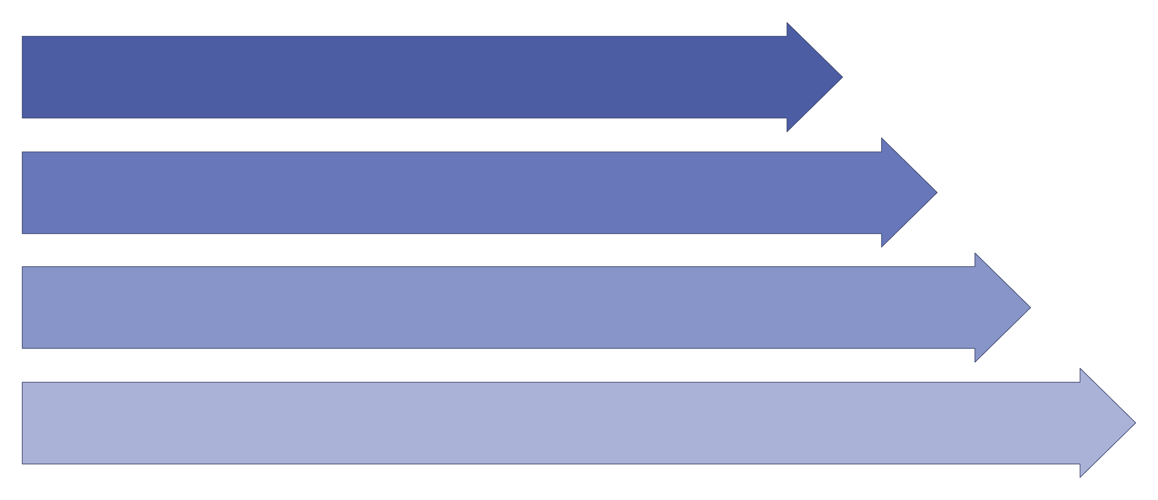
Benchmark at a Glance
~1,000 Source Files
7,674+ Labeled Lines
LLM Review Report
TP / FP / FN Scoring
Key Metrics
Recall = GT lines hit ÷ total GT lines [Sensitivity] Of all the real vulnerabilities, how many did we catch?
Precision = TP ÷ (TP + FP) [Accuracy] Of everything we flagged, how much was actually a real issue?
F1 = harmonic mean of recall and precision [Score] A single score that balances catching more vs. false alarms

Slide 6

Simple Review: Experiments We Ran
/simple-review — source-only LLM review, no rule pack attached
Experiment | Compared
GPT 5.5 vs Opus 4.8 | simple-review-opus-4.8 vs simple-review-gpt-5.5-first-run
Same model (GPT 5.5), different time | GPT 5.5 first vs second run
vs Ground Truth | Both models vs GT
Model choice matters, but not much; re-running helps, but does not substitute for systematic coverage.

Slide 7
Simple Review: Recall (Sensitivity to Vulnerable Code)
1.4%
1.2%
Opus4.8 Recall
GPT-5.5 First Run Recall
155 findings across 139/1,000 files (13.9% coverage)
114 findings across 96/1,000 files (9.6% coverage)
0.3%
GPT-5.5 Second Run Recall
102 findings across 89/1,000 files (8.9% coverage)

Slide 8
Simple vs. Simple Comparison
Run | Findings | Files with ≥1 finding | File coverage | Recall | Precision | F1
gpt-5.5-first-run | 114 | 96 / 1,000 | 9.6% | 1.2% | 69.3% | 2.3%
gpt-5.5-second-run | 102 | 89 / 1,000 | 8.9% | 0.3% | 23.5% | 0.6%
opus-4.8 | 155 | 139 / 1,000 | 13.9% | 1.4% | 51.0% | 2.7%

Slide 9

Simple review doesn't work — but why?
I didn't know at first. It was only after running guided review and looking back that the answer became clear.

Slide 10

Guided Review: Evolution Timeline
v1.0 — Rule-Backed Pass
1
Narrow rule globs → ~12 findings/bundle · Recall 1.3%
2
v1.1 — Language-Neutral Globs
global-scr-* pattern expansion → No material gain (+0.1 pp recall)
v1.2 — Mandatory Per-File Review
3
Breakthrough: Required file coverage — 455 findings · Recall 5.6% · Precision 89.2%
4
v1.3 — File Ledger + C Sink Scan
Required and verified file coverage: 982 findings · Recall 11.3% · Files covered 69.8%
v1.4 — Language-Specific Screening
5
<language>*-inspection.mdc + regression registry → 2,062 findings · Recall 35.2% · Precision 80.9%
The biggest leaps came from workflow changes, not from swapping models.

Slide 11
Overall Trend v1.0 → v1.4
Findings (absolute count)
v1.0 ████ 124
v1.1 ████ 129
v1.2 ███████████████ 455
v1.3 ████████████████████████████████ 982
v1.4 ████████████████████████████████████████████████████████████████████ 2,062
F1 (% Quality of findings)
v1.0 ██ 2.5%
v1.1 ██ 2.7%
v1.2 ████████ 10.5%
v1.3 ████████████████ 19.8%
v1.4 ████████████████████████████ 35.2%
Takeaways
Findings grew ~16.6× from v1.0 (124) to v1.4 (2,062); largest jump v1.3→v1.4 (+110%).
F1 rose from 2.5% to 35.2% — recall improved without precision collapsing (v1.4 precision is 80.9%).

Slide 12
Simple vs. Simple vs. Guided Comparison
Run | Findings | Files with ≥1 finding | File coverage | Recall | Precision | F1
gpt-5.5-first-run | 114 | 96 / 1,000 | 9.6% | 1.2% | 69.3% | 2.3%
gpt-5.5-second-run | 102 | 89 / 1,000 | 8.9% | 0.3% | 23.5% | 0.6%
opus-4.8 | 155 | 139 / 1,000 | 13.9% | 1.4% | 51.0% | 2.7%
guided-ver-1.4 | 2,062 | 725 / 900 | 80.6% | 35.2% | 80.9% | 35.2%
Guided v1.4 reports ~18x more findings and ~6x wider file coverage than the best simple-review run, with much higher recall (22.5% vs 1.4%) and F1 (35.2% vs 2.7%).

Slide 13

Optimized Rule for Vulnerability Category & Language: Where v1.4 Wins
Category Recall (Vulnerability Sensitivity)
Language Recall (Vulnerability Sensitivity)
Category | v1.2 | v1.4
1.2 Command Injection | 10.4% | 80.8%
6.1 Unsafe Deserialization | 31.5% | 92.7%
10.1 Buffer Overflow | 4.1% | 10.9% (still hard)
Language | v1.2 | v1.4
Python | 20.6% | 78.5%
PHP | 11.7% | 77.5%
JavaScript | 9.7% | 98.9%
C | 5.6% | 15.0% (gap remains)
v1.4 language rules specifically targeted injection, deserialization, and crypto patterns — memory safety at scale remains the primary open challenge.

Slide 14

What Worked
Major Change | Version | Impact
Per-file inventory → read → triage loop | v1.2 | Findings 3.5×; recall +4.2 pp; precision +9.4 pp
Review ledger (100% file accounting) | v1.3 | Files touched: 40.8% → 69.8%
c-memory-func-lib systematic pass | v1.3 | C recall: 5.6% → 14.1%
Language screening patterns | v1.4 | Command injection recall: 13.6% → 80.8%
FalsePositive-OnlyGT → rule seeds | v1.4 | 18/20 regression targets captured (expected improvement goal)
Every major recall gain traces directly to a process or workflow change — not a model upgrade and rule imperovements.

Slide 15
Why Simple Review Doesn't work? Strengths & Limits
✅ Strengths
⚠️ Limits
Fast, minimal setup cost
Low recall; high run-to-run variance
Finds "obvious" high-severity issues quickly
Knows patterns, not programming languages — misses language-specific edge cases
LLM training rewards: takes shortcuts, skips lines, and skips files
Besides 'good' code, LLM also Trained on vulnerable code — carries bad priors about what "vulnerable" looks like
Good at "generative" (prediction), not "judgement" — it completes patterns, not evaluates risk
Non-deterministic — outputs are probability-based, not grounded in real knowledge

Slide 16
What Failed in Early Experiments
❌ v1.0 → v1.1: "Fix the Globs"
❌ Whole-Bundle / Shallow Passes (context window matters)
❌ Simple Review Alone
Widened global-scr-* rules to **/**
Result: +5 findings total; recall essentially flat
Lesson: Bottleneck was review granularity, not rule file matching
Cannot reach line-level GT coverage on buffer-overflow-heavy benchmarks
Model variance: less than 3% exact overlap between runs
Lesson: Stochastic outputs require deterministic process anchors
v1.2+ explicitly forbids reviewing all files in one prompt
Bundle-wide grep without per-file reads creates false confidence
Lesson: Surface-level scans miss line-level detail entirely

Slide 17


What Worked — Specific to Code Review
1
2
3
Ask Specific Questions
Show Examples of Good, Bad, and Potentially Bad
Don't Be Greedy — Review Limited Files at a Time
Instead of “identify vulnerable code,” ask targeted questions like “does this function validate buffer length before memcpy?” Specificity forces the LLM to reason, not pattern-match.
Provide concrete code examples in each prompt/rule. Label what safe code looks like, what vulnerable code looks like, and what ambiguous patterns to flag. Don't leave it to the model to infer.
Asking the LLM to review an entire bundle at once leads to shallow, skipped coverage. Review file-by-file to maintain depth and line-level attention.
4
5
6
Trust but Verify — Confirm Every File Was Reviewed
Leverage Deterministic Knowledge
Control the Pace and Process — Pause and Go Deeper
If a pattern is known to be bad (e.g., strcpy without bounds check), write it down. Use Cursor/agent to codify it as a rule or script. Use deterministic tools as a solid, reliable base layer.
After each pass, verify the LLM actually read and responded to every file. Don't assume coverage — check it explicitly.
Don't rush through files. Pause at suspicious patterns, ask follow-up questions, and probe deeper. Process discipline beats model capability.

Slide 18

Beyond Code Review
Rules (Knowledge)
Encode judgement and standards
Commands (Methodology)
Define precise instructions and workflows
You + LLM = Trustworthy Workflow
Iteration (Improvement)
Deterministic (Regression Guard)
Refine outputs through repeated cycles
Lock down known-bad patterns
Deterministic as the Floor
Non-Deterministic as the Ceiling
Known-bad patterns, rules, and scripts lock in gains and prevent regression. The reliable base layer.
Better prompts, examples, and model tuning push the frontier. Your expertise deepens the model’s understanding.

Slide 19

Tooling & Measurement Loop
Generate Artifacts
Run Improved Guided Workflow
Evaluate, Score Effectiveness
Research, Retrospect, Update -> Feed Knowledge & Trends

Slide 20



What's Next — The Road Ahead
LLMs Keep Getting Stronger
Human Judgment Remains the Edge
Agent-to-Agent Workflows
Reasoning models will dramatically improve at understanding context, intent, and nuance. The ceiling keeps rising.
Individual workflows become nodes in larger pipelines. Agents coordinate, delegate, and verify each other at scale.
Domain expertise, rules, and patterns are the irreplaceable layer. You define what matters — the model executes.
The future isn't humans vs. AI — it's humans designing the systems that AI operates within.

Slide 21
Appendix: Version Changelog
REFERENCE
Version | Change
v1.0 | Initial rule-backed guided review with narrow glob patterns
v1.1 | Language-neutral global-scr-* rule globs — no material gain
v1.2 | Mandatory per-file review loop — first major breakthrough
v1.3 | Two-tier review ledger + c-memory-func-lib sink scan pass
v1.4 | *-inspection.mdc language screening + expected-improvements verification

Slide 22
Appendix: Data Sources
REFERENCE
CVEfixes
SARD (Software Assurance Reference Dataset)
https://www.kaggle.com/datasets/girish17019/cvefixes-vulnerable-and-fixed-code
CVEfixes is a comprehensive vulnerability dataset automatically collected and curated from Common Vulnerabilities and Exposures (CVE) records in the public U.S. National Vulnerability Database (NVD). The goal is to support data-driven security research based on source code and source code metrics related to fixes for CVEs in the NVD by providing detailed information at different interlinked levels of abstraction, such as the commit-, file-, and method level, as well as the repository- and CVE level.
https://www.nist.gov/itl/csd/secure-systems-and-applications/samate/software-assurance-reference-dataset-sard
SARD is a growing collection of almost two hundred thousand test programs with documented weaknesses. Test cases vary from small synthetic programs to large applications. The programs are in C, C++, Java, PHP, and C#, and cover over 150 classes of weaknesses.

