Slide 1
Compliance — From the Perspective of Security, in Plain Words

Slide 2

Compliance: Proof of Protection
Security
Compliance
Protection
Proof
The technical and operational work of keeping systems, data, and people safe from harm.
The structured process of demonstrating that protection is real, consistent, and verifiable.
Security does the work. Compliance shows the receipts.

Slide 3
Proof Requires Two Things
Intent: We say what we do
Execution: We do what we say
Policies — the rules we commit to
Standards — the benchmarks we meet
Procedures — the steps we follow
Controls — the mechanisms in place
Testing — validation that they work
Evidence — the record that proves it

Slide 4
What Are We Protecting? Data
Confidentiality
Integrity
Availability
Who can see it?
Who can change it?
Can authorized users control it?

Slide 5
Data Exists in Three States
At Rest
In Transit
In Use
Databases, files, backups
APIs, network traffic
Memory, processing

Slide 6
Three Lenses of Security Analysis
Lifecycle Analysis
State Machine Analysis
Data Flow Analysis
Create → Store → Use → Share → Retain → Delete
Source → Process → Storage → Destination
State → Event → New State

Slide 7
From Implementation to Analysis
Security Principles (Developer)
Threat Modeling (Security Engineer)
Least Privilege
Grant only the minimum access required. Nothing more.
Defense in Depth
Layer controls so no single failure is catastrophic.
Fail Securely
When something breaks, it should default to safe — not open.
A structured exercise that asks three questions about every asset and flow:
What can go wrong? — Enumerate threats systematically
Where can it go wrong? — Map threats to specific components
What is the impact? — Prioritize by consequence
The output is a prioritized list of risks that drives security requirements.

Slide 8
Protection = Security Controls
Authentication & Authorization
Encryption
Render data unreadable to unauthorized parties — at rest, in transit, and increasingly in use.
Verify identity. Enforce permissions. Who you are determines what you can do.
Network Restrictions
Logging & Monitoring
Limit what can communicate with what. Firewalls, segmentation, and zero-trust architectures.
Record what happens. Detect anomalies. Enable investigation and audit trails.

Slide 9
Back to Compliance: Controls Produce Evidence
Requirement
Evidence
Authorized access only — no shared credentials, no standing admin access.
Configs, logs, access records — screenshots, exported policies, audit logs showing enforcement.
1
2
3
4
Control
Compliance
SSO + MFA + RBAC — single sign-on enforced, multi-factor required, roles defined and assigned.
Collects and evaluates the evidence — maps it to framework requirements, identifies gaps, produces findings.

Slide 10
Security & Compliance Are Continuous
There is no finish line. Systems evolve, threats mutate, and regulations change. A control that worked last year may be insufficient today. Compliance is not a one-time audit — it is an ongoing operational discipline.

Slide 11
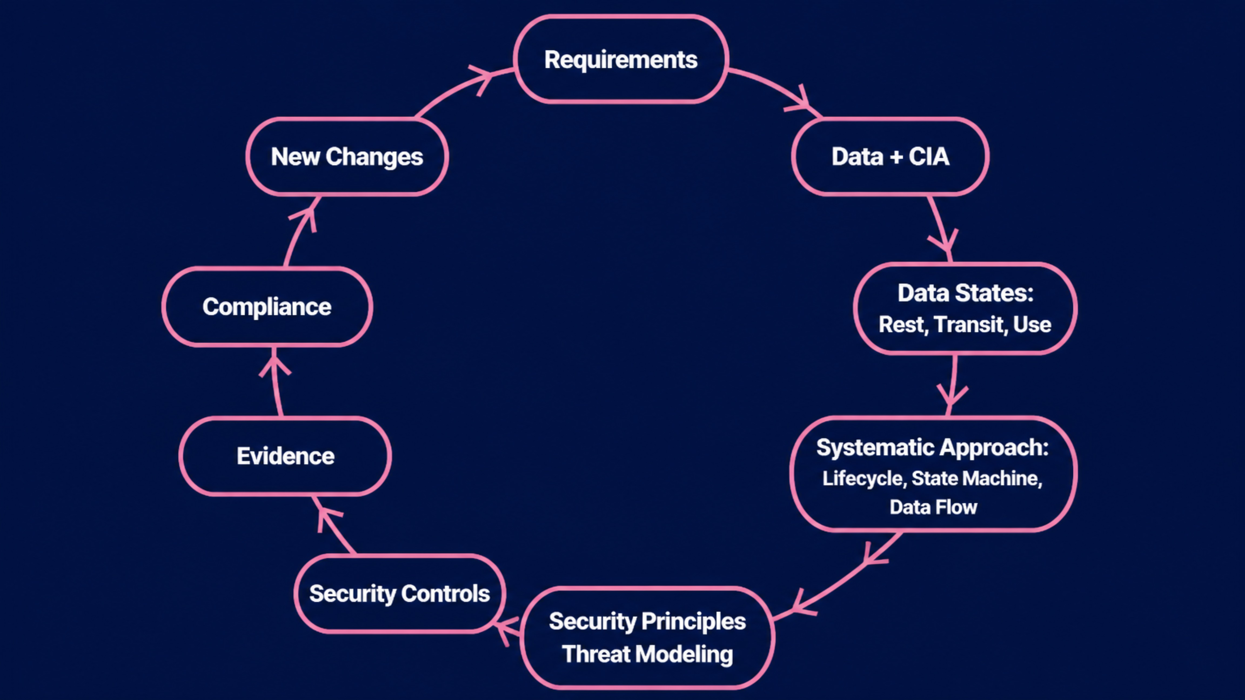
The Complete Chain: Proof of Protections
Security defines, implements, and validates protection. Compliance proves it. ↺

