Slide 1

SEM Breakeven Bid Case Study
Team HELLO DATA
Ziang (Allen) Lu
Jiajia (Deborah) Yin
Yi Zhang
Yilun (Tom) Zhang

Slide 2
Overview
Background
Problem Formalization
III. Statistical Methods
i. Data Preprocessing and Transformation
ii. CR, AR, PR Modelling
iii. Validation Set Prediction
IV. Business Insights

Slide 3
Background -- Capital One
Capital One
COST
In house Mail Ads
High Delivery Cost
Customer
Capital One
Customer
Cost Per Click
COST
Keyword Search Ads

Slide 4
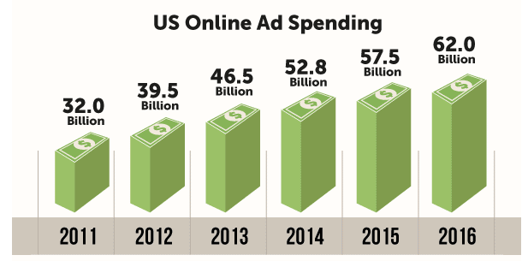
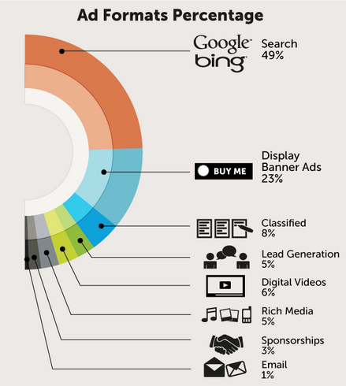
Background – Online Ad Industry Overview
Source: IAB
Increased growth rate at online ads. spending each year
Keyword search occupies half of the market shares
Cost-efficient investments to boost business
Source: IAB
Google
Bing
Buy Me
Source: IAB

Slide 5
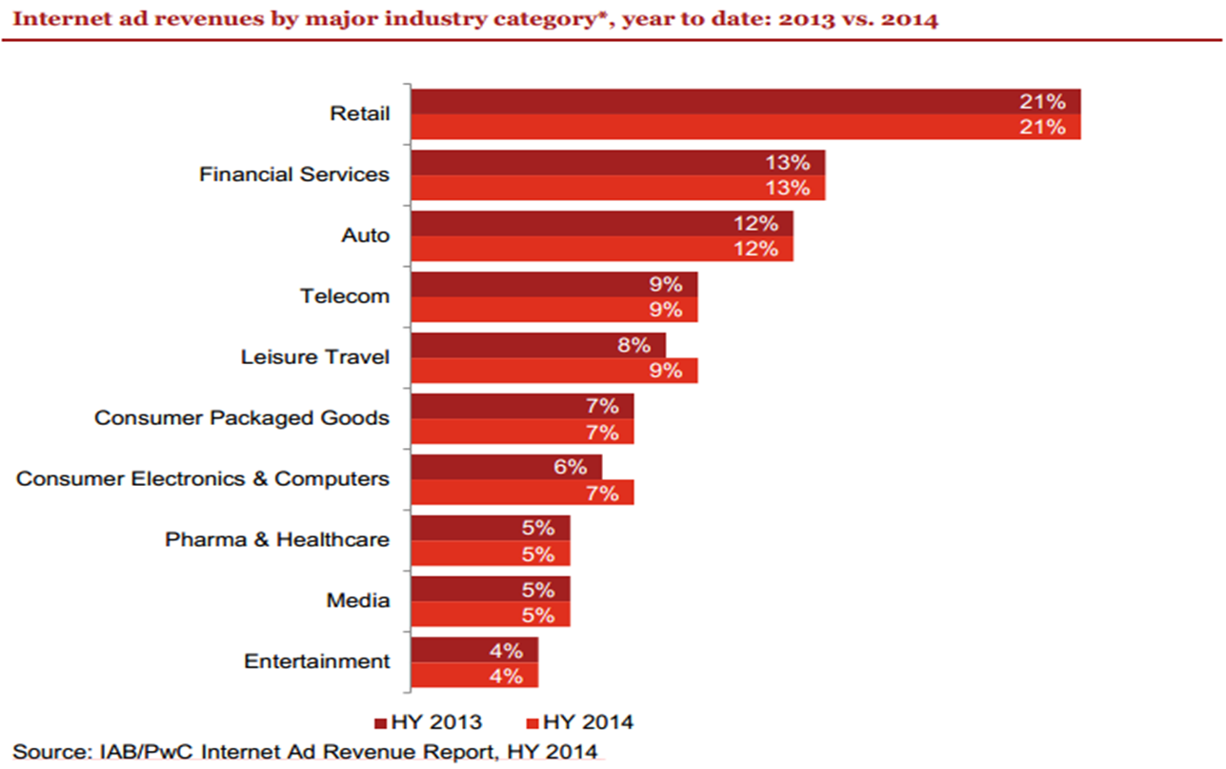
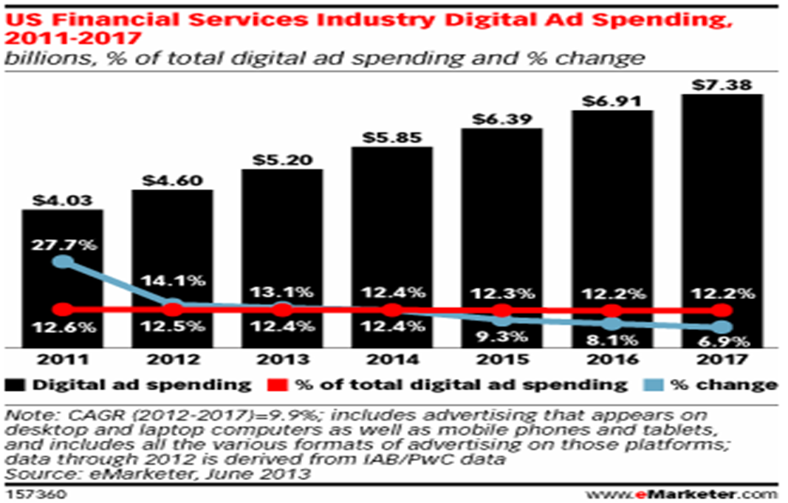
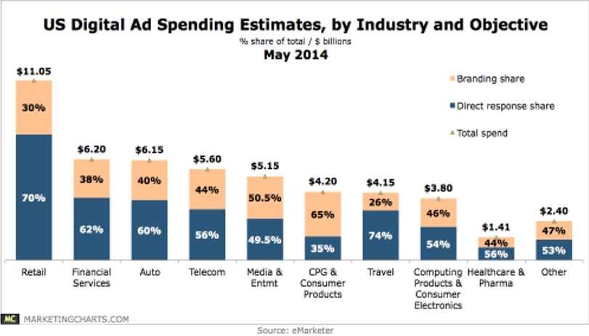
Background -- Finance Industry Outlook
Second largest industry spent in online ads market
Spending amount grows dramatically each year
Proper bidding strategy is essential in attracting more customers than peers
Source: IAB

Slide 6
Problem Formalization
Ad Displayed
Pay for Clicks
Make Bid
User Click
Revenue
Approve
Apply
Browse Products

Slide 7
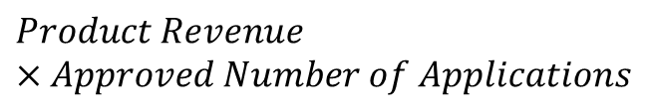

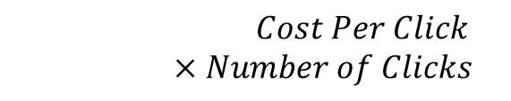

Problem Formalization – Formulas
$Total$ Revenue
Equality
$$Total Cost$$
$$Product Revenue×Approved Number of Applications$$
$$Cost Per Click×Number of Clicks$$
$$Breakeven Bid=$$
$$Product Revenue×Conversion Rate×Approval Rate$$

Slide 8
Problem Formalization
For each bid
What’s its expected Conversion Rate?
Ultimate
What is the maximum amount we are willing to pay for each click to breakeven (i.e. max bid)?
What’s its expected Approval Rate?
What’s its expected Revenue generated?

Slide 9
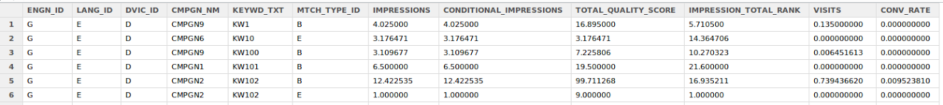
Statistical Methods – Preprocessing & Transformation
Selected significant features:
ENGN_ID, LANG_ID, DVIC_ID, KEYWD_TXT, MTCH_TYPE_ID, etc.
Separated keyword combinations to single keywords
Grouped all information, using the combination of above features and SINGLE keywords as the primary key
Calculated Conversion Rate for existing data
Substituted NaN/NA with appropriate value (mostly 0)

Slide 10
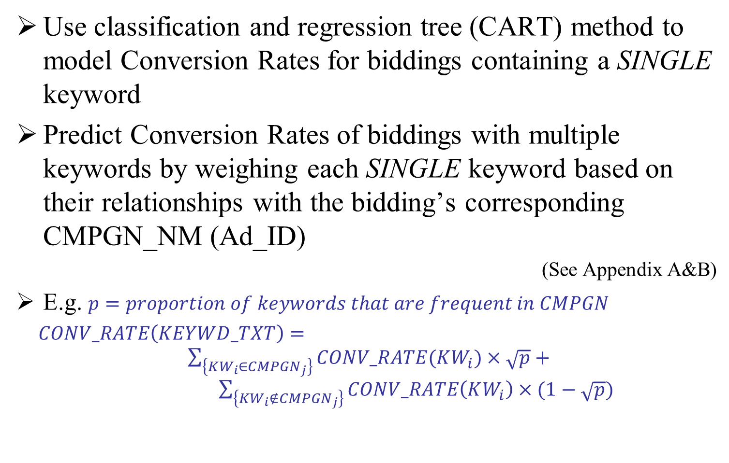
Statistical Methods -- Conversion Rate Modelling
Use classification and regression tree (CART) method to model Conversion Rates for biddings containing a SINGLE keyword
Predict Conversion Rates of biddings with multiple keywords by weighing each SINGLE keyword based on their relationships with the bidding’s corresponding CMPGN_NM (Ad_ID)
(See Appendix A&B)
E.g. $p=proportion of keywords that are frequent in CMPGN$
$CONV_RATE\left(KEYWD_TXT\right)=$ $\sum_{\left\{KW_{i}∈CMPGN_{j}\right\}}{CONV_RATE(KW_{i})}×\sqrt{p}+ \sum_{\left\{KW_{i}∉CMPGN_{j}\right\}}{CONV_RATE\left(KW_{i}\right)}×(1−\sqrt{p})$

Slide 11
Statistical Methods -- Conversion Rate Modelling & Evaluation
Model Name | Root Mean Squared Error
CART | 0.0594
Decision Table | 0.0729
KStar | 0.0784
Decision Stump | 0.0785
M5Rules | 0.0808
Linear Regression | 0.0808
ZeroR | 0.0811
Regression By Discretization | 0.0811
Multi Scheme | 0.0811
REP Tree | 0.0812
M5P | 0.0828
IBk | 0.1051
CART is a decision tree based method that calculates the average of known data according to some of their common features to make predictions by placing new data into the appropriate branch of the decision tree
Comparing to other models run in Weka, CART has the best root mean squared error (from 10-fold-cross-validation)
* For Weka Software, see Appendix C
Notes:
Weka is a tool for a collection of machine learning algorithms for data mining tasks. See: http://www.cs.waikato.ac.nz/ml/weka/

Slide 12
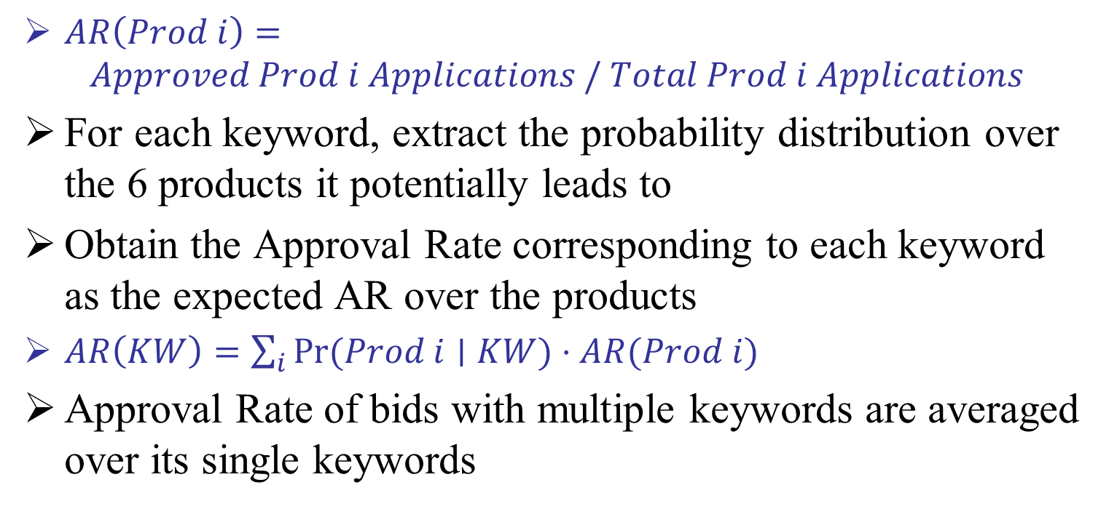
Statistical Methods -- Approval Rate Modelling
$AR\left(Prod i\right)=$
$$Approved Prod i Applications / Total Prod i Applications$$
For each keyword, extract the probability distribution over the 6 products it potentially leads to
Obtain the Approval Rate corresponding to each keyword as the expected AR over the products
$AR\left(KW\right)=\sum_{i}{Pr⁡(Prod i∣KW)}⋅AR(Prod i)$
Approval Rate of bids with multiple keywords are averaged over its single keywords

Slide 13
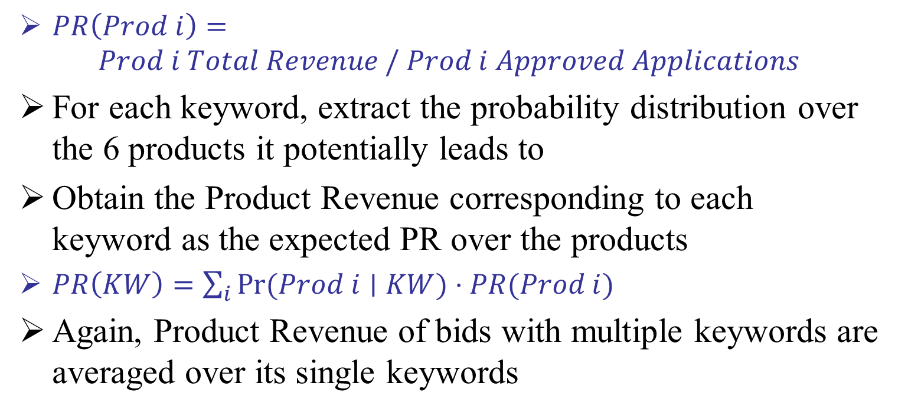
Statistical Methods -- Product Revenue Modelling
$PR\left(Prod i\right)=$
$$Prod i Total Revenue / Prod i Approved Applications$$
For each keyword, extract the probability distribution over the 6 products it potentially leads to
Obtain the Product Revenue corresponding to each keyword as the expected PR over the products
$PR\left(KW\right)=\sum_{i}{Pr⁡(Prod i∣KW)}⋅PR(Prod i)$
Again, Product Revenue of bids with multiple keywords are averaged over its single keywords

Slide 14
Statistical Methods -- Validation Set Prediction
Obtained Conversion Rate, Approval Rate and Product Revenue for all combinations of SINGLE keyword and selected features
Estimated the above three values for each bidding in the validation set
Thus, determined the breakeven bid (max bid) for each bidding
Note that there are 22 new SINGLE keywords and 286 new keyword combinations in the validation set, thus using the SINGLE keywords in modelling reduces the amount of unknown information
Performance of prediction will be improved when more data containing these keywords are gathered

Slide 15
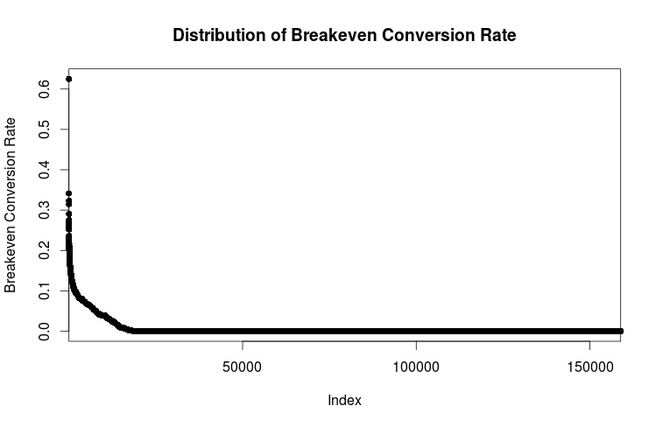
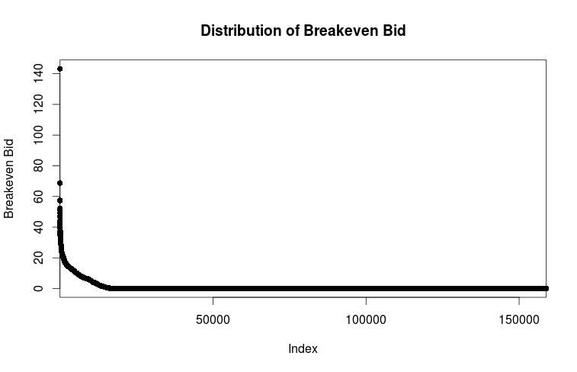
Statistical Methods -- Result Visualization
The Conversion Rate and the Breakeven Bid have similar distributions
137466 (86.53%) zeros in predicted Conversion Rate
138143 (86.95%) zeros in predicted Breakeven Bid

Slide 16
Statistical Methods -- Discussion
Due the variety in KEYWD_TXT, some models including linear regression and logistic regression are either very ineffective or unable to run in reasonable time
Due to the nature of this problem which results in many conversion rates being zero, our model tends to be positively biased and overestimate the Conversion Rate when it is actually low (i.e. 0)
In the future, meta algorithms such as bagging or boosting can be used to improve the prediction accuracy
Programmatic feature selections (PCA, forward/ backward/ stepwise selection) can be conducted to reduce the dimensionality of the problem as well as potentially improve the accuracy

Slide 17
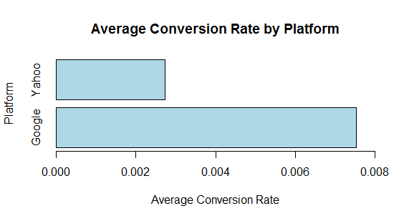
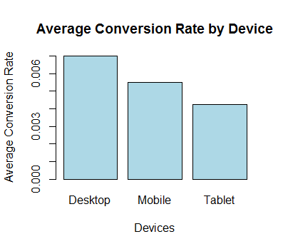
Business Insights
Google is a more profitable search platform to investment in comparing to Yahoo!
Desktop is still a significant leader in average number of product applications per user click among digital devices
To boost up Conversion Rates of other devices, we could potentially improve the user experiences on them or introduce promotions for these devices

Slide 18
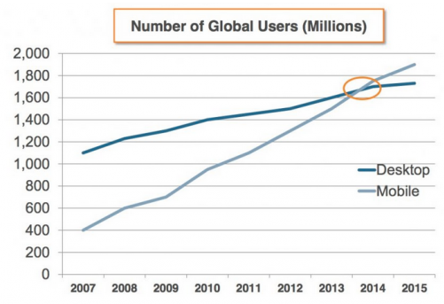
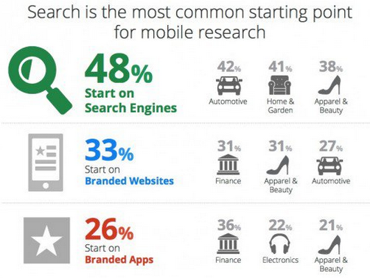
Business Insights
The trend in mobile usage beats the trend in desktop starting from 2014
Mobile searching will play a significant role in future search engine market

Slide 19
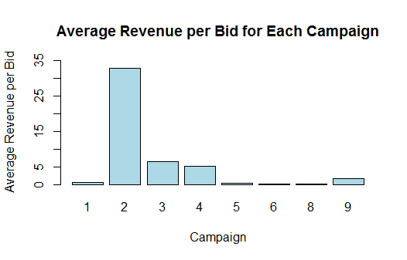
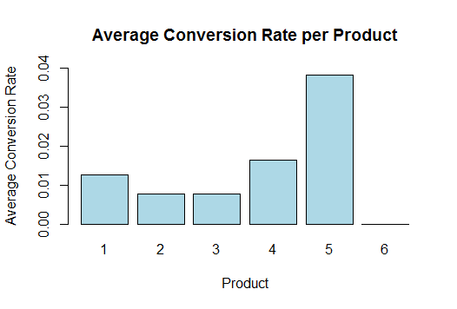
Business Insights
Campaign 2 has been the most successful in terms of revenue generated per bid we place, where future lesson could be learned
Product 5 has been most popular product in terms of its average conversion rate, and other ones need to catch up
Most frequent key words from the most successful Campaigns 2 are: KW104, KW382

Slide 20
Key Findings Summary
Determining the maximum bidding strategy is absolutely crucial
From the data set, we made separate quantitative models
CART for the Conversion Rates
Weighted Average for Approval Rates and
Weighted Average for Product Revenue
to calculate the maximum bid
We made deeper observations on the data for future directions

Slide 21
Q&A

Slide 22
THANK YOU

Slide 23
Appendix A
-- Table for Keyword Frequency in Campaign (Ads Group)
CMGPN1 |  | CMPGN2 |  | CMPGN3 |  | CMPGN4 |  | CMPGN5 |  | CMPGN6 |  | CMPGN8 |  | CMPGN9
KW | Freq | KW | Freq | KW | Freq | KW | Freq | KW | Freq | KW | Freq | KW | Freq | KW | Freq
KW178 | 6852 | KW104 | 11601 | KW104 | 102 | KW178 | 9183 | KW178 | 5142 | KW97 | 8697 | KW195 | 1200 | KW178 | 19206
KW121 | 3424 | KW382 | 9262 | KW382 | 93 | KW426 | 4999 | KW587 | 4029 | KW121 | 7158 | KW25 | 607 | KW121 | 10865
KW587 | 2677 | KW178 | 2266 | KW124 | 84 | KW121 | 4471 | KW121 | 3856 | KW178 | 7138 | KW121 | 495 | KW587 | 9105
KW306 | 1977 | KW97 | 2242 | KW178 | 42 | KW587 | 4284 | KW340 | 3333 | KW92 | 6877 | KW178 | 487 | KW340 | 6795
KW97 | 1556 | KW92 | 2159 | KW340 | 19 | KW97 | 2376 | KW563 | 1709 | KW288 | 6379 | KW97 | 233 | KW97 | 4867
KW324 | 1523 | KW121 | 2053 | KW196 | 17 | KW62 | 2267 | KW125 | 1585 | KW340 | 4104 | KW515 | 229 | KW124 | 4544
KW560 | 1522 | KW340 | 1881 | KW92 | 11 | KW340 | 1765 | KW53 | 1510 | KW456 | 3476 | KW340 | 209 | KW567 | 4228

Slide 24
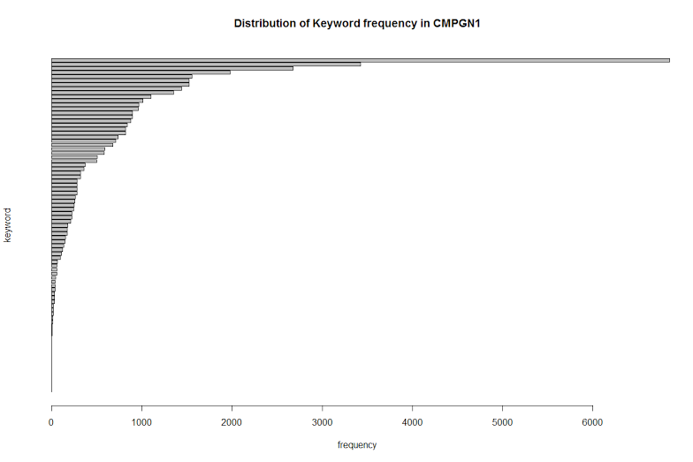
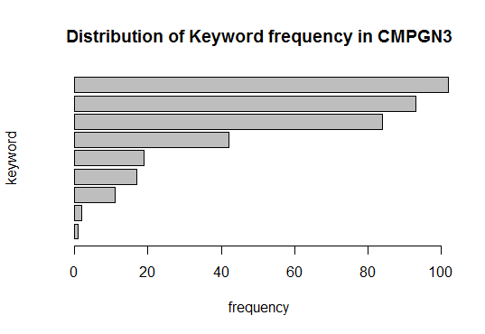
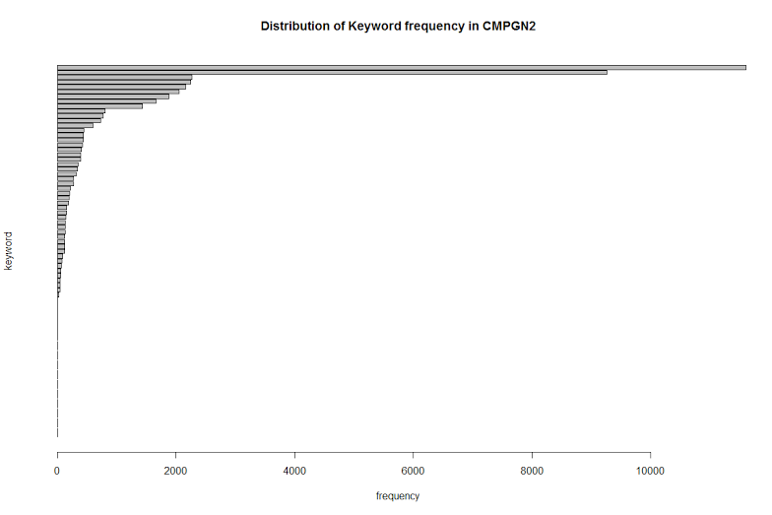
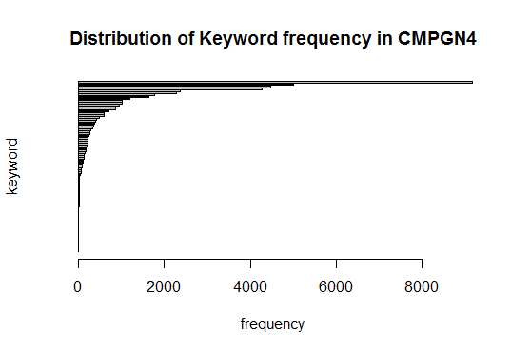
Appendix B
-- Plots for Keyword Frequency in Campaign (Ads Group)

Slide 25
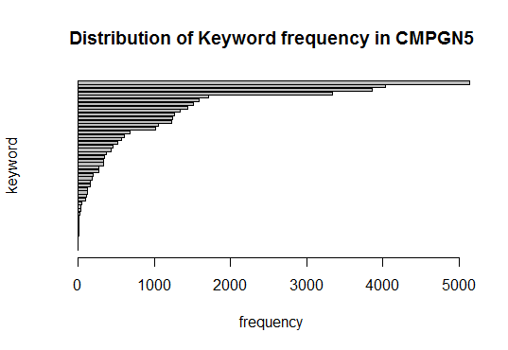
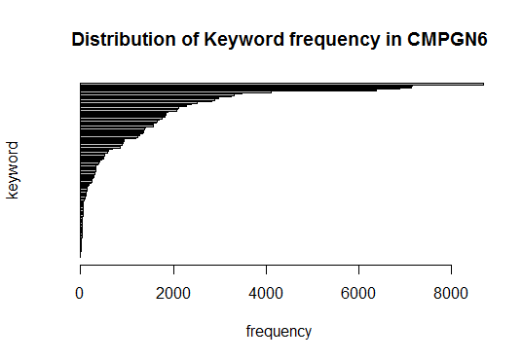
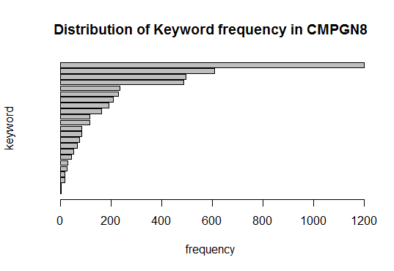
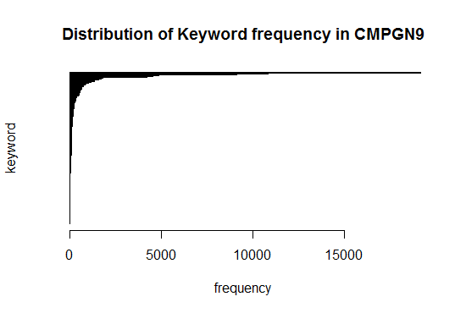
Appendix B
-- Plots for Keyword Frequency in Campaign (Ads Group)

Slide 26
Appendix C
-- Weka Software
Please see attached Word document for Weka Software instruction

