Slide 1

Tackling imbalanced data in online fake review detection
Yi Zhang
Catherine Mou
Satheesh Joseph
Genuine reviews are all alike;
every fake review is fake in its own way
- Tolstoy

Slide 2
Agenda
Introduction
Data Imbalance Issue
Hypothesis
GAN & GPT-2
Approaches
Experiments & Results
Future Works

Slide 3

Introduction
What is online fake review detection?
What are the impacts of fake reviews?
What is our dataset?

Slide 4
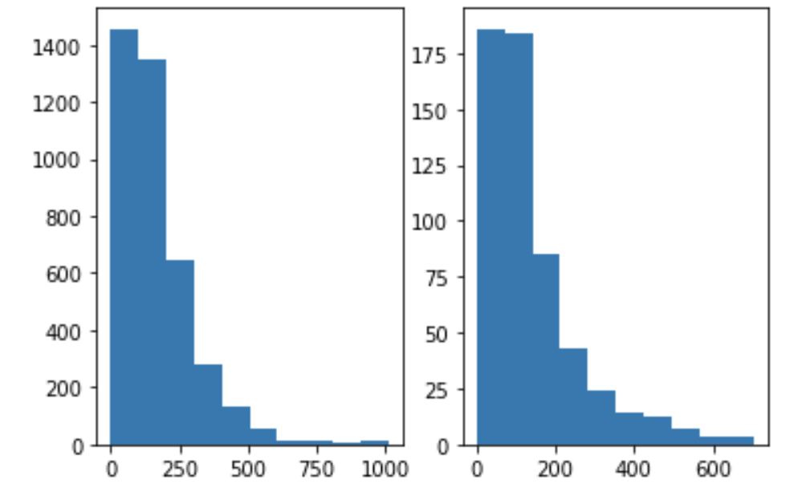
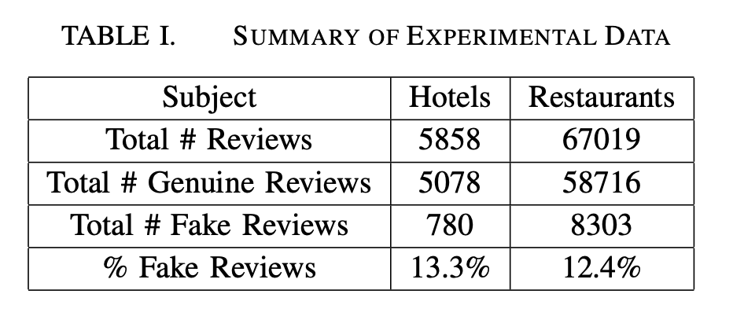
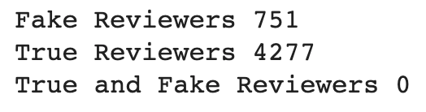
Data Imbalance Issue
Number of reviews
Number of words

Slide 5
Hypothesis
Our hypothesis is that it’s possible to make up the data imbalance by generating fake reviews from a language model trained and/or finetuned on actual fake reviews
GAN
GPT-2
Language Model

Slide 6
GAN
Generative Network - generates candidates (GPT-2)
Discriminative Network - evaluates them
A batch size of 512, well defined sentence length, vocabulary size of 50,000
Domain specific fake reviews
by adding layers on top and training with our raw data set
With multiple trials and errors - made improvements that led to higher quality generated fake reviews.

Slide 7
GAN – Discriminative Network
Neural Network using ELMo embedding with LSTM and 2 dense layers on the original data set as the discriminative network.
Even though this Network itself has not performed well in distinguishing genuine and fake reviews, it does do a good job distinguishing coherent, relevant reviews about hotels/restaurants and irrelevant sentences.
Generated 44k fake reviews

Slide 8
Balancing Dataset
For a balanced training set:
we first limit the pool of reviews to be the ones prior to 2012-01-01
we take all the actual fake reviews
we include all generated fake reviews
we sample the same number of reviews from the genuine reviews
this gives us a balanced, non-duplicated training set
For a balanced test set:
we first limit the pool of reviews to the first review per reviewer after 2012-01-01
we take all the fake reviews (because there are fewer)
we sample the same number of reviews from the genuine reviews
this gives us a balanced, non-duplicated test set

Slide 9
Approach
Model 1: Baseline model w GloVe embedding and 1 layer of LSTM.
Model 2: Our main model w GloVe embedding, 1 layer of Bidirectional LSTM, and 3 dense layers.
Model 3: A BERT-based model.

Slide 10
Approach
LF: uses linguistic features from the review content only, by extracting bigrams from the reviews data.
CNN: uses the same bigram features but trained using a Convolutional Neural Network.
LF+BF: is a concatenation of linguistic as well as behavioral features from the the review, including its length, rating, and other reviews by the same reviewer.
bfGAN: is the state-of-the-art algorithm using behavioral features

Slide 11
Approach
Training set 1: raw, imbalanced training set
Training set 2: balanced training set by under-sampling genuine reviews to the number of fake reviews
Training set 3: balanced training set by over-sampling fake reviews with replacement to the number of genuine reviews
Training set 4: balanced training set by including generated fake reviews

Slide 12
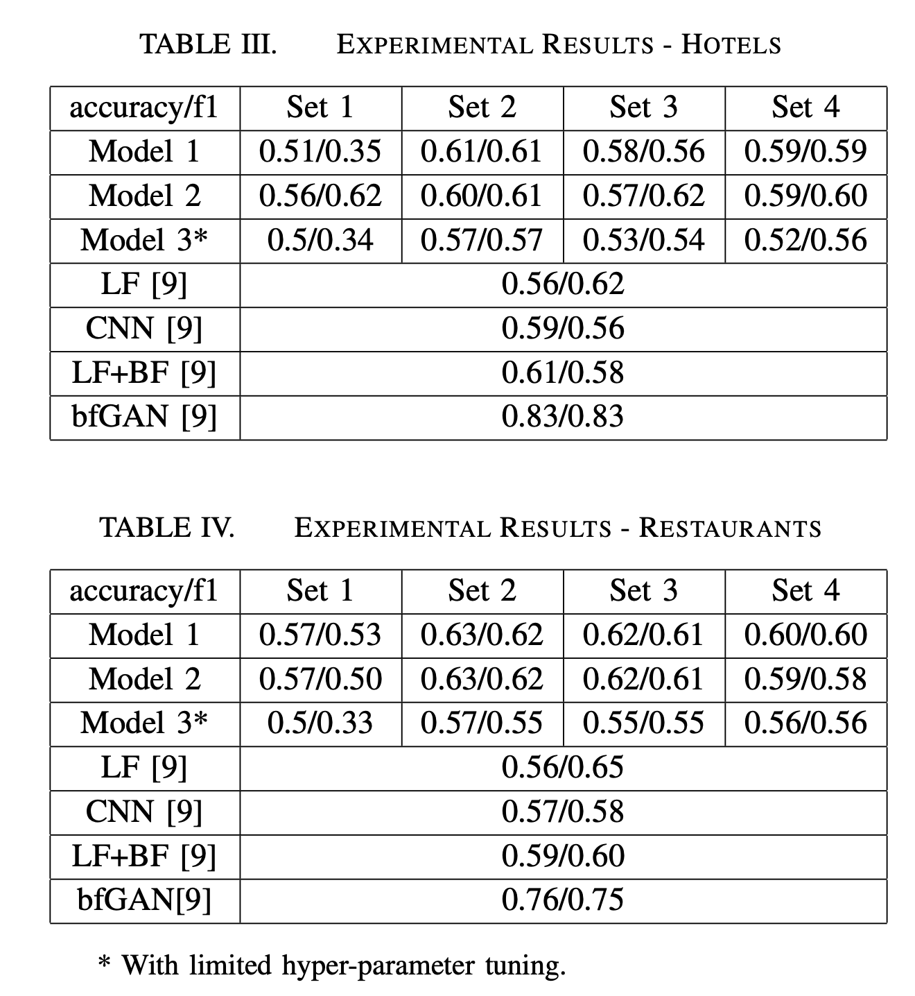
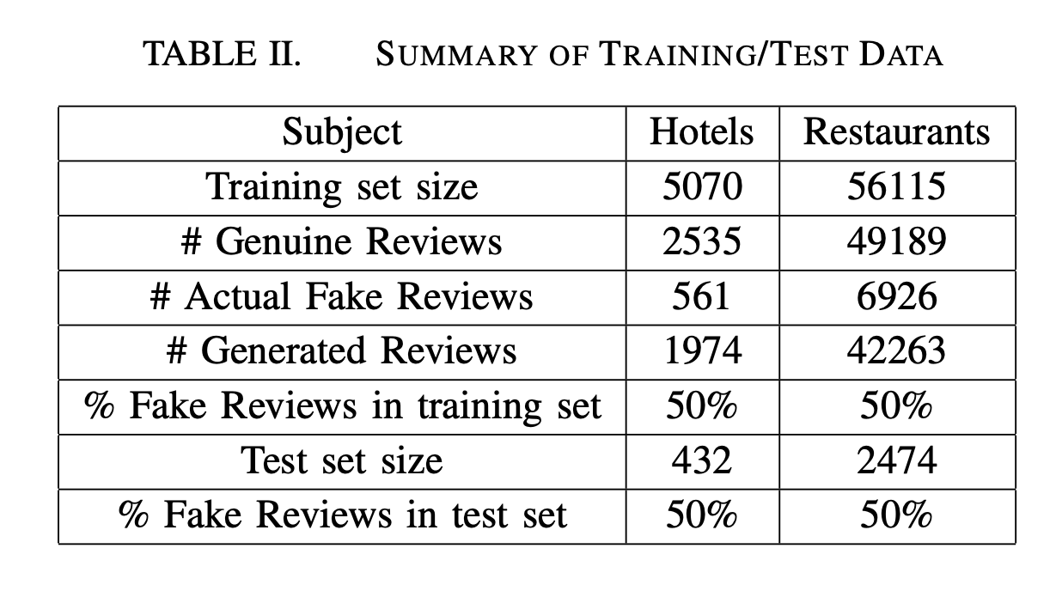
Experiments

Slide 13
Future Works
XLNet
auto-regressive language model
Computation heavy
All permutations of word tokens in a sentence as opposed to just those to the left or just those to the right of the target token.
GPT-2
Improve fidelity of the generated fake reviews
Model Tuning
Try different hyperparameters

Slide 14

Q&A
Thank You!

