Slide 1

Tackling imbalanced data in on-line fake review detection
Yi Zhang
Catherine Mou
Satheesh Joseph
Genuine reviews are all alike; every fake review is fake in its own way - Tolstoy

Slide 2
Agenda
Intro
Data Imbalance Issue
Hypothesis
Journey & Approaches
Experiments & Results
Future Works

Slide 3
Intro
What is on-line fake review detection?
What is our Dataset?

Slide 4
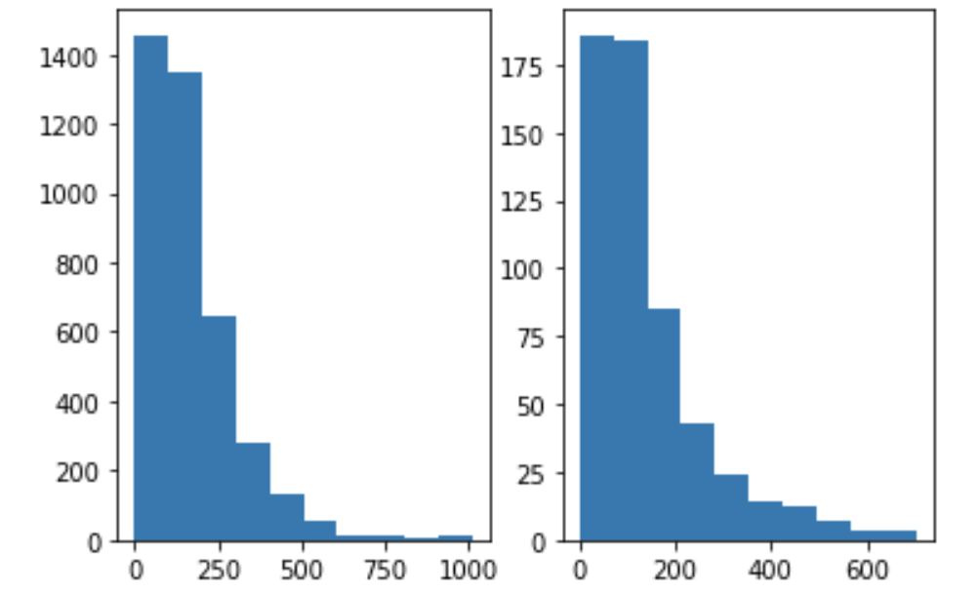
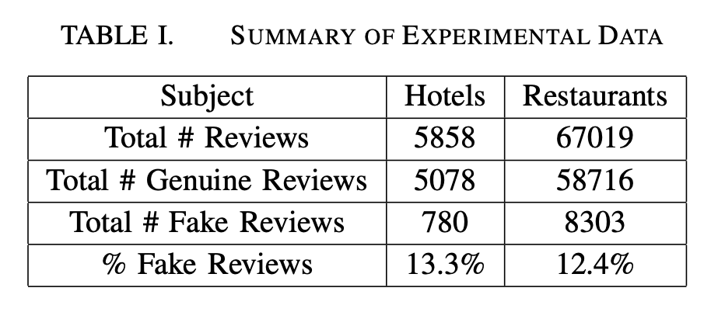
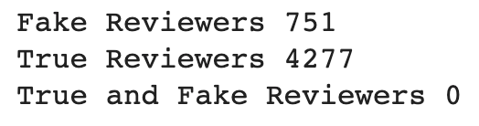
Data Imbalance Issue

Slide 5
Hypothesis
Our hypothesis is that it’s possible to make up the data imbalance by generating fake reviews from a language model trained and/or finetuned on actual fake reviews
GAN
GPT-2
Language Model

Slide 6
GAN
Generative Network that generates candidates as well as a Discriminative Network that evaluates them
Generative Network - pre-trained GPT-2 language model
A batch size of 512, well defined sentence length, vocabulary size of 50,000
To generate domain specific fake Yelp reviews, we fined-tuned the pre-trained GPT-2 model by adding layers on top and trained with our raw data set
With multiple trial and error, we eventually made a few improvements that led to higher quality generated fake reviews.

Slide 7
GAN
We trained a simple Neural Network using ELMo embedding with LSTM and 2 dense layers on the original data set as the discriminative network.
Even though this Network itself has not performed well in distinguishing genuine and fake reviews, it does do a good job distinguishing coherent, relevant reviews about hotels/restaurants and irrelevant sentences, making it a good candidate for the discriminative network in the GAN. And finally, we only picked reviews that sufficiently confused this network (with predicted probability of more than 80%) to be included in the final generated fake review set.

Slide 8
Approach
To validate our hypothesis on the usefulness of the generated fake reviews, we set up a 2-stage experiment.
Firstly, we use the GAN methods to generate fake reviews for both hotels and restaurants.
Secondly, we add the generated fake reviews to the training data to obtain a balanced training set, then run a number of classification models on the mixed training set and compare it against our benchmark results.

Slide 9
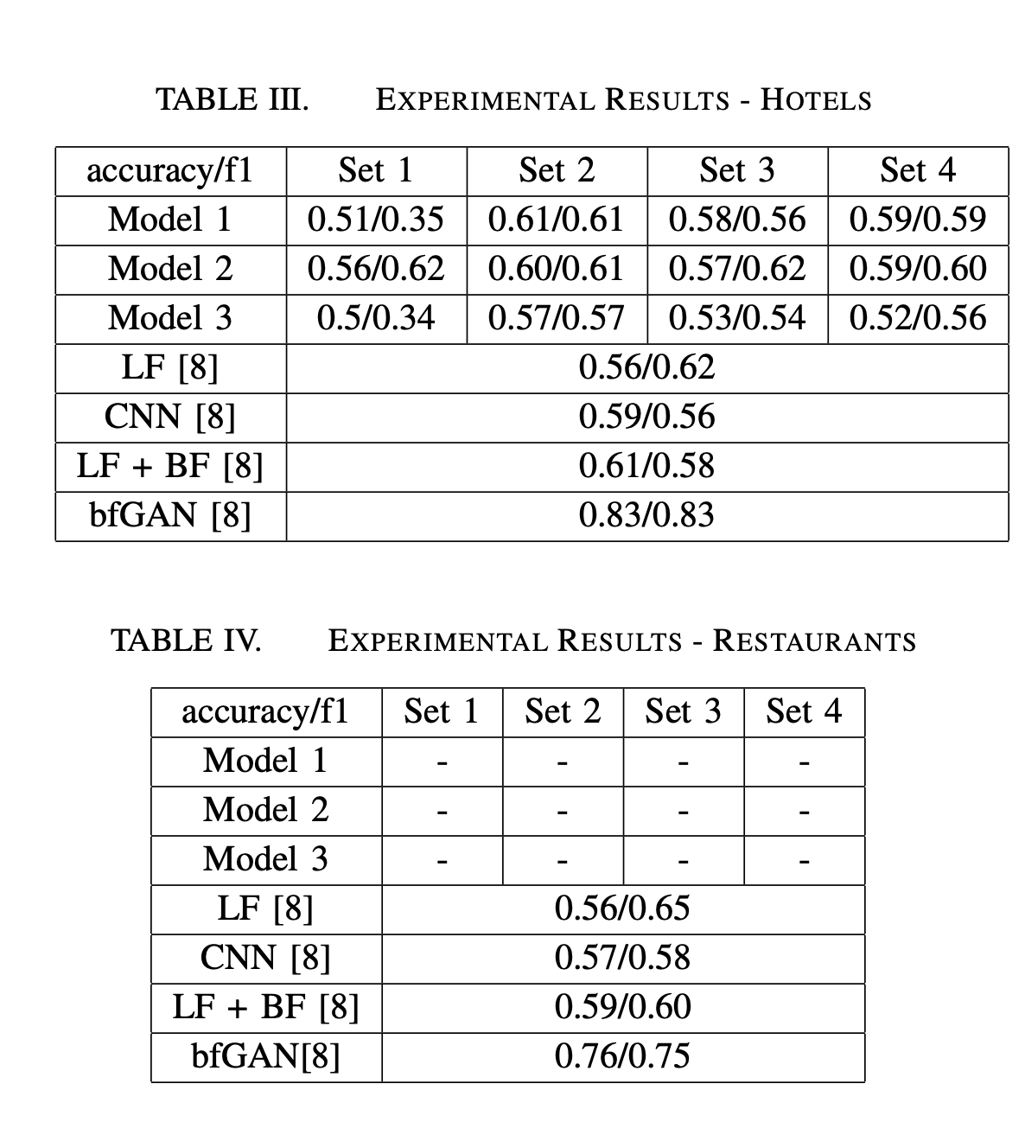
Experiments

Slide 10
Future Works
XLNet

Slide 11

Q&A
Thank You!

