Slide 1
TIOVX – TI’s OpenVX Implementation
18 June 2018
Kedar Chitnis, Jesse Villarreal
Automotive Processors, ADAS
NOTE: Some slides are
“TI Confidential – NDA Restrictions”

Slide 2
Agenda
Introduction to OpenVX
OpenVX example use-case on TI SoC
TI OpenVX Implementation Overview
OpenVX on different TI SoCs
TI OpenVX Implementation Details
OpenVX and other frameworks (OpenCL/CV/…)
Getting Started with TI OpenVX
Summary
Notes:
OpenVX has this idea of computation graphs, where image operations called nodes process data.
The nodes may be dedicated HW blocks, or if they run for example on a GPU, they may be written in OpenCL.
The application first sets up a graph, telling system in advance which type of processing it will want to perform.
The system then has a possibility to work on the processing graph, to spend some effort to optimize the total graph, before executing it.
The host, the CPU, needs only pass in some data, and then can idle, while the OpenVX subsystem, in more power-efficient HW, autonomously executes the graph.

Slide 3
Introduction to OpenVX

Slide 4

OpenVX – Low-Power Vision Acceleration
Higher-level abstraction API
Targeted at real-time mobile and embedded platforms
Performance portability across diverse architectures
Multi-core CPUs, GPUs, DSPs, ISPs, Dedicated hardware, …
Extends portable vision acceleration to very low-power domains
Doesn’t require high-power CPU/GPU Complex
Lower precision requirements than OpenCL
Vision Engine
Middleware
Application
X100
Dedicated Hardware
Vision Processing Efficiency
Vision DSPs
X10
GPU Compute
Power Efficiency
Accelerator
Multi-core
CPU
Accelerator
X1
Accelerator
Computation Flexibility
Notes:
OpenVX is a special API for low-power vision acceleration.
It is a fairly high-level API, especially compared to programming language approach like with OpenCL, and it is aimed to provide real-time computer vision support on mobile and embedded devices.
The API abstracts the underlying hardware, the implementation can use multi-core CPUs, or GPUs, or DSPs, or ISPs, or some new dedicated computer vision HW.
But the programmer doesn’t have to care exactly how the API is implemented, the device manufacturers take care of those details instead.
Now even very low-power wearable devices can address vision workloads without involving the high-power CPU/GPU complex.
As OpenVX has lower precision requirements than OpenCL, it is mostly fixed-point API, whereas OpenCL is mostly a floating-point API, in OpenVX computations can be done with simpler, lower-power HW.

Slide 5
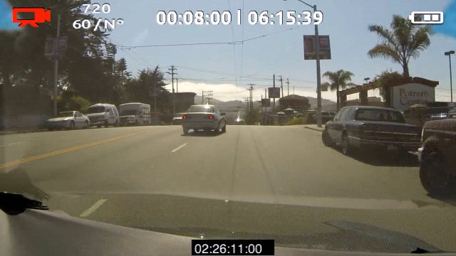


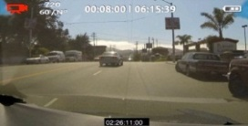
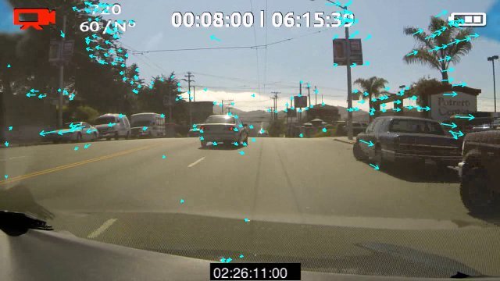
OpenVX Graphs
OpenVX developers express a graph of image operations (‘Nodes’)
Nodes can be on any hardware or processor coded in any language
For example, on GPU, nodes may implemented in OpenCL
Minimizes host interaction during frame-rate graph execution
Host processor can setup graph which can then execute almost autonomously
Camera Input
Pyr_{t}
Rendering
Output
OpenVX Nodes
RGB
Frame
Color Conversion
YUV
Frame
Channel Extract
Gray
Frame
Image
Pyramid
Optical Flow
Array of
Keypoints
Harris Track
Array of
Features
OpenVX Graph
Ftr_{t-1}
Notes:
OpenVX has this idea of computation graphs, where image operations called nodes process data.
The nodes may be dedicated HW blocks, or if they run for example on a GPU, they may be written in OpenCL.
The application first sets up a graph, telling system in advance which type of processing it will want to perform.
The system then has a possibility to work on the processing graph, to spend some effort to optimize the total graph, before executing it.
The host, the CPU, needs only pass in some data, and then can idle, while the OpenVX subsystem, in more power-efficient HW, autonomously executes the graph.

Slide 6
An OpenVX “Hello, World !!!” Program
vx_context context = vxCreateContext();
vx_graph graph = vxCreateGraph( context );
vx_image input = vxCreateImage( context, 640, 480, VX_DF_IMAGE_U8 );
vx_image output = vxCreateImage( context, 640, 480, VX_DF_IMAGE_U8 );
vx_image intermediate = vxCreateVirtualImage( graph, 640, 480, VX_DF_IMAGE_U8 );
vx_node F1 = vxF1Node( graph, input, intermediate );
vx_node F2 = vxF2Node( graph, intermediate, output );
vxVerifyGraph( graph );
vxProcessGraph( graph );
context
graph
input
F1
inter-
mediate
F2
output
Notes:
First, we create a context for the OpenVX operations and data, and then we start a graph in that context.
We then create the input image, the output image, and an intermediate, virtual image, that we will never look at.
We then add two nodes, the first one connecting input to intermediate, the second the intermediate to output.
We then verify the graph, and now the system can perform optimizations, such as tiling, etc.
Finally, we process the graph.

Slide 7
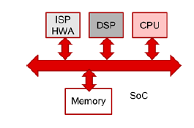
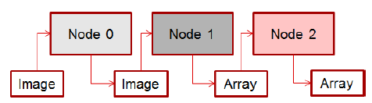
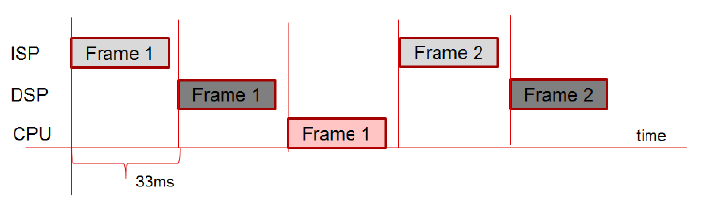
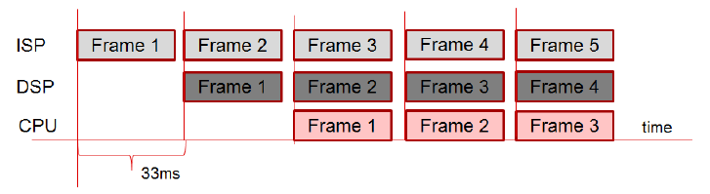
OpenVX Pipelining Extension
Provide a way of Pipelining, streaming, and batch processing
Multiple initiations of a graph with different inputs and outputs
Increase hardware utilization and throughput
Executes
OpenVX Graph
Example SoC, with three independent
Heterogeneous compute units
Without Pipelining extension
With Pipelining extension

Slide 8
More Details on OpenVX Standard
Khronos OpenVX website
https://www.khronos.org/openvx/
OpenVX v1.1 specification and additional resources
https://www.khronos.org/registry/OpenVX/
https://www.khronos.org/openvx/resources
Khronos OpenVX v1.1 Video Tutorials
https://youtu.be/JZZCNcfIqqs?list=PLYO7XTAX41FP01wTyWfwiNW3xq9IDRAnO

Slide 9
OpenVX Example Use-case on TI SoC

Slide 10
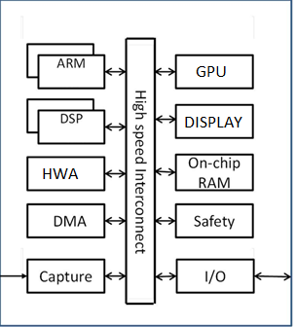
Heterogeneous Multi-Core System Example
Multiple computation cores each used depending on its suitability for that compute functions
Goal is to balance performance with power consumption on embedded devices
Pixels
HW Accelerator
ISP
Pixels
Post Processing HWA
HWA
Feature Vector
DSP
DSP
Classified output
TI TDAxx SoC
ARM
Decision/Control

Slide 11
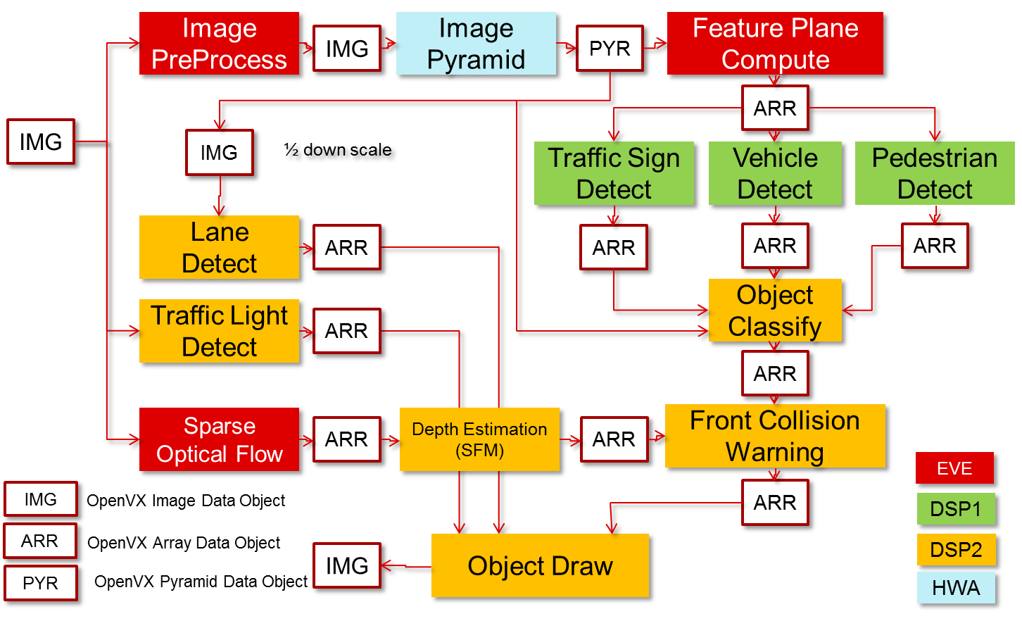
Mono-camera Analytics Processing Graph (Example)

Slide 12
TI OpenVX Implementation Overview

Slide 13
TIOVX - OpenVX Implementation on TI SoC
GOAL: Help customers easily maximize performance on TI platforms while minimizing development cost.
Result: Full entitlement on TI SoCs and remove barrier to entry for OpenVX developers
Performance
Graph-based model
Maximizes system utilization and minimizes run-time latencies.
True Heterogeneous Compute
Unified access to all ARM, DSP, Vision/HWA
Optimized Libraries
Development Cost
Open Standard
Conformant to OpenVX v1.1 with support for graph pipelining extension
Hardware Abstraction
Same application works across TDA2x/3x family of SoCs on range of SW environments from Linux to TI-RTOS
Ease of use
Full development, including DSP intrinsic emulation, can be done on PC using TI OpenVX, then simple recompile on platform.
PyTIOVX tool generates OpenVX Application/Kernel code
Fully optimized OpenVX 1.1 kernels on DSP
DMA Integration
Simple interface to add block-based DMA to kernels (BAM)

Slide 14
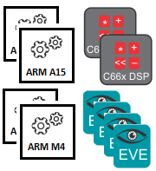
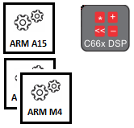
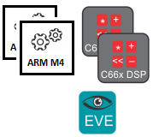


TI OpenVX Supported Platforms
TDA2x
TDA2Eco
TDA3x
OpenVX v1.1
Target CPUs
OS

Slide 15
TI OpenVX SW Stack on TDA2x/3x
Khronos Conformance Test
TI Extension Conformance Test
Examples / Use-cases with Processor SDK - Vision
Examples / Use-cases with Processor SDK - Vision
OpenVX API
TIOVX API
TIOVX Framework
Context
Node
Target
Obj Desc
Image
Array
Graph
Kernel
Target Kernel
Scalar
Pyramid
…
TIOVX Platform
Queue
Mutex
Task
Event
IPC
Platform
Memory
TIOVX Kernel Wrapper
VXLIB
EVELIB
User kernels
Target kernels
TI
Khronos
Customer

Slide 16
VXLIB Overview
Scope of VXLIB
Lowest level algorithm library (like VLIB, IMGLIB, DSPLIB)
Only dependency is compiler
No OS dependency, no memory allocation, no DMA dependency
Implements OpenVX 1.1 kernels on DSP
Will also implement additional DSP vision kernels
OpenCV acceleration, Support DSP algorithms, etc.
Supported Targets
C66 DSP (elf)
Host emulation support:
X86/X64 MSVC (windows)
X86/x86_64 GCC (linux)
Conformance
MISRAC Compliant (Klocwork static analysis)

Slide 17
VXLIB - Kernel List
VXLIB (114)
VXLIB_absDiff_i16s_i16s_o16s
VXLIB_absDiff_i8u_i8u_o8u
VXLIB_accumulateImage_i8u_o16s
VXLIB_accumulateSquareImage_i8u_o16s
VXLIB_accumulateWeightedImage_i8u_o8u
VXLIB_add_i16s_i16s_o16s
VXLIB_add_i8u_i16s_o16s
VXLIB_add_i8u_i8u_o16s
VXLIB_add_i8u_i8u_o8u
VXLIB_addSquare_i8u_i16s_o16s
VXLIB_addWeight_i8u_i8u_o8u
VXLIB_and_i8u_i8u_o8u
VXLIB_box_3x3_i8u_o8u
VXLIB_cannyNMS_i16s_i16s_i16u_o8u
VXLIB_channelCombine_1to1_i8u
VXLIB_channelCombine_2to1_i8u
VXLIB_channelCombine_3to1_i8u
VXLIB_channelCombine_4to1_i8u
VXLIB_channelCombine_yuyv_i8u
VXLIB_channelExtract_o8u
VXLIB_colorConvert_IYUVtoNV12_i8u_o8u
VXLIB_colorConvert_IYUVtoRGB_i8u_o8u
VXLIB_colorConvert_IYUVtoYUV4_i8u_o8u
VXLIB_colorConvert_NVXXtoIYUV_i8u_o8u
VXLIB_colorConvert_NVXXtoRGB_i8u_o8u
VXLIB_colorConvert_NVXXtoRGBX_i8u_o8u
VXLIB_colorConvert_NVXXtoYUV4_i8u_o8u
VXLIB_colorConvert_RGBtoIYUV_i8u_o8u
VXLIB_colorConvert_RGBtoNV12_i8u_o8u
VXLIB_colorConvert_RGBtoRGBX_i8u_o8u
VXLIB_colorConvert_RGBtoYUV4_i8u_o8u
VXLIB_colorConvert_RGBXtoRGB_i8u_o8u
VXLIB_colorConvert_YUVXtoIYUV_i8u_o8u
VXLIB_colorConvert_YUVXtoNV12_i8u_o8u
VXLIB_colorConvert_YUVXtoRGB_i8u_o8u
VXLIB_colorConvert_YUVXtoRGBX_i8u_o8u
VXLIB_convertDepth_16to8
VXLIB_convertDepth_8to16
VXLIB_convolve_3x3_i8u_c16s_o16s
VXLIB_convolve_3x3_i8u_c16s_o8u
VXLIB_convolve_5x5_i8u_c16s_o16s
VXLIB_convolve_5x5_i8u_c16s_o8u
VXLIB_convolve_7x7_i8u_c16s_o16s
VXLIB_convolve_7x7_i8u_c16s_o8u
VXLIB_convolve_i8u_c16s_o16s
VXLIB_convolve_i8u_c16s_o8u
VXLIB_dilate_3x3_i8u_o8u
VXLIB_doubleThreshold_i16u_i8u
VXLIB_edgeTracing_i8u
VXLIB_equalizeHist_i8u_o8u
VXLIB_erode_3x3_i8u_o8u
VXLIB_fastCorners_i8u
VXLIB_fastCornersDetect_i8u
VXLIB_fastCornersNMS_i8u
VXLIB_fastCornersScore_i8u
VXLIB_gaussian_3x3_i8u_o8u
VXLIB_gaussian_5x5_i8u_o8u
VXLIB_halfScaleGaussian_5x5_i8u_o8u
VXLIB_harrisScore_i16s_i16s_o32f
VXLIB_harrisScore_i32s_i32s_o32f
VXLIB_histogram_i8u_o32u
VXLIB_histogramCdfLut_i32u_o8u
VXLIB_histogramSimple_i8u_o32u
VXLIB_integralImage_i8u_o32u
VXLIB_magnitude_i16s_i16s_o16s
VXLIB_meanStdDev_i8u_o32f
VXLIB_median_3x3_i8u_o8u
VXLIB_minMaxLoc_i16s
VXLIB_minMaxLoc_i8u
VXLIB_multiply_i16s_i16s_o16s
VXLIB_multiply_i8u_i16s_o16s
VXLIB_multiply_i8u_i8u_o16s
VXLIB_multiply_i8u_i8u_o8u
VXLIB_normL1_i16s_i16s_o16u
VXLIB_normL2_i16s_i16s_o16u
VXLIB_not_i8u_o8u
VXLIB_or_i8u_i8u_o8u
VXLIB_phase_i16s_i16s_o8u
VXLIB_remapBilinear_bc_i8u_i32f_o8u
VXLIB_remapNearest_bc_i8u_i32f_o8u
VXLIB_scaleImageBilinear_bc_i8u_o8u
VXLIB_scaleImageBilinear_br_i8u_o8u
VXLIB_scaleImageBilinear_i8u_o8u
VXLIB_scaleImageNearest_i8u_o8u
VXLIB_sobel_3x3_i8u_o16s_o16s
VXLIB_sobel_5x5_i8u_o16s_o16s
VXLIB_sobel_7x7_i8u_o16s_o16s
VXLIB_sobel_7x7_i8u_o32s_o32s
VXLIB_sobelX_3x3_i8u_o16s
VXLIB_sobelY_3x3_i8u_o16s
VXLIB_subtract_i16s_i16s_o16s
VXLIB_subtract_i8u_i16s_o16s
VXLIB_subtract_i8u_i8u_o16s
VXLIB_subtract_i8u_i8u_o8u
VXLIB_tableLookup_i16s_o16s
VXLIB_tableLookup_i8u_o8u
VXLIB_thresholdBinary_i8u_o8u
VXLIB_thresholdRange_i8u_o8u
VXLIB_warpAffineBilinear_bc_i8u_c32f_o8u
VXLIB_warpAffineBilinear_i8u_c32f_o8u
VXLIB_warpAffineNearest_bc_i8u_c32f_o8u
VXLIB_warpAffineNearest_i8u_c32f_o8u
VXLIB_warpPerspectiveBilinear_bc_i8u_c32f_o8u
VXLIB_warpPerspectiveBilinear_i8u_c32f_o8u
VXLIB_warpPerspectiveNearest_bc_i8u_c32f_o8u
VXLIB_warpPerspectiveNearest_i8u_c32f_o8u
VXLIB_xor_i8u_i8u_o8u
HarrisCorners
OpticalFlowLK
LaplacianPyramid
LaplacianReconstruct
Median
Erode
Dilate

Slide 18
TI OpenVX on different TI SoCs

Slide 19
TI OpenVX – Abstract “Thread” View
HOST-TARGET CMDs.
Target 1
TARGET-TARGET CMDs
(Subset of HOST-TARGET CMDs)
Target 4
HOST
(OpenVX API)
Target 2
Target 3
HOST
User Thread on HOST CPU, calls OpenVX APIs
Target
TI OpenVX “Target” Thread.
A target executes a OpenVX node
A target can run on same CPU as HOST.
Multiple targets can run on same CPU.
Targets execute in parallel to each other.

Slide 20
TI OpenVX on TDA3x
HOST-TARGET CMDs.
Target DSP1
TARGET-TARGET CMDs
(Subset of HOST-TARGET CMDs)
Target
DSP2
HOST (IPU1-0)
(OpenVX API)
Target IPU1-0
Target EVE1
User Thread on HOST CPU, calls OpenVX APIs
HOST
TI OpenVX “Target” Thread. Can run on same CPU as HOST. Multiple Target on a CPU possible. Target execute in parallel to each other
Target

Slide 21
TI OpenVX on TDA2x
Target DSP1
Target EVE2
Target
DSP2
Target
A15
Target
A15
HOST (A15)
(OpenVX API)
Target EVE1
Target IPU1-0
Here OpenVX APIs is called by HOST on A15 optionally running HLOS like Linux

Slide 22
TI OpenVX Implementation on TDA4x
TI Confidential – NDA Restrictions

Slide 23
TI OpenVX on TDA4x TI SoC
Target DSP C7x
Target HWA VPAC
HOST (ARM A72)
(OpenVX API)
Target HWA
CSI2RX
Target HWA DMPAC
Target ARM
Target
…
DSP (C6x, C7x), ARM (R5F, Axx), HWAs (DMPAC, VPAC, MMA) will be exported as OpenVX nodes
VXLIB on C6x DSP will run OpenVX compliant kernels
Streaming camera capture and display will also be exported as OpenVX
Graph pipeline and streaming extension will allow OpenVX nodes to pipelined across frames at system level
User kernels can be run on DSP, ARM and other SW programmable nodes on the SoC
TI Confidential – NDA Restrictions

Slide 24
TI OpenVX SW Stack – TDA4x Platform
Khronos Conformance Test
TI Extension Conformance Test
Examples / Use-cases with Processor SDK Automotive
Examples / Use-cases with Processor SDK Automotive
OpenVX API
TIOVX API
TIOVX Framework
Context
Node
Target
Obj Desc
Image
Array
Graph
Kernel
Target Kernel
Scalar
Pyramid
…
TIOVX Platform
Queue
Mutex
Task
Event
IPC
Platform
Memory
TIOVX Kernel Wrapper
NF
MSC
DOF
VXLIB
Camera
Target kernels
LDC
VISS
SDE
TIDL
Display
User kernels
TI Confidential – NDA Restrictions
TI
Khronos
Customer

Slide 25
Pipelined Graph Execution in TDA4x
OpenVX Application
OpenVX extension for graph pipelining supports pipelined graph execution with capture and display
Complete application can be written using OpenVX APIs
Pipelined execution of OpenVX nodes with camera and display improves system utilization
OpenVX Camera
Target DSP1
Target HWA
Target
DSP2
Target
ARM
OpenVX compute nodes
Target
A15
Target CSI2RX
Target DSS
OpenVX Display
TDA4x SoC
TI Confidential – NDA Restrictions

Slide 26
TDA4x OpenVX Application Development Flow
OpenVX Parking Spot Detect Application
OpenVX App …
OpenVX Parking Spot Detect Application
OpenVX App …
OpenVX API
OpenVX API
TIOVX Framework
TIOVX Framework
TIOVX Platform Abstraction Layer (x86)
TIOVX Platform Abstraction Layer (J7 / TDA4x)
TIOVX Kernel Wrapper
TIOVX Kernel Wrapper
Vision HWA
VXLIB
TIDL
User kernels
Vision HWA
VXLIB
TIDL
User kernels
HWA Bit exact C Models (x86)
C6x / C7x / MMA x86 model
HWA Drivers (R5F)
C6x / C7x / MMA
CPU
VPAC LDC
VPAC MSC
DMPAC SDE
VPAC LDC
VPAC MSC
DMPAC SDE
VISS
VPAC NF
DMPAC DOF
VISS
VPAC NF
DMPAC DOF
x86-64 Linux PC
TDA4x / J7 SoC
Develop and test kernels, application on x86 PC
Run on J7 / SoC without modifications
TI
Customer
TI Confidential – NDA Restrictions

Slide 27
TI OpenVX Case Study: Park Space Detect on TDA4x
TI Confidential – NDA Restrictions

Slide 28
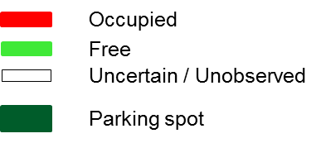
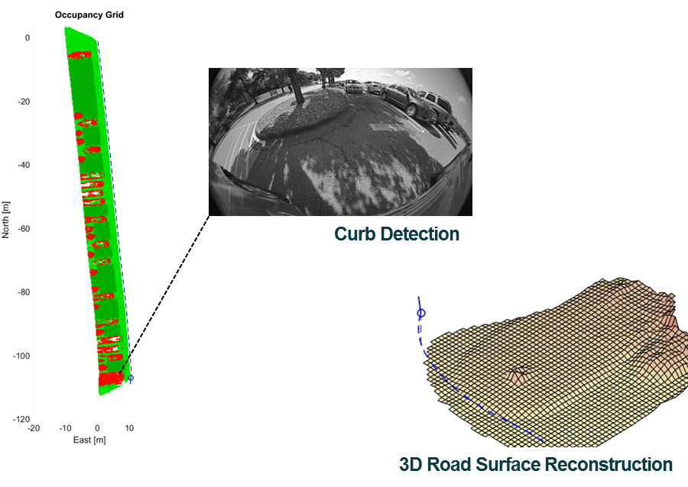
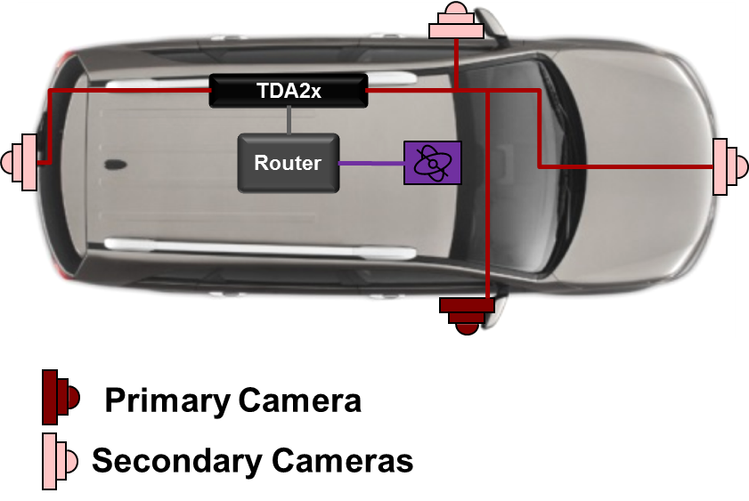
Demo Setup
Sensors
Fisheye Camera
Novatel INS
TI Confidential – NDA Restrictions

Slide 29
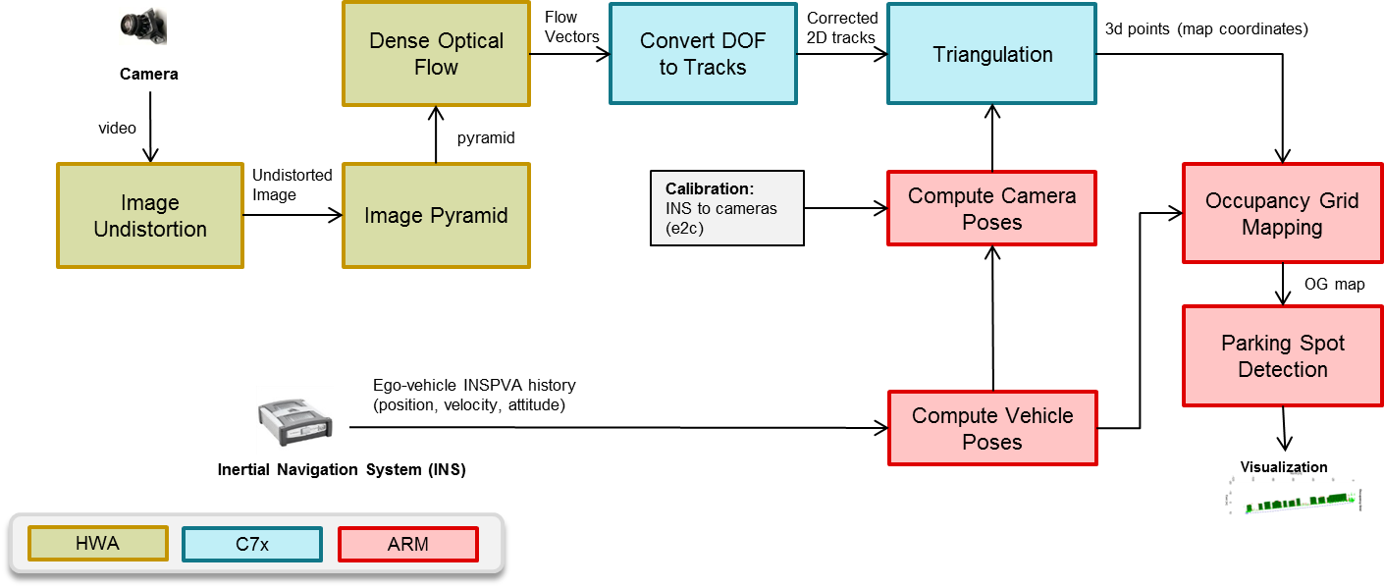
Functional Blocks Diagram (J7 / TDA4x)
Heavy weight processing is offloaded to HWA such as optical flow, pyramids, undistort…etc.
>80% processing on HWA & <20% on DSP/ARM enables >5X power reduction!!
Dense Optical Flow HWA creates highly accurate (industry leading) & dense (full image points) flow map.
Vision HWA enables lower latency pipleline vs. processing in programmable compute.
TI Confidential – NDA Restrictions

Slide 30
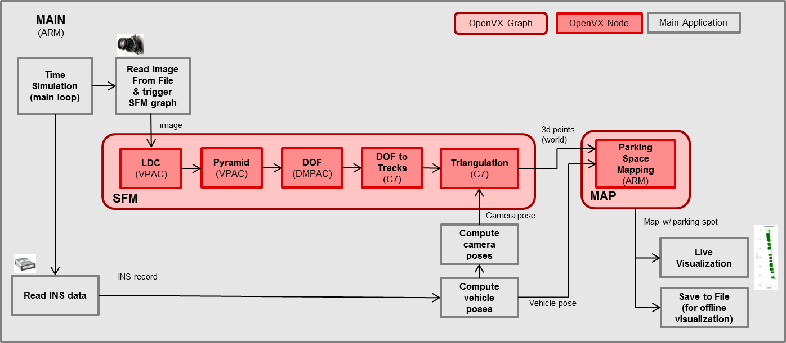
Implementation with OpenVX
Each processing element is implemented as a OpenVX Node
OpenVX node enables platform portability and Ease of Development
TI OpenVX graph approach enables connected nodes with fewer trips to external memory or host processor – Lower Latency
TI OpenVX nodes for Jacinto 7 IP is available using simulation models.
TI OpenVX graph toolkit is available Now!
TI Confidential – NDA Restrictions

Slide 31
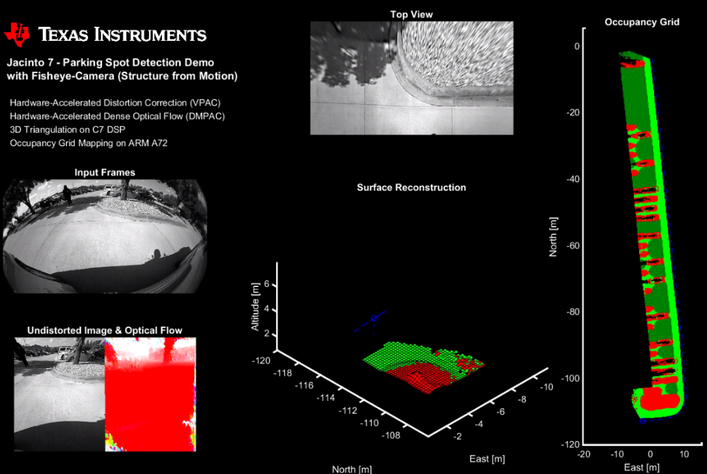
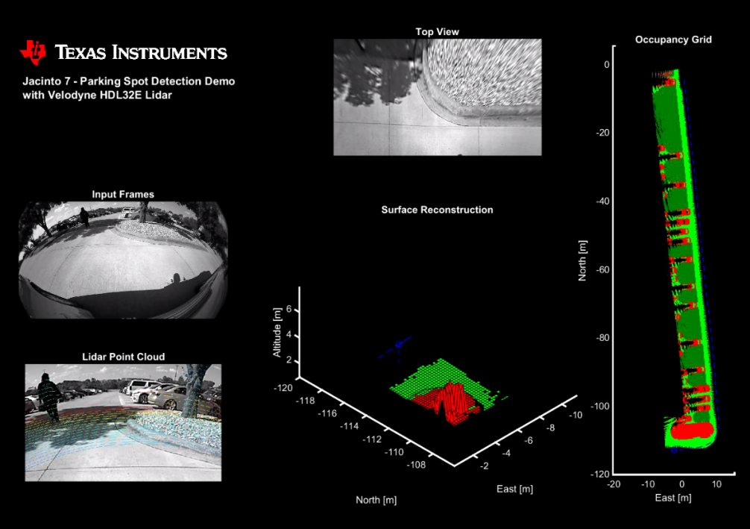
Parking Spot Detect Demo Screenshots
Camera
LIDAR
High accurate depth map (OG map) using TI HWA (Dense Optical Flow, VPAC, …).
Correlates well with LIDAR map (see right side) – Industry leading KPIs
Offloads >80% processing on Hardware accelerators - Lowest power embedded solution, Scalable
TI Confidential – NDA Restrictions

Slide 32
TI OpenVX Implementation Details

Slide 33
Mono-camera Analytics Processing Graph (Example)

Slide 34
Distributed Graph Execution
M4
EVE1
ISS
DSP1
DSP2
vxScheduleGraph
(1)
IMG PP
(1)
TLR
SOF
(2)
IMG PYR
(3)
(3)
LD
FPC
(4)
SFM
(5)
PD
TSR
VD
CPU Idle
(6)
OC
FCW
DRAW
vxWaitGraph
(7)
NOT TO SCALE
Distributed graph execution minimizes overheads at “HOST” ARM CPU and reduces system latency

Slide 35
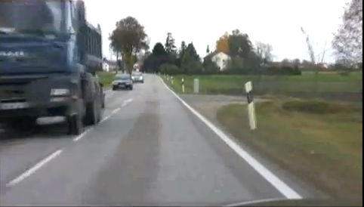
Block Access Manager (BAM) Framework
Non-BAM based programming model
Divides an input into smaller 2-D blocks and pipelines kernels using BAM
BAM manages DMA, including abstracting the overlap reads required for filtering kernels.
Reduces the input/output accesses made in the external memory
"Virtual Image” in OpenVX is used to eliminate intermediate buffers.
Most OpenVX v1.1 kernels optimized on DSP using BAM
Big External memory
DSP
Compute Unit
L2 Cache
Data I/O
Data I/O
BAM framework based programming model
Big External memory
DSP
Compute Unit
On-chip
L2 RAM
DMA
Data I/O
Data I/O
Data I/O

Slide 36

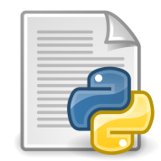

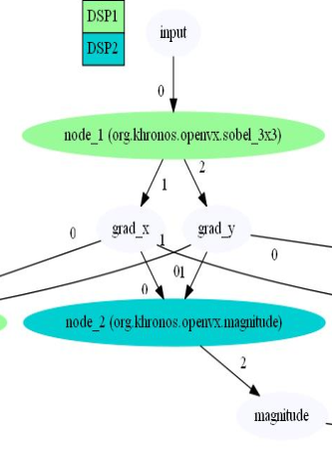
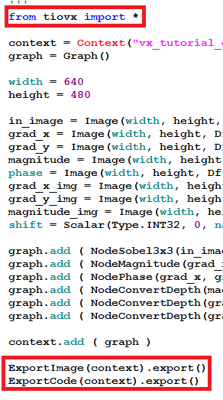

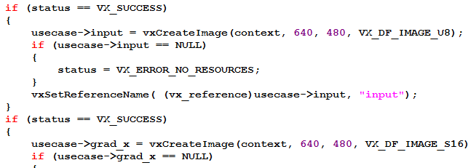
PyTIOVX - Automated OpenVX “C” Code Generation
Generated C code can run on SoC without modifications
Visualize graph connections
Trap and fix common mistakes before executing on target SoC
PyTIOVX

Slide 37
TI OpenVX and other frameworks

Slide 38
Pipelined Graph Execution with Processor SDK – Vision (TDA2x/3x)
Camera Link
OpenVX used for compute
Processor SDK – Vision used for Camera, Display, system level control
Pipelined execution of OpenVX with camera and display improves system utilization
Target DSP1
Target EVE2
OpenVX Link
OpenVX Application
Target
DSP2
Target
ARM A15
Target
A15
Target EVE1
Target ARM M4
Display Link
TDA2x SoC

Slide 39
TI OpenVX with Customer Frameworks
OpenVX Application
Customer SW Stack
Reuse customer SW
New customer SW
OpenVX API (HOST)
TI SW
OpenVX Framework
OpenVX Framework
Customer SW Stack
OpenVX Kernel Wrapper
OpenVX Kernel Wrapper
Customer Kernels
Customer Kernels
ARM
DSP
OpenVX Targets can be enabled only on required CPUs, HWAs
On the same CPU, an OpenVX as well as other customer threads/algorithms can co-exists
Customers can plugin their own algorithms as OpenVX nodes
Existing algorithms can be used as-is with a OpenVX kernel wrapper
When not using TI Vision SDK framework, minor porting in “platform” layer of OpenVX may be required to make OpenVX work with customer framework

Slide 40
TI OpenVX with OpenCL on TDA2x (Example)
Target DSP1
Target EVE2
OpenCL Device
DSP1
Target A15
Target
OpenCL (A15)
Target A15
OpenCL Device
DSP2
HOST (A15)
(OpenVX API)
Target EVE1
Target IPU1-0
Here OpenVX kernel on Target OpenCL (A15) offloads work to DSPs running OpenCL using OpenCL framework
Target A15 is used for generic compute on A15

Slide 41
TI OpenVX with OpenCV on TDA2x (Example)
Target DSP1
Target EVE2
Target
DSP2
Target
A15
OpenCV API
(A15)
Target
A15
HOST (A15)
(OpenVX API)
Target EVE1
Target IPU1-0
Here OpenCV APIs can be called by OpenVX nodes running on HOST

Slide 42
Getting Started with TI OpenVX

Slide 43
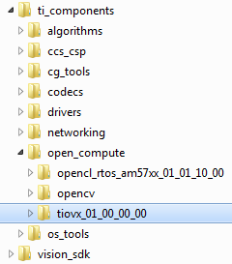
TIOVX within Processor SDK - Vision
TIOVX is present in Processor SDK – Vision at the location shown below
TIOVX package

Slide 44
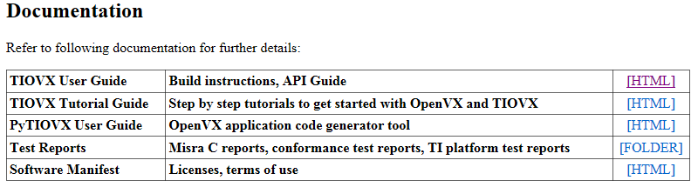
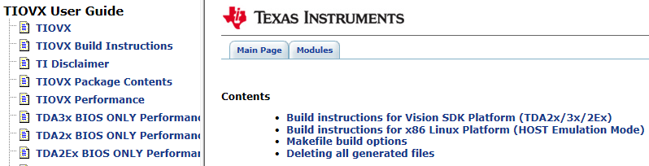
TIOVX Getting Started
TIOVX sample application can be run on Linux x86 PC as well as TI TDA2x/3x SoC/EVM
Follow steps in user guide to run sample applications on Linux x86 PC or SoC/EVM

Slide 45
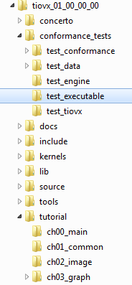
TIOVX Sample Applications
main() for Khronos conformance test suite, including TI extension test suite on Linux x86 PC
Helps confirm installation is fine and TI implementation meets OpenVX conformance
main() for TI OpenVX Step-by-step Tutorials on Linux x86 PC
Recommended starting point to learn TI OpenVX

Slide 46
TIOVX Tutorials
Step by step examples to understand OpenVX, followed TI extensions to OpenVX including developing kernels on TI C6xx DSP
Graph with multiple targets, DSP1 and DSP2
Load and Save VX images
Graph generated with PyTIOVX tool
Image manipulation using VXU APIs
Graph with user kernels on ARM
Image manipulation using graph and VX node APIs
Graph with target kernels on DSP

Slide 47
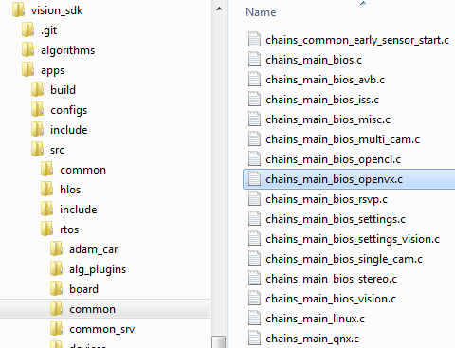
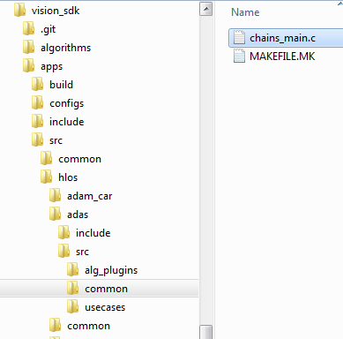
TIOVX on TI SoC/EVM
TI OpenVX sample application entry point to run on TI SoC/EVM can be found within Processor SDK – Vision
RTOS OpenVX applications
Embedded Linux OpenVX applications

Slide 48
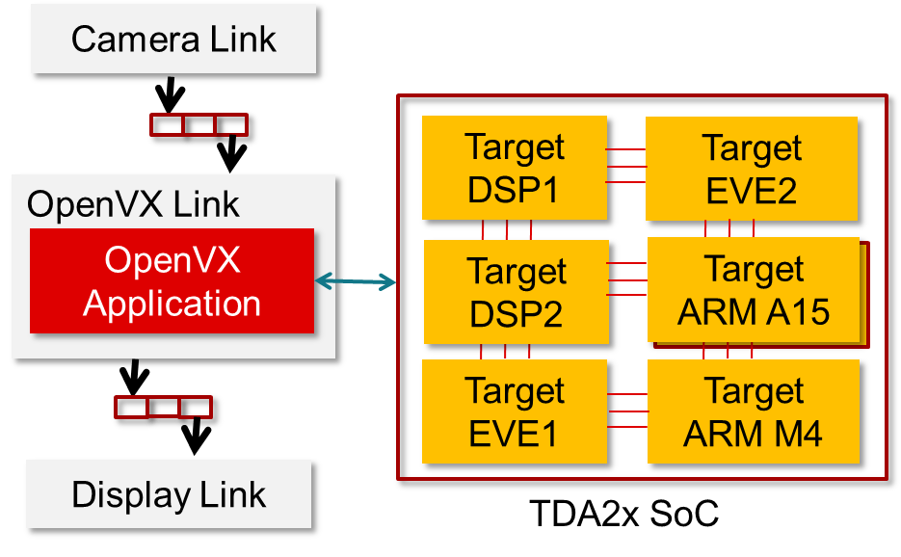
TIOVX on TI SoC/EVM with Capture and Display
A TI OpenVX sample application shows interaction of OpenVX with links framework for capture and display.
OpenVX use-case with capture and display “links”
\vision_sdk\apps\src\rtos\usecases\vip_single_cam_openvx
OpenVX “link” used in the use-case
\vision_sdk\apps\src\rtos\alg_plugins\openvx

Slide 49
Summary and Additional Resources

Slide 50
Summary
TI OpenVX supports true multi-core heterogeneous compute on TDA2x/3x and next gen TI SoCs
TI OpenVX implementation differentiates via
Distributed graph execution
DMA acceleration using BAM
Pipelined graph execution and streaming IO nodes (camera/display)
Ease of use via code generation (PyTIOVX) tool, PC emulation mode
Ability to run on “Big ARM” CPUs with HLOS as well as “MCU ARM” CPUs using RTOS
TI OpenVX is included as part of Processor SDK – Vision on TDA2x/3x SoCs

Slide 51
Additional TIOVX Resources
Release notes – READ this first
\tiovx_xx_xx_xx_xx\tiovx_release_notes.html
User guide, tutorial guide, PyTIOVX guide
\tiovx_xx_xx_xx_xx\docs\user_guide\index.html
\tiovx_xx_xx_xx_xx\docs\tutorial_guide\index.html
\tiovx_xx_xx_xx_xx\docs\pytiovx_guide\index.html
Processor SDK – Vision resources
\vision_sdk\docs\Index.htm
Web resources
http://www.ti.com/processors/automotive-processors/tdax-adas-socs/overview.html
https://training.ti.com/openvx-implementation-ti-tda-adas-socs
http://www.ti.com/tool/processor-sdk-vision
https://e2e.ti.com/support/arm/automotive_processors/f/1021

Slide 52
Thank You !!!

Slide 53
Revision History
Date | Version | Author | Remarks
13 Jun 2016 | 0.50 | Kedar C | First draft
23 Aug 2016 | 0.60 | Kedar C | Added revision history
26 Aug 2016 | 0.70 | Kedar C | Added conceptual view on different SoCs and interaction with other frameworks
21 Sept 2016 | 0.82 | Kedar C | Edited to make it friendly for sharing with customers. Separated Net Gen TI SoC information in a separate slide. Added slides on co-existence with customer SW stacks.
23 Sept 2016 | 0.83 | Kedar C | Removed references to “ASIL” and made it “Safety ready”
29 Nov 2016 | 0.90 | Kedar C | Updated based on current implementation progress
10 Jan 2017 | 1.00 | Kedar C | Updated based on current implementation progress
15 Jan 2017 | 1.01 | Kedar C | TIOVX Stack updated
13 Mar 2017 | 1.02 | Kedar C | Minor updates
3 Apr 2017 | 1.03 | Kedar C | Updates based on current status and plans
7 Jun 2017 | 1.04 | Kedar C | Minor update in block diagram
28 Jun 2017 | 1.05 | Kedar C | Updated plans based on aligned features
7 Nov 2017 | 1.06 | Kedar C | Updated based on latest updates
23 May 2018 | 1.08 | Kedar C | Updated based on latest updates
18 Jun 2018 | 1.09 | Kedar C | Added details on parking space detect OpenVX demo

Slide 54
TI OpenVX Implementation Plan
Milestone | Features | Schedule
Phase 1 | OpenVX v1.1 on TDA2x/3X SoCs with Processor SDK – Vision 3.x | AVAILABLE NOW
Phase 2 | Enable TDA4x “PC Emulation” of HWAs, C7x | AVAILABLE NOW
Phase 3 | Additional enhancements (ex, graph pipelining, TIDL) | Q2 2018
Phase 4 | Additional enhancements (ex, camera/display nodes) | Q1 2019
Phase 5 | OpenVX on J7/TDA4x with Processor SDK Automotive | Q3 2019
* Schedule and features are preliminary and subject to change
TI Confidential – NDA Restrictions

