Slide 1
TIOVX – TI’s OpenVX Implementation
28 Sept 2017

Slide 2
Agenda
Introduction to OpenVX
OpenVX on TI SoCs – TIOVX
Getting Started with TIOVX
Notes:
OpenVX has this idea of computation graphs, where image operations called nodes process data.
The nodes may be dedicated HW blocks, or if they run for example on a GPU, they may be written in OpenCL.
The application first sets up a graph, telling system in advance which type of processing it will want to perform.
The system then has a possibility to work on the processing graph, to spend some effort to optimize the total graph, before executing it.
The host, the CPU, needs only pass in some data, and then can idle, while the OpenVX subsystem, in more power-efficient HW, autonomously executes the graph.

Slide 3
Agenda
Introduction to OpenVX
OpenVX on TI SoCs – TIOVX
Getting Started with TIOVX
Notes:
OpenVX has this idea of computation graphs, where image operations called nodes process data.
The nodes may be dedicated HW blocks, or if they run for example on a GPU, they may be written in OpenCL.
The application first sets up a graph, telling system in advance which type of processing it will want to perform.
The system then has a possibility to work on the processing graph, to spend some effort to optimize the total graph, before executing it.
The host, the CPU, needs only pass in some data, and then can idle, while the OpenVX subsystem, in more power-efficient HW, autonomously executes the graph.

Slide 4

OpenVX – Low-Power Vision Acceleration
Higher-level abstraction API
Targeted at real-time mobile and embedded platforms
Performance portability across diverse architectures
Multi-core CPUs, GPUs, DSPs, ISPs, Dedicated hardware, …
Extends portable vision acceleration to very low-power domains
Doesn’t require high-power CPU/GPU Complex
Lower precision requirements than OpenCL
Vision Engine
Middleware
Application
X100
Dedicated Hardware
Vision Processing Efficiency
Vision DSPs
X10
GPU Compute
Power Efficiency
Accelerator
Multi-core
CPU
Accelerator
X1
Accelerator
Computation Flexibility
Notes:
OpenVX is a special API for low-power vision acceleration.
It is a fairly high-level API, especially compared to programming language approach like with OpenCL, and it is aimed to provide real-time computer vision support on mobile and embedded devices.
The API abstracts the underlying hardware, the implementation can use multi-core CPUs, or GPUs, or DSPs, or ISPs, or some new dedicated computer vision HW.
But the programmer doesn’t have to care exactly how the API is implemented, the device manufacturers take care of those details instead.
Now even very low-power wearable devices can address vision workloads without involving the high-power CPU/GPU complex.
As OpenVX has lower precision requirements than OpenCL, it is mostly fixed-point API, whereas OpenCL is mostly a floating-point API, in OpenVX computations can be done with simpler, lower-power HW.

Slide 5
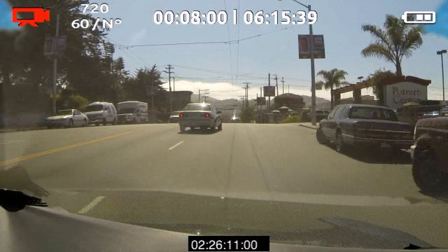



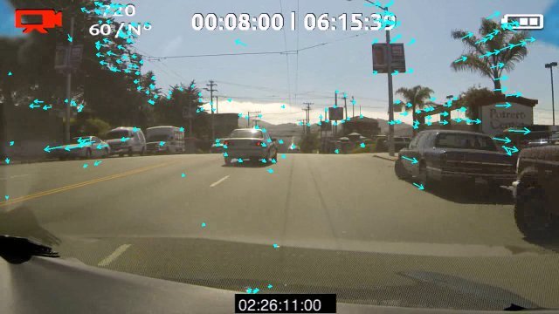
OpenVX Graphs
OpenVX developers express a graph of image operations (‘Nodes’)
Nodes can be on any hardware or processor coded in any language
For example, on GPU, nodes may implemented in OpenCL
Minimizes host interaction during frame-rate graph execution
Host processor can setup graph which can then execute almost autonomously
Camera Input
Pyr_{t}
Rendering
Output
OpenVX Nodes
RGB
Frame
Color Conversion
YUV
Frame
Channel Extract
Gray
Frame
Image
Pyramid
Optical Flow
Array of
Keypoints
Harris Track
Array of
Features
OpenVX Graph
Ftr_{t-1}
Notes:
OpenVX has this idea of computation graphs, where image operations called nodes process data.
The nodes may be dedicated HW blocks, or if they run for example on a GPU, they may be written in OpenCL.
The application first sets up a graph, telling system in advance which type of processing it will want to perform.
The system then has a possibility to work on the processing graph, to spend some effort to optimize the total graph, before executing it.
The host, the CPU, needs only pass in some data, and then can idle, while the OpenVX subsystem, in more power-efficient HW, autonomously executes the graph.

Slide 6
An OpenVX “Hello, World !!!” Program
vx_context context = vxCreateContext();
vx_graph graph = vxCreateGraph( context );
vx_image input = vxCreateImage( context, 640, 480, VX_DF_IMAGE_U8 );
vx_image output = vxCreateImage( context, 640, 480, VX_DF_IMAGE_U8 );
vx_image intermediate = vxCreateVirtualImage( graph, 640, 480, VX_DF_IMAGE_U8 );
vx_node F1 = vxF1Node( graph, input, intermediate );
vx_node F2 = vxF2Node( graph, intermediate, output );
vxVerifyGraph( graph );
vxProcessGraph( graph );
context
graph
input
F1
inter-
mediate
F2
output
Notes:
First, we create a context for the OpenVX operations and data, and then we start a graph in that context.
We then create the input image, the output image, and an intermediate, virtual image, that we will never look at.
We then add two nodes, the first one connecting input to intermediate, the second the intermediate to output.
We then verify the graph, and now the system can perform optimizations, such as tiling, etc.
Finally, we process the graph.

Slide 7
More Details on OpenVX Standard
Khronos OpenVX website
https://www.khronos.org/openvx/
OpenVX v1.1 specification and additional resources
https://www.khronos.org/registry/OpenVX/
https://www.khronos.org/openvx/resources
Khronos OpenVX v1.1 Video Tutorials
https://youtu.be/JZZCNcfIqqs?list=PLYO7XTAX41FP01wTyWfwiNW3xq9IDRAnO

Slide 8
Agenda
Introduction to OpenVX
OpenVX on TI SoCs – TIOVX
Getting Started with TIOVX
Notes:
OpenVX has this idea of computation graphs, where image operations called nodes process data.
The nodes may be dedicated HW blocks, or if they run for example on a GPU, they may be written in OpenCL.
The application first sets up a graph, telling system in advance which type of processing it will want to perform.
The system then has a possibility to work on the processing graph, to spend some effort to optimize the total graph, before executing it.
The host, the CPU, needs only pass in some data, and then can idle, while the OpenVX subsystem, in more power-efficient HW, autonomously executes the graph.

Slide 9
TIOVX - OpenVX Implementation on TI SoC
GOAL: Help customers easily maximize performance on TI platforms while minimizing development cost.
Result: Full entitlement on TI SoCs and remove barrier to entry for OpenVX developers
Performance
Graph-based model
All work defined at initialization time to maximize system utilization and minimize run- time latencies.
True Heterogeneous Compute
Easy/unified access to all ARM, DSP, Vision (EVE) Cores
Optimized Libraries
Development Cost
Open Standard
Conformant to OpenVX v1.1
Hardware Abstraction
Same application works across TDA2x/3x family of SoCs on range of SW environments from Linux to TI-RTOS
Ease of use
Full development, including DMA, DSP/EVE intrinsic emulation, can be done on PC using TI OpenVX, then simple recompile on platform.
PyTIOVX tool generates OpenVX Application code using compact graph description
Fully optimized OpenVX 1.1 kernels on C6x DSP
DMA Integration
Simple interface to add block-based DMA to kernels (BAM)
Virtual Buffers
Intermediate buffers can be optimized out, or reside only in L2.

Slide 10
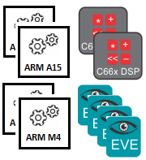
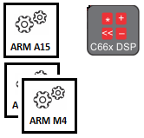
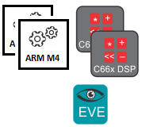


OpenVX 1.1 Supported Platforms
TDA2x
TDA2Eco
TDA3x
OpenVX
Target CPUs
OS

Slide 11
TI OpenVX SW Stack
Khronos Conformance Test
TI Extension Conformance Test
Examples / Use-cases with Processor SDK - Vision
Examples / Use-cases with Processor SDK - Vision
OpenVX API
TIOVX API
TIOVX Framework
Context
Node
Target
Obj Desc
Image
Array
Graph
Kernel
Target Kernel
Scalar
Pyramid
…
TIOVX Platform
Queue
Mutex
Task
Event
IPC
Platform
Memory
TIOVX Kernel Wrapper
VXLIB
EVELIB
User kernels
Target kernels
TI
Khronos
Customer

Slide 12
TI OpenVX on TDA3x
HOST-TARGET CMDs.
Target DSP1
TARGET-TARGET CMDs
Target
DSP2
HOST (IPU1-0)
(OpenVX API)
Target IPU1-0
Target EVE1
HOST
User Thread on HOST CPU, calls OpenVX APIs
Target
TI OpenVX “Target” executes vision kernels. Target can run on same CPU as HOST. Multiple Targets on a CPU possible. Target execute in parallel to each other

Slide 13
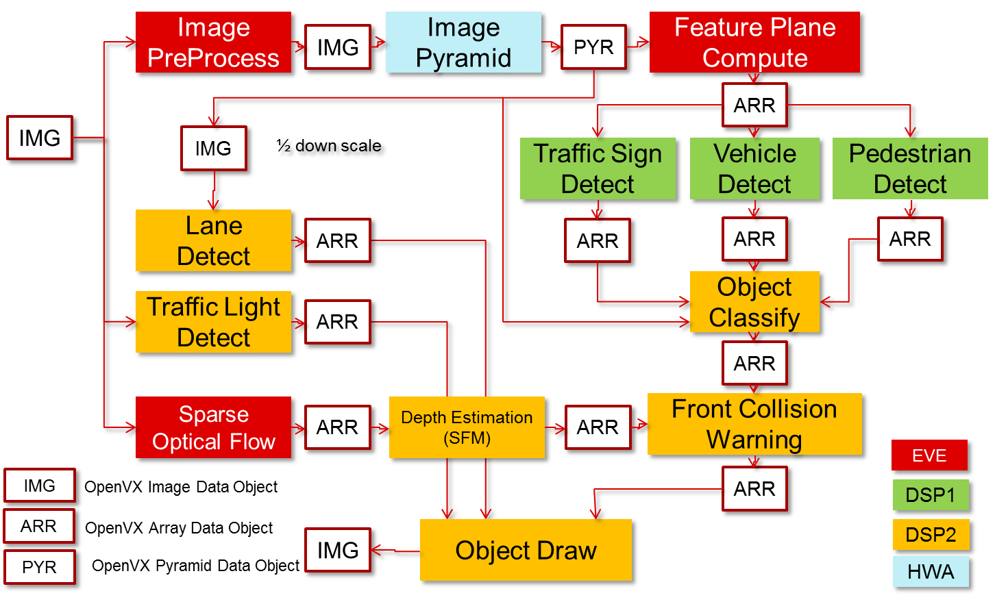
Mono-camera Analytics Processing Graph (Example)

Slide 14
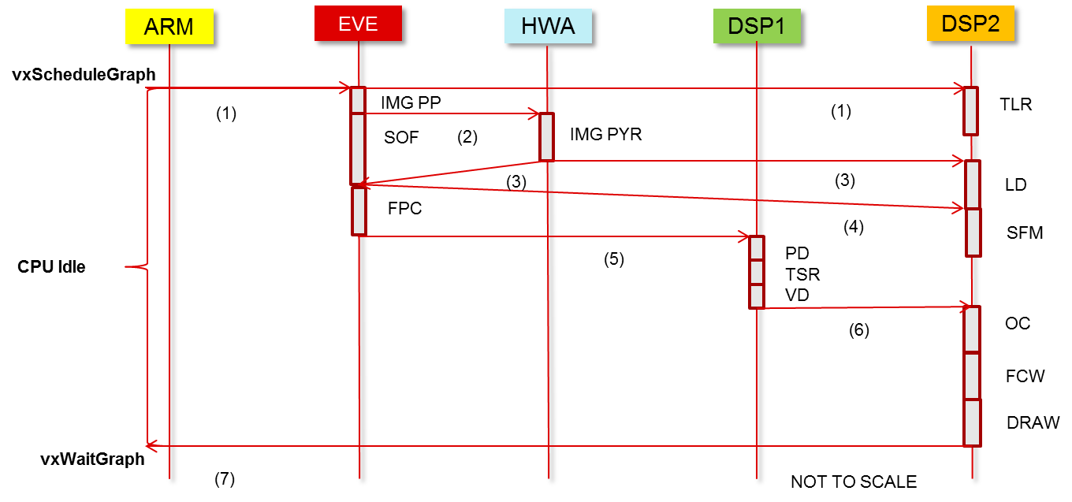
Distributed Graph Execution
Distributed graph execution minimizes overheads at “HOST” ARM CPU and reduces system latency

Slide 15
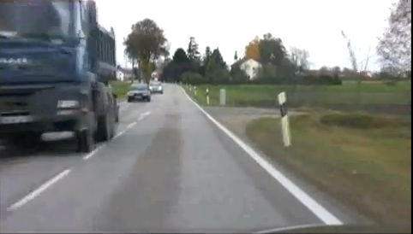
Block Access Manager (BAM) Framework
Non-BAM based programming model
Divides an input into smaller 2-D blocks and pipelines kernels using BAM
BAM manages DMA, including abstracting the overlap reads required for filtering kernels.
Reduces the input/output accesses made in the external memory
"Virtual Image” in OpenVX is used to eliminate intermediate buffers.
Most OpenVX v1.1 kernels optimized on DSP using BAM
Big External memory
DSP
Compute Unit
L2 Cache
Data I/O
Data I/O
BAM framework based programming model
Big External memory
DSP
Compute Unit
On-chip
L2 RAM
DMA
Data I/O
Data I/O
Data I/O

Slide 16



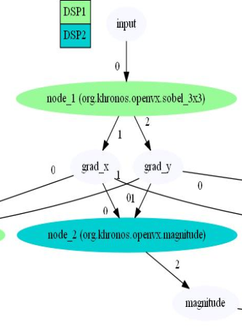
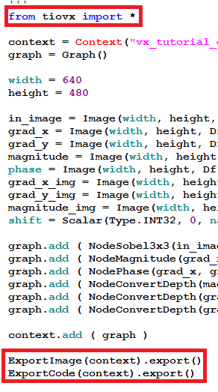

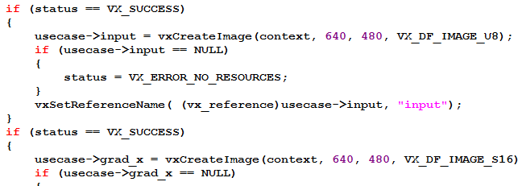
PyTIOVX - Automated OpenVX “C” Code Generation
Generated C code can run on SoC without modifications
Visualize graph connections
Trap and fix common mistakes before executing on target SoC
PyTIOVX

Slide 17
Pipelined Graph Execution with Processor SDK - Vision
Camera Link
OpenVX used for compute
Processor SDK – Vision used for Camera, Display, system level control
Pipelined execution of OpenVX with camera and display improves system utilization
Target DSP1
Target EVE2
OpenVX Link
OpenVX Application
Target
DSP2
Target
ARM A15
Target
A15
Target EVE1
Target ARM M4
Display Link
TDA2x SoC

Slide 18
Summary
TI OpenVX supports true multi-core heterogeneous compute on TDA2x/3x SoCs
TI OpenVX implementation differentiates via
Distributed graph execution
DMA acceleration using BAM
Pipelined graph execution and streaming IO nodes (camera/display)
Ease of use via code generation (PyTIOVX) tool, PC emulation mode
Ability to run on “Big ARM” CPUs with HLOS as well as “MCU ARM” CPUs using RTOS

Slide 19
Agenda
Introduction to OpenVX
OpenVX on TI SoCs – TIOVX
Getting Started with TIOVX
Notes:
OpenVX has this idea of computation graphs, where image operations called nodes process data.
The nodes may be dedicated HW blocks, or if they run for example on a GPU, they may be written in OpenCL.
The application first sets up a graph, telling system in advance which type of processing it will want to perform.
The system then has a possibility to work on the processing graph, to spend some effort to optimize the total graph, before executing it.
The host, the CPU, needs only pass in some data, and then can idle, while the OpenVX subsystem, in more power-efficient HW, autonomously executes the graph.

Slide 20
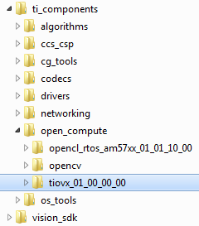
TIOVX within Processor SDK - Vision
TIOVX is present in Processor SDK – Vision at the location shown below
TIOVX package

Slide 21
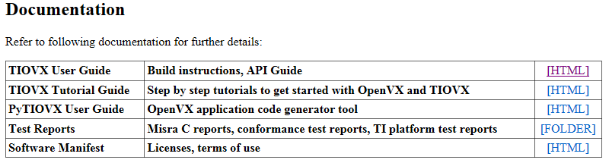
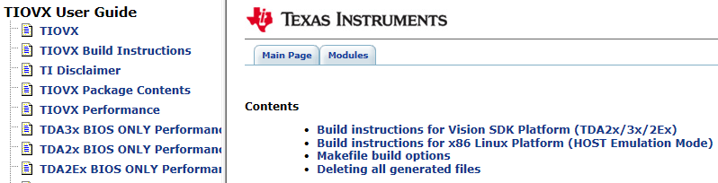
TIOVX Getting Started
TIOVX sample application can be run on Linux x86 PC as well as TI TDA2x/3x SoC/EVM
Follow steps in user guide to run sample applications on Linux x86 PC or SoC/EVM

Slide 22
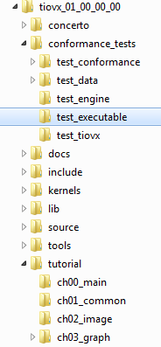
TIOVX Sample Applications
main() for Khronos conformance test suite, including TI extension test suite on Linux x86 PC
Helps confirm installation is fine and TI implementation meets OpenVX conformance
main() for TI OpenVX Step-by-step Tutorials on Linux x86 PC
Recommended starting point to learn TI OpenVX

Slide 23
TIOVX Tutorials
Step by step examples to understand OpenVX, followed TI extensions to OpenVX including developing kernels on TI C6xx DSP
Graph with multiple targets, DSP1 and DSP2
Load and Save VX images
Graph generated with PyTIOVX tool
Image manipulation using VXU APIs
Graph with user kernels on ARM
Image manipulation using graph and VX node APIs
Graph with target kernels on DSP

Slide 24
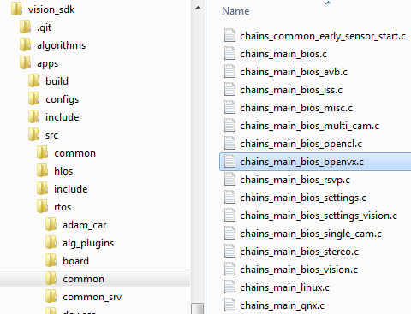
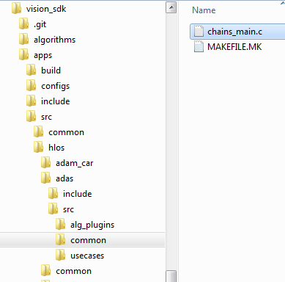
TIOVX on TI SoC/EVM
TI OpenVX sample application entry point to run on TI SoC/EVM can be found within Processor SDK – Vision
RTOS OpenVX applications
Embedded Linux OpenVX applications

Slide 25
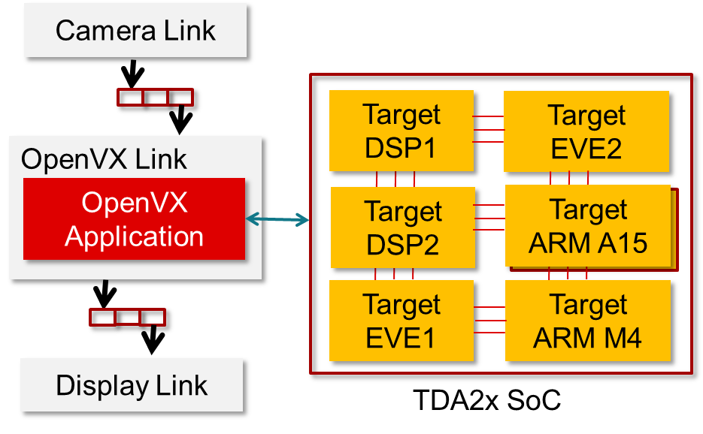
TIOVX on TI SoC/EVM with Capture and Display
A TI OpenVX sample application shows interaction of OpenVX with links framework for capture and display.
OpenVX use-case with capture and display “links”
\vision_sdk\apps\src\rtos\usecases\vip_single_cam_openvx
OpenVX “link” used in the use-case
\vision_sdk\apps\src\rtos\alg_plugins\openvx

Slide 26
Additional TIOVX Resources
Release notes – READ this first
\tiovx_xx_xx_xx_xx\tiovx_release_notes.html
User guide, tutorial guide, PyTIOVX guide
\tiovx_xx_xx_xx_xx\docs\user_guide\index.html
\tiovx_xx_xx_xx_xx\docs\tutorial_guide\index.html
\tiovx_xx_xx_xx_xx\docs\pytiovx_guide\index.html
Processor SDK – Vision resources
\vision_sdk\docs\Index.htm
Web resources
http://www.ti.com/processors/automotive-processors/tdax-adas-socs/overview.html
http://www.ti.com/tool/processor-sdk-vision
https://e2e.ti.com/support/arm/automotive_processors/f/1021

Slide 27
Thank You !!!

