Slide 1
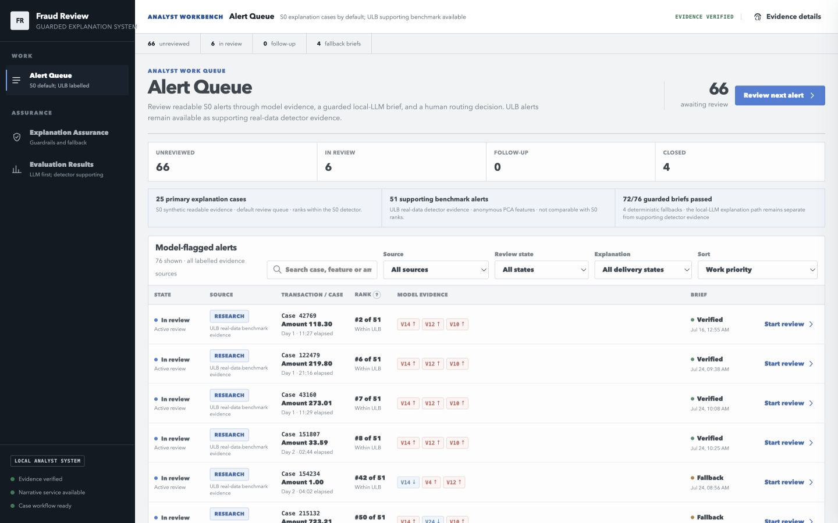
SUNWAY UNIVERSITY | CAPSTONE PROJECT 2
Evidence-Grounded Local-LLM Explanations for Fraud Alert Review
A fail-closed explanation delivery boundary built on detector evidence, SHAP reason codes, deterministic validation, and fallback.
Ng Yi Zhen | 23076003
Local analyst workbench using frozen, source-labelled evidence
Notes:
Good morning. My project is about credit-card fraud alert review, but the main contribution is not a new fraud-detection algorithm. The detector is treated as the model that produces the fraud score, and SHAP reason codes are treated as the evidence explaining that score. The local LLM is only allowed to translate that evidence into a short review brief. If the generated text changes, loses, or invents evidence, a deterministic validator rejects it and the system falls back to the original evidence. So the project studies a controlled explanation-delivery boundary: what can safely reach an analyst, what must be rejected, and how this can be measured.

Slide 2
Problem and Motivation
02
• Fraud detection is highly imbalanced; accuracy is misleading.
• Explanations can mislead if generated text is treated as evidence.
• Prior work shows the need for faithful narrative explanation, not just readable prose.
• Local LLMs may reduce external exposure, but local generation can still drift from evidence.
• The project asks how to keep generated explanations inside the model-evidence contract.
Rare-event detection
Technical attribution
Narrative risk
Controlled delivery
Accuracy hides the fraud minority; AP, recall, precision, and F1 matter.
SHAP gives signed model evidence, but raw attribution is not analyst prose.
LLM text may omit, add, or reverse evidence if delivered unchecked.
Deterministic guardrails either accept the brief or return fallback evidence.
→
→
→
Visible literature gap
AlMarri (2025): SHAP-faithfulness concern • Zytek (2024): narrative explanations • Rebedea (2023): programmable guardrails
This project measures the delivery boundary between evidence and generated articulation.
Evidence-grounded local-LLM fraud alert review
Notes:
The problem has two parts. First, credit-card fraud is a rare-event classification problem, so a useful detector must be evaluated with AP, precision, recall, F1, and confusion counts rather than headline accuracy. Second, explanation is a separate risk. The literature already shows that readable narrative explanations can be useful, but faithfulness remains difficult. AlMarri highlights mismatches between LLM explanation and SHAP evidence, Zytek shows the value of narrative explanation, and Rebedea motivates programmable guardrails. My project focuses on the gap between those ideas: can local generated text be constrained, measured, and rejected when it violates the model evidence?

Slide 3
Research Questions and Evidence Roles
03
• RQ1: How effectively do deterministic guardrails detect local-LLM output violations and enforce fallback?
• RQ2: What does guarded local-LLM delivery add, preserve, or lose compared with SHAP reason codes and deterministic briefs?
• ULB is the real anonymised benchmark and anonymous-feature prompt stress test.
• S0 is the synthetic readable-feature study for semantic and operational evaluation.
• They are two evidence roles in one study, not two competing detector datasets.
• S0 follows Fraud Detection Handbook concepts to make feature semantics inspectable.
ULB benchmark
S0 semantic study
Real anonymised credit-card data Role: detector benchmark, SHAP chain, anonymous-feature prompt stress test Boundary: no readable business semantics
Synthetic readable transaction stream Role: operational explanation, workbench review, human pilot stimuli Source basis: Le Borgne et al. (2022)
One contribution: evidence-governed local-LLM explanation delivery
Evidence-grounded local-LLM fraud alert review
Notes:
The project has two research questions. RQ1 is about the guardrail and fallback mechanism: when the LLM output violates the contract, can the system detect that and prevent delivery? RQ2 is about what the LLM actually adds or loses in an analyst-facing workflow. I use two evidence contexts. The European ULB dataset is the real anonymised benchmark and keeps the work connected to the approved CP1 fraud-detection task. However, its V1 to V28 features are anonymous, so it is limited for business-readable explanation. S0 is a synthetic stream informed by Fraud Detection Handbook concepts, used to test semantic explanation behaviour with readable fields. The two are not directly compared as detector results.

Slide 4
End-to-End Methodology
04
• Deduplicate source data and create stable case IDs.
• Split before scaling, SMOTE, autoencoder fitting, threshold selection, and SHAP.
• Train six detector groups across five fixed seeds.
• Freeze the selected detector and generate signed SHAP reason codes.
• Generate local-LLM briefs, validate them, and fall back when needed.
• Consume the same artifacts in the React/FastAPI workbench.
Data controls
Detector
SHAP evidence
dedupe split first
→
G0/G1/G2/G3/G6/G7 validation freeze
→
signed top-3 reason codes
Local LLM
Validator
Workbench
minimized payload raw output retained
→
format grounding direction
→
review action fallback visible
Core rule: the generated brief can never change the stored evidence.
Evidence-grounded local-LLM fraud alert review
Notes:
The methodology is designed around leakage control and provenance. The source data are checked and deduplicated before modelling, and stable case IDs are used for joins across later artifacts. Splitting happens before preprocessing or feature construction, so scaling, SMOTE, autoencoder fitting, and threshold selection do not use test data. The detector benchmark produces logged metrics and predictions. The selected detector is then frozen and explained with signed SHAP reason codes. The local LLM receives only a minimized reason-code package, and the validator decides whether to deliver it or fall back. Finally, the workbench consumes the exact recorded artifacts rather than recalculating model logic.

Slide 5
Detector Benchmark: What Was Tested
05
• Groups: G0, G1, G2, G3, G6, and G7 over seeds 42 to 46.
• G0: original features with XGBoost.
• G1/G3: training-only SMOTE.
• G2/G3/G7: autoencoder reconstruction or latent features.
• G6: cost-sensitive XGBoost using scale_pos_weight.
• Detector comparison is supporting evidence, not the main novelty.
Group
Input
Imbalance
G0
Original features
None
G1
Original features
SMOTE
G2
Original + AE reconstruction
None
G3
Original + AE reconstruction
SMOTE
G6
Original features
Cost-sensitive
G7
Original + AE latent features
None
Selection discipline
Detector comparison supplies a reproducible evidence source; it is not the project novelty.
Evidence-grounded local-LLM fraud alert review
Notes:
For the detector benchmark, I evaluated six groups over five fixed seeds. G0 is the original-feature XGBoost reference. G1 adds SMOTE to the training set only. G2 adds autoencoder reconstruction error. G3 combines reconstruction error and SMOTE. G6 uses cost-sensitive XGBoost through `scale_pos_weight`, and G7 uses the autoencoder latent features. This part is important because the explanation layer must be based on a reproducible detector, but I do not claim algorithmic novelty here. The detector stage supplies the frozen model evidence for the later explanation experiment.

Slide 6
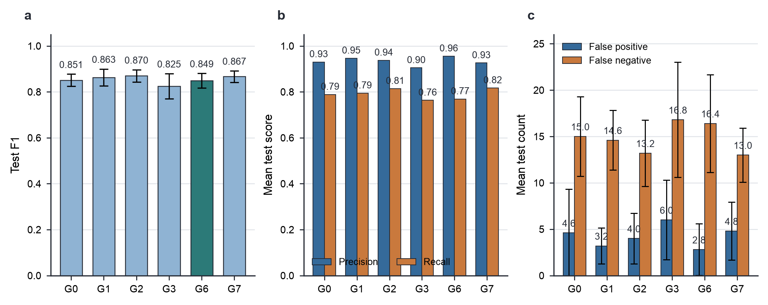
Detector Results and Honest Interpretation
06
• G6 had the numerically highest mean test AP: 0.855214 ± 0.027097.
• G2 had the highest mean F1: 0.870054 ± 0.026465.
• G7 had the highest mean recall: 0.816901 ± 0.041063.
• G6 had the highest mean precision and lowest mean false-positive count.
• No group led every metric, and no ranked-winner claim is made.
Evidence-grounded local-LLM fraud alert review
Notes:
The detector findings are mixed. G6 had the highest mean AP, but its advantage over G0 was very small. G2 had the best mean F1, and G7 had the best mean recall. G6 was strongest on precision and false positives, which made it a defensible downstream evidence source, but it was not clearly stronger across all metrics. This is an important critical point. The autoencoder variants did not show a clear added value over the original-feature baseline. Therefore, I present the detector comparison as a disciplined supporting benchmark, not as proof that the hybrid detector is better.

Slide 7
Explanation Boundary: SHAP to Local LLM to Guardrail
07
• G4 generated signed SHAP reason codes for 51 flagged ULB test cases.
• The LLM payload excluded raw rows, exact values, labels, probabilities, and SHAP magnitudes.
• OFF-policy analysis measures raw LLM violations.
• ON-policy delivery validates the same raw output and falls back on failure.
• Fallback is generated from reason codes, not from rejected prose.
SHAP reason codes
Minimized LLM payload
rank + feature + direction
→
no row, labels, score, SHAP magnitude
Raw candidate
Validator
preserved for OFF-policy measurement
→
format • completeness • grounding • direction
PASS
FAIL / OUTAGE
deliver candidate unchanged
deliver deterministic fallback
Evidence-grounded local-LLM fraud alert review
Notes:
The explanation boundary is the central design. G4 produces signed reason codes from SHAP. These reason codes state which features pushed the detector score toward fraud or legitimacy. The LLM does not receive the full transaction, exact feature values, historical labels, detector probabilities, or SHAP magnitudes. It only receives a minimized evidence package. The experiment then separates two policies. OFF policy measures the raw text returned by the model. ON policy sends that exact same text through the validator. If it fails, the delivered output is generated from the original reason codes, not repaired from the LLM text. This prevents a normalizer from hiding generation failures.

Slide 8
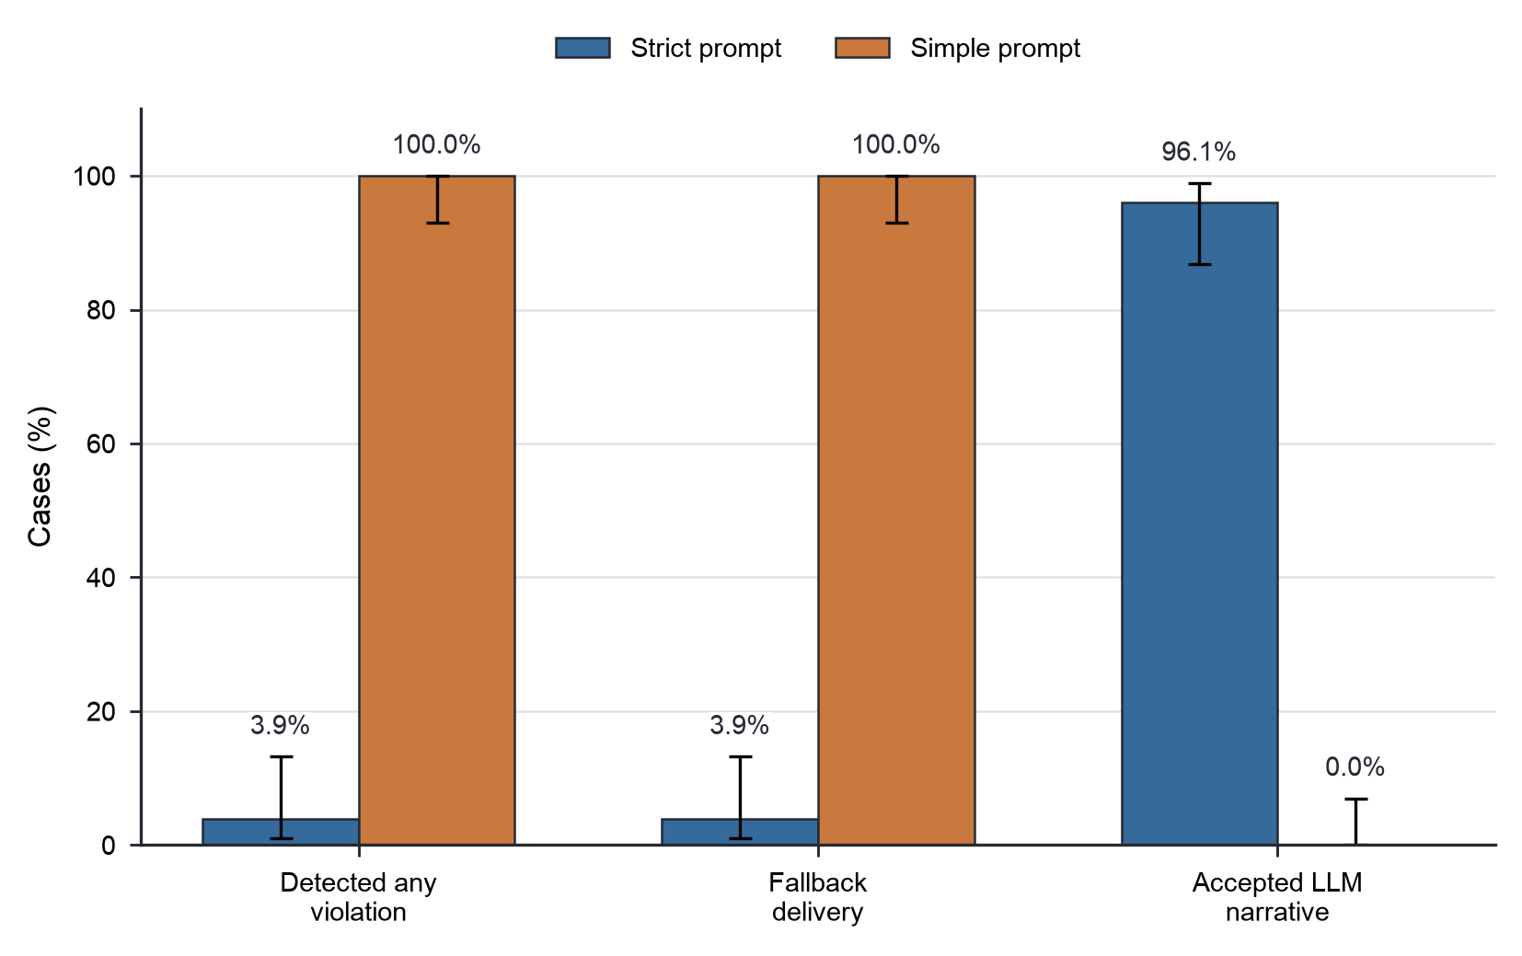
Guardrail Results: Why Validation Matters
08
• ULB strict prompt: 2/51 detected-any violations, 3.92% [1.08%, 13.22%].
• ULB simple prompt: 51/51 detected-any violations, 100% [93.00%, 100%].
• Every detected failure activated deterministic fallback.
• Corpus calibration intercepted 330/330 ULB attacks and accepted 318/318 faithful controls.
• Blinded manual audit: 0/49 delivered strict narratives had a semantic violation [0%, 7.27%].
• The audit used one student reviewer; it is bounded evidence, not universal proof.
Evidence-grounded local-LLM fraud alert review
Notes:
The guardrail results show why validation matters. Under the strict prompt, two of the 51 raw ULB outputs had a detected violation, so both fell back. Under the simple prompt, every output violated the accepted contract, so no simple-arm narrative was delivered. The 0/49 detected rate among delivered strict narratives is expected from the policy, but I also completed a separate blinded manual review of all 49 delivered narratives. I found no semantic violation against their supplied evidence, giving a 95% Wilson interval from zero to 7.27%. This is stronger than relying on the validator alone, although it remains a single-reviewer result and is not universal proof.

Slide 9
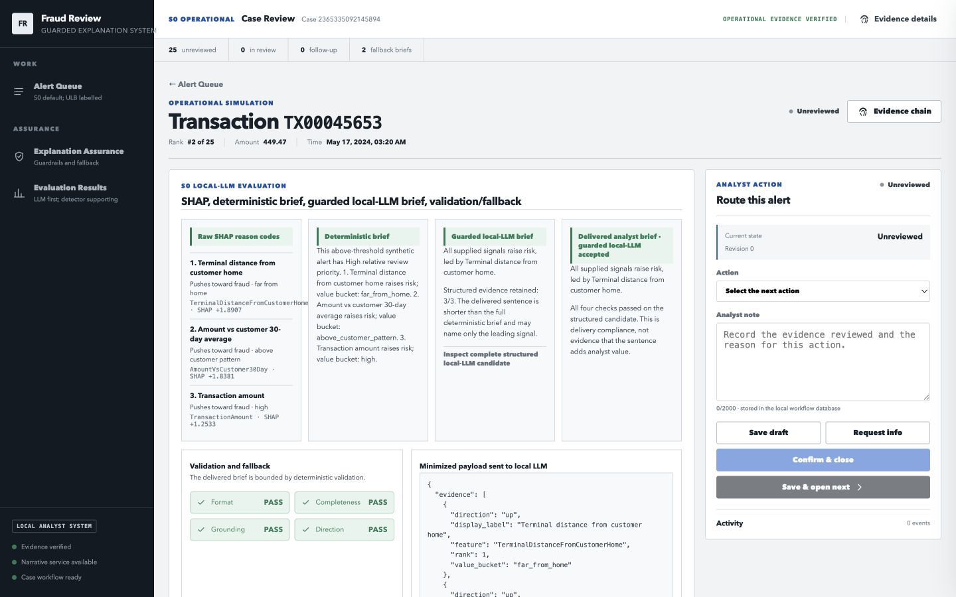
S0 Operational Study and Application
09
• S0 contains 50,000 synthetic transactions with readable operational fields.
• S0 test AP was 0.544017; precision 0.720000, recall 0.400000, F1 0.514286.
• The selected explanation set contained 25 above-threshold alerts.
• Guarded local-LLM briefs passed validation for 23/25 and fell back for 2/25.
• The application presents one source-labelled queue and separates Work from Model Evidence.
Evidence
Validation
Analyst action
SHAP + deterministic brief
pass/fallback is visible
local workflow state only
Evidence-grounded local-LLM fraud alert review
Notes:
S0 addresses the limitation of anonymous ULB features. It is synthetic, so I do not treat it as real-bank validation, but it gives readable evidence such as amount compared with the customer's recent behaviour, terminal distance, night-time status, and terminal fraud risk. On the frozen S0 test period, the detector had AP 0.544 and F1 0.514. The explanation comparison used the 25 selected alerts, which in this run were exactly the above-threshold cases. The workbench opens on one queue with source labels, so S0 and ULB are visible in the same application without mixing their score scales. The application supports review, evidence inspection, validation display, fallback, and local workflow notes.

Slide 10
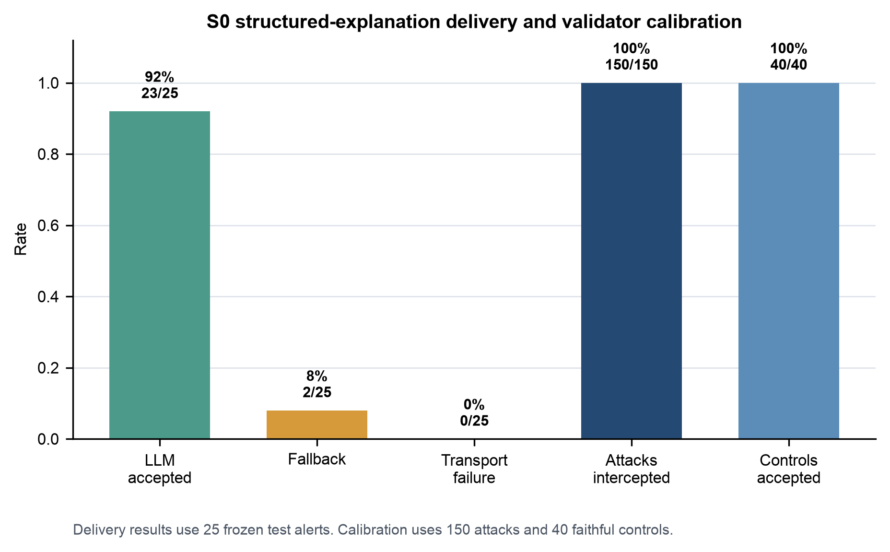
What the LLM Added and Lost
10
• The deterministic S0 brief preserved all three evidence items.
• All 23 accepted guarded-LLM summaries selected the shorter permitted option.
• Accepted guarded summaries averaged 12 words and one named evidence item.
• Deterministic briefs averaged 39.09 words and three named evidence items.
• Participants more often selected the LLM brief as clearest, but it did not add evidence detail.
39.09
12.00
words | 3 evidence items
words | 1 evidence item
Evidence-grounded local-LLM fraud alert review
Notes:
The most important S0 finding is that the LLM did not add analytical detail. In this design, it was not allowed to invent new evidence. It was given two permitted summary options: a detailed option naming all three evidence items and a shorter option naming the leading signal. All accepted LLM outputs selected the shorter option. That made them more compact, but less complete than the deterministic brief. The two outputs that attempted the detailed route corrupted structured fields and were rejected. In the human pilot, participants more often selected the LLM brief as clearest and preferred for first pass, but the deterministic brief was selected most often as trustworthy. The deterministic brief remains the trusted baseline, while the LLM is only an optional articulation layer.

Slide 11
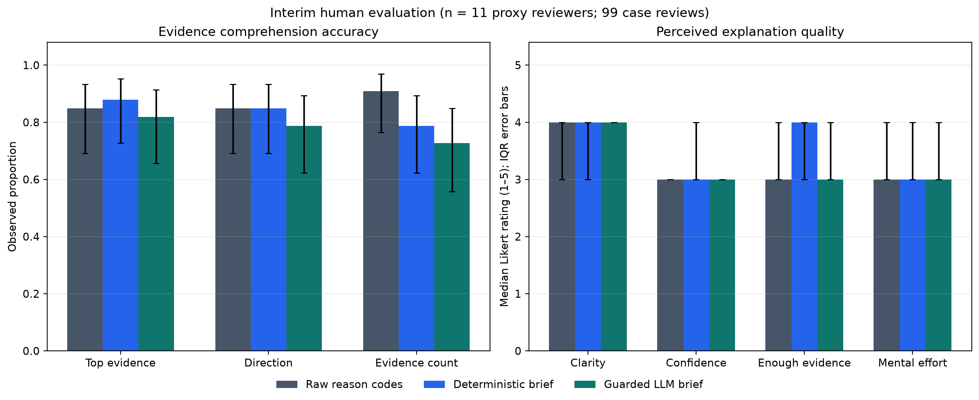
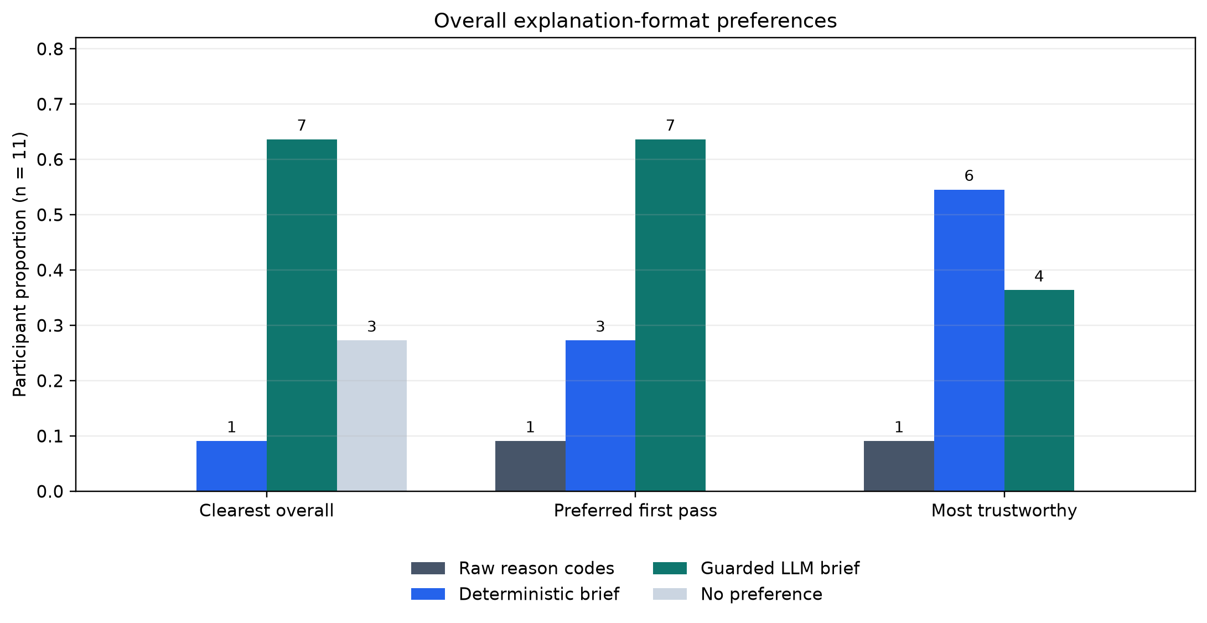
Human Evaluation: What People Preferred
11
• Eleven proxy reviewers completed 99 case reviews.
• Accuracy did not favour the guarded LLM brief on any comprehension check.
• Median clarity was 4/5 for all three formats.
• Guarded LLM brief was selected as clearest and preferred first-pass format by 7/11.
• Deterministic brief was selected as most trustworthy by 6/11.
• Interpretation: readability preference did not equal stronger evidence understanding.
Evidence-grounded local-LLM fraud alert review
Notes:
The human evaluation gives a useful but bounded result. Eleven proxy reviewers completed 99 synthetic case reviews, so I treat the findings descriptively rather than as a formal analyst-productivity claim. The objective comprehension checks did not favour the guarded LLM brief. In fact, its point estimates were lower for leading evidence, direction, and evidence count. However, participants still tended to choose the guarded LLM brief as the clearest and preferred first-pass format. The deterministic brief was most often chosen as the most trustworthy. This separates readability from trust and evidence retention. It supports the design decision that readable LLM text should not replace the deterministic evidence layer.

Slide 12
Conclusion, Limitations, and Next Work
12
• Main contribution: a provenance-linked fail-closed delivery boundary for local-LLM fraud-alert briefs.
• Detector result: autoencoder features did not show a clear advantage over baseline.
• Explanation result: guardrails can measure and block detected violations under tested contracts.
• Human result: perceived clarity and trust do not fully align.
• Societal/environmental relevance: local, minimized, fallback-first design may reduce unsupported explanation exposure and unnecessary model calls.
• Next work: independent audit replication, professional analyst study, additional local models, and real interpretable data.
MODEL EVIDENCE
↓
OPTIONAL LLM
↓
VALIDATOR
↓
BRIEF OR FALLBACK
Readable text never replaces the evidence layer.
Evidence-grounded local-LLM fraud alert review
Notes:
My conclusion is that the project contributes a verifiable explanation-delivery boundary, not a new fraud detector and not an open-ended generative explanation system. The detector benchmark is reproducible but does not show a clear autoencoder advantage. The explanation experiments show that raw local-LLM behaviour must be measured separately from what is delivered to the analyst. The fallback design preserves evidence when validation fails. A blinded manual review found no semantic violation in the 49 delivered strict-arm narratives, although the 7.27% upper confidence bound and single-reviewer design remain important limits. The human pilot adds a separate caution: people may prefer the more readable LLM-style brief, but that does not mean it is more complete or more trustworthy. The societal value is prospective: the design may reduce unsupported explanation exposure by making fallback visible. Environmentally, the deterministic baseline means the LLM can be disabled or avoided when not needed, but I did not measure energy or carbon impact. The next steps are to replicate the audit with independent reviewers, test professional analyst use, compare additional local models, and apply the boundary to real interpretable fraud data.

