Slide 1



UbiComp 2026
PIGDAssess: Wearable Dual-Task Sensing
for Self-Administered PIGD Assessment
in Parkinson’s Disease
Yizhen Zhang¹, Jinjian Wang¹, Wentao Xie¹, Qingyong Hu¹,
Haiyan Hu¹, Guihua Li², Qian Zhang¹
¹ The Hong Kong University of Science and Technology
² Guangdong Second Provincial General Hospital
1

Slide 2
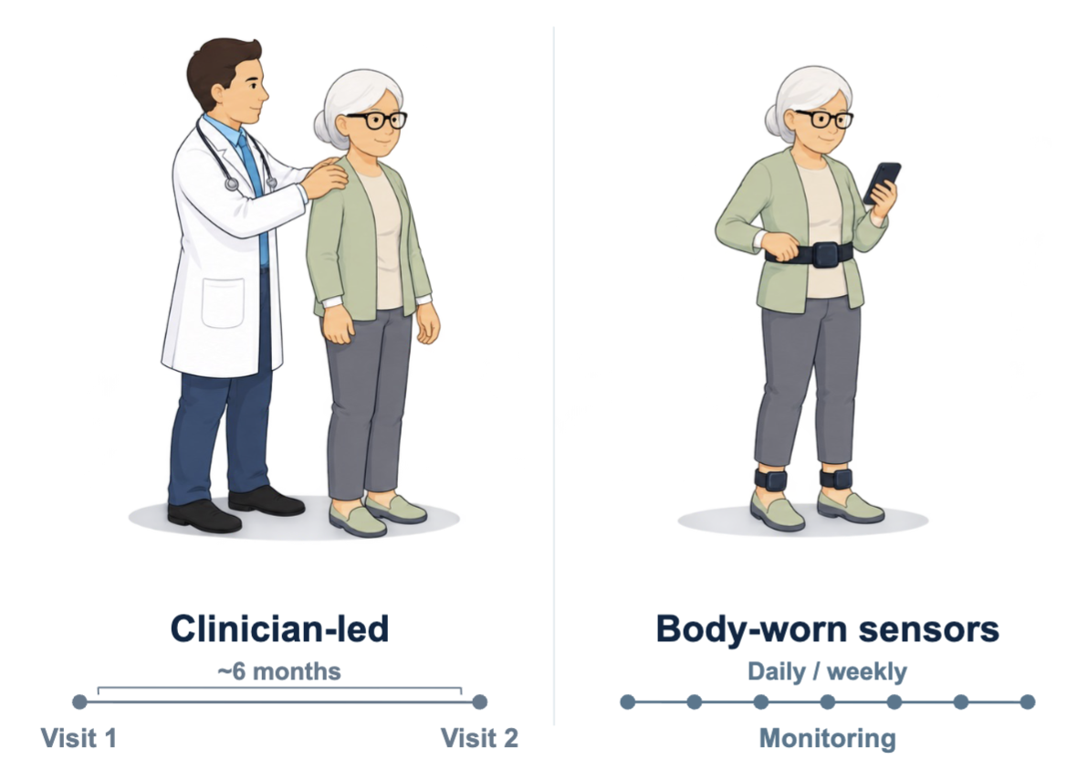
PIGD Needs Frequent Assessment
Postural instability and gait difficulty affect standing, walking, and fall risk
Clinic visits give
intermittent snapshots
Frequent measurements support
treatment review between visits.
Patients need a repeatable
home assessment.
PIGD Needs Frequent Assessment
2

Slide 3
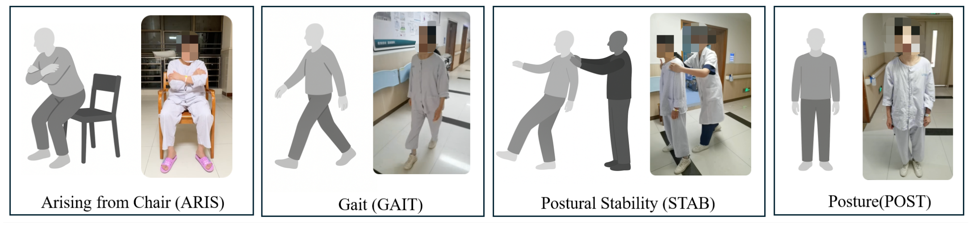
Clinical PIGD Assessment
Four UPDRS motor items describe different aspects of axial function
3.9 ARIS | 3.10 GAIT | 3.12 STAB | 3.13 POST
Arising from chair | Gait | Postural stability | Posture
The clinician observes each item and assigns a severity score
3

Slide 4
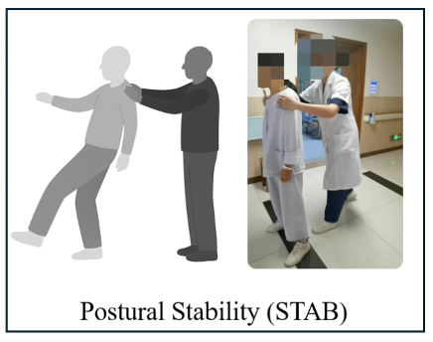
The Pull Test Limits Home Self-Assessment
Postural stability usually requires a clinician to perturb the patient’s balance
A backward pull requires
physical assistance
Home movements must reveal
clinically meaningful balance deficits.
Can cognitive load provide
a useful balance probe?
4

Slide 5
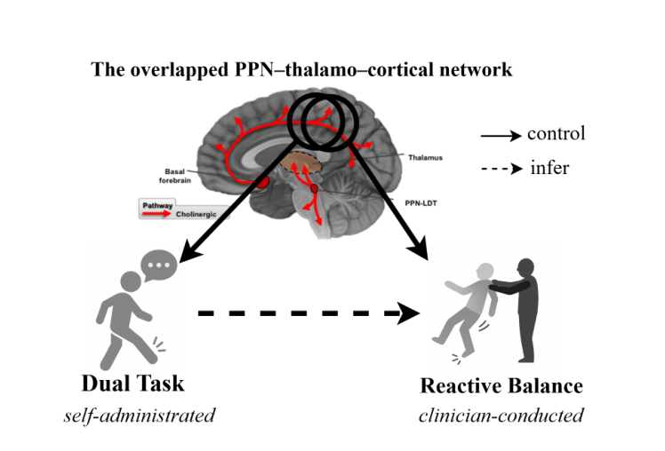
Observation: Dual-Task Sensing
Combining single-task and dual-task features improves PIGD estimation
Cognitive load
probes balance control
STAB macro-F1: 0.27 (ST) to 0.58 (ST + DT)
5

Slide 6
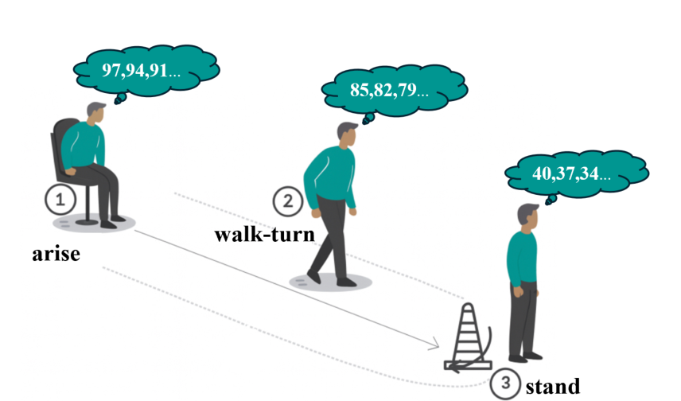
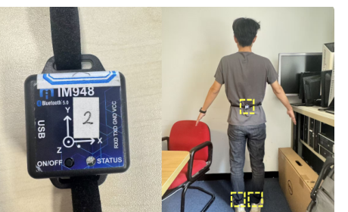
PIGDAssess: A Short Wearable Protocol
Three IMUs record three actions under single-task and dual-task conditions
3 commodity IMUs
Lumbar + both feet
50 Hz
Single task: movement only
Dual task: serial-3 subtraction
Walk two laps along a 3 m path with turns; stand for 30 s
6

Slide 7
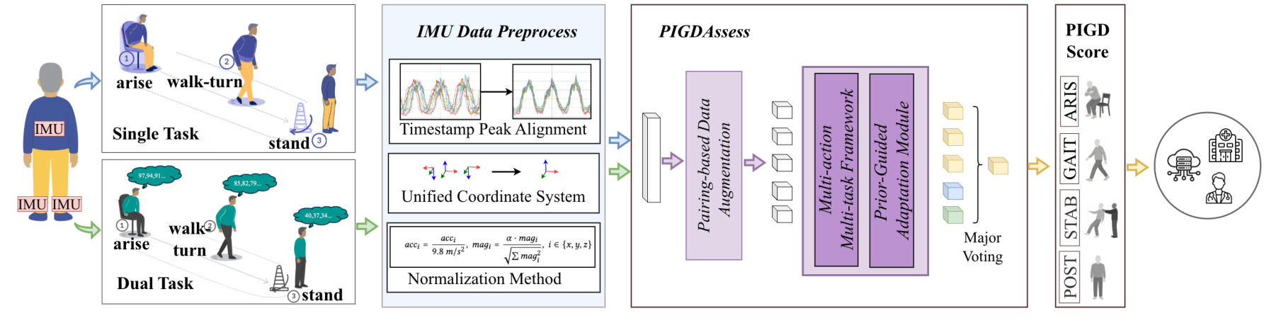
PIGDAssess Overview
Paired motion signals produce four item-level PIGD scores
Paired ST/DT encoding
Action-weighted scoring
Prior-guided adaptation
7

Slide 8
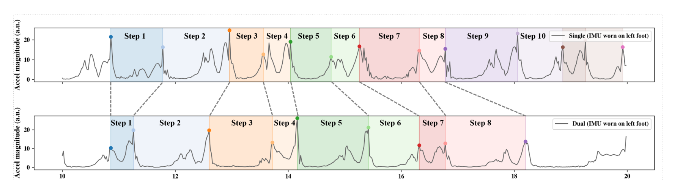
Challenge 1: ST/DT Trial Mismatch
The same timestamp can correspond to different movement phases
ST and DT differ in pace, step count, and gait phase.
Naive time matching introduces phase mismatch
that can obscure useful ST/DT contrasts.
8

Slide 9
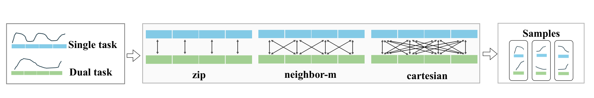
Design 1: Paired ST/DT Encoding
Structured pairing and shared encoding retain both movement conditions
1 Segment and pair short windows for each action
3 s for arise; 10 s for walk–turn and stand
Zip: corresponding
Neighbor: nearby
Cartesian: all pairs
2 Encode paired windows with a shared ResNet1D
Within each action, concatenate ST and DT embeddings
into one action token for downstream scoring.
9

Slide 10
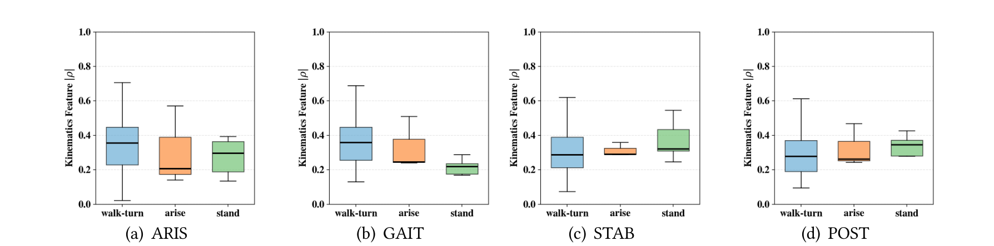
Challenge 2: Overlapping Action Cues
Three actions contribute differently to four clinical items
One action can reveal several impairments.
The most informative action differs across clinical items.
A fixed fusion can dilute item-specific evidence.
10

Slide 11
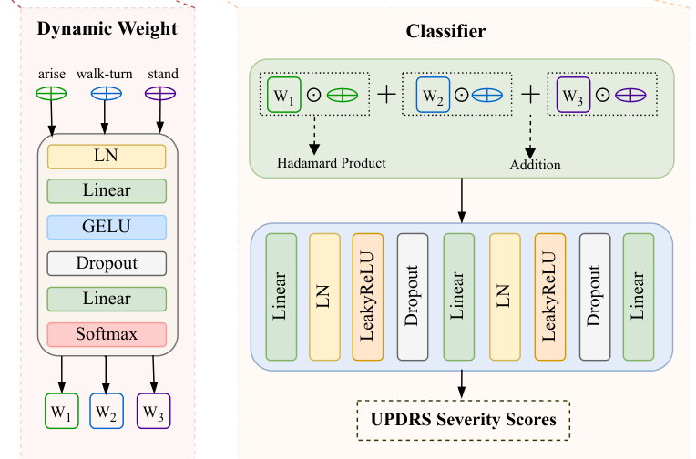
Design 2: Action-Weighted Task Heads
Each clinical item learns sample-specific weights over the three actions
1 Score action tokens
Use paired ST/DT features from
arise, walk–turn, and stand.
2 Normalize with softmax
Produce action weights for
this item and this sample.
3 Fuse and classify
Weighted sum of action tokens
predicts item severity.
Four heads share the action encoders
ARIS · GAIT · STAB · POST
11

Slide 12
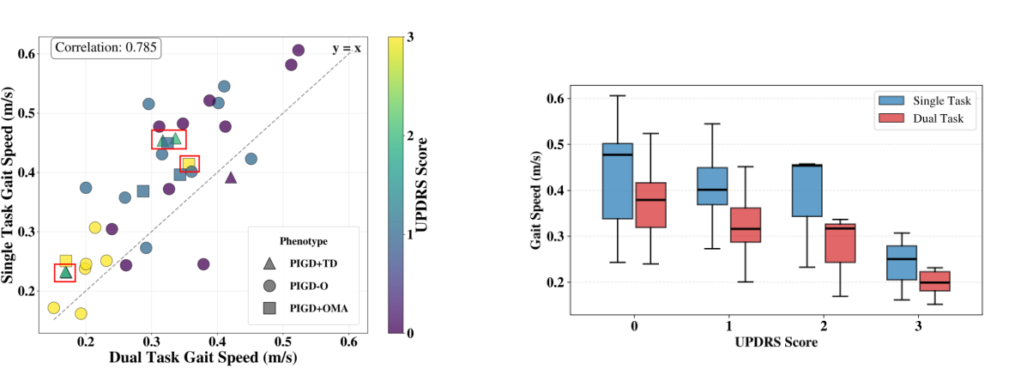
Challenge 3: Patient Variation
The same clinical severity can produce different movement patterns
Same score,
different motion
Motor symptoms and
compensation alter
movement patterns.
Score levels are ordered
Patient variation can mask severity; removing it
can also blur the ordered clinical levels.
12

Slide 13
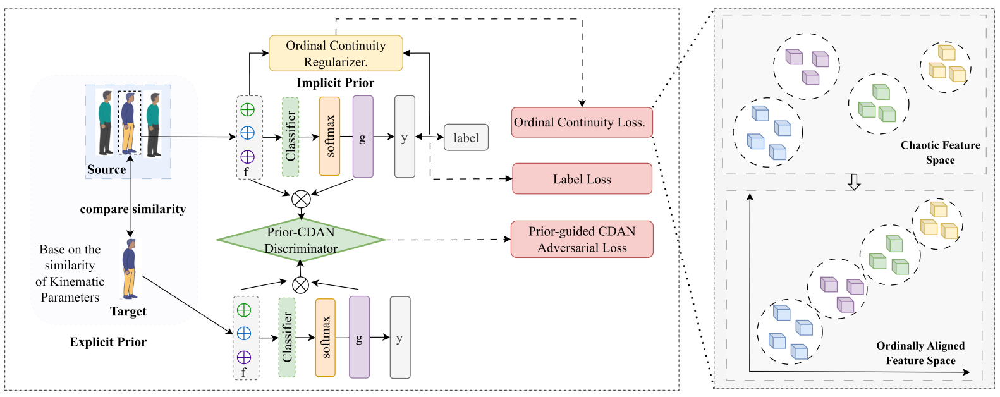
Design 3: Prior-Guided Adaptation
Kinematic similarity and ordinal continuity constrain feature alignment
1 Kinematic prior
2 Prior-CDAN
3 Ordinal continuity
Pair source and target
by motion similarity.
Align features using
predicted severity.
Encourage nearby features
for neighboring scores.
Adaptation uses unlabeled IMU data from the target participant
13

Slide 14
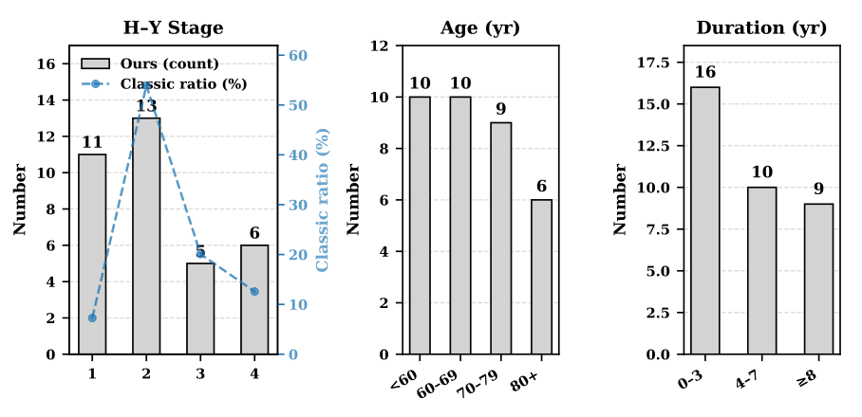
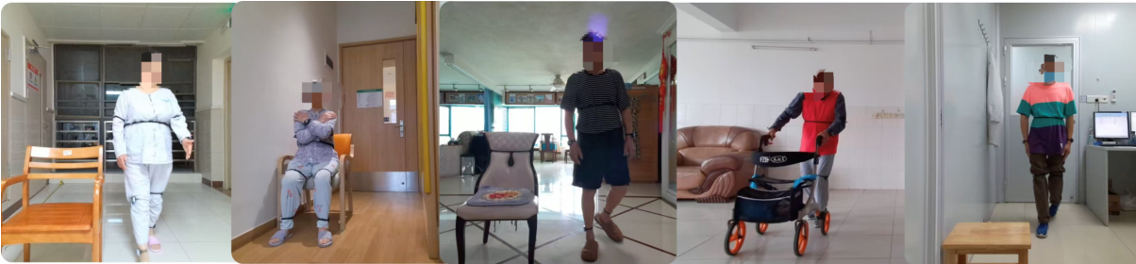
PIGDAssess Evaluation
35 participants with Parkinson’s disease in clinical and home settings
35 participants
20 women and 15 men
About 6 hours of IMU data
More than 3 trials per condition
Two neurologists independently
scored all four clinical items
Clinical settings and patients’ homes
14

Slide 15
PIGDAssess Evaluation
The system achieves 0.87 macro-F1 across the four PIGD items
Item | Acc | F1 | MAE
ARIS | 0.88 | 0.91 | 0.16
GAIT | 0.79 | 0.84 | 0.29
STAB | 0.89 | 0.92 | 0.16
POST | 0.75 | 0.79 | 0.40
0.83 Accuracy 0.87 Macro-F1 0.25 MAE
LOSO trial-level results with sample voting and unlabeled target adaptation
15

Slide 16
Ablation: Each Component Contributes
The full model improves sample-level macro-F1 from 0.55 to 0.75
Prior-CDAN replaces standard CDAN in the final model
10-fold user-independent CV, sample-level predictions without voting
16

Slide 17
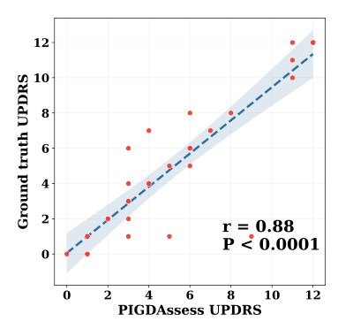
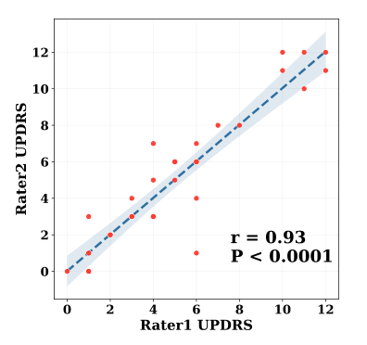
Agreement with Clinician Scores
PIGDAssess total scores correlate strongly with clinician consensus
System vs. consensus
Clinician vs. clinician
Pearson r = 0.88
Pearson r = 0.93
17

Slide 18
Robustness in Different Test Conditions
Performance remains stable across rooms and walking distances
Path length (macro-F1)
Missing IMUs (macro-F1)
Corridor / room: 0.86 / 0.86 macro-F1
The lumbar sensor contributes most
to robust scoring
18

Slide 19
Clinician Feedback and Next Steps
Four neurologists reviewed patient-level predictions and deployment needs
4.75 / 7
Priorities for home use
Longitudinal reliability
and repeatability
Mean confidence in individual results
Clear interpretation of scores
and clinical oversight
Remote triage
was the most selected use case
Larger and more diverse
external validation
19

Slide 20
Takeaways
Cognitive load reveals useful PIGD information
Paired single-task and dual-task IMU signals support home assessment.
One short protocol estimates all four items
Three wearable IMUs and action-weighted scoring include postural stability.
Strong agreement in a 35-participant study
0.87 trial-level macro-F1 and Pearson r = 0.88 with clinician total scores.
20

Slide 21
Thank you!
Yizhen Zhang: yzhangtf@connect.ust.hk
Paper: doi.org/10.1145/3810193
Dataset: zenodo.org/records/19450832
21

