Slide 1
Hotel Booking Analysis
Focus on Hotel Guest Information
Team 16:
42054011 Jiachong Li
42054057 Shiyu Wei

Slide 2
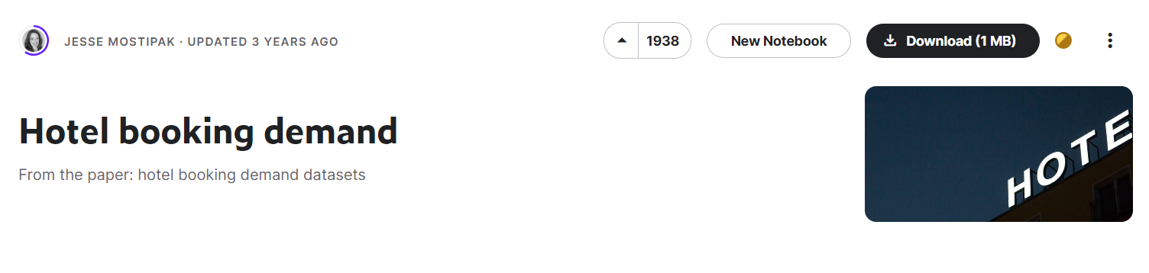
Dataset: Hotel Booking Demand
when the booking was made
length of stay
This data set contains booking information for a city hotel and a resort hotel, assisting the analysis about the trend of coming guests, average daily rate and the customer persona.
the number of adults, children, and/or babies
the number of available parking spaces
and so on…

Slide 3
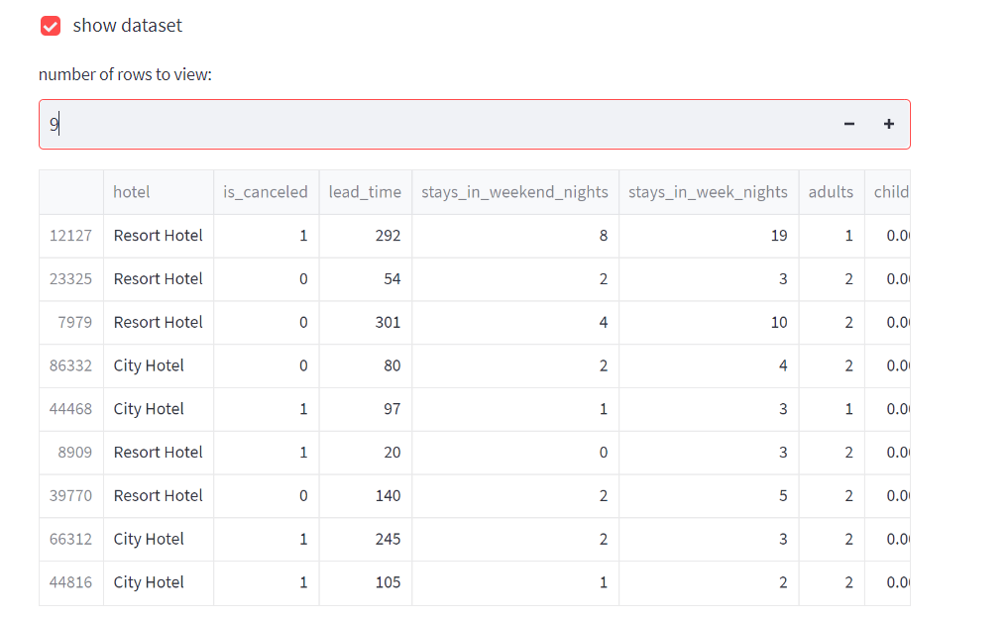


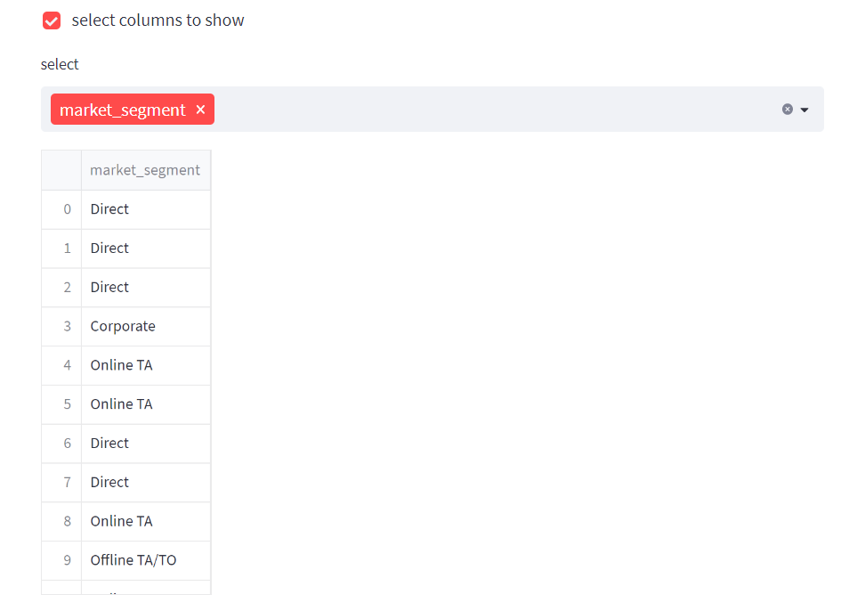
Dataset: Hotel Booking Demand
man-machine interaction
input
output
enter number (1-1000)
relevant data
select indicator

Slide 4

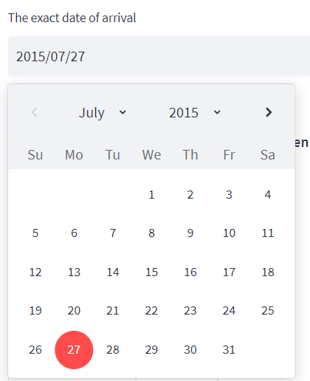
Analysis
1. The trend of the coming guests
view of the calendar (from 2015-07-01 to 2017-08-31)
arrival number display (from the individual and the whole)
chart type: bar chart, line chart, table
*date selection

Slide 5
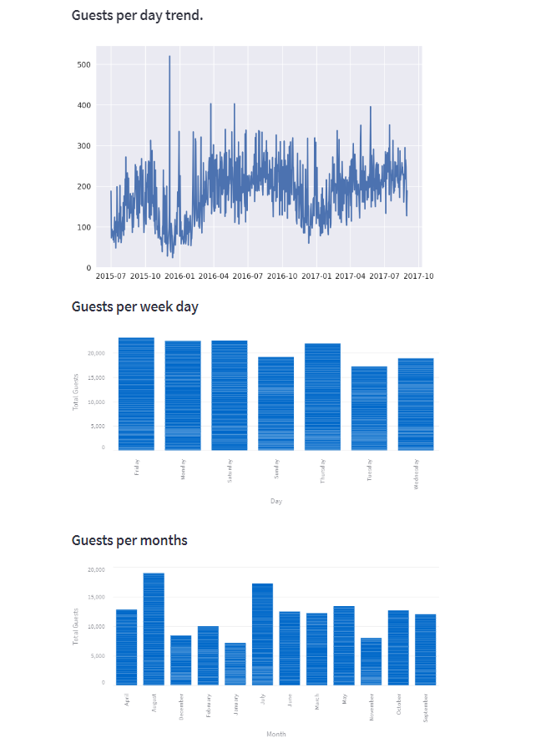
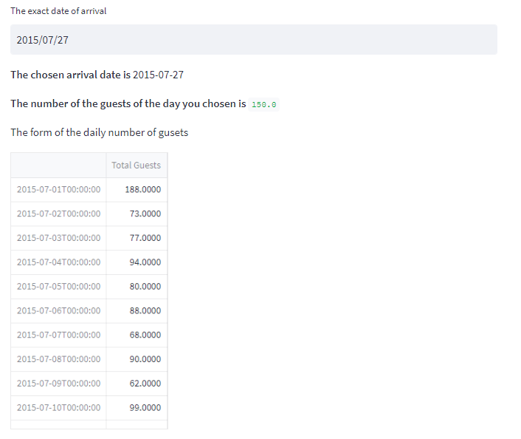
Analysis
1. The trend of the coming guests
specific arrival on one day
*150 is the number of the
guests of 2015-07-27
general table of daily arrival number

Slide 6
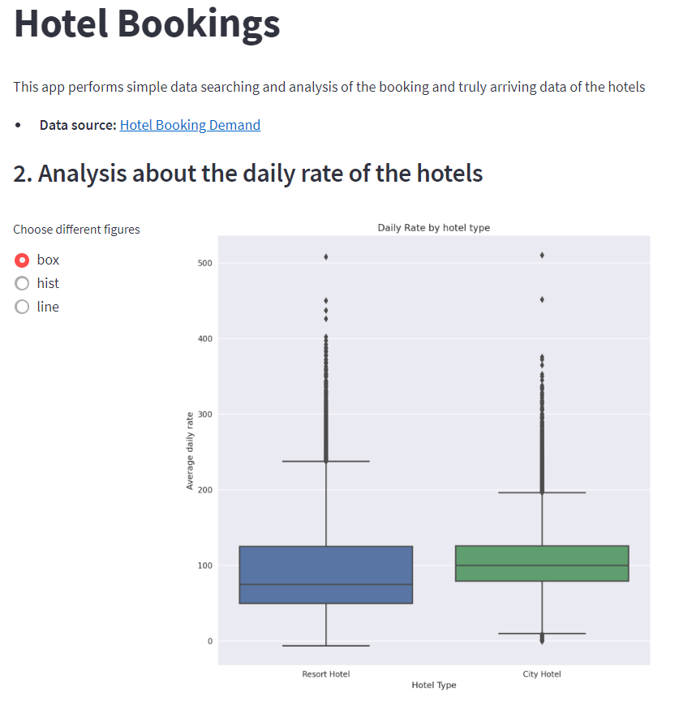
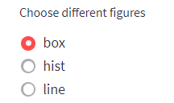

Analysis
2. Average daily rate
Average Daily Rate = $\frac{Sum of All Lodging Transactions}{Total Number of Staying Nights}$
Different Figure Choices
box
hist
line

Slide 7
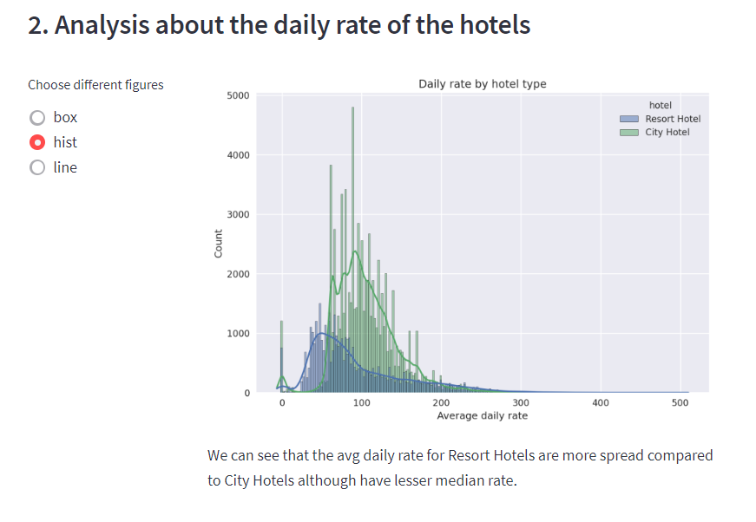
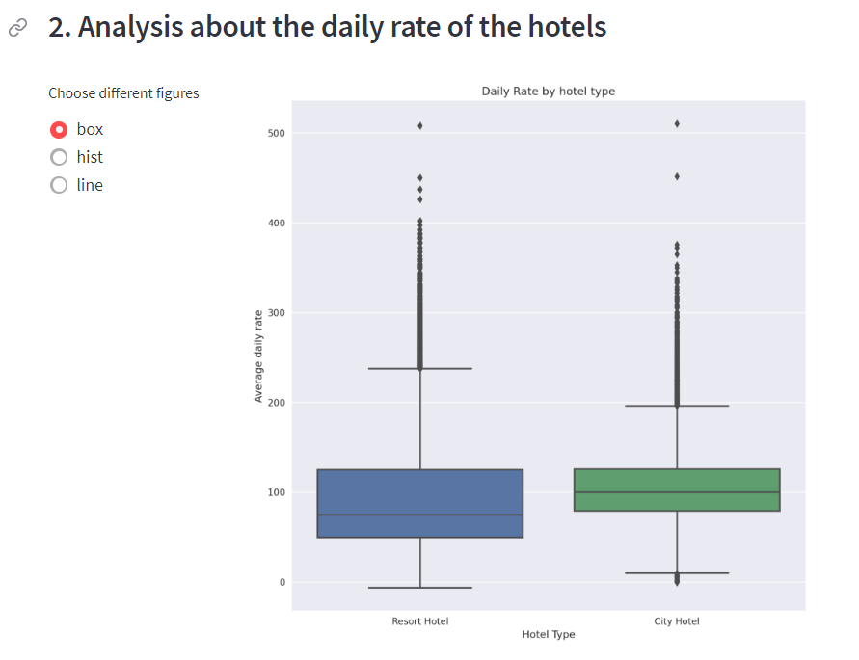
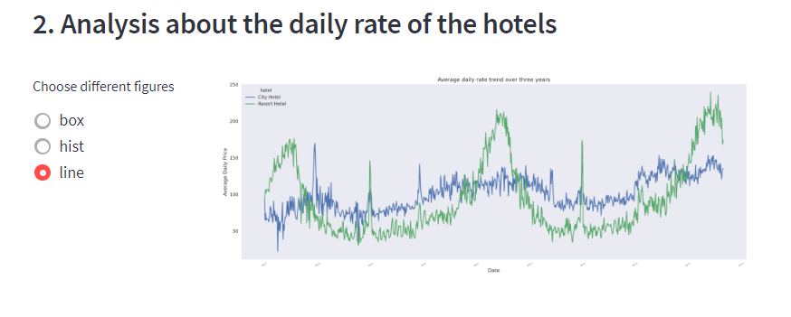
Analysis
2. Average daily rate
*hist plot
*box plot
*line plot

Slide 8
Analysis
3. The customer persona
Customer group information
Customer preference analysis
focus on
Types of customer
Distribution of nationality

Slide 9
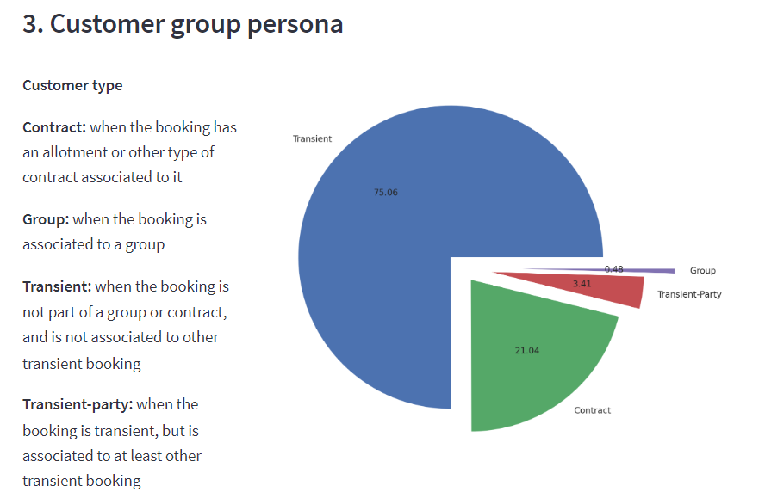
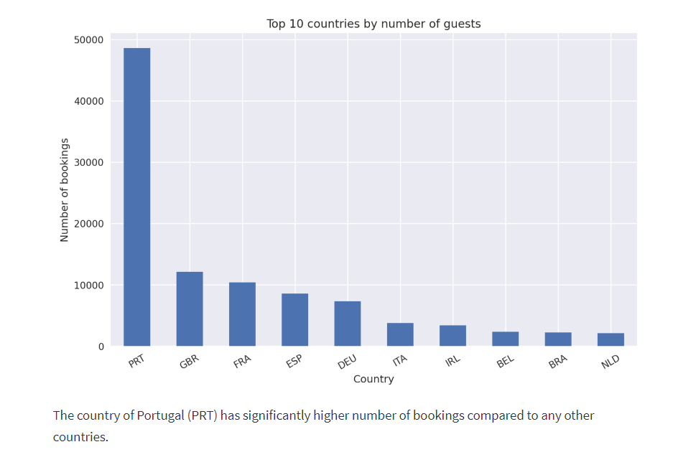
Analysis
3. The customer persona

Slide 10
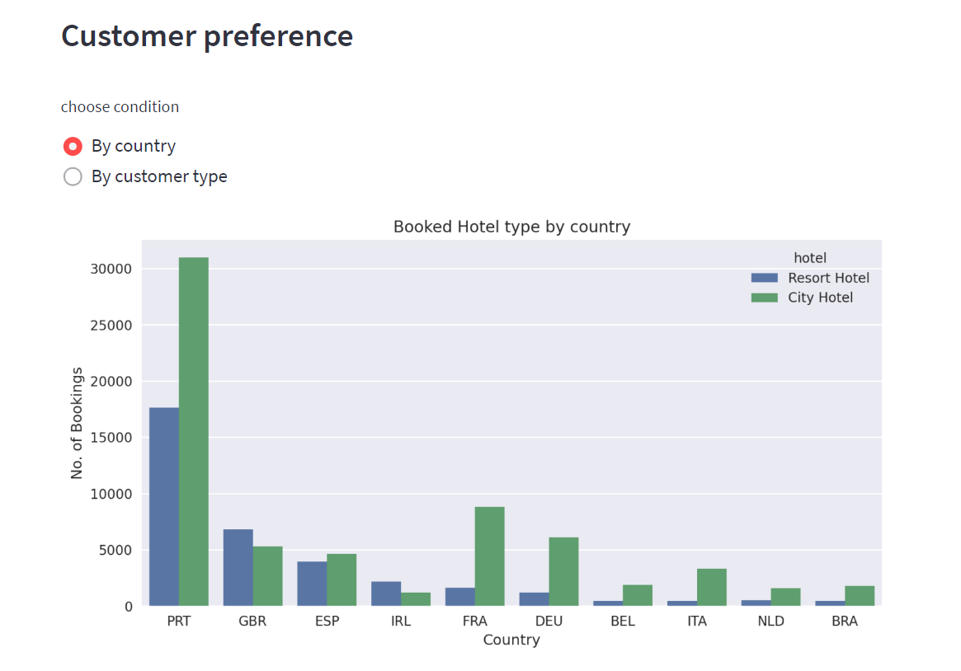
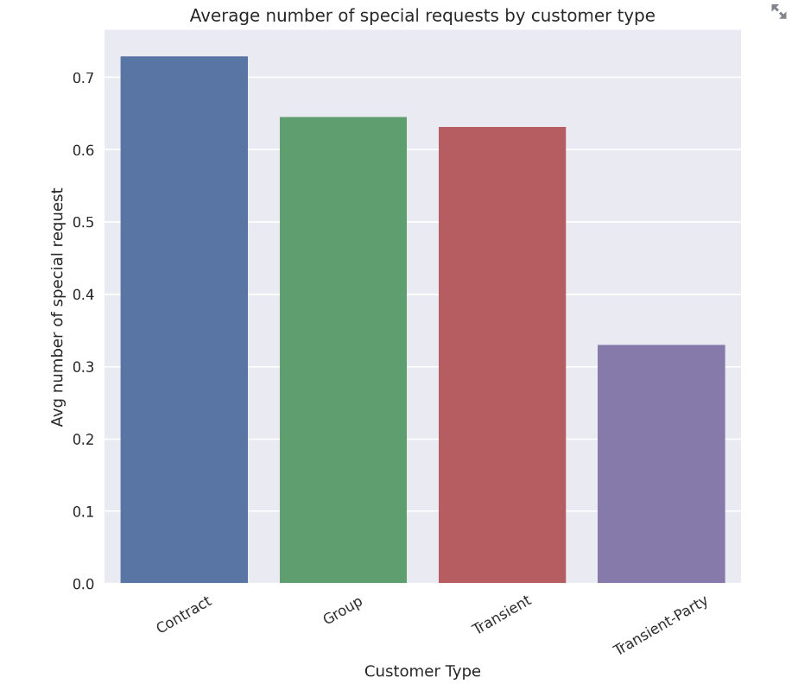
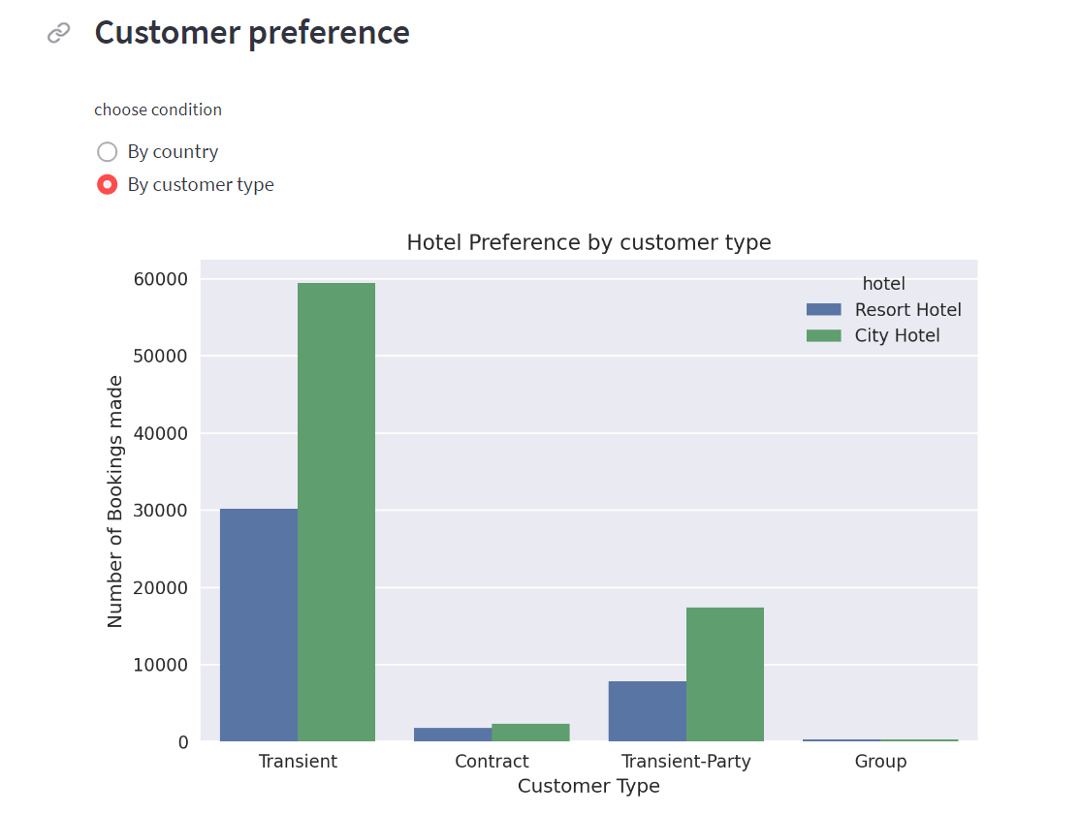
Analysis
3. The customer persona

Slide 11
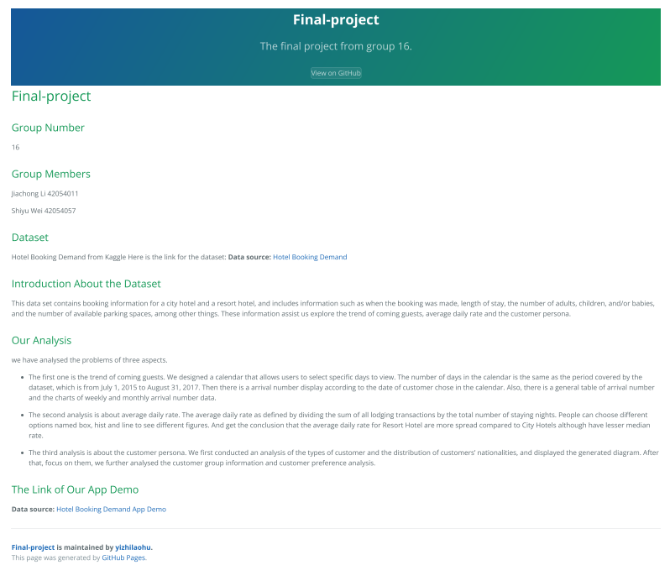
Data App Demo
The link to our final-project:
https://yizhilaohu.github.io/Final-project/
link of the app demo
*screenshot of the homepage

Slide 12
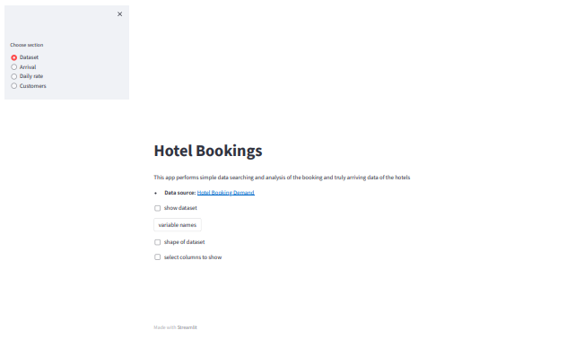
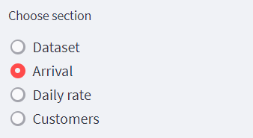
Data App Demo
The link to our final-project:
https://yizhilaohu.github.io/Final-project/
link of the dataset
buttons for interface switch
*screenshot of the app demo

