Slide 1
Inverse Rational Control (Package)
Zhe Li

Slide 2
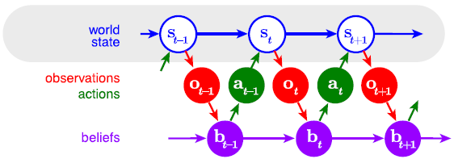
Hypothesis
Animal behavior is not optimal, but rational.
Suboptimal behavior = optimal policy + incorrect assumptions
Wu et al, 2020

Slide 3
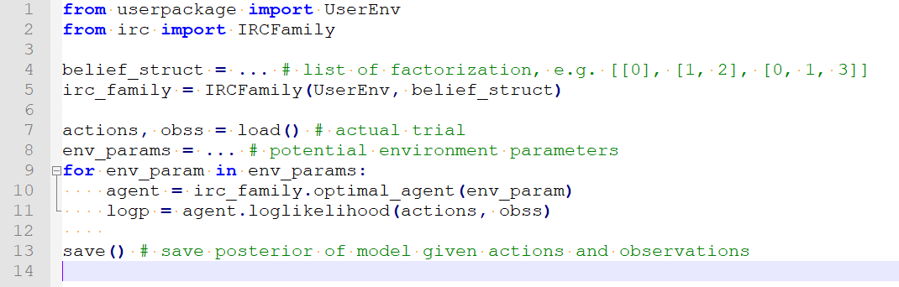
Usage template

Slide 4
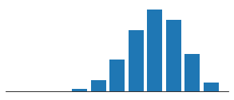
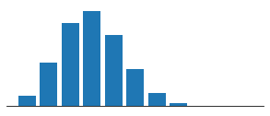
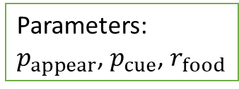
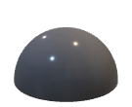



Minimal example: single-box foraging
has food: $p_{cue}$
no food: $1−p_{cue}$
Parameters:
$p_{appear}$, $p_{cue}$, $r_{food}$
push cost: 1

Slide 5
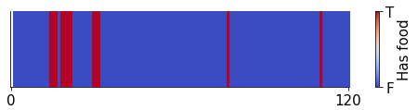
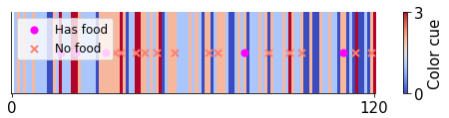
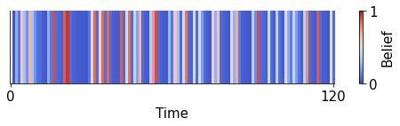
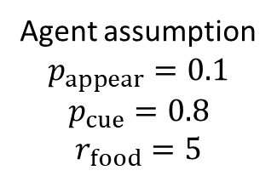
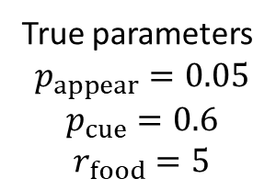
A suboptimal agent
True parameters
$$p_{appear}=0.05$$
$$p_{cue}=0.6$$
$$r_{food}=5$$
Agent assumption
$$p_{appear}=0.1$$
$$p_{cue}=0.8$$
$$r_{food}=5$$

Slide 6
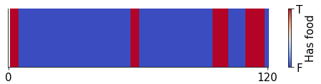
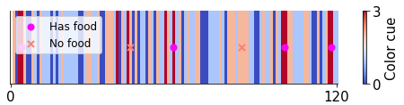
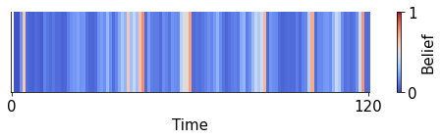
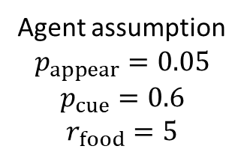
An optimal agent
True parameters
$$p_{appear}=0.05$$
$$p_{cue}=0.6$$
$$r_{food}=5$$
Agent assumption
$$p_{appear}=0.05$$
$$p_{cue}=0.6$$
$$r_{food}=5$$

Slide 7
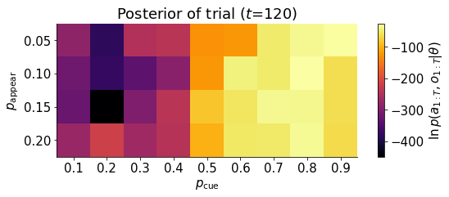
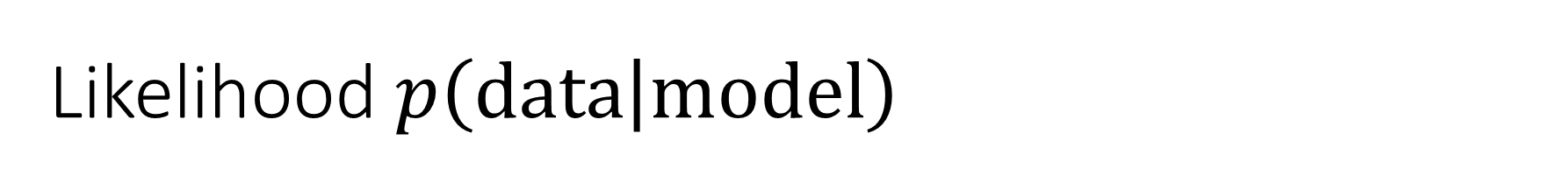
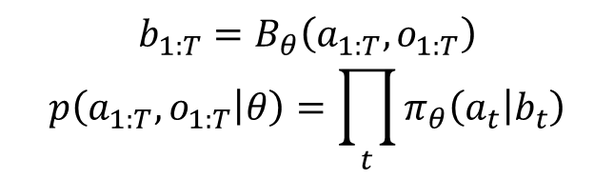
Likelihood $p\left(data | model\right)$
$$b_{1:T}=B_{θ}\left(a_{1:T},o_{1:T}\right)$$
$$p\left(a_{1:T},o_{1:T} | θ\right)=\prod_{t}{π_{θ}\left(a_{t} | b_{t}\right)}$$
Likelihood

Slide 8
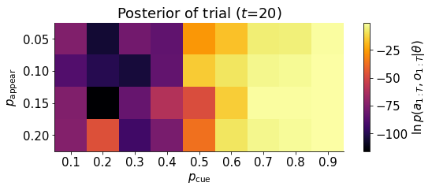
Fewer data
Likelihood

Slide 9
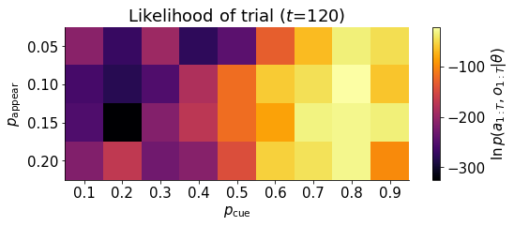
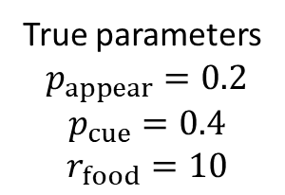
Different real environment
True parameters
$$p_{appear}=0.2$$
$$p_{cue}=0.4$$
$$r_{food}=10$$

Slide 10
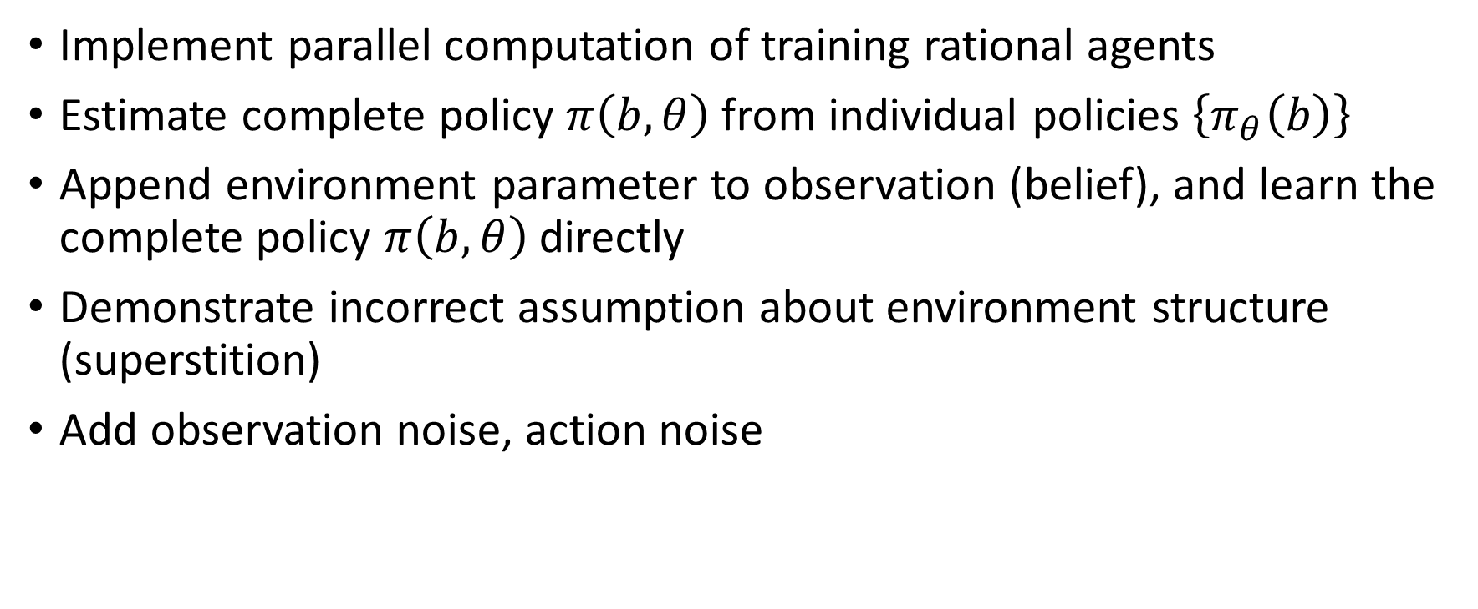
Next steps
Implement parallel computation of training rational agents
Estimate complete policy $π\left(b,θ\right)$ from individual policies $\left\{π_{θ}\left(b\right)\right\}$
Append environment parameter to observation (belief), and learn the complete policy $π\left(b,θ\right)$ directly
Demonstrate incorrect assumption about environment structure (superstition)
Add observation noise, action noise
Notes:
jax, brax

