Slide 1
Lee’s Wire Routing Algorithm

Slide 2
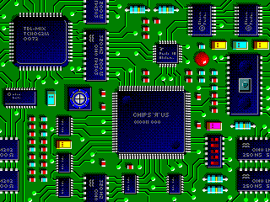
Application of Queue: Wire Routing
Select paths to connect all pairs of pins that need to be connected together.
An important problem in electronic design automation.

Slide 3
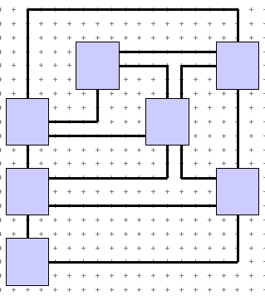
A Simplified Problem
Condition: We have all blocks laid on the chip. We also have some of the wires routed.
Problem: We want to connect the next pair of pins.
Constraint: we can only draw wires horizontally or vertically.
End Pin
Start Pin

Slide 4
Modeling as a Grid
Start Pin
End Pin
Blue squares are blocked squares.
Orange squares are available to route a wire.
How to find a path from the start pin to the end pin?

Slide 5
Wire Routing: Lee’s Algorithm
A queue of reachable squares from the start pin is used.
The cell of the start pin is set with a distance value of 0.
It is enqueued into an initial empty queue.
While the queue is not empty.
A cell is dequeued from the queue and made the examine cell.
Is the examine cell the end pin? If yes, path found and return.
Otherwise, all unreached unblocked squares adjacent to the examine cell are marked with their distance (this is 1 more than the distance value of the examine cell) and enqueued.
When queue becomes empty but not reach end pin yet, means no path found.

Slide 6
Illustration of Lee’s Algorithm
start pin
end pin
1
0
1
Expand “0”
queue: 0

Slide 7
Illustration of Lee’s Algorithm
start pin
end pin
2
1
0
1
2
2
Expand right “1”
queue: 1, 1
Notes:
Now the queue becomes 1,1, since 0 is removed and two 1’s are added.

Slide 8
Illustration of Lee’s Algorithm
start pin
end pin
2
2
1
0
1
2
2
2
Expand left “1”
queue: 1,2,2,2
Notes:
Now the queue becomes 1,2,2,2.

Slide 9
Illustration of Lee’s Algorithm
start pin
end pin
2
2
1
0
1
2
2
2
Expand and reach all squares 3 units from start.
Notes:
It is like expand and reach all squares 2 units from start.

Slide 10
Illustration of Lee’s Algorithm
start pin
3
3
end pin
2
2
1
0
1
2
2
2
3
3
Expand and reach all squares 4 units from start.

Slide 11
Illustration of Lee’s Algorithm
start pin
4
3
3
end pin
2
2
1
0
1
2
2
2
3
4
3
4
4
4
Expand and reach all squares 5 units from start.

Slide 12
Illustration of Lee’s Algorithm
5
start pin
4
5
3
3
end pin
2
2
1
0
1
2
2
2
3
4
3
4
5
4
4
5
5
5
Expand and reach all squares 6 units from start.

Slide 13
Illustration of Lee’s Algorithm
6
5
6
start pin
4
5
3
3
end pin
2
2
1
0
1
2
2
2
6
3
4
3
4
5
6
4
4
5
6
5
6
5
6
6
End pin reached. Trace back.

Slide 14
Illustration of Lee’s Algorithm
6
5
6
start pin
4
5
3
3
end pin
2
2
1
0
1
1
2
2
2
2
6
3
4
3
3
4
4
5
5
6
4
4
5
6
5
6
5
6

