Slide 1
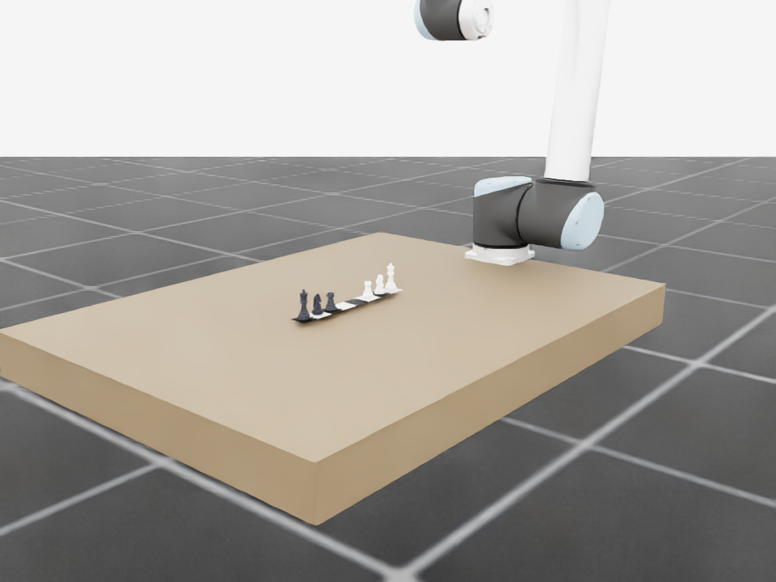
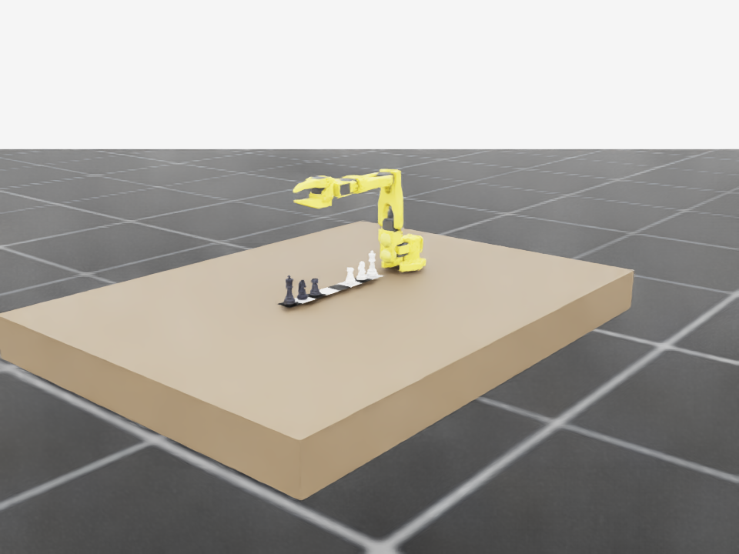
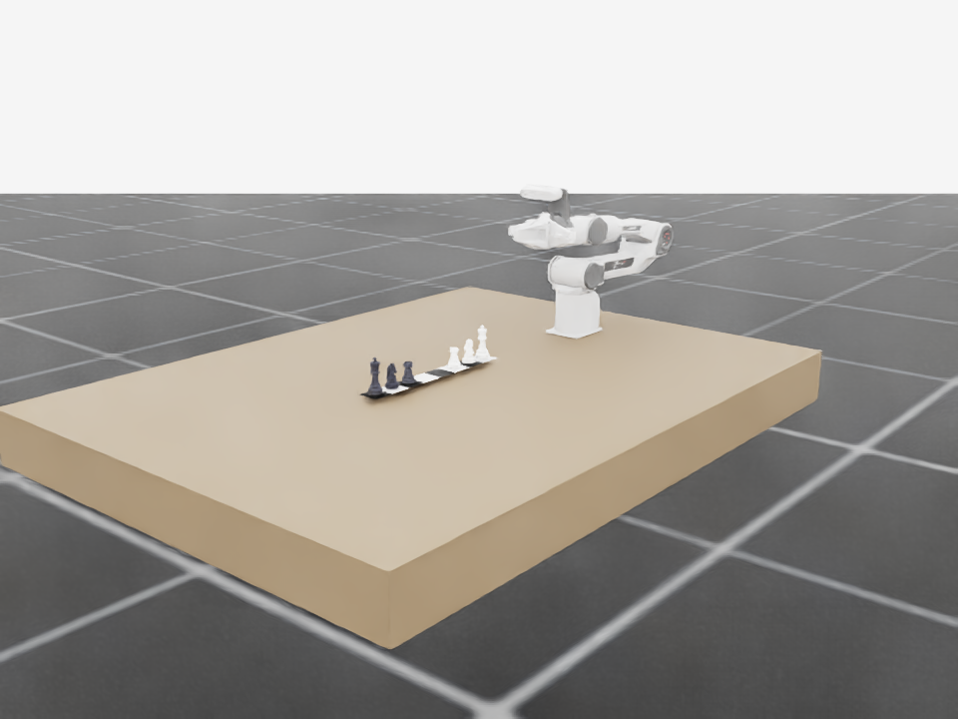
RoboChess
A configurable Isaac Lab task for sim-to-real robot learning
CoRL 2026 Workshop • Sim-Real Robot Learning
From board configuration to embodiment diversity — a single-arm visual task ready for policy development.
Implementation snapshot • August 2026

Slide 2
Why RoboChess? A compact testbed for the sim-to-real gap
A challenge format makes perception, manipulation, planning, and robustness measurable together.
Perceive
Manipulate
Generalize
Board state, piece identity, pose, and camera variation.
Pick, place, avoid collisions, and execute legal moves.
Across simulators, robot embodiments, and real-world perturbations.
Workshop research questions
Uniform, quantitative evaluation of robot-learning methods
RoboChess contribution
A standardized sim-to-real manipulation challenge that combines chess reasoning with physical execution.
From visually plausible rollouts to repeatable long-horizon task solving
Robustness under lighting, viewpoint, object-pose, and embodiment shifts
Source: CoRL 2026 workshop proposal and challenge site
RoboChess × Isaac Lab
2 / 5

Slide 3
Isaac Lab task: one interface, four chess scales, six embodiments
Manager-based scene configuration keeps the first visual stage simple and composable.
Chess scenario argument
Robot argument
1D
3 × 3
4 × 4
8 × 8
SO-101
Piper
UR10
six-piece line
pawn microgame
minichess
standard chess
Flexiv Rizon
Rebot
YAM
Launch contract
python scripts/zero_agent.py --task RoboChess-UR10-Visual-v0 --chess_scenario 1d --robot ur10
Local chess USD assets • table and camera • stationary single-arm visual scene • no teleoperation
RoboChess × Isaac Lab
3 / 5

Slide 4
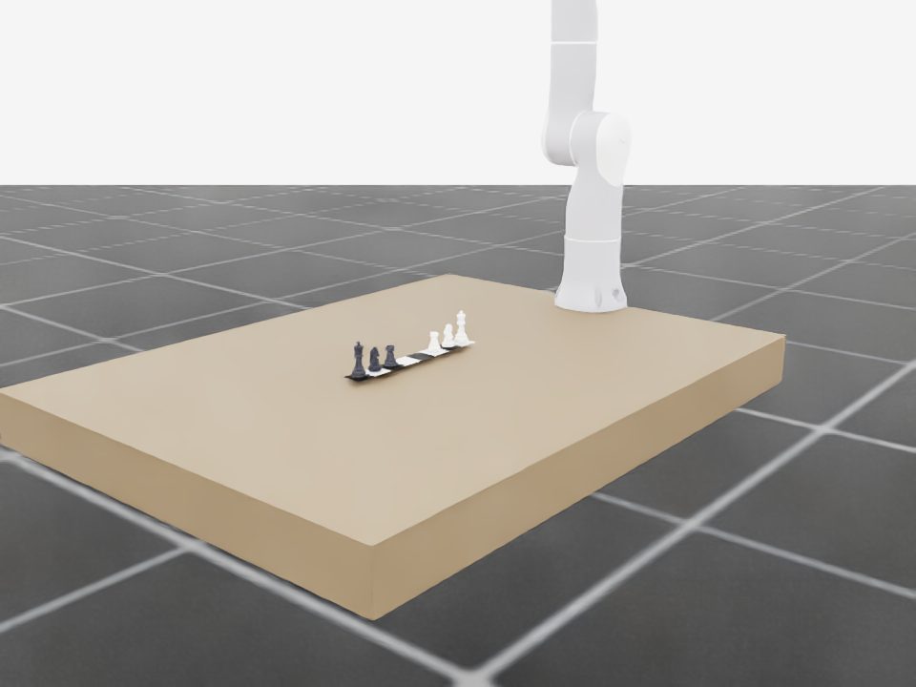
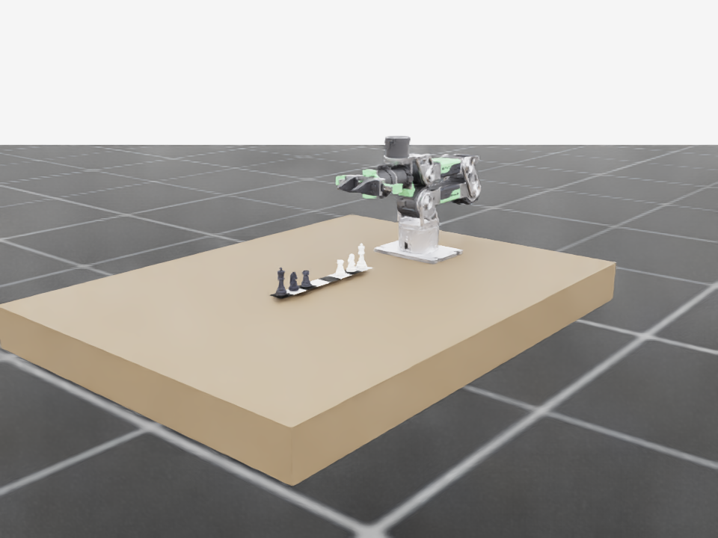
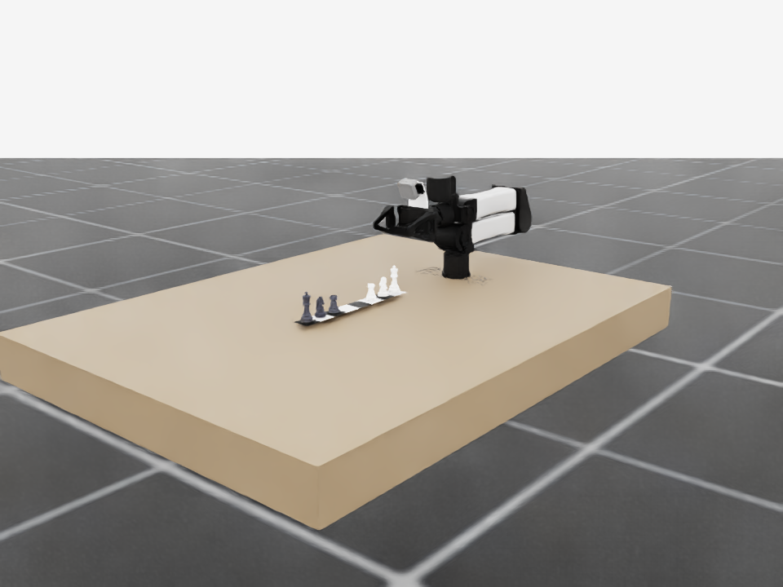
Visual validation: 1D chess rendered across robot options
The corrected camera explicitly targets the tabletop, chess pieces, and robot workspace.
SO-101
Piper
UR10
Flexiv Rizon
Rebot
YAM
All six configurations were instantiated for the same 1D board layout. These are scene-validation renders, not policy results.
RoboChess × Isaac Lab
4 / 5

Slide 5
From visual task to benchmark-ready learning loop
A staged path from reliable scene construction to reproducible sim-to-real evaluation.
01
02
03
04
Task mechanics
Learning interface
Robustness suite
Sim-to-real track
Piece poses, grasp logic, legal actions, and resets
Observations, rewards, success metrics, and baselines
Camera, lighting, pose, and embodiment randomization
Calibration, demonstrations, real robot evaluation
Current deliverable
A versioned Isaac Lab RoboChess scene with scenario and robot selection, local chess assets, and camera-validated renders.
References: CoRL 2026 Workshop Proposal • sites.google.com/view/corl-workshop-robochess/home
5 / 5

