Slide 1
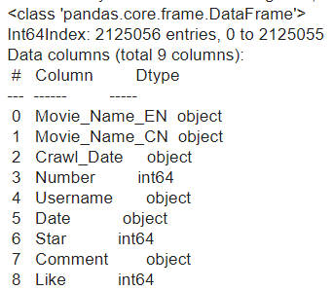
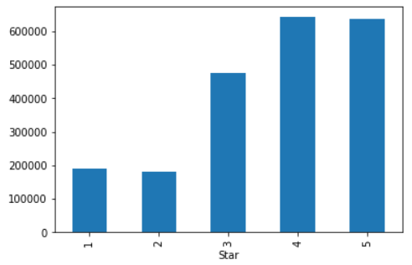
Dataset Overview
Over 200k+ reviews
Dataset contains 9 column, the key information for our study
Comment (in Chinese)
Stars
Notes:
In our Chinese Movie Review Dataset, there are over 200k+ reviews. Dataset contains 9 columns, but we only keep Chinese comments and stars as our key columns. Because our reviews have 200k+ which is really big, and within the reviews, there are more positive reviews than negative reviews. So we use randomization to balance the amount of reviews. And we only keep the useful information like the stars and reviews.

Slide 2
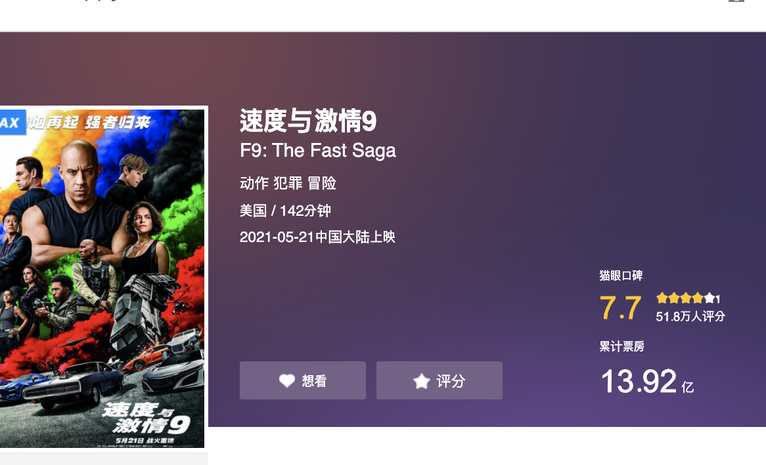
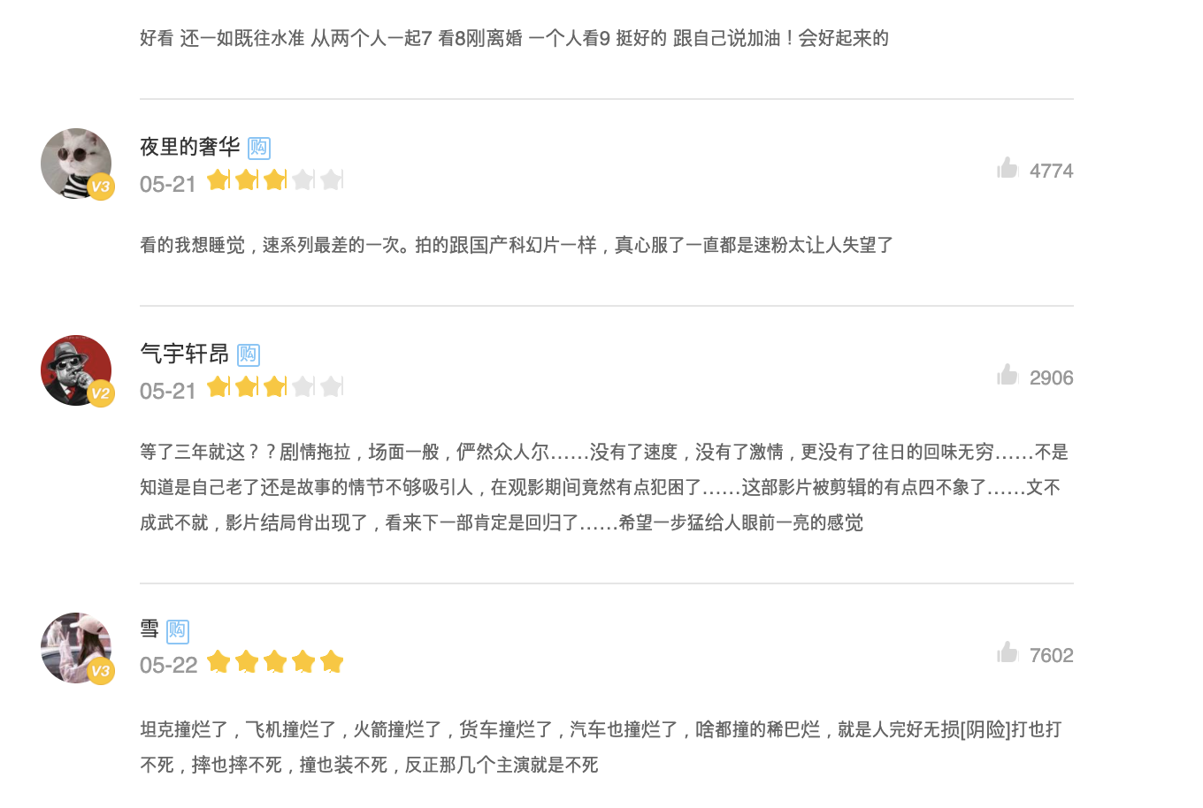

Slide 3
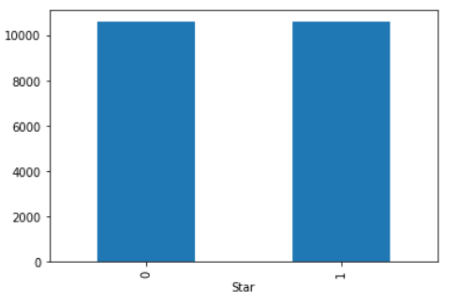
Train and test set construction
We sample same quantity of positive/negative reviews from each film
eliminate the potential impact of unbalanced total amount of positive/negative reviews and that of each film
Notes:
Because our reviews have 200k+ which is really big, and within the reviews, there are more positive reviews than negative reviews. So we use randomization to balance the amount of reviews. And we only keep the useful information like the stars and reviews.

Slide 4
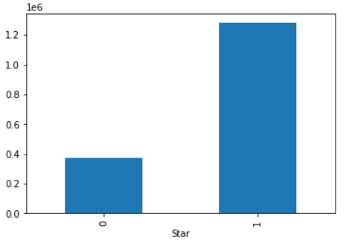
Preprocessing
Comment(in chinese)
Remove illegal characters and words with no meaning
Need to separate the words
#Import jieba
Stars
According to rule of Cat’s Eye, convert the stars to binary sentiment tag: positive(4-5) and negative (1-2)
“南京市长江大桥欢迎您”
南京市/长江/大桥/欢迎/您 ？ Welcome to the Yangtze River Bridge in Nanjing City
南京/市长/江大桥/欢迎/您 ？ Mr. Jiang Daqiao, Mayor of Nanjing city welcomes you
Notes:
step2: Data preprocessing
2.1. Using NLP to clean the reviews by removing the stopwords and punctuations， here we use Harbin Institute of Technolodgy's stopwords. Using NLP segmentation to convert text to key words, and here we use Chinese segmentation tool called Jieba.
a. Remove the punctuations
b. Use Jieba to segment the text
c. Remove the phrases if they displayed in the stopwords list

Slide 5
Word Vectorization
Method I : keras.tokenizer
Use jieba to separate the sentences
Use stopword list (from Harbin Institute of Technology) to filter meaningless words
Method II: Chinese Word Vector
100+ Chinese Word Vectors (embeddings) trained with different representations (dense and sparse), context features (word, ngram, character, and more), and corpora
Available at github https://github.com/Embedding/Chinese-Word-Vectors
sentences
Tuple of words
jieba
Word vector
Tokenizer.fit_on_text

Slide 6
Deep Learning Model
Fully Connect NN
Dense layers
RNN
Embedding
1D CNN
Embedding
Plain vanilla model
LSTM
1D CNN with different dimensions
Overview

Slide 7
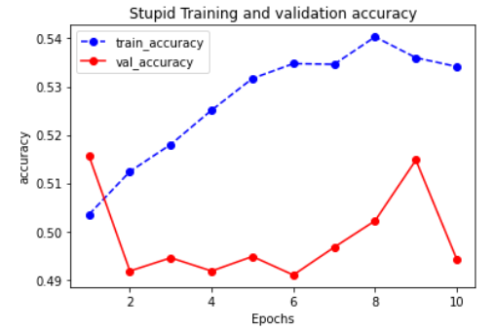
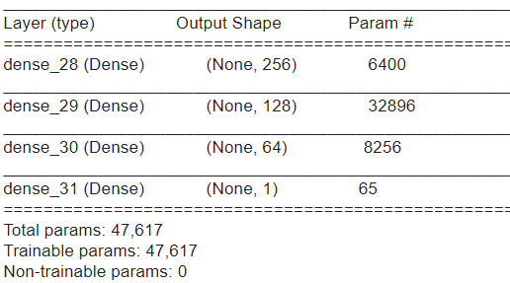
Deep Learning Model
FCNN ~ guess

Slide 8
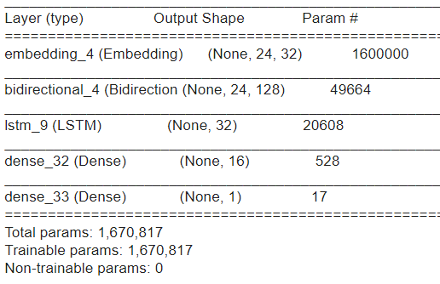
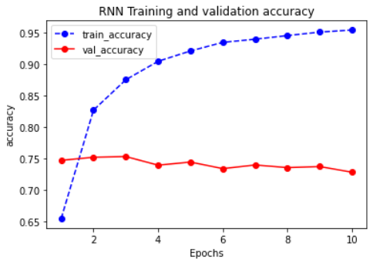
Deep Learning Model
RNN~75% accuracy, overfits started at epoch2(related to train set size)

Slide 9
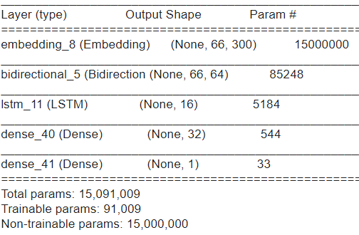
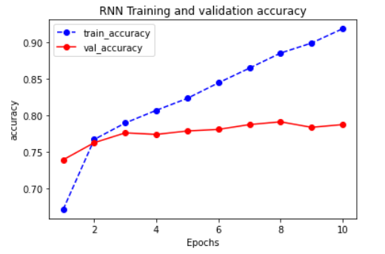
Deep Learning Model
RNN+ pre-trained embedding matrix~78% accuracy, overfits started at epoch3

Slide 10
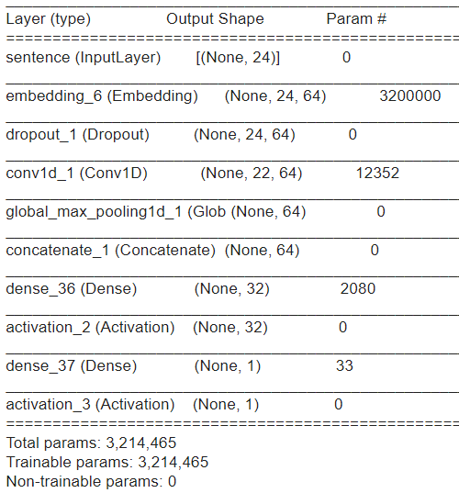
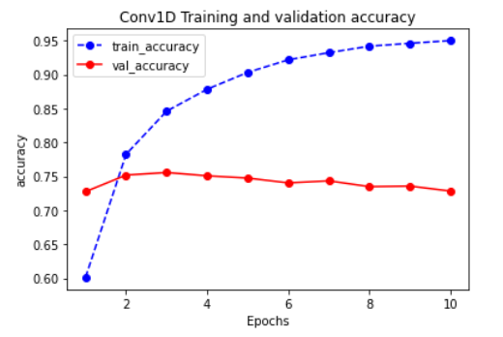
Deep Learning Model
CNN~75% accuracy overfit at 3rd epoch

Slide 11
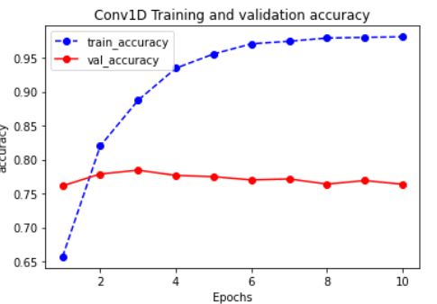
Deep Learning Model
CNN + pre-trained embedding matrix ~78% accuracy overfit at 3rd epoch

Slide 12
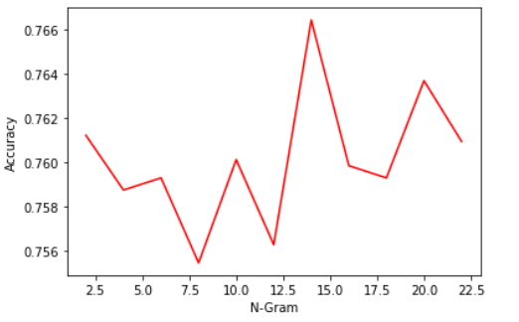
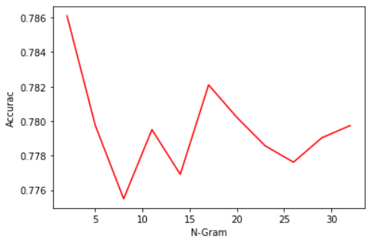
Deep Learning Model
Impact of CNN window size
Vectorization Method I
Vectorization Method II

Slide 13
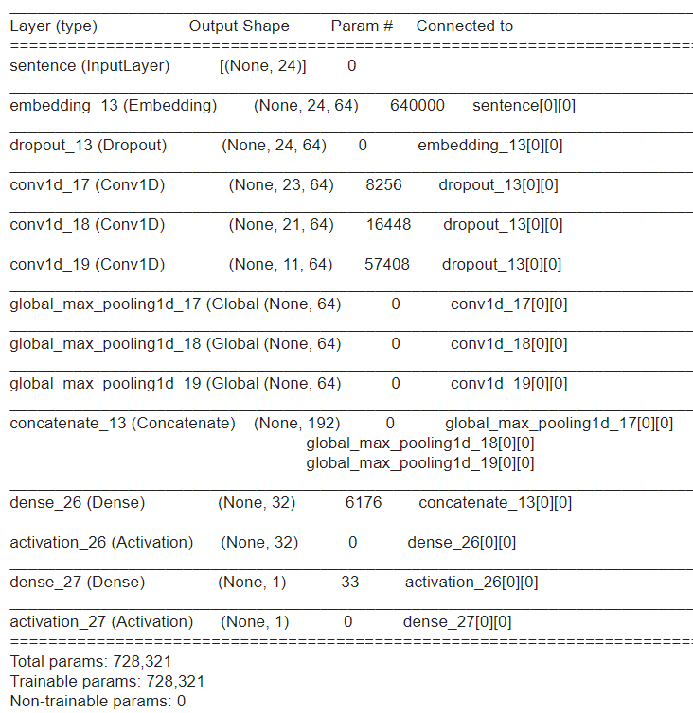
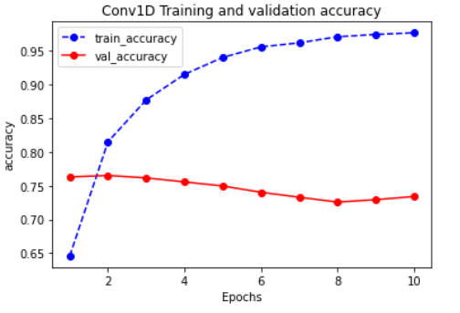
Deep Learning Model
Multiwindow: slightly improved, less fluctuation

Slide 14
Deep Learning Model
Calculation time (s/epoch)

Slide 15
Discussion
RNN效果最好，但最费时间。 CNN精度还可以的前提下，大幅减少时间
数据集体量下，模型还是比较容易over-fit的，后面可以考虑增加dropout（计算时间）和L1、L2正则调整。
关于如何向量化。由于Chinese Word Vector提供的词向量经过了预训练，可以将embedding层设置为不可训练，进而扩大CNN模型的广度。提高精度。而且这个模型相对不太容易overfit。
除此之外一些词语仍然难以识别，影响了学习效果。采用第一种向量化，这些词因为没有识别出来被作为停止词过滤掉了，导致关键信息漏掉。第二种向量化方式，也会因为可能不存在预训练向量中而被忽略 一些网络用语：因吹丝挺、城会玩、厉害了word哥、emmmmm、扎心了老铁 一些谐音词： 碉堡 特殊语境下的词：寡姐、美队、荷兰弟
下一步优化方向考虑建立本地特殊词字典，通过提高这些类别词的分词成功率使他们进入词向量。或者考虑使用其它预训练词向量，比如腾讯AI Lab的等等
电影评论不同于商品评价、酒店评价那样来的直接。大部分长文本影评里面有很多感性的描写，因此难度要大于亚马逊/酒店评价数据集。

