Slide 1


December 10
Introduction to Data Management and Processing
Amazon Electronic Product Reviews for Sentiment Analysis
Nishtha Sawhney
Yi Zu
Notes:
Jeff Bezos once said, 'We’re not competitor obsessed, we’re customer obsessed.' But what do customer reviews really tell us? That’s where sentiment analysis comes in.

Slide 2

Objectives and Goals
Use sentiment analysis model for processing informal text.
Analyze sentiment distribution across categories and ratings to identify customer satisfaction trends.
Visualize sentiment data with interactive charts like pie charts, bar charts, and stacked plots.
Generate in-depth insights from customer feedback through keyword and text analysis.
Notes:
2 mins

Slide 3
Project Scope
Dataset Parameters
Analyze 5,000 product reviews from Amazon Electronics category
Focus on reviews up to July 2014
Using publicly available Amazon product reviews dataset
Along with metadata
Key Deliverables
Processed and cleaned dataset
Sentiment analysis of reviews
Dashboard containing interactive visuals
Keyword analysis and trends
Notes:
Check what visualizations are needed

Slide 4

Existing Work:
Amazon Reviews Dataset Analysis (McAuley, J., & Leskovec, J. (2013)
Dataset Contribution
Established largest public Amazon review dataset (1996-2014)
Became industry standard for e-commerce research
Important Contribution
First large-scale integration of ratings and text analysis
Enabled analysis of user sentiment from unstructured, informal text like reviews, social media posts, and comments
offering real-world insights beyond structured surveys
Notes:
Source: https://cs.stanford.edu/people/jure/pubs/reviews-recsys13.pdf

Slide 5
Why is sentiment analysis for product reviews significant?
Reveals Hidden Factors Driving Ratings
Uncovers insights behind ratings, such as product features, pricing, durability, or customer service quality
Identifies Strengths and Weaknesses
Helps pinpoint specific aspects of the product that customers appreciate or dislike.
Enhances Product Development
Competitive Benchmarking
Builds Customer Trust
Demonstrates responsiveness to customer feedback, enhancing brand loyalty and trust.
Improves Marketing Strategies
Highlights customer-valued features in marketing campaigns.
Notes:
Source: https://cs.stanford.edu/people/jure/pubs/reviews-recsys13.pdf

Slide 6
Data Preprocessing
Notes:
1 minute

Slide 7
Data Integration Methods
1. Data Format Conversion
Converted metadata from JSON to CSV format
Flattened nested JSON structures for processing
2. Data Merging & Standardization
Merged review data with product metadata
Standardized data formats across sources
3. Quality Control
Removed 30,368 duplicate product entries
Identified 1,838 reviews without metadata
Handled missing values with standardized labels
Notes:
Retrieve the metadata for products
which contains product name, category, and other relevant information
Merged the asin number from the processed table with the metadata

Slide 8
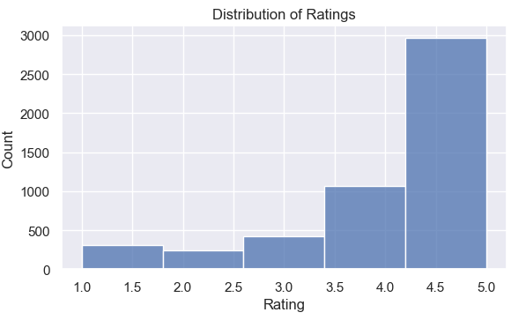
Data Processing Methods
1. Text Processing & Cleaning
Converted text to lowercase and removed HTML tags
Removed URLs, special characters, and extra whitespace
Filtered out common stopwords
Word tokenization
2. Data Quality Control
Handled missing reviewer, product category and names
Removed duplicates and empty reviews
3. Final Dataset
Final clean dataset: 4,966 reviews after processing

Slide 9
Sentiment Analysis
Notes:
3 minutes

Slide 10
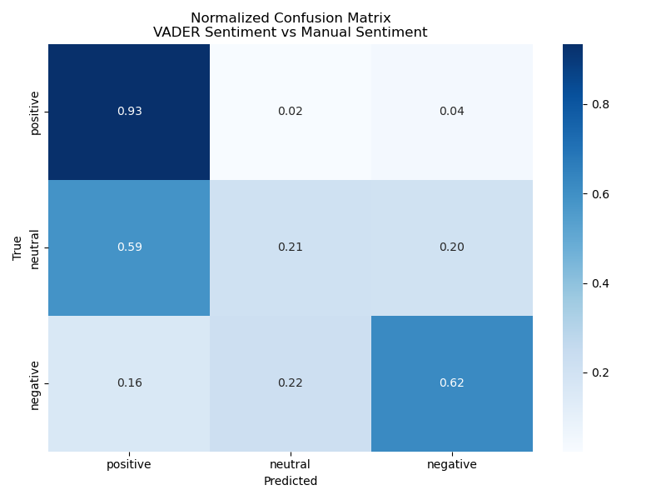

First Approach
1. Use VADER library
lexicon and rule-based sentiment analysis tool that is specifically attuned to sentiments
Pros
Specifically for social media, informal text
Build-in handling of negations and modifiers
Cons
Tend to over classify positive sentiment (positivity bias)
May not capture subtle or implied sentiments
Accuracy: 81.88%
precision
positive 0.33
neutral 0.49
negative 0.89

Slide 11
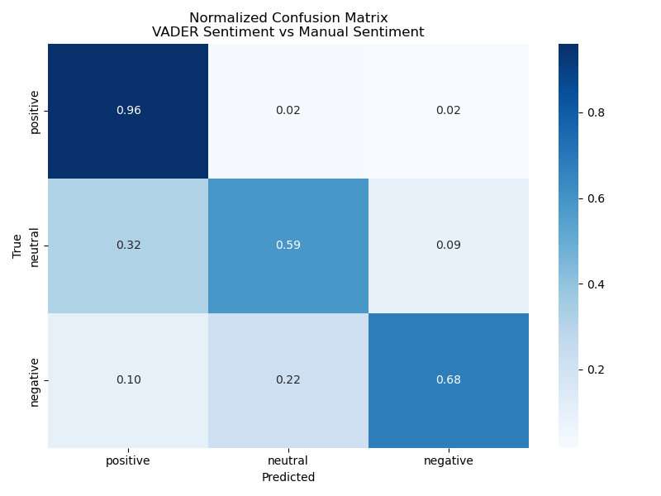
Second Approach
1. Use VADER + TextBlob
TextBlob: processing text that uses nlp and pattern analysis to determine text sentiment and subjectivity.
Method
Used weighted scoring between VADER and TextBlob results.
Add TextBlob subjectivity score
Implement “agreement checking” b/w classifiers
If agree, then continue with classification
If disagree, then consider “neutral” classification
Address approach #1 drawbacks:
Reduce positivity bias
Better capture subtle sentiment
TextBlob’s subjectivity analysis
agreement-based confidence
Accuracy: 89.49%
precision
positive 0.56
neutral 0.74
negative 0.94

Slide 12
Demo
Notes:
3 minutes

Slide 13
Text & Keyword Analysis
Notes:
3 minutes

Slide 14
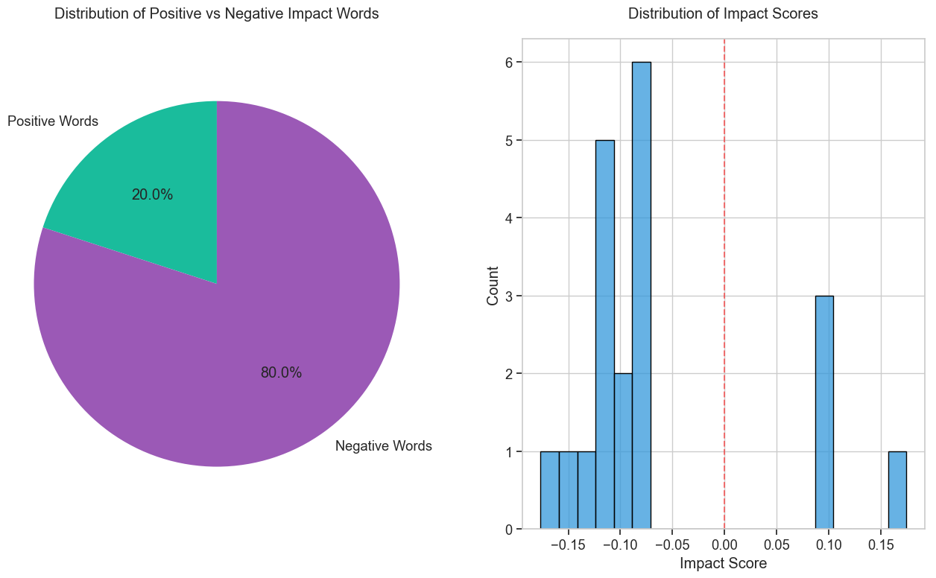
Review Language Shows Surprising Negativity Bias Despite Positive Overall Ratings
Impact: Strength of frequency of words with respect to positive/negative ratings
80% of impactful words are negative despite overall positive ratings
Most impact scores cluster around moderate negative values
Range of impact scores from -0.17 to +0.17
Notes:
Impact is how strong each word’s usage corresponds to positive/negative ratings.
Correlation between frequency of keywords and review ratings.
The text shows that while most reviews were actually positive overall, when people used impactful language, they tended to use negative words more frequently than positive ones.
This could indicate that customers are more likely to use strong negative language when dissatisfied than strong positive language when satisfied, even though they're generally satisfied with products (as shown by the overall positive ratings).

Slide 15
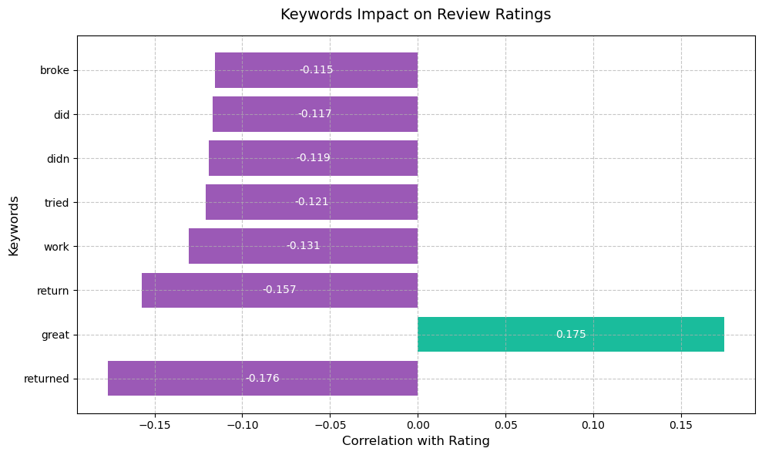
Key Drivers of Customer Ratings: Keyword Impact Analysis
Product returns show strongest negative relationship with review ratings
Functionality-related words consistently predict lower ratings
Only one word ("great") strongly predicts higher ratings, while negative predictors are more diverse
Notes:
Main point of slide:
Positive reviews tend to use general positive language ("great"), negative reviews are more specific, focusing on returns and functionality problems.
The keyword impact on review ratings is calculated by converting review text into (Term Frequency-Inverse Document Frequency) scores and finding the correlation between how often each word appears and the review ratings, revealing which words are most predictive of positive or negative reviews.

Slide 16
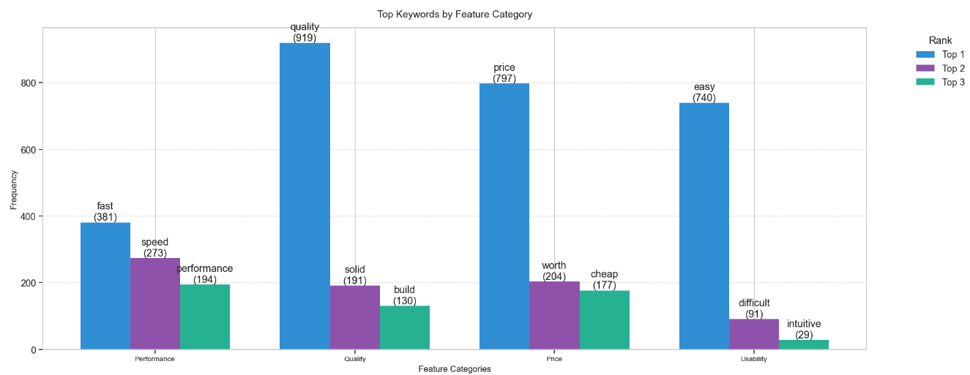
Analysis of Feature Categories and Top Keywords in Reviews
Price & Value (1,468) - 31% of feature mentions
Most mentioned category, indicating customers prioritize value assessment
Worth" and "value" dominate discussions over price complaints
Quality (1,306) - 28% of feature mentions
Strong correlation with ratings, particularly build quality mentions
Performance (1,069) - 23% of feature mentions
Speed and efficiency drive technical discussions
Often mentioned alongside price to justify value proposition
Usability (883) - 18% of feature mentions
Focus primarily on ease of use aspects
Notes:
• Price and Quality Lead Reviews (31% + 28%)
- Combined, they represent 59% of all feature discussions
- Shows customers primarily evaluate products on value proposition
• Value Over Price Complaints
- Terms like "worth" appear more than price complaints
- Indicates customers willing to pay if value is demonstrated
• Technical Performance (23%)
- Often tied to justifying price points
- Speed and efficiency most mentioned aspects
• Chart Shows Clear Priorities
- Declining bar heights reflect customer priorities
- Simple pattern: Value → Quality → Performance → Usability

Slide 17
Key Findings
1. Multilayered Sentiment Analysis Approach for Higher Accuracy
2. Review Expression Patterns
80% of impactful words in reviews are negative despite generally positive overall ratings
Customer reviews are more detailed and specific when describing problems compared to successes
3. Critical Sentiment Drivers
Product returns and functionality issues ("didn't work", "broke") show strongest negative correlation (-0.176)
"Great" demonstrates highest positive impact (0.175), particularly in relation to ease of use and quality
4. Feature Category Distribution
Price and quality dominate discussions, accounting for nearly 60% of all feature mentions
Performance and usability features appear less frequently but show strong correlation with overall satisfaction

Slide 18
Recommendations for Future Work
Expand Dataset Analysis
Analyze newer Amazon reviews (post-2014) to track sentiment evolution over time
Include cross-category comparisons beyond Electronics to identify industry-specific patterns
Enhance Sentiment Analysis
Implement aspect-based sentiment analysis to better capture nuanced opinions about specific product features
Develop feature-specific sentiment analysis (e.g., separate scores for quality, usability, value)
Technical Improvements
Integrate additional NLP libraries beyond VADER and Textblob for comparative sentiment scoring
Create methods for detecting and handling sarcasm in reviews

Slide 19
Thank you!
Questions?

Slide 20
Appendix

Slide 21
Relation of Our Work with Previous Work
Builds on their established Amazon electronics review dataset, focusing on 5000 recent reviews up to 2014 for targeted sentiment analysis
Extends their combined rating-text analysis approach by applying VADER sentiment analysis to understand emotional content in technical reviews
Advances their work through interactive visualizations and temporal analysis, making sentiment patterns more accessible and actionable
Notes:
Appendix

Slide 22
Analysis Tools & Libraries
Core Libraries
pandas: Data manipulation and analysis
numpy: Numerical computations
matplotlib: Data visualization
seaborn: Statistical visualization
Data Processing
json: JSON parsing
gzip: Compressed file handling
datetime: Time series management
ast: Literal string evaluation to calculate helpful ratio
Notes:
Libraries for both data exploration and processing

Slide 23
EDA

Slide 24
Time Complexity Analysis
Major Operations:
Data Loading: O(n) where n = number of reviews
Text Processing: O(n * m) where m = avg review length
Statistical Analysis: O(n)
Time Series Grouping: O(n log n)
Space Complexity:
Primary DataFrame: O(n)
Auxiliary Data Structures: O(k) where k = unique categories

Slide 25
Time & Space Complexity
Loading & Initial Processing:
Data Loading: O(n) - linear with number of reviews
Text Cleaning: O(n * m) where m = avg text length
Feature Creation: O(n)
Memory Requirements:
Primary DataFrame: O(n) where n = number of reviews
Text Processing: O(m) temporary storage per review
Feature Storage: O(k * n) where k = number of features

Slide 26
Data Preprocessing

Slide 27
Data Exploration Methods
Data Import & Cleaning
Parsed 5,002 Amazon electronics reviews from GZIP JSON
Handled timestamps and metadata extraction
Statistical Analysis
Rating distributions and review metrics
Text length and content assessment
Quality Assessment
Missing value detection
Duplicate review identification
Data range validation (1999-2014)

