Slide 1
Automatic Exam Grading
Sujan Baskota (078BCT093) Yugesh KC (078BCT095) Yujal Shrestha (078BCT096)

Slide 2
1. Introduction
Problem Statement
Current Solutions
Methodology
Experimental Setup
Results
Conclusion
Intro

Slide 3
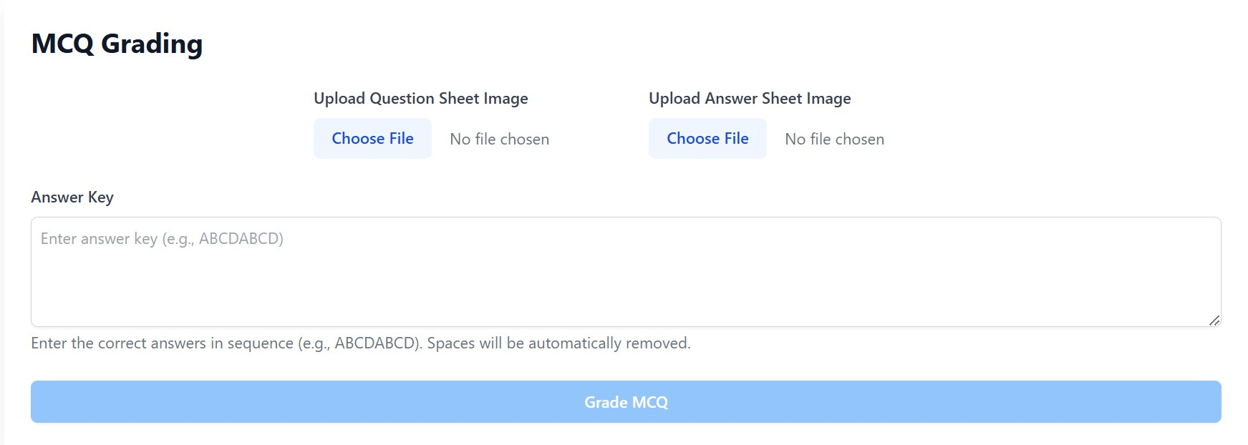
3
Automatic Exam
The Automatic Exam Grading System (AEGS) utilizes AI, ML, and OCR to enhance grading efficiency, reducing errors in large classrooms.

Slide 4
4
Problem Statement
Large classrooms present unique challenges for grading.
Manual grading is often time- consuming and inefficient.
01
02
There is a critical need for unbiased and consistent
evaluations.
Human errors can lead to unfair grading outcomes.
03
04

Slide 5
5
Current Solutions
1. Basic image processing techniques are widely used for various applications, providing foundational capabilities in image analysis.
01
3. Existing automated grading systems utilize algorithms to assess student submissions, streamlining the evaluation process.
02
2. Hybrid systems that combine Optical Character Recognition (OCR) with Machine Learning (ML) enhance accuracy and efficiency in data extraction.
03

Slide 6
6
Methodology Overview
Feasibility Study
The first step involves conducting a feasibility study and requirement analysis to ensure the project aligns with stakeholder expectations and technical capabilities.
Data Preparation
Following the analysis, data preparation
is crucial ensuring organized
for system development, that
all necessary data is and ready for
implementation.

Slide 7
7
Experimental Setup
Frameworks
Computer vision libraries are
applied for effective image processing.
Setup
Our project utilizes a robust
hardware and software infrastructure.
Vision
We implement deep learning
frameworks for enhanced performance.

Slide 8
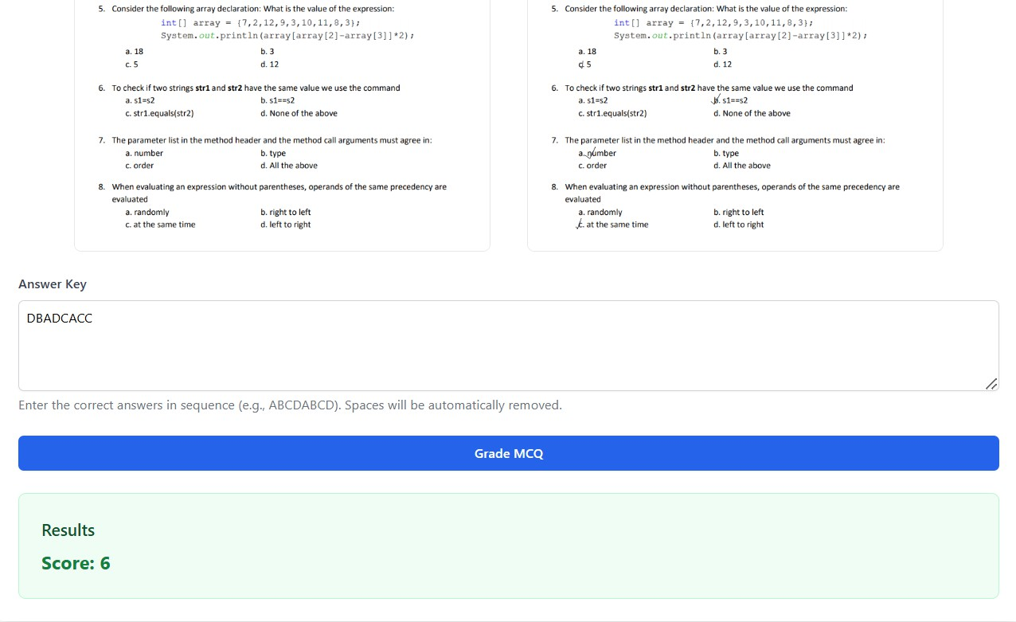
8
Results Overview
The AEGS effectively
evaluates questions,
multiple-choice
subjective responses, and diagrams, ensuring prompt and dependable assessments for educators.

Slide 9
9
Conclusion
AEGS significantly enhances educational assessment by providing a structured framework.
2
Moreover, it ensures fairness in grading processes, benefiting all students.
3
It promotes efficiency and accuracy in grading, reducing human error and bias.
4

Slide 10
Thank You
Sujan Baskota, Yugesh K.C., Yujal Shrestha, Tribhuvan University

Slide 11
11
References
"Automated Grading Systems: A Review," Journal of Educational Technology, 2023. www.journalofedutech.com
"Optical Character Recognition Techniques: A Survey," International Journal of Computer Applications, 2022. www.ijcaonline.org
"Natural Language Processing in Education: Applications and Challenges," Educational Data Mining, 2023. www.educationaldatamining.org

