Slide 1
What AI Hallucinations Actually Are
8 classes, 51 types, 1,690 measured events
You probably think it means the AI makes things up.
In 1,690 measured failures, that was 29% of them.
A 5-minute orientation, not a full treatment.
Johnny Morgan · University of Maryland, Baltimore County
Notes:
Open with the hook and let it sit for a beat.
Everyone in the room has heard "hallucination" and thinks it means the model
invented a fact. That is real, and it is under a third of what we measured. The
other two thirds is the model doing the work wrong while sounding exactly as
confident as when it does the work right.
Say what this is NOT: not a survey of the literature, not a safety talk. It is
what we found by instrumenting our own work.

Slide 2
THE DEFINITION
What a hallucination is
Output the model presents with confidence that is not grounded in anything real:
not in the data it was given, not in the tools it has, not in what actually happened.
It is about grounding, not truth
A model can be right by accident, having checked nothing. The process that produced it will be wrong next time.
It is about confidence
It sounds the same whether it verified or guessed. That is why the failure is invisible where you would catch it.
It is not only about facts
Saying a job is done when it is not, or rebuilding a tool that exists, is the same failure wearing different clothes.
The definition
1
Notes:
Read the boxed definition out loud. It is the only definition in the talk.
The three points underneath are the ones people push back on:
Grounding not truth - "but it was right!" It was right by luck. Same process,
different day, wrong answer.
Confidence - this is why it is dangerous rather than merely annoying.
There is no tell.
Not only facts - this is the bridge to the next slide, where 7 of the 8
classes are not about inventing facts at all.

Slide 3
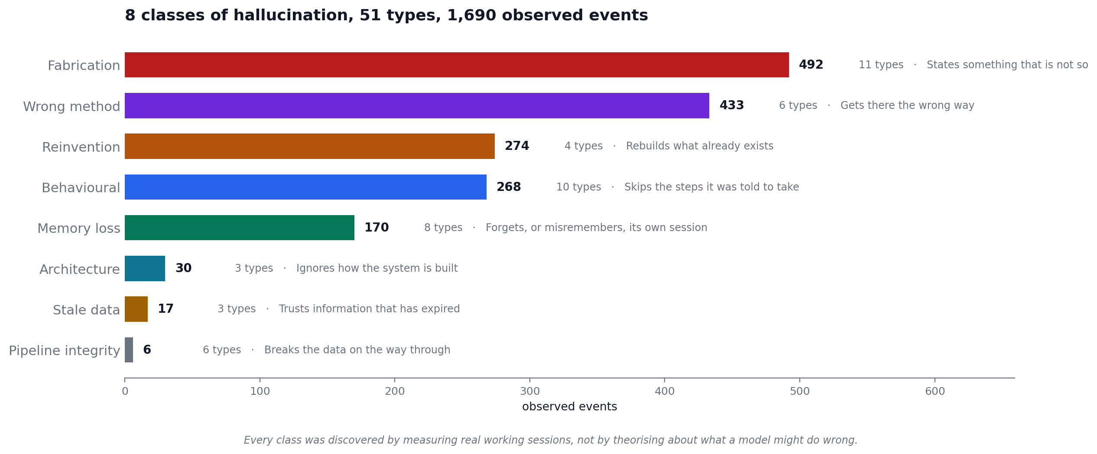
WHAT WE FOUND
The 8 classes we found
Discovered by measuring real working sessions, not by theorising
The classes
2
Notes:
Walk the top four, they are 87% of everything.
Fabrication 492 - the one everyone knows. Largest class, still under a third.
Wrong method 433 - the model gets the right answer the slow way.
Reinvention 274 - it rebuilds something that already existed.
Behavioural 268 - it skips the steps it was told to take.
The bottom four are small in count. Pipeline integrity has 6 types and 6 events,
which mostly means those failures are hard to see, not that they are rare.
If someone asks where the classes came from: they were not designed up front.
Each was named the first time it happened, then detection was automated so it
could be counted rather than remembered.

Slide 4
THE BREAKOUT
The types inside each class
All 51 are named and defined. The most frequent are shown here.
Class | Types | Events | The ones you would recognise
Fabrication | 11 | 492 | schema hallucination (172), path hallucination (162)
Wrong method | 6 | 433 | computational naivety (394), redundant recomputation (17)
Reinvention | 4 | 274 | tool reinvention (230), code reinvention (42)
Behavioural | 10 | 268 | skipped verification (87), monitoring loop (74)
Memory loss | 8 | 170 | narrative smoothing (72), error inflation (58)
Architecture | 3 | 30 | architecture ignored (20), architecture unknown (7)
Stale data | 3 | 17 | stale ephemeral state (10), stale data citation (4)
Pipeline integrity | 6 | 6 | index misalignment (5), label miscount (1)
The breakout
3
Notes:
Do not read the table. Point at three rows.
computational naivety, 394 - the single most common failure in the whole
record, and nothing it produced was false. It
used a slow method when a fast one existed.
tool reinvention, 230 - second most common. It wrote new code to do a job
an existing tool already did.
schema + path hallucination - 334 between them. Querying columns that do not
exist, referencing files that are not there.
These are the most confirmable failures we have,
because a path either exists or it does not.
The point to land: the top two are not fabrication.

Slide 5
Three things to take away
1
It is not mostly making things up
Fabrication is 29% of measured events. A programme that addresses only fabrication addresses under a third of the problem while reporting that hallucination is solved.
2
The most common failure costs time, not truth
The single largest type produced nothing false. It did the work the slow way. That will not show up in any accuracy metric.
3
Naming a failure is the cheap part
All 51 types are named. 30 have a mitigation aimed at them. Detecting, reducing, and proving the reduction get harder in that order.
Where a deeper session goes: does naming reduce it, which ones are worth fixing, and can a model catch itself in flight?
Takeaways
4
Notes:
Land on the three, then open the floor.
If there is time and appetite, the four open questions are:
1. Does naming a failure reduce it? We can measure this: the record has the
date each type was named and the date each mitigation landed.
2. Which are worth mitigating? 394 cheap events may matter less than 7 that
silently corrupt a result.
3. Can a model detect its own hallucinations in flight? After the fact in a
transcript, yes, for several types. At the moment of production, no.
4. How much of this transfers beyond one project? Nobody has run that.
Caveat to offer if challenged: this is one project's sessions, research
engineering work. Treat the classes as portable and the percentages as local.
Every count is a floor, since it counts what we detected.

Slide 6
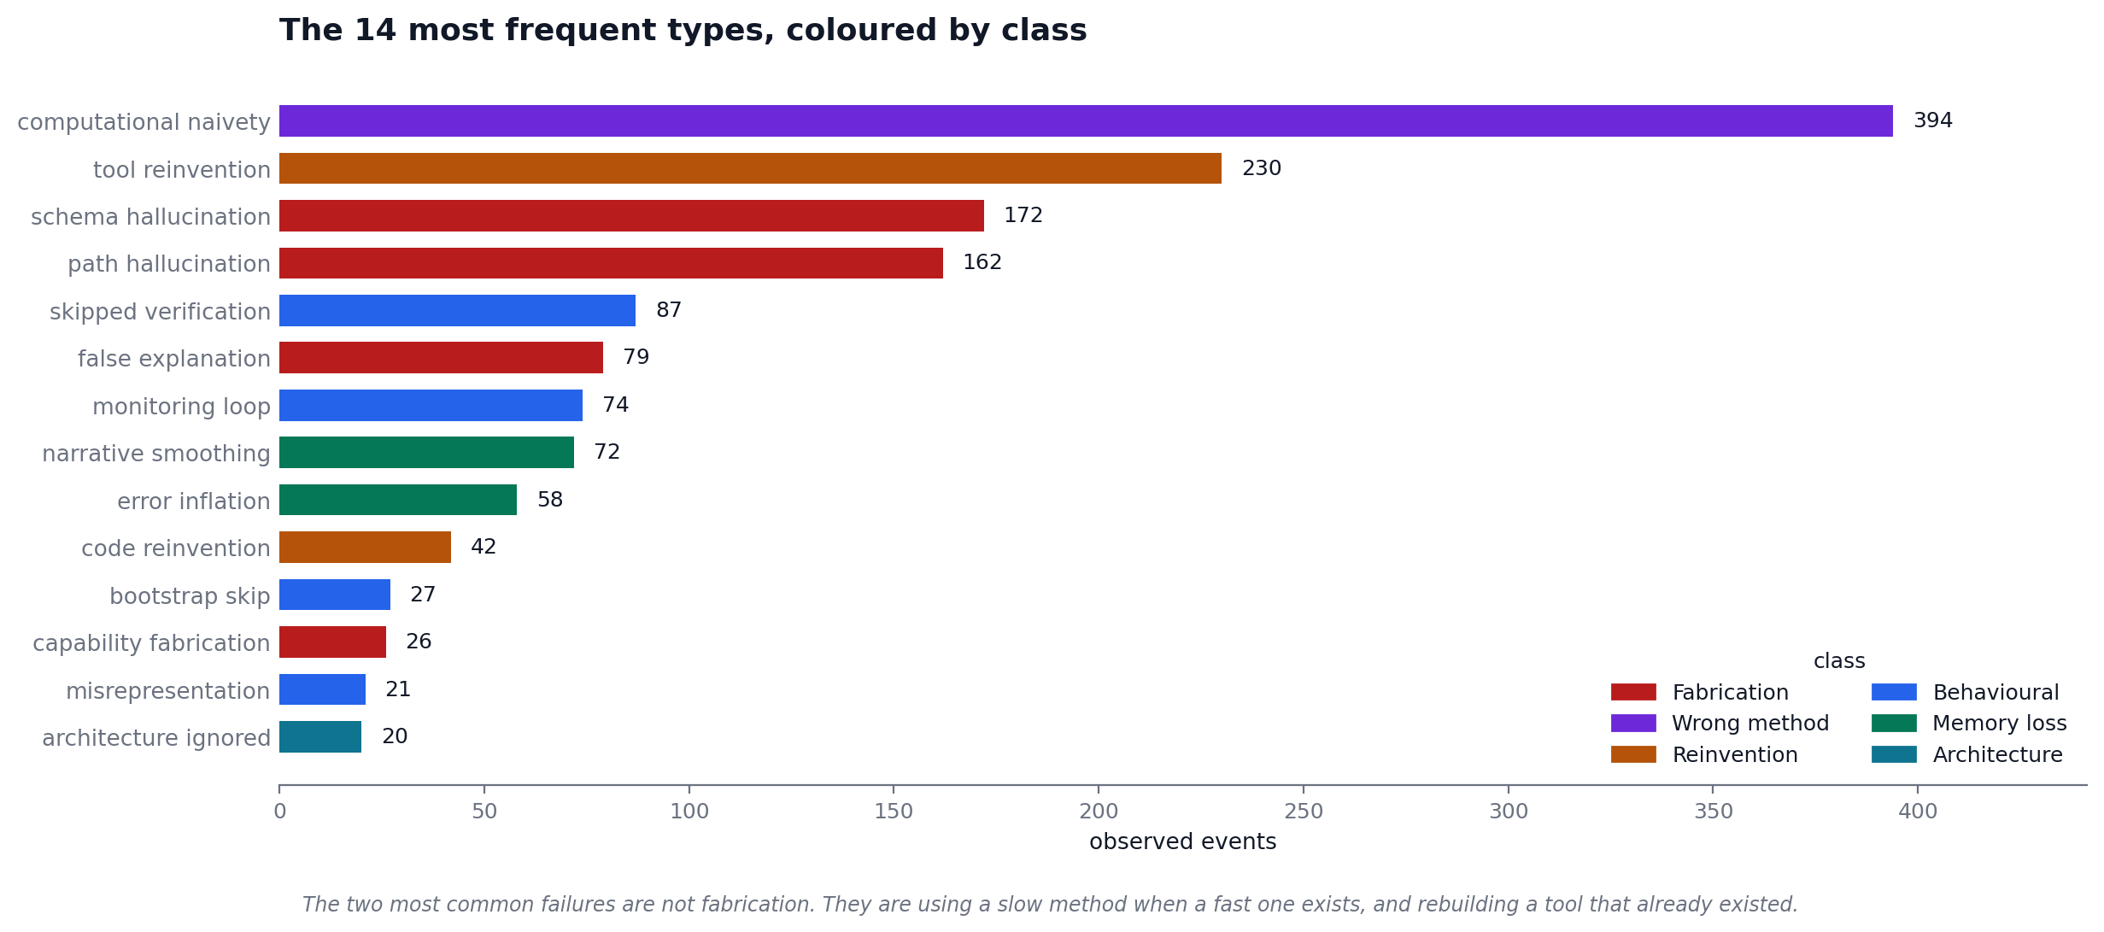
BACKUP
Backup: the most frequent types
Not part of the 5-slide talk. Delete or keep for questions.
Backup
B
Notes:
Hold this for the question "so what does it actually look like?"
Colour is the class. The two longest bars are purple and orange, wrong method
and reinvention. Red, fabrication, does not appear until third place.

