Slide 1

ABOUT ME
Data enthusiast | Life-long learner
Optimization & Machine Learning| Ecommerce | Supply Chain

Slide 2



Who I am?
Ivy is a Data Scientist at Pitney Bowes with more than 3 years of experience in optimization and machine learning. She is currently leading the optimization initiatives using data science techniques to help solve some of the toughest challenges for the company’s logistics service sector, including reducing operating costs, improving delivery cycle time, and enhancing visibility into parcel journey and parcel profile.
She has a track record of uncovering hidden patterns from her data science work, continuously delivering actionable insights and strategies to stakeholders, and streamlining data informing processes, such as building dashboards, developing self-service data applications and deploying them using cloud service.
Ivy is a quick learner, a curious person, and always passionate about using data science skills to uncover business insights. With her solid background in Operations Research and years of working experience in applying advanced analytics to solve challenging problems, she is absolutely a valuable asset to any organization.
Here is her GitHub repository attached: https://github.com/yj333?tab=repositories
Master’s Degree in Operations Research (2016-2017), Cornell University
Bachelor’s Degree in Chemical Engineering (2012-2016), Georgia Institute of Technology

Slide 3


















Overview of my specialties
Weekly meeting with stakeholders
Brainstorm on MURAL board
Document requirements on Confluence
Exploratory data analysis
Dashboard
Data processing
Feature engineering
Productionize models on Elastic Beanstalk
Send real-time notifications to Microsoft Teams channel
Linear programming/Mixed integer programming
Linear regression
Random Forest
XGBoost
Clustering
Time series forecasting
Image identification
Customer Obsession
Monte Carlo simulation
Sensitivity analysis
Before-and-after scenario

Slide 4
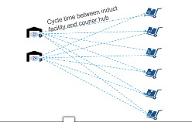
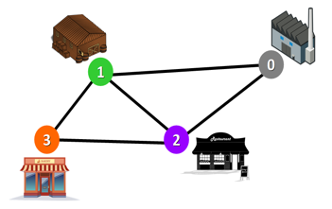
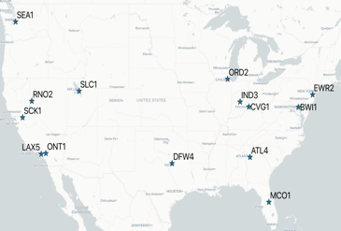

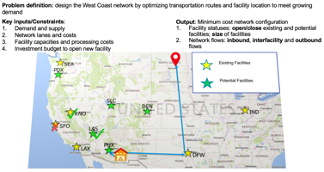
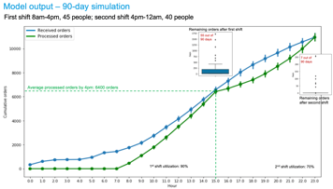
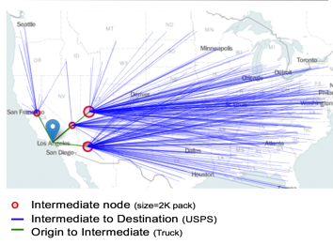
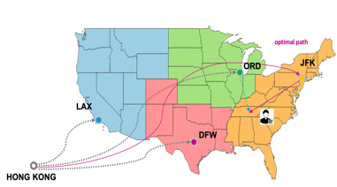
Highlights of my past projects
Self-service
Self-service
Facility-Region Assignment
Shortest Path
Returns Pricing
West Coast Network Design
Self-service
Fulfillment Shift Scheduling
Shift Scheduler App
Cornell University Student Projects – project advisor
Transportation/Facility Operations
Global Inbound Optimization

Slide 5
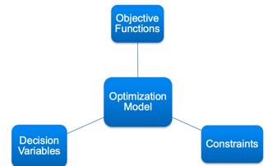
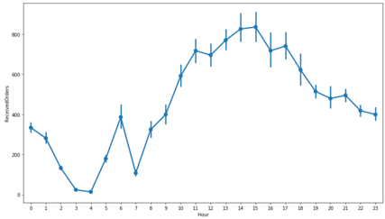
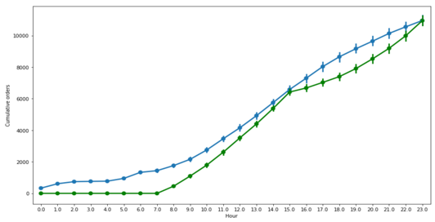
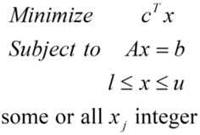
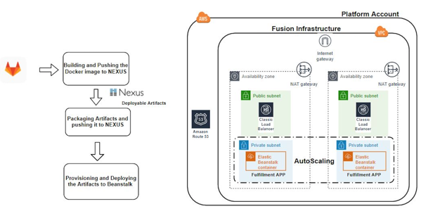
Workforce optimization – Shift scheduling model
Received orders by hour
(from simulation or forecasts)
Mixed integer programming
Headcounts
Hourly throughput
Cost and utilization
8am-4pm shift: 45 people
Utilization: 98%
Labor cost: $6.6k
2. Potential shift schedules
3. Orders processing rate
4pm-12am shift: 40 people
Utilization: 99%
Labor cost: $5.9k
Goal: minimize rollovers and labor cost
Constraints:
Workstation capacity
Processing order
Self-service Data App

Slide 6
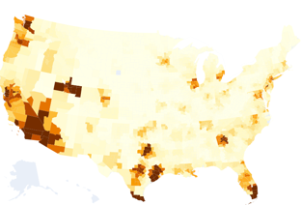





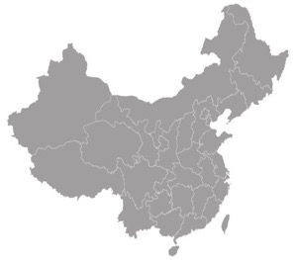
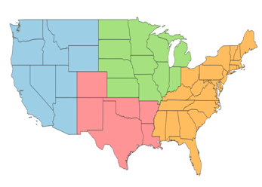
Global inbound route optimization
1. Parcels volume distribution by zip code
Mixed integer programming
Zip-level inbound route decision
Wheels Down
Port of Entry
Customs Clearance
Induction
ShipFrom
Courier Line Haul
USPS Delivery
Delivered
2. Potential port of entries: JFK, LAX, ATL, ORD
3. Interfacility linehaul cost
4. Interfacility transit time
ORD
JFK/EWR
LAX
Goal: minimize transportation and operational cost
Constraints: 90% of parcels delivered with 10 calendar days
ATL
Destination
HONG KONG

Slide 7


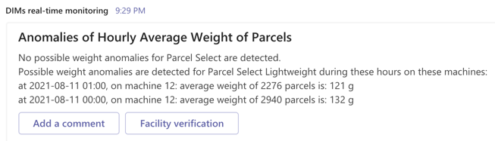
Real-time parcels anomaly detection
Step 1: Historical baseline
(Facility-level; past 30-day)
Step 2: Real-time monitoring
(Machine-level; by hour)
Step 3: Weekly report
(Client-level; by week)
Realtime hourly average weight by machine
Low-latency parcel automation table
Historical mean and standard deviation of hourly average weight of parcels
Compare hourly average weight on each machine against historical baseline
Aggregate the number of parcels by client from the impacted machines in the past week
Anomaly detection algorithm
Possible anomaly
Staging table
Yes
Client impact
Write anomalies to a staging table on Snowflake
Six Sigma control chart
CUSUM change point detection
Local Outlier Factor
#. of parcels scanned > 100
Yes
Notify operations of abnormal weight detected by time and by machine on Teams
Alert triggered
Notes:
Machineid 14-17 are secondary sorters, parcels going on these have already gone through primary induction, so they do not need to capture DIMs again

