Slide 1
Machine Vision image tracking
YU-JUI, CHEN
B053021023

Slide 2
Abstract
Open image
Method 1
Method 2
Test

Slide 3
Method 1
Three step search
Sum of square difference

Slide 4
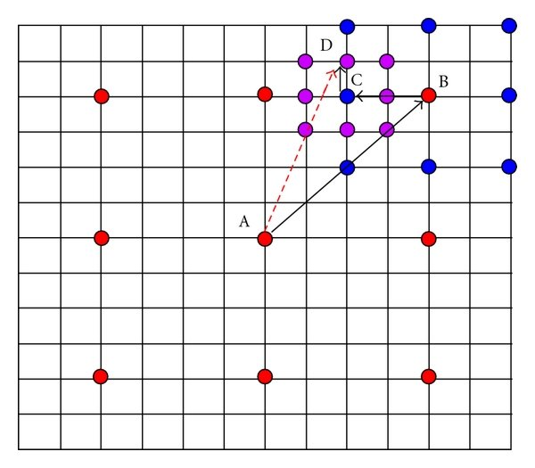
Three step search
Is a simple and effective algorithm to reduce the amount of calculation
Starting from setting the center and then decide the distance of other eight positions in the figure. Comparison the calculated values of the nine positions. According to the conditions of the judgment, select the desired position among the nine points.
Reduce the distance, and then repeat the above steps twice.

Slide 5
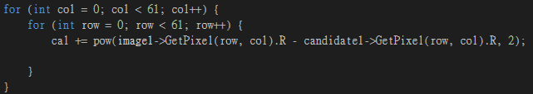

Sum of square difference
$\sum_{i=1}^{m}{ \sum_{j=1}^{n}{}}{\left\{f\left[i,j\right]−g\left[i,j\right]\right\}}^{2}$
$f\left[i,j\right]$= test image
$g\left[i,j\right]$= template image
Red color only

Slide 6
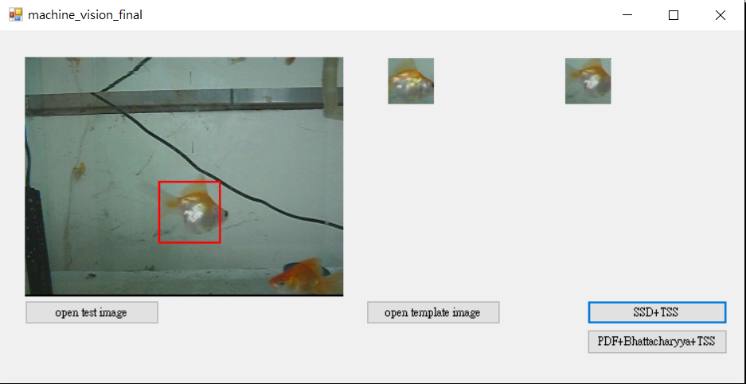
Result – test image 1

Slide 7
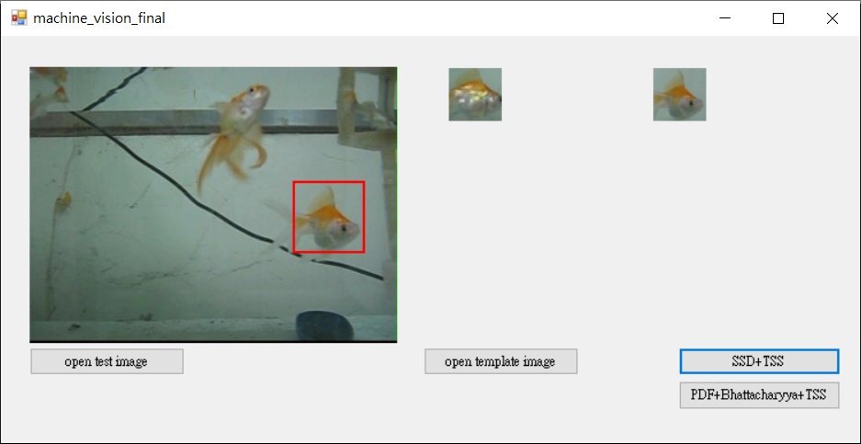
Result – test image 4

Slide 8
Method 2
Three step search
Probability density function approach
Bhattacharyya coefficient

Slide 9
Three step search
Is a simple and effective algorithm to reduce the amount of calculation
Starting from setting the center and then decide the distance of other eight positions in the figure. Comparison the calculated values of the nine positions. According to the conditions of the judgment, select the desired position among the nine points.
Reduce the distance, and then repeat the above steps twice.

Slide 10
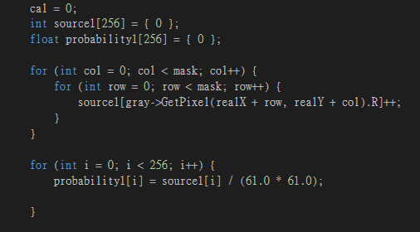
Probability density function approach
Add all the pixels in the test image and template image with same size of mask and divided the sum with the number of pixels

Slide 11


Bhattacharyya coefficient
As we know the probability density in both test image and template image with same size of mask, then we multiple two probability density and square it.

Slide 12
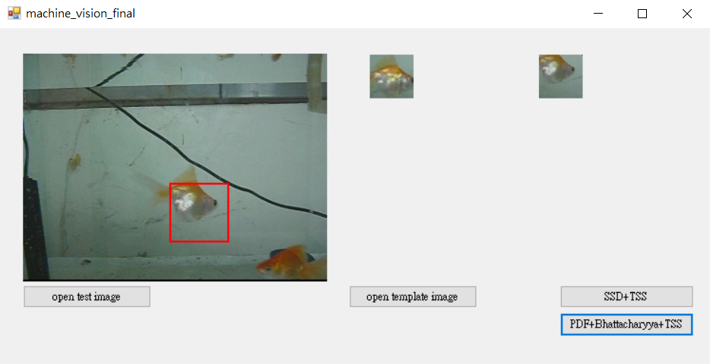
Result – test image 1

Slide 13
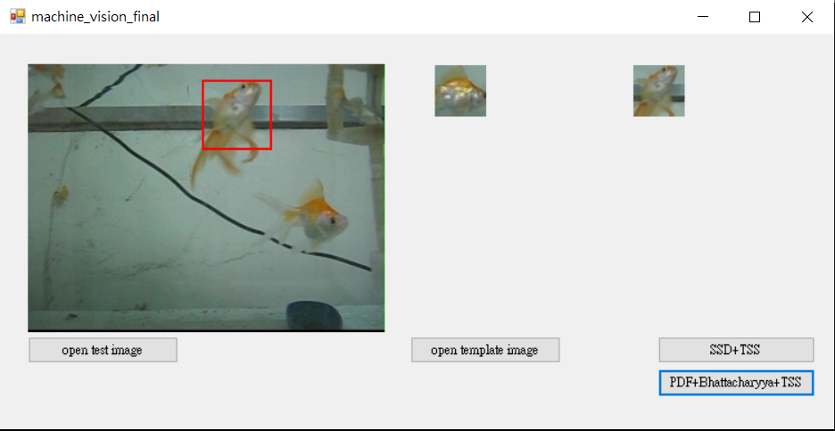
Result – test image 4

Slide 14

Test

