Slide 1
Machine Vision lead frame inspection
YU-JUI, CHEN
B053021023

Slide 2
Abstract
Open Picture
Binary
Sobel Edge Detection
Find Circle
Find Angle
Find Width

Slide 3
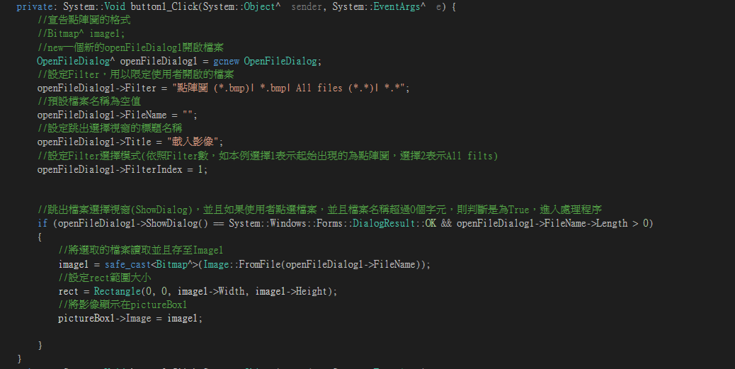
Open Picture

Slide 4

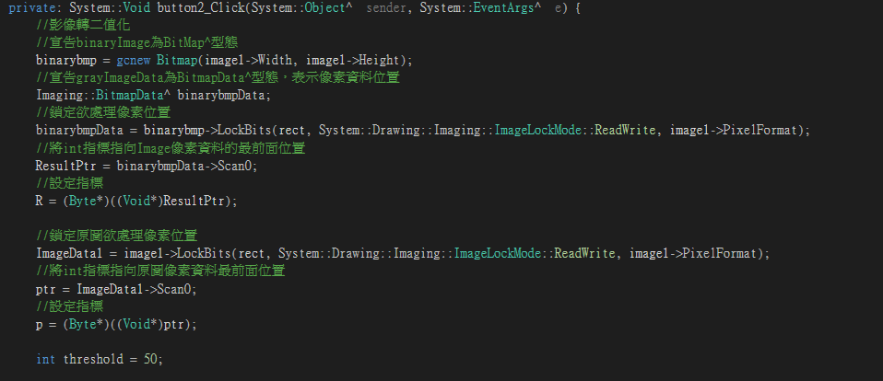
Binary

Slide 5


Sobel Edge Detection

Slide 6
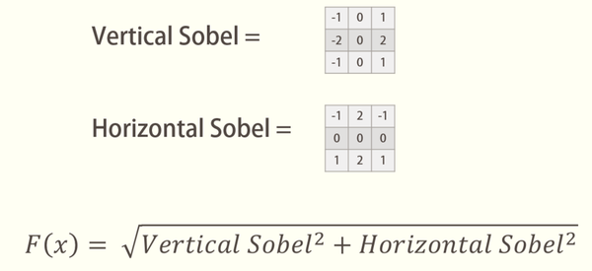

Slide 7
Find Circle
A. Connected component labeling
B. Find Diameter

Slide 8


a. Connected component labeling

Slide 9

b. Find Diameter

Slide 10
Scan Direction

Slide 11

Find Angle

Slide 12
First Step
Second Step

Slide 13
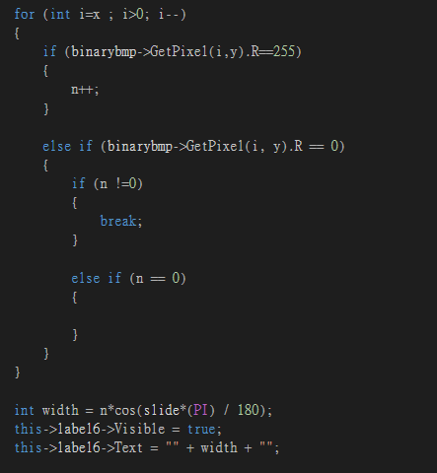
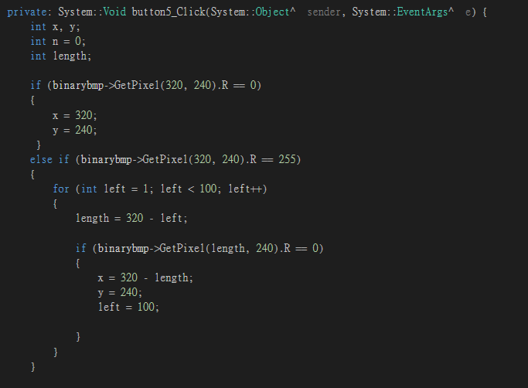
Find Width

Slide 14
Notes:
hypotenuse

Slide 15
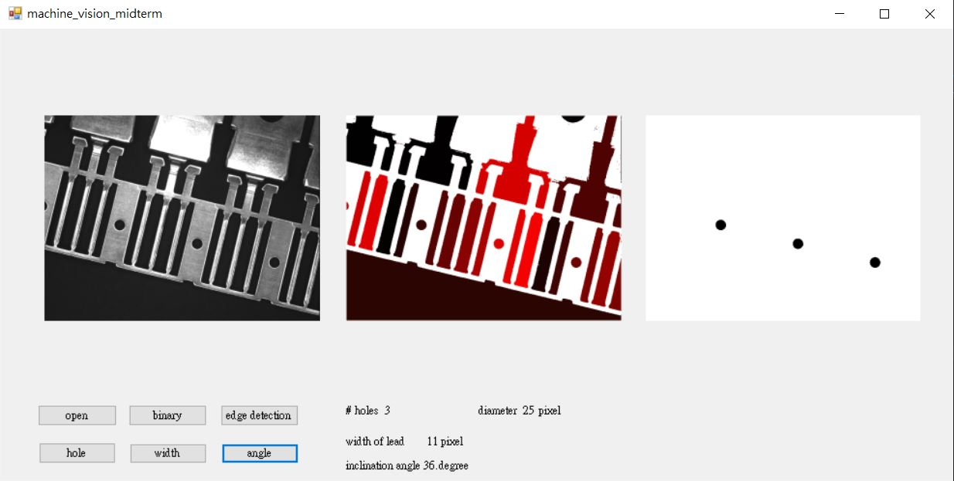
result

Slide 16
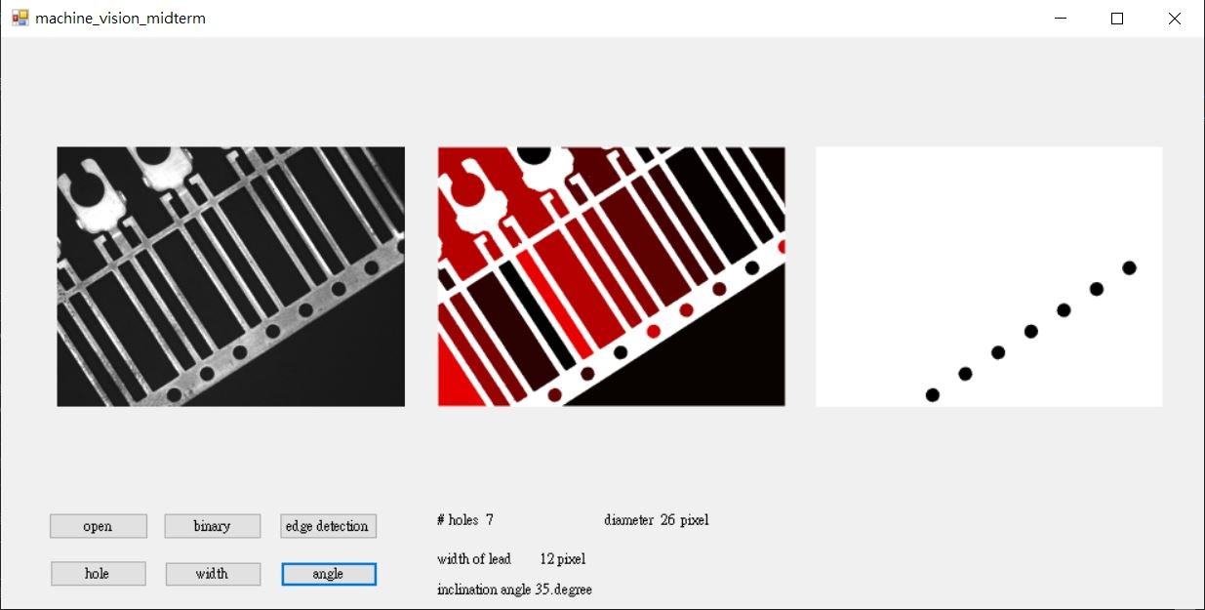
result

Slide 17

Computer test

