Slide 1

Semi-supervised methods of text processing, and an application to medical concept extraction
Yacine Jernite
Text-as-Data series
September 17. 2015

Slide 2
What do we want from text?
Extract information
Link to other knowledge sources
Use knowledge (Wikipedia, UpToDate,…)
Notes:
High precision, low recall annotation

Slide 3
How do we answer those questions?
What do people talk about on social media, and how? (Sentiment analysis)
What actions are described in a news article? (Semantic parsing)
In a medical setting: what symptoms does a patient exhibit?
Notes:
High precision, low recall annotation

Slide 4
Pipeline

Slide 5
Pipeline
Text
Information, Features

Slide 6
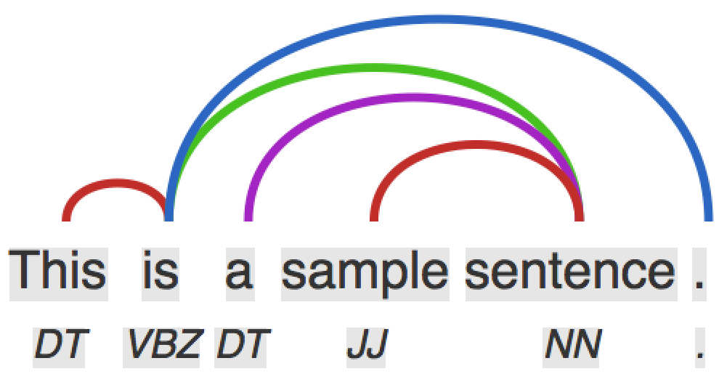
Pipeline
Text
Low level NLP
Information, Features
IE algorithms

Slide 7
Pipeline
Text
Low level NLP
End-to-end NLP
Information, Features
IE algorithms

Slide 8
Machine learning approach
Specify task
Specify training algorithm
Get data
Train
Notes:
High precision, low recall annotation

Slide 9
Machine learning approach
Specify task
Specify training algorithm
Get data
Train
Notes:
High precision, low recall annotation

Slide 10
So much text, so few labels
5M English Wikipedia articles (3G words)
54M Reddit comments
1G Words in Gigaword dataset (newswire text)
5-grams from 1T words
Notes:
So. Why is it so important to develop semi-supervised learning algorithms for NLP?

Slide 11
So much text, so few labels
1M words in Penn TreeBank (parsing)
Machine translation: highly language (and domain) dependent
A few thousand to few hundred thousand sentence…
And so many other custom tasks
Notes:
UN for MT: 400M words: http://www.un.org/depts/DGACM/Translation.shtml
Arabic, Chinese,English, French, Russian, and Spanish
Makes end-to-end training difficult, especially for DL

Slide 12
Presentation outline
Literature review on semi-supervised paradigms
Label induction
Feature learning
Current work: Semi-Supervised Medical Entity Linking
Notes:
The presentation will be in two parts.
I will first give an overview of semi-supervised paradigms which have been used in recent NLP work.
Many of these works can broadly be split according to whether the semi-supervision has to do with the label space or with the feature space, and I will use this distinction to organize the first part of the talk.
We will then go over some of my on-going work. I will start by presenting a paper which was published at ICML 2015 about Markov Random Fields language models, after which I will present my current efforts in medical concept extraction, with a system that builds upon my ICML work in an semi-supervised manner.

Slide 13
Overview
Label induction
Labeling data is costly
Automatically obtain approximate labeling on larger dataset
Train using pseudo-labels

Slide 14
Overview
Feature learning
Feature quality affects accuracy
Learn features using other sources
Train with features on small labeled dataset

Slide 15
So much text, so few labels
Label induction
Feature learning
Domain adaptation
Multi-view learning

Slide 16
Overview
Labels
Fine Grained Entity Recognition
Ling and Weld, 2012
Distant Supervision for RE with an incomplete KB
Min et al., 2013
Co-Training for DA
Chen et al. 2011
Semi-Supervised FSP for Unknown Predicates
Das and Smith, 2011

Slide 17
Fine Grained Entity Recognition
Method type: Automatic labeling
Task: Identify entities in text, and tag them with one of 112 types
Labeled data: Hand-labelled news reports
Auxiliary data: Wikipedia, Freebase

Slide 18
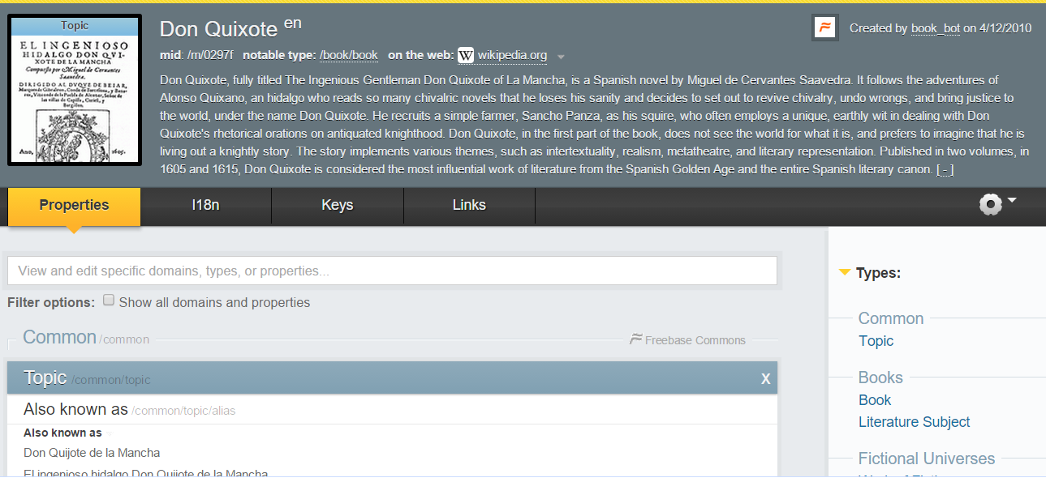
Fine Grained Entity Recognition
Freebase
Notes:
High precision, low recall annotation

Slide 19
Fine Grained Entity Recognition
Automatically label entity spans in Wikipedia text
Don Quixote
…
Meaning
Harold Bloom says that Don Quixote is the writing of radical nihilism and anarchy,…
Notes:
High precision, low recall annotation

Slide 20
Fine Grained Entity Recognition
Automatically label Wikipedia text
Spans are obtained from hyperlinks
Types are obtained from Freebase
Don Quixote
…
Meaning
Harold Bloom says that Don Quixote is the writing of radical nihilism and anarchy,…
Harold Bloom:
Topic, Academic, Person, Author, Award winner, Influence node
Nihilism:
Topic, Field of study, Literature subject, Religion

Slide 21
Fine Grained Entity Recognition
Train CRF and perceptron on pseudo-labeled data
B
I
O
O
B
I
O
Harold
Bloom
says
that
Don
Quixote
is
person
book

Slide 22
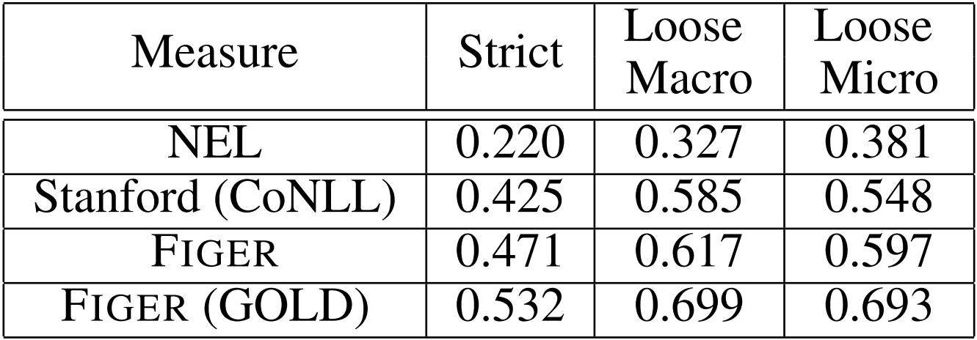
Fine Grained Entity Recognition
Compares to
Stanford NER: 4 most common classes
Ratinov et al. Named Entity Linking
Results:

Slide 23
Distant Supervision for Relation Extraction with an incomplete Knowledge Base
Method type: Automatic labeling, Label inference
Task: Relation extraction
Labeled data: TAC 2011 KBP dataset
Auxiliary data: Wikipedia infoboxes, Freebase
Notes:
The relation Extraction work has a somewhat more evolved

Slide 24
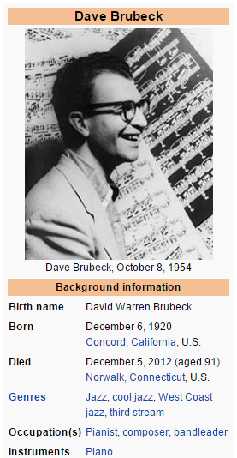
Distant Supervision for Relation Extraction with an incomplete Knowledge Base
Entity pairs extracted from Wikipedia infoboxes
Labeled with FreeBase relations: origin

Slide 25
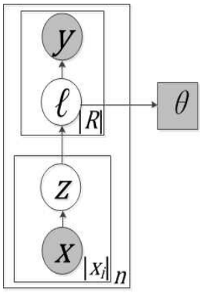
Distant Supervision for Relation Extraction with an incomplete Knowledge Base
Latent variable algorithm to learn from positive-only labels
X: entity pair mention
Z: mention level label
l: bag level label
Y: KB entity pair label
θ: Number of positive labels
Notes:
Explicitly models the low recall we mentioned previously.
The true label is a latent variable, which allows to account for the missed pairs.

Slide 26
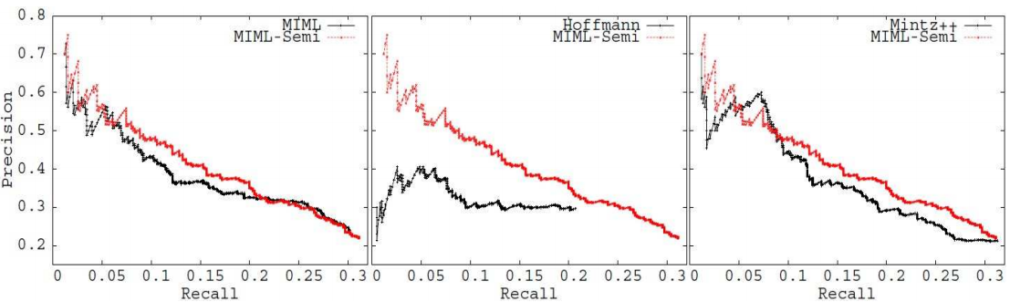
Distant Supervision for Relation Extraction with an incomplete Knowledge Base
Learns with EM, compares to (y = l)
Notes:
MIML: same without noise
MultiR: Hoffmann et al., 2011: supports overlapping relations differently than multi-label
Mintz++: looks as at sentences that contain a pair in unlabeled dataset

Slide 27
Co-Training for Domain Adaptation
Method type: Automatic labeling, Domain adaptation
Task: Text classification - review polarity
Labeled data: Amazon reviews for books, DVD, electronics, kitchen
Auxiliary data: Cross-domain training
Notes:
High level idea: Slowly move from source-domain to target-domain features

Slide 28
Self-Training
Unlabeled
data
Labeled
data

Slide 29
Self-Training
Unlabeled
data
Labeled
data
Classifier 1
Pseudo-labeled
data

Slide 30
Self-Training
Unlabeled
data
Labeled
data
Classifier 1
Pseudo-labeled
data
Classifier 2

Slide 31
Self-Training
Algorithm
Train System-1 on labeled data
Label some data with System-1
Train System-2 on combined data
Not much improvement
Less than 1% parsing accuracy
Somewhat better “portability”

Slide 32
Co-Training
Unlabeled
data
Labeled
data

Slide 33
Co-Training
Unlabeled
data
Classifier 1
Labeled
data
Classifier 2
Pseudo-labeled
data

Slide 34
Co-Training
Unlabeled
data
Classifier 1
Labeled
data
Classifier 2
Selection
Pseudo-labeled
data

Slide 35
Co-Training
Unlabeled
data
Classifier 1
Labeled
data
Classifier 2
Selection
Pseudo-labeled
data

Slide 36
Co-Training
Algorithm
Train System-1 and System-2 on labeled data with disjoint feature sets
Add data which is confidently labeled by exactly one system
Re-train, iterate
Theoretical guarantees for “independent” feature sets

Slide 37
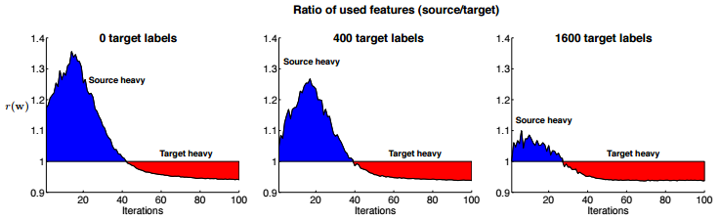
Co-Training for Domain Adaptation
L1 regularization: starts using more target-domain features
Notes:
The paper we are talking about now implements this idea as a constrained optimization problem for cross-domain training.
They use an L1 regularization for feature selection, and you can see that as data from the target domain is added, it learns to use target domain features.

Slide 38
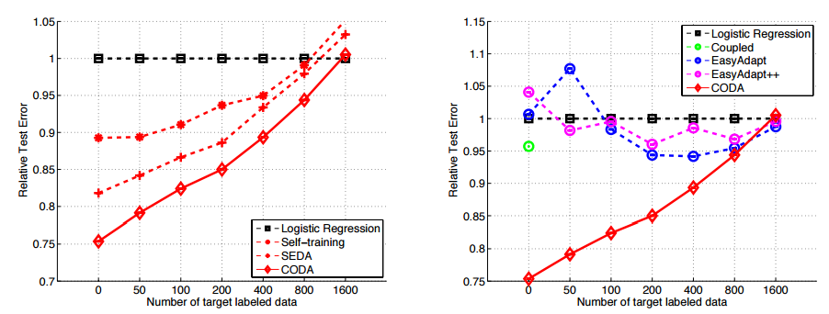
Co-Training for Domain Adaptation
Best improvement adding a limited number of examples
Notes:
Most prominently, Daume [11] trains separate source and target ´ models, but regularizes these models to be close to one another. The EasyAdapt++ variant of this algorithm, which we compared against, generalizes this to the semi-supervised setting by making the assumption that for unlabeled target instances, the tasks should be similar.

Slide 39
Semi-Supervised Frame-Semantic Parsing for Unknown Predicates
Method type: Label pre-selection
Task: Frame-semantic parsing
Labeled data: SemEval 2007
Auxiliary data: Gigaword corpus, FrameNet
Notes:
Ok. So now let’s talk about the last paper on the “label” side of semi-supervised learning.

Slide 40
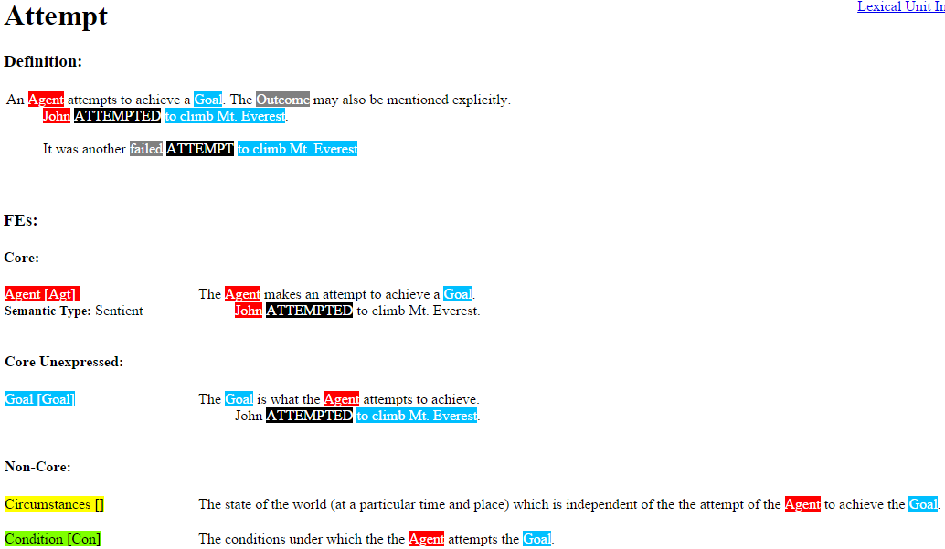
Semi-Supervised Frame-Semantic Parsing for Unknown Predicates
Ted really tried to read Infinite Jest, but was discouraged by the size of the book.
Notes:
The role of FSP is to find the arguments of a semantic unit.

Slide 41
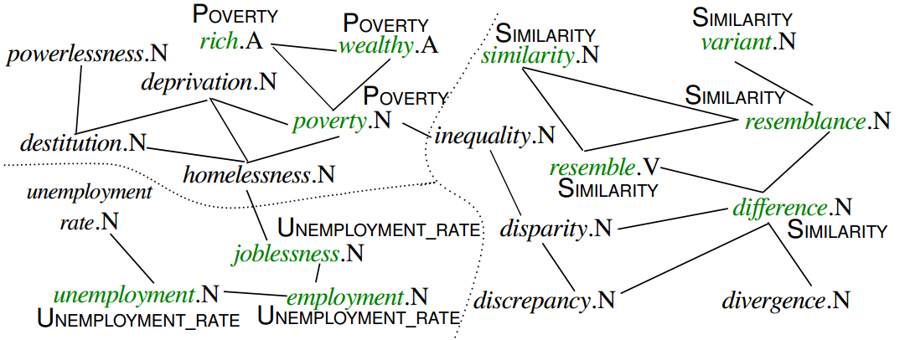
Semi-Supervised Frame-Semantic Parsing for Unknown Predicates
Extracts possible frame targets from unlabeled data
Notes:
Green targets are observed in the FrameNet data. Above/below them are shown the most frequently observed frame that these targets evoke. The black targets are unobserved and label propagation produces a distribution over most likely frames that they could evoke.

Slide 42
Semi-Supervised Frame-Semantic Parsing for Unknown Predicates
Extracts possible frame targets from unlabeled data
Notes:
Green targets are observed in the FrameNet data. Above/below them are shown the most frequently observed frame that these targets evoke. The black targets are unobserved and label propagation produces a distribution over most likely frames that they could evoke.

Slide 43
Semi-Supervised Frame-Semantic Parsing for Unknown Predicates
Graph construction
Distance from dependency parsed text
About 60,000 targets (about 10,000 in FrameNet)
Convex quadratic optimization problem
Notes:
Label propagation

Slide 44
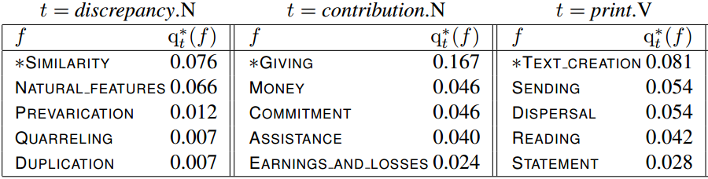
Semi-Supervised Frame-Semantic Parsing for Unknown Predicates
Learned neighbor frame distribution
Notes:
Similarity between argument 1 and argument two
Give amount from so to so

Slide 45
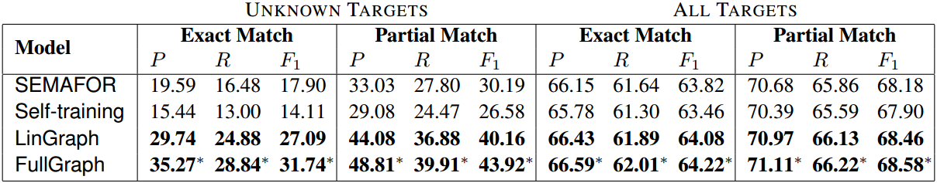
Semi-Supervised Frame-Semantic Parsing for Unknown Predicates
Parsing results
Notes:
Predict among most likely frames, beats baseline.

Slide 46
Overview
Features
Prototype-Driven Learning for Sequence Models
Haghighi and Klein, 2006
DA with Structural Correspondence Learning
Blitzer et al., 2006
NLP (almost) from scratch
Collobert et al., 2011
On Using Monolingual Corpora in NMT
Gulcehere et al., 2015

Slide 47
Prototype-Driven Learning for Sequence Models
Method type: Feature learning
Task: POS tagging, Classified ads segmentation
Labeled data: PTB/CTB, Classifieds
Auxiliary data: Prototypes
Notes:
High level idea: Similar tokens should have similar labels

Slide 48
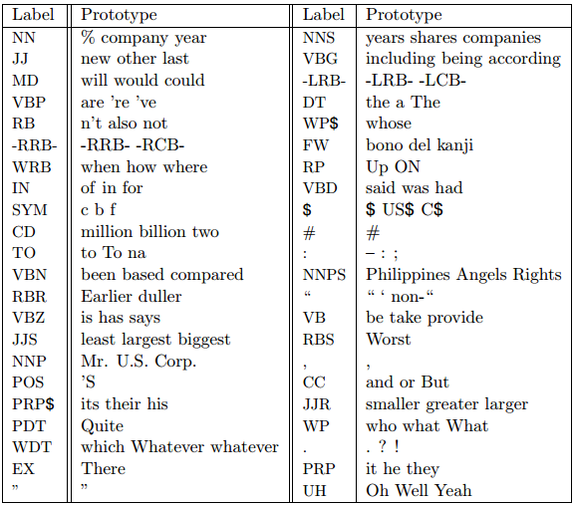
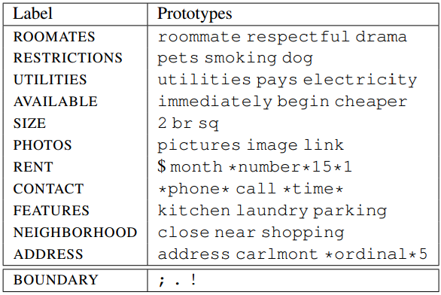
Prototype-Driven Learning for Sequence Models
Example prototypes:

Slide 49
Prototype-Driven Learning for Sequence Models
Gives prototypes of tag-token pairs
Compute a similarity measure on tokens
Adds similarity to the prototypes as a feature

Slide 50
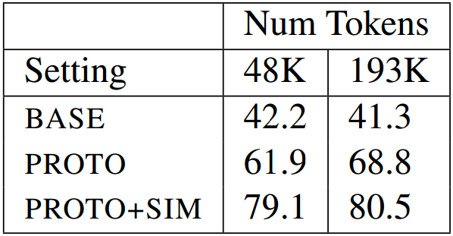
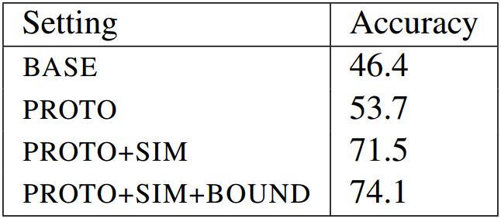
Prototype-Driven Learning for Sequence Models
Results:
Classifieds segmentation
POS tagging

Slide 51
Domain Adaptation with Structural Correspondence Learning
Method type: Feature learning, Multi-view learning, Domain adaptation
Task : POS tagging
Labeled data: MEDLINE (target domain)
Auxiliary data: WSJ (source domain)
Notes:
High level idea: Learns a linear transformation from source to target domain using common features

Slide 52
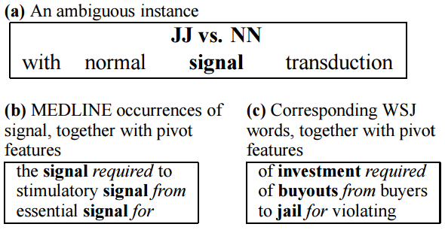
Domain Adaptation with Structural Correspondence Learning
Example: pivot features required, from, for

Slide 53
Domain Adaptation with Structural Correspondence Learning
Defines a set of pivot features, present in both source and target
Sets up a set of mini-tasks: “predict the presence of pivot feature f”
Runs SVD on the learned weights w_{f}

Slide 54
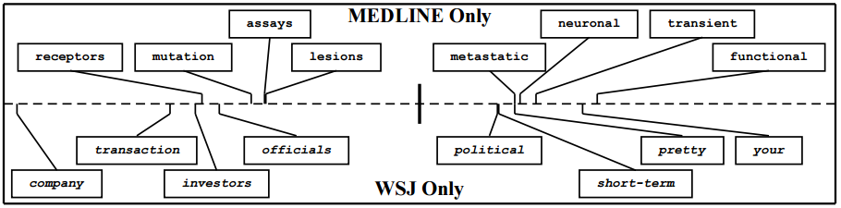
Domain Adaptation with Structural Correspondence Learning
Projection on first singular vector:

Slide 55
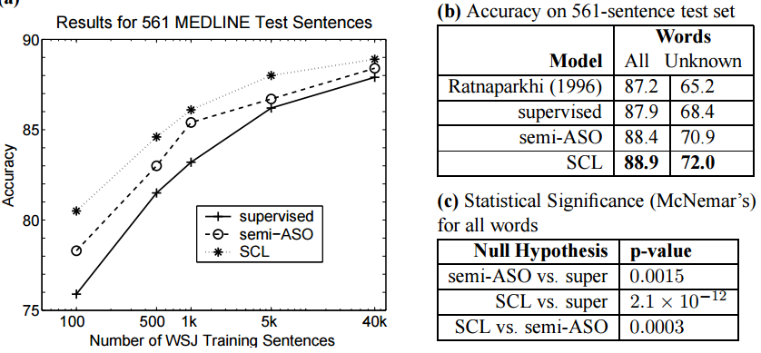
Domain Adaptation with Structural Correspondence Learning
Results:
Notes:
ASO: different tasks (called structural learning): predict words / predict top-k choices of the classifier

Slide 56
NLP (almost) from Scratch
Method type: Feature learning, Multi-view learning
Task : POS, chunking, NER, SRL
Labeled data: PTB, CoNLL
Auxiliary data: 852M words from Wikipedia + Reuters
Notes:
High level idea: Sharing word representations across NLP tasks

Slide 57
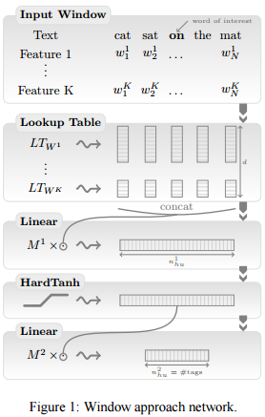
NLP (almost) from Scratch
Neural network architecture

Slide 58
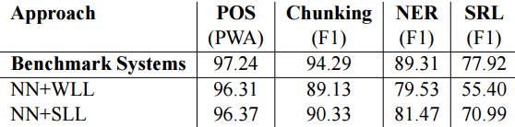
NLP (almost) from Scratch
First approach: supervised training of neural networks for tasks

Slide 59
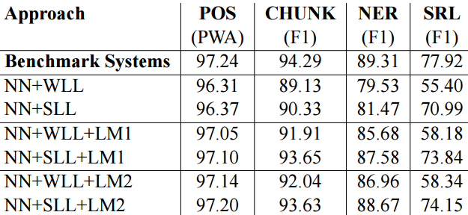
NLP (almost) from Scratch
Second approach: initialize with word representations from LM

Slide 60
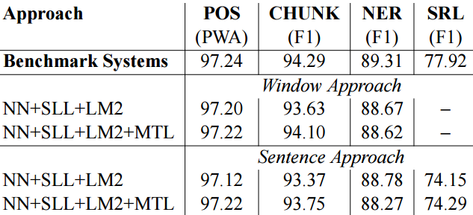
NLP (almost) from Scratch
Finally: joint training

Slide 61
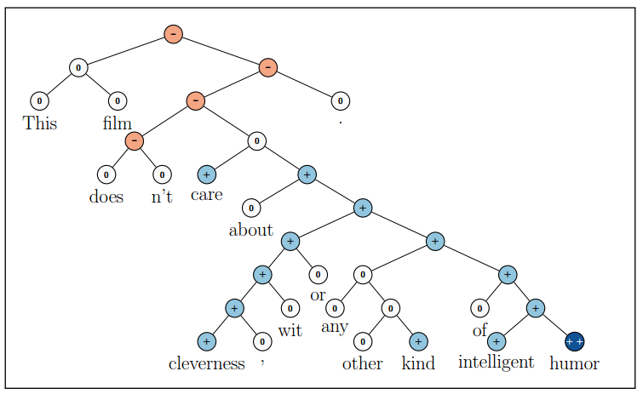
Recursive Deep Models for Semantic Compositionality Over a Sentiment Treebank
Sentiment analysis using word embeddings and syntactic parses

Slide 62
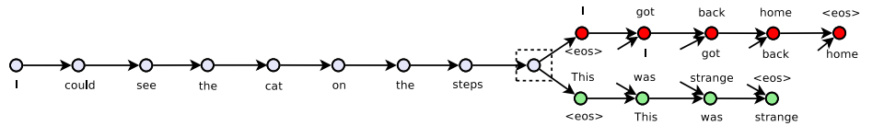
Skip-Thoughts Vectors (Kiros et al., NIPS 2015)
Encodes sentences directly
Improves sentence-level tasks
Classification
Paraphrase
Image-sentence ranking

Slide 63
On Using Monolingual Corpora in NMT
Method type: Feature learning, Target distribution
Task : Machine Translation
Labeled data: Aligned text
Auxiliary data: Monolingual corpora
Notes:
High level idea: Sharing word representations across NLP tasks

Slide 64
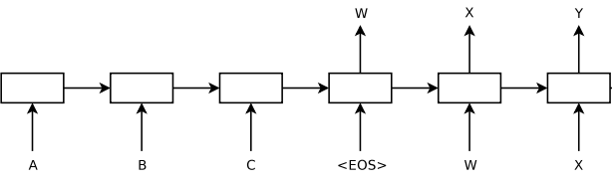
On Using Monolingual Corpora in NMT
Neural Machine Translation as sequence to squence modeling
RNN ancoder and decoder:
Notes:
High level idea: Sharing word representations across NLP tasks

Slide 65
On Using Monolingual Corpora in NMT
Train Neural Machine Translation system
Train target language model: RNN
Shallow fusion: beam search on combined scores
Deep fusion: add language model hidden state as input to decoder (+controller)
Notes:
High level idea: Sharing word representations across NLP tasks

Slide 66
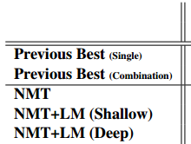
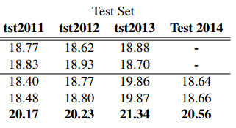
On Using Monolingual Corpora in NMT
Turkish
Notes:
High level idea: Sharing word representations across NLP tasks

Slide 67
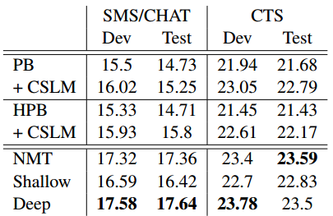
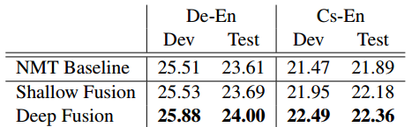
On Using Monolingual Corpora in NMT
Chinese
Notes:
High level idea: Sharing word representations across NLP tasks

Slide 68

Semi-Supervised Learning for Entity Linkage using Variational Inference
Yacine Jernite, Alexander Rush and David Sontag
Notes:
Hello! Today, I am presenting work done with Alexander Rush and David Sontag on a fast learning algorithm for a new family of Markov Random Fields language models.

Slide 69
Semi-Supervised Learning for Entity Linkage using Variational Inference
Method type: Feature learning, Label inference
Task: Medical concept extraction
Labeled data: Semeval 2015 (annotated medical notes)
Auxiliary data: MIMIC-II (medical text), UMLS
Notes:
High level idea: Learn correlation between entities using unlabeled data.

Slide 70
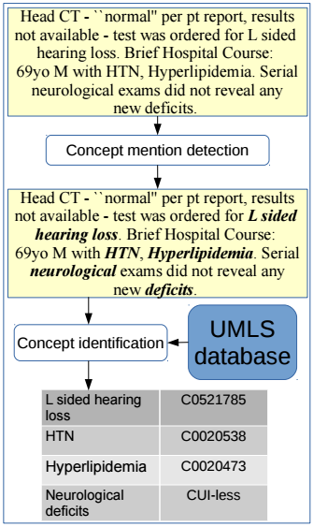
Task description
We have:
Medical text from the MIMIC database
Medical knowledge base UMLS with concept descriptions
We want to identify concepts in the text and link them to UMLS

Slide 71
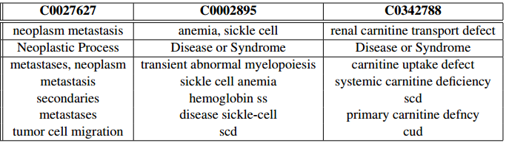
UMLS samples
Ambiguous, incomplete

Slide 72
UMLS samples
Ambiguous, incomplete

Slide 73
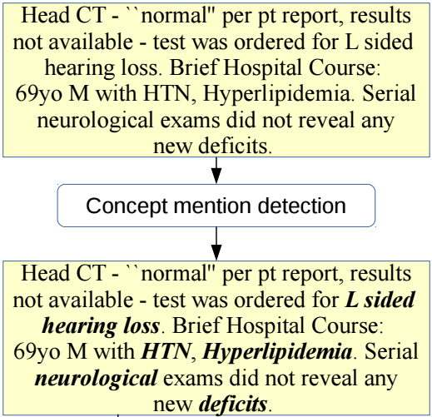
Step 1: Mention Detection

Slide 74
Step 1: Mention Detection
B, I, O – ID, OD tagging with CRF
O
O
B
I
I
I
O
ordered
for
L
sided
hearing
loss
.
B
OD
OD
OD
OD
OD
ID
neuro
exams
did
not
reveal
any
deficits

Slide 75
Step 1: Mention Detection
Duplicating incompatible examples
B
I
I
I
O
O
O
L
sided
hearing
loss
and
pain
.
B
I
OD
OD
OD
ID
O
L
sided
hearing
loss
and
pain
.
Notes:
Non-separable. BUT, only problem with MAP usage

Slide 76
Step 1: Mention Detection
Run inference on unlabeled and test set
Approximate marginal probability
Threshold
Notes:
Non-separable. BUT, only problem with MAP usage.

Slide 77
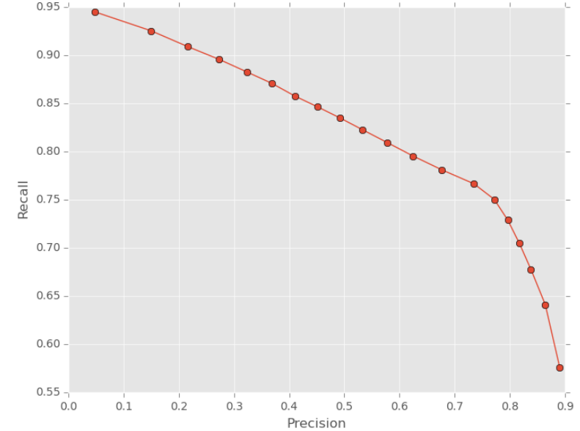
Step 1: Mention Detection
PR curve:
Notes:
High recall: another chance to deal with mistakes

Slide 78
Step 1: Mention Detection
Other approaches:
ezDI: A Supervised NLP System for Clinical Narrative Analysis, Pathak et al., 2015
BIO for continuous, SVM to join
ULisboa: Recognition and Normalization of Medical Concepts, Leal et al., 2015
BIOENS tagging scheme, Brown clusters, domain lexicons
Notes:
Non-separable. BUT, only problem with MAP usage.

Slide 79
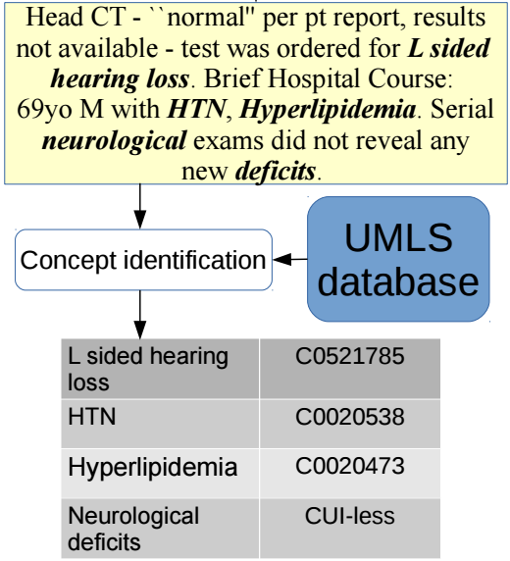
Step 2: Mention Identification

Slide 80
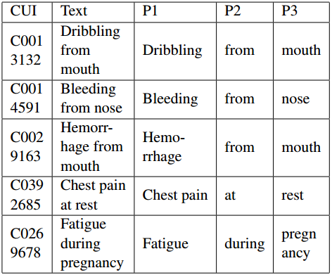
Step 2: Mention Identification
Pathak et al.:
Simple lookup
Semi-automated modified descriptions
Edit distance

Slide 81
Step 2: Mention Identification
Leal et al.
Abbreviation dictionary
UMLS lookup
Similarity: Lucene, n-gram and edit distane
Lowest Information Content (specificity, using UMLS tree structure)

Slide 82
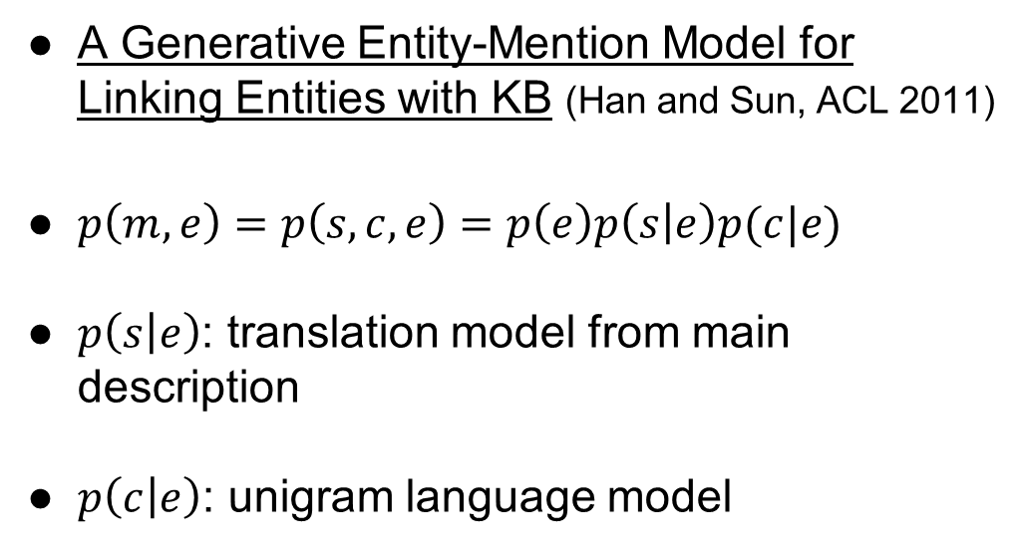
Step 2: Mention Identification
A Generative Entity-Mention Model for Linking Entities with KB (Han and Sun, ACL 2011)
$p\left(m,e\right)=p\left(s, c, e\right)=p\left(e\right)p\left(s | e\right)p(c|e)$
$p\left(s | e\right)$: translation model from main description
$p\left(c | e\right)$: unigram language model

Slide 83
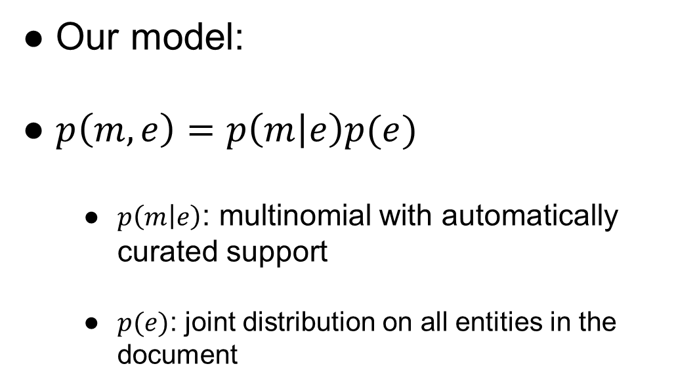
Step 2: Mention Identification
Our model:
$p\left(m, e\right)=p\left(m | e\right)p(e)$
$p\left(m | e\right)$: multinomial with automatically curated support
$p(e)$: joint distribution on all entities in the document

Slide 84
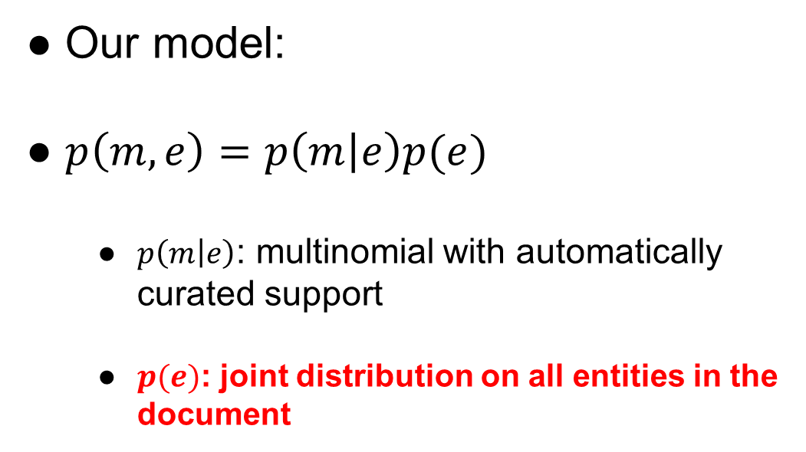
Step 2: Mention Identification
Our model:
$p\left(m, e\right)=p\left(m | e\right)p(e)$
$p\left(m | e\right)$: multinomial with automatically curated support
$p(e)$: joint distribution on all entities in the document

Slide 85

Step 2: Mention Identification
$p\left(e\right)$: MRF on CUIs
L sided
hearing loss
HTN
Hyper-lipidemia
Neuro-logical deficits
…

Slide 86
Step 2: Mention Identification
Problem: CUIs are latent variables on MIMIC (unlabeled)
Variational learning, following:
Autoencoding Variational Bayes, Kingma and Welling, ICLR 2014

Slide 87
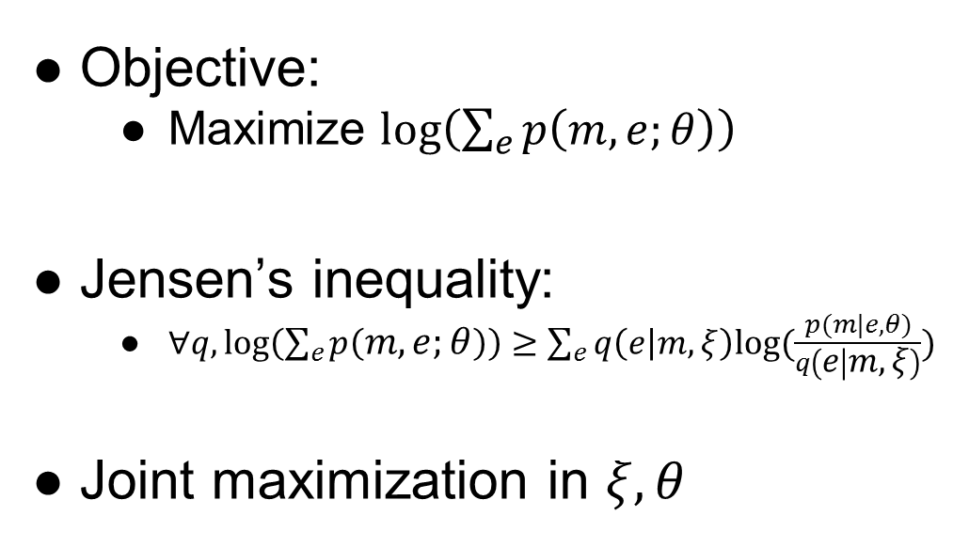
Step 2: Mention Identification
Objective:
Maximize $log\left(\sum_{e}{p\left(m,e;θ\right)}\right)$
Jensen’s inequality:
$∀q,log\left(\sum_{e}{p\left(m,e;θ\right)}\right)≥\sum_{e}{q\left(e | m, ξ\right)log⁡(\frac{p(m|e, θ)}{q\left(e | m, ξ\right)})}$
Joint maximization in $ξ, θ$

Slide 88

Step 2: Mention Identification
Factorized $q$:
$q\left(e | m\right)=\prod_{i}{q(e_{i}|m)}$
L sided
hearing loss
HTN
Hyper-lipidemia
Neuro-logical deficits
…

Slide 89

Step 2: Mention Identification
Considers mention and neighbors:
$q\left(e_{i} | m\right)= q\left(e_{i} | m_{i−2},m_{i−1},m_{i},m_{i+1},m_{i+2}\right)$
L sided
hearing loss
HTN
Hyper-lipidemia
Neuro-logical deficits
…

Slide 90
Step 2: Mention Identification
Neural network parameterization
Semi-automated restricted support
Supervised training gives 2nd best accuracy on 2014 task

Slide 91
Step 2: Mention Identification
Next steps:
Pre-train parameters
Use correlation model
Train with variational algorithm

Slide 92
Review of Semi-Supervised methods
Automatic labeling of data
Label pre-selection
Use prototypes
Use features learned on larger corpus

Slide 93
Review of Semi-Supervised methods
Domain adaptation: PubMed
Multi-view learning

Slide 94
Review of Semi-Supervised methods
Multi-view learning:
Other information on the patient: diagnosis codes, procedures, demographics, etc…
Jointly learn to predict those

Slide 95
Questions?

