Slide 1
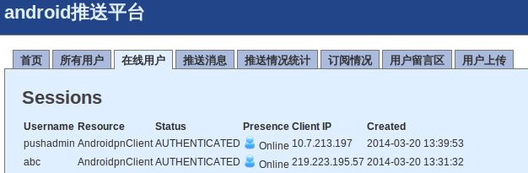

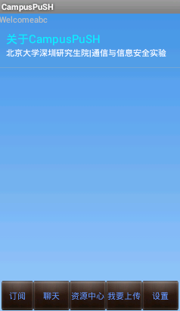
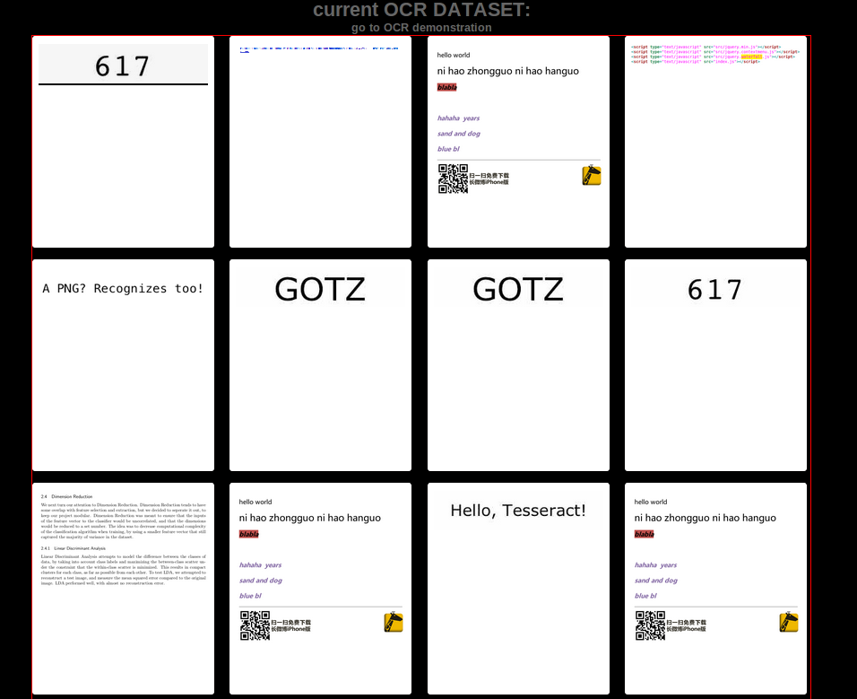
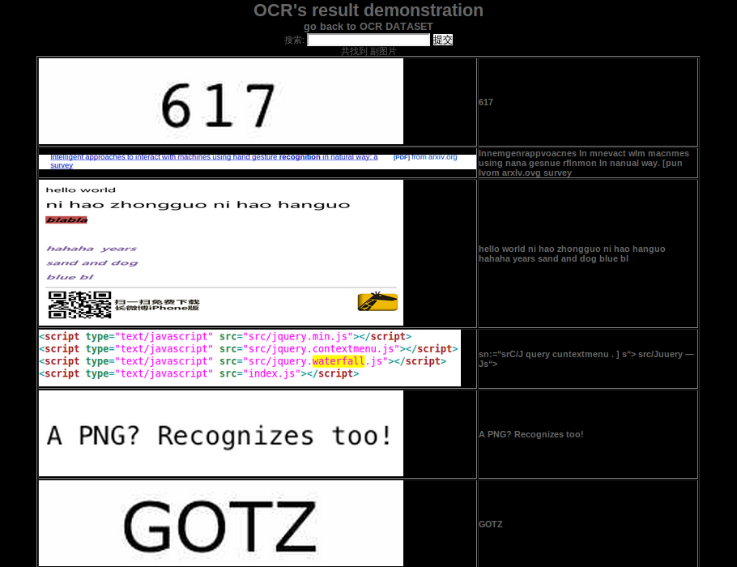
Part 2 Implemention of web security system based on natural image OCR

Slide 2
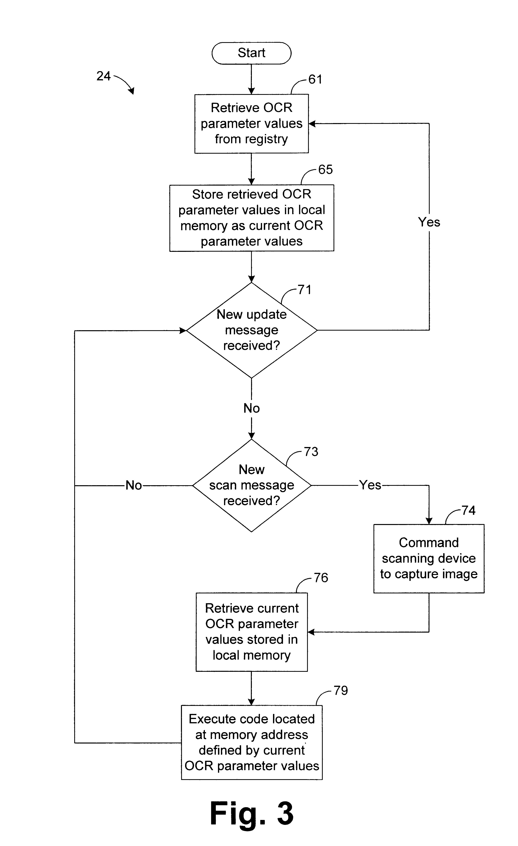
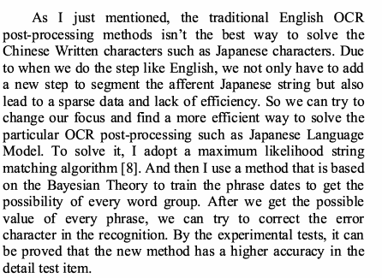

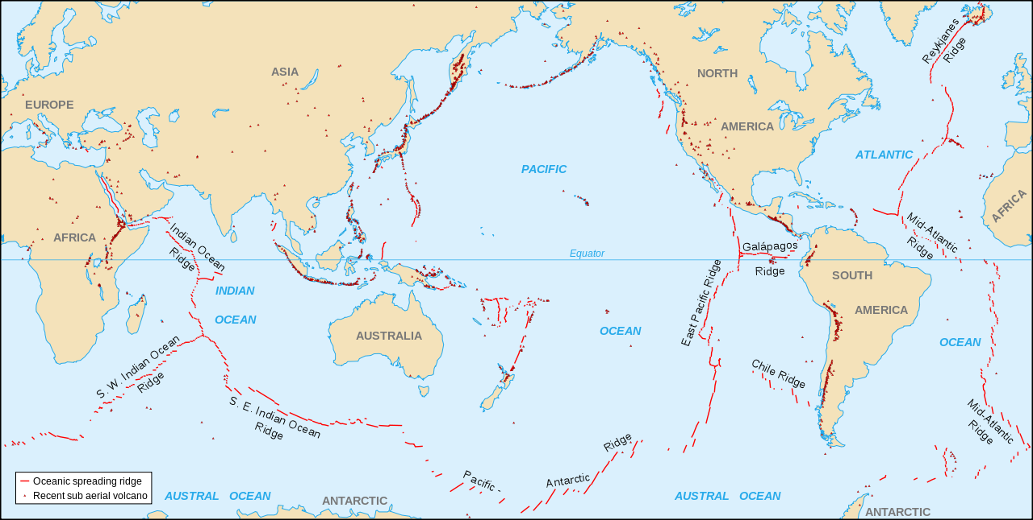
System application scenarios
Web with images
  Charts,Scene images,Printed images...
Growing need to anaylize, index and monitor the images
  OCR and Data Mining

Slide 3
System architecture
System target
  Collect images from web (SNS Website and Client)
  Text Recognization with web images(OCR)
  Real time alarm using push system(Push Service)
web
Image text
detection
And OCR
Web security
administrator's
mobile end
images
Alarm Notification
Via push service

Slide 4
System architecture
SNS App client
Security Admin client
Various images
SNS Image Collection Server
images
Security alarm notifications via
push service
Text Detection Instance
OCR Instance
Detected
Image
Areas via
our algorithm
OCR results
Alarm Instance

Slide 5
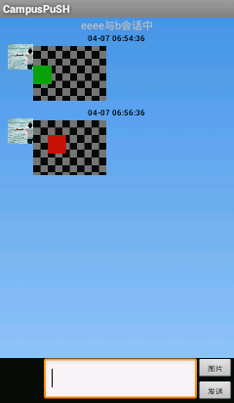
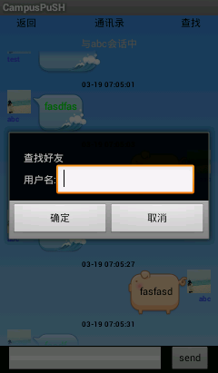
System implemention
SNS App Client
  Collect images from SNS users to the SNS image processing server
Sending
pictures
Client A
Client B
SNS
online talk
Images
Images
SNS Image Collection Server
Images
Images
Images
Text Detection Instance

Slide 6
System implemention
SNS image Collection Server
  Collect images from SNS Clients
Client A
Client B
Image collection Server
Images
Images
SNS Image Collection Server
Images
Text Detection Instance

Slide 7
System Implemention
Text Detection and OCR Instance
SNS Image Collection Server
images
Text Detection Instance
OCR Instance
Detected
Image
Areas via
our algorithm
OCR results
Alarm Instance
Text Detect and OCR
Result demonstration

Slide 8


System Implemention
Alarm Instance
  A xmpp client on the mobile used by the security admin
  A xmpp server
Security Admin client
Security admin
Client, receive
alarm notifications
from xmpp server
Alarm notification
OCR Instance
OCR results
Alarm Instance

