Slide 1
Natural image text detection and an application example in web security system

Slide 2

Part 1 Natural image text detection

Slide 3
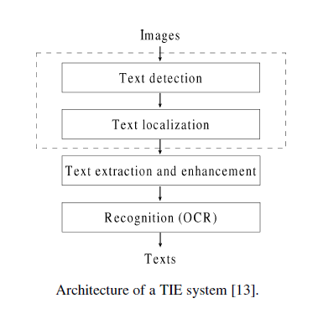
OCR
Steps
  Text detection/localization
    detect text area from complex background
  Text segmatation
    Segment words or characters
  Text recorgnization
    Recorgnize words or characters
  Post processing
    Spell correction etc.
key steps:
  Text detection
  Character recognization

Slide 4
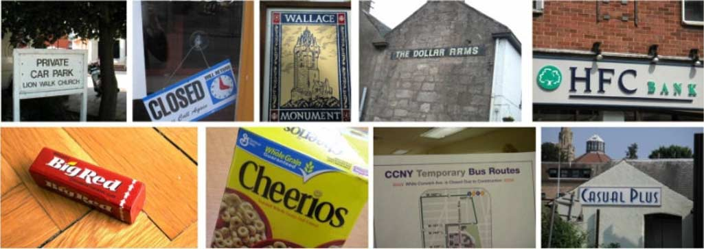
Natural Image OCR
Natural scene images embed text in arbitrary shapes, sizes, and orientations into complex background,
Most off-the-shelf OCR software cannot handle complex
background interferences and non-orienting text lines

Slide 5
Natural image text detection Overview
Defination:
  Detecting texts from a natural image which has a complex background
  Often as a pre-processing of natural image OCR
  Highly effect the performance of natural image OCR

Slide 6
Method 1: Slide Window
Divide image into fix-sized regions
Machine Learning to classify or recognize the regions
  Unsupervised: autoencoder,sparse coding
  K-means cluttering

Slide 7
Method 2:Connected component analysis
Partition(content-based/non-~)
  Gradient,color,
  the minimum and maximum size,
  aspect ratio,
  contrast between character strokes and background,
  stroke width transform..
Classifing and grouping partitioned text regions
  Classify: feature like size and shape of text characters
  group: detectors of color, texture, contour, temporal
    invariance...

Slide 8
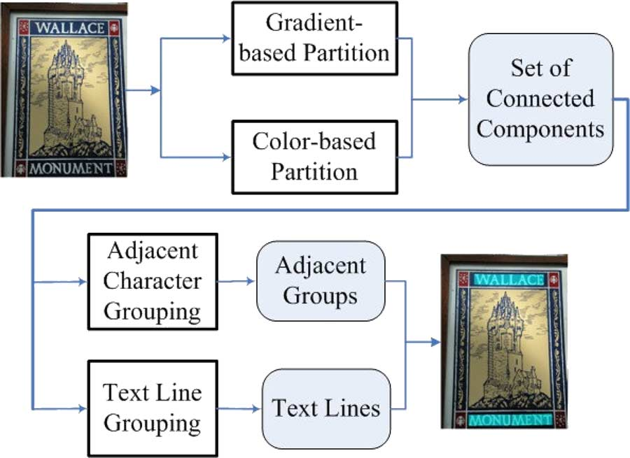
I
Method 2:Connected component analysis
Text String Detection From Natural Scenes by Structure-Based Partition and Grouping ,Transactions On Image processing

Slide 9
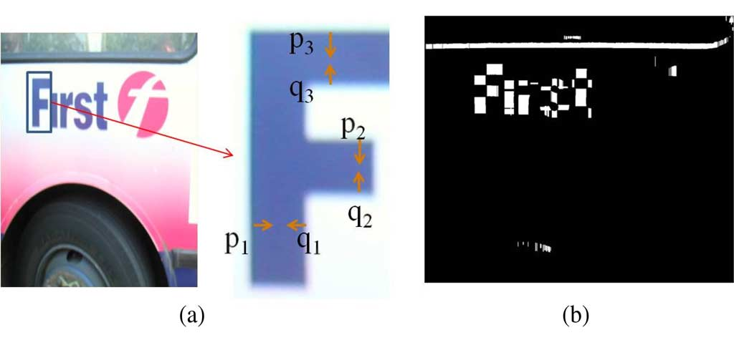
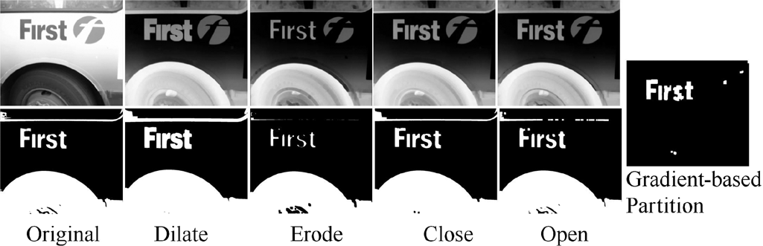
Stage 1:partition
1.Gradient partition

Slide 10
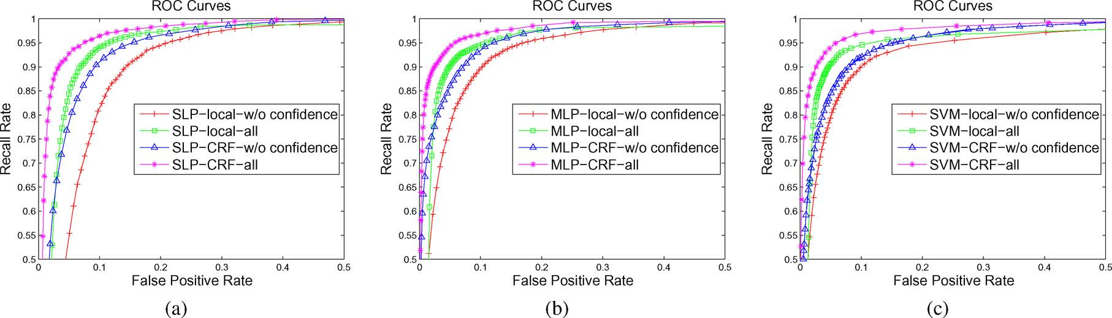
Stage 2:classify and merge
  Use classifier to classify text regions out of all partitioned image regions

Slide 11
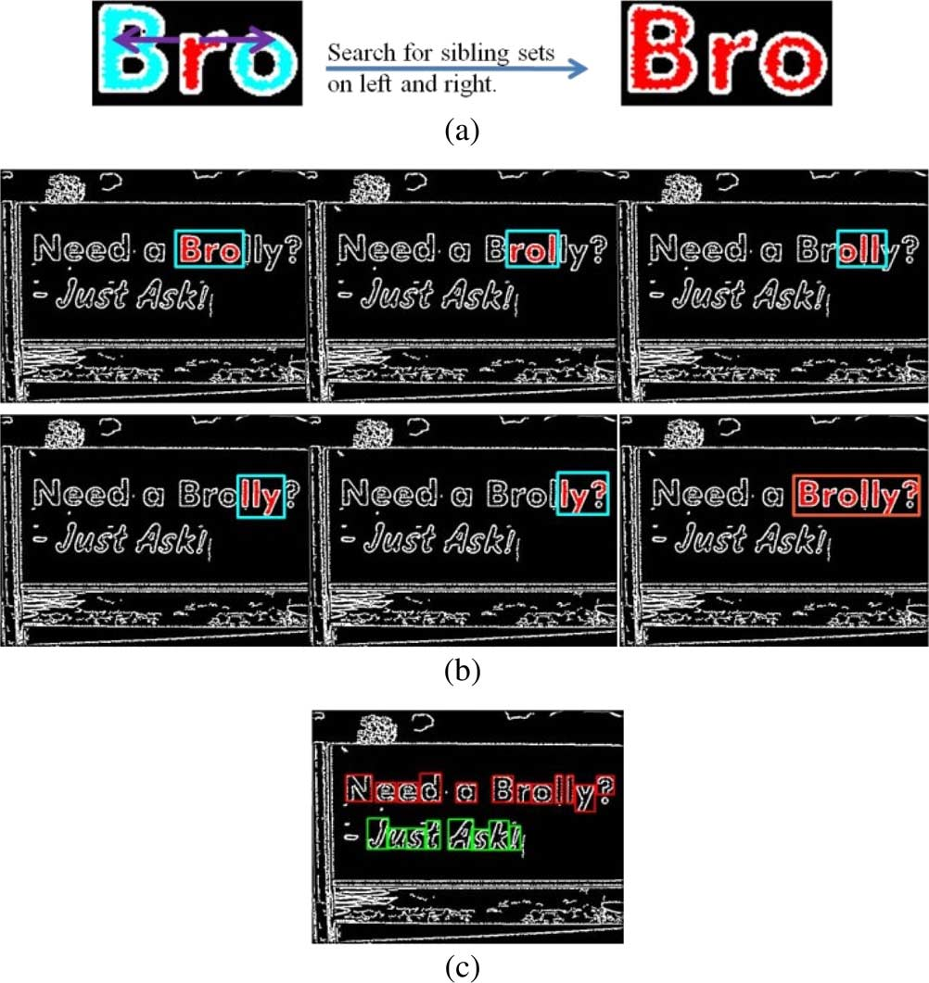
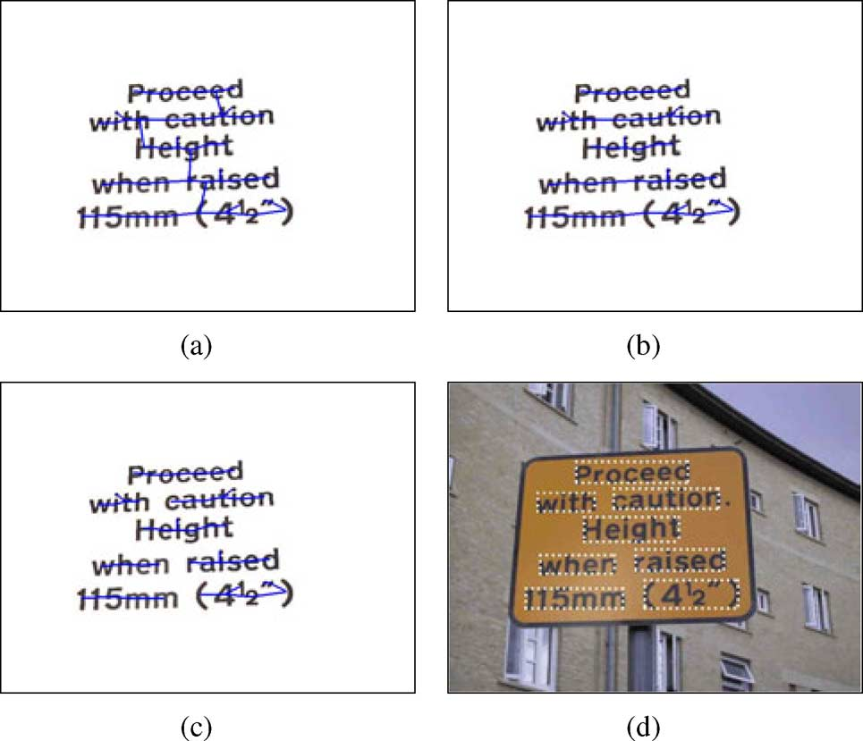
Stage 2:classify and merge
2.merge
Example of the text grouping stage. (a) Building component tree with
MST. (b) Text line partition. (c) Text word partition. (d) Text localization results.

Slide 12
Latest methods since 2011
MSERs(maximally s based)
  MSER is an particular case of an Extremal Region whose size remains virtually unchanged over a range of thresholds.
  Procedures:
    Partition into Connected Component region
    recognize candidate text region based on MSER
  Performance:
    perform well generally
    Bad on blurry images or characters with low contrast.
    detecting of repeating components

Slide 13
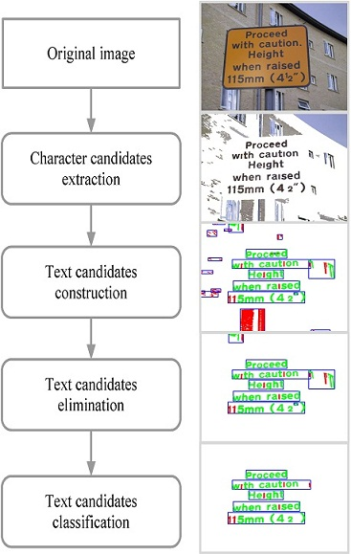
Latest: Improved MSER

