Slide 1
Natural image text detection and an application example in web security system

Slide 2

Part 1 Natural image text detection

Slide 3
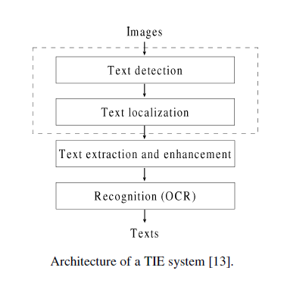
OCR
Steps
  Text detection/localization
    detect text area from complex background
  Text segmatation
    Segment words or characters
  Text recorgnization
    Recorgnize words or characters
  Post processing
    Spell correction etc.
key steps:
  Text detection
  Character recognization

Slide 4
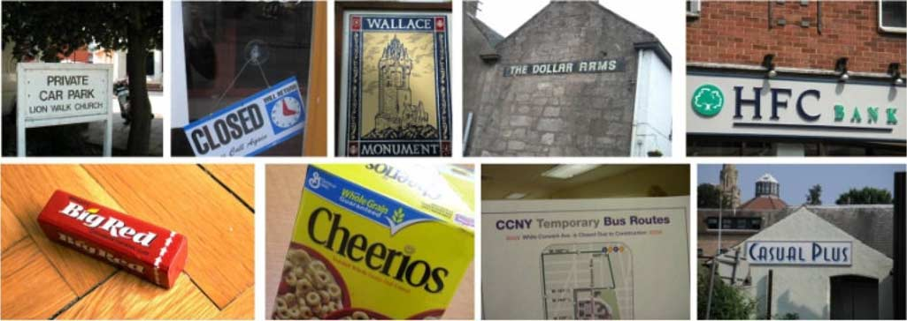
Natural Image OCR
Natural scene images embed text in arbitrary shapes, sizes, and orientations into complex background,
Most off-the-shelf OCR software cannot handle complex
background interferences and non-orienting text lines

Slide 5
Natural image text detection Overview
Defination:
  Detecting texts from a natural image which has a complex background
  Often as a pre-processing of natural image OCR
  Highly effect the performance of natural image OCR

Slide 6
Current Methods Overview
General Components:
  text detection: Partition/segment image into text/character/fixed regions ( based on connected components, or as a sliding window)
  text candidates construction: based on detected regions(merge/classify/clusttering)

Slide 7
Method 1: Slide Window
Partition: into fix-sized regions
Recognization: Machine Learning to classify or recognize the regions
  Unsupervised: autoencoder,sparse coding
  K-means cluttering

Slide 8
Method 2:Connected component analysis
text detection /Partition(content-based/non-~)
  Gradient,color,
  the minimum and maximum size,
  aspect ratio,
  contrast between character strokes and background,
  stroke width transform..
  MSER
text candidates construction Classify and group partitioned text regions
  Classify: feature like size and shape of text characters
  group: detectors of color, texture, contour, temporal
    invariance...

Slide 9
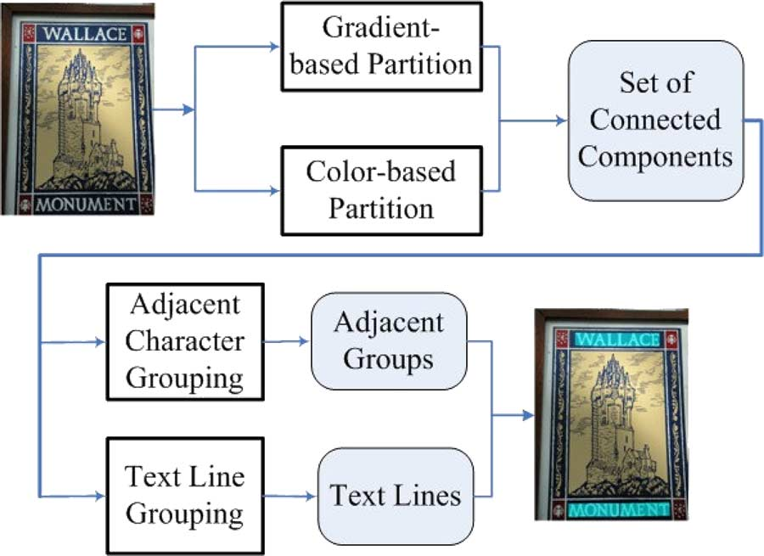
I
Method 2:Connected component analysis example
Text String Detection From Natural Scenes by Structure-Based Partition and Grouping ,Transactions On Image processing

Slide 10
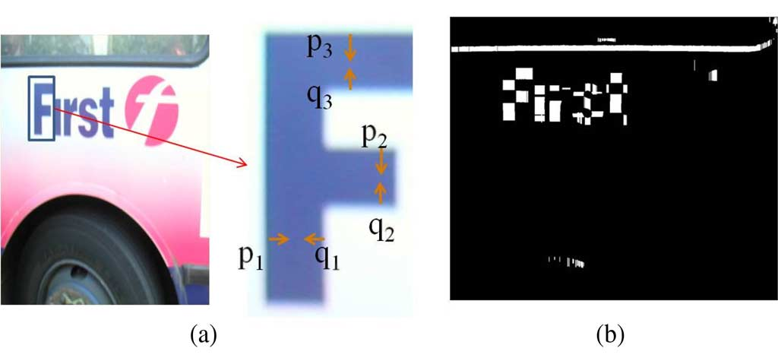
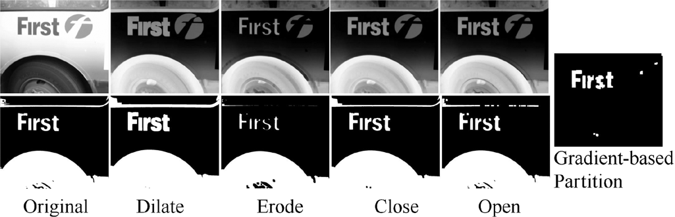
Stage 1:partition algorithm
1.Gradient partition

Slide 11
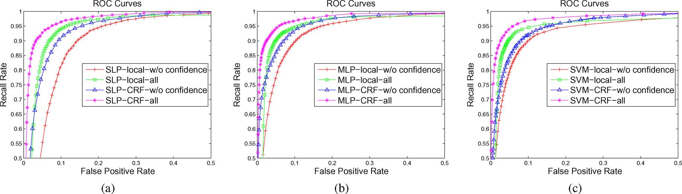
Stage 2:text candidates construction algorithm
  Use classifier to classify text regions out of all partitioned image regions

Slide 12
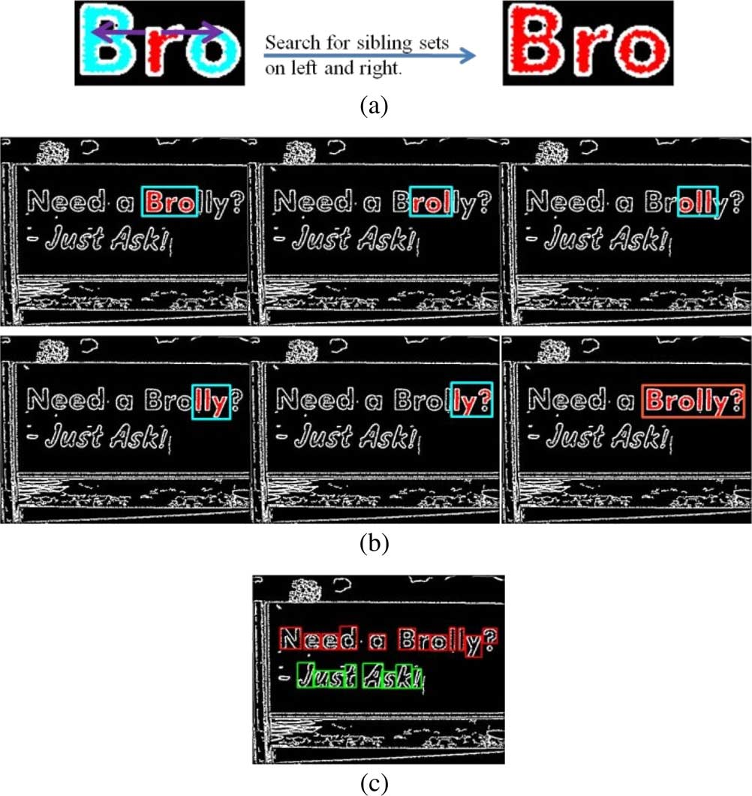
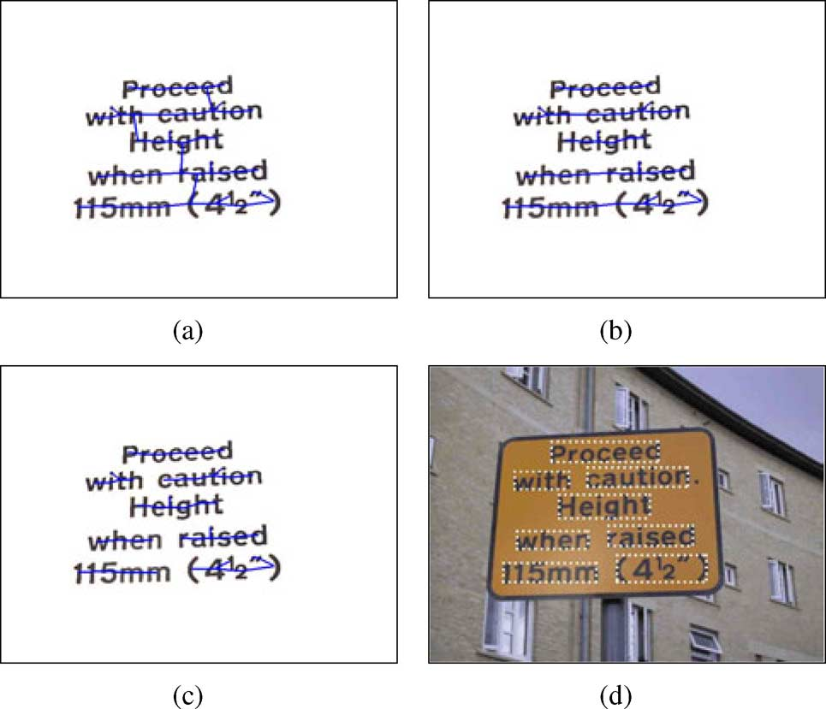
Stage 2:classify and merge
2.merge
Example of the text grouping stage. (a) Building component tree with
MST. (b) Text line partition. (c) Text word partition. (d) Text localization results.

Slide 13
Latest methods since 2011
MSERs(maximally stable extreme region based)
  MSER is an particular case of an Extremal Region whose size remains virtually unchanged over a range of thresholds.
    This method do Character candidates detection/extraction algorithm based on MSER,
    return partitions that contains text.
  Procedures:
  Performance:
    perform well generally
    Bad on blurry images or characters with low contrast.
    detecting of repeating components

Slide 14

MSER
    Experiment Results:
    Room for Accuracy speed improvements
    repeating regions
    Insufficient text candidates construction algorithms

Slide 15
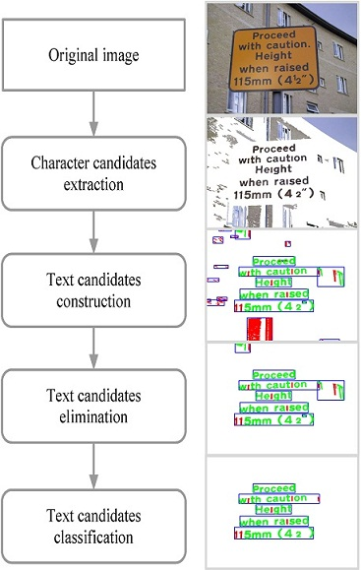
Latest: Improved MSER

