Slide 1
Natural image text detection and an application example in web security system

Slide 2

Part 1 Natural image text detection

Slide 3
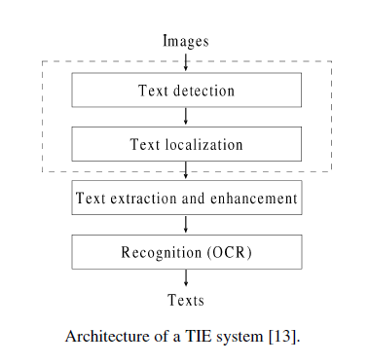
OCR
Steps
  Text detection/localization
    detect text area from complex background
  Text segmatation
    Segment words or characters
  Text recorgnization
    Recorgnize words or characters
  Post processing
    Spell correction etc.
key steps:
  Text detection
  Character recognization

Slide 4
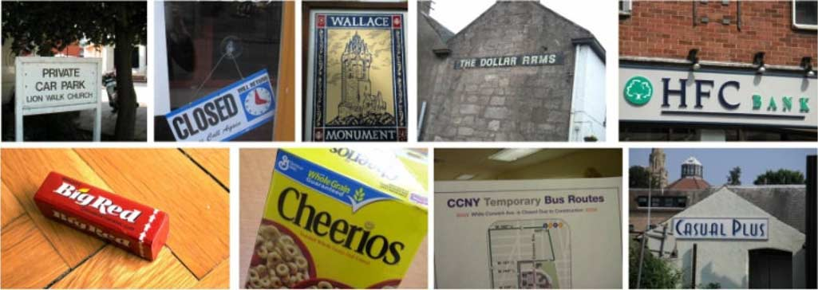
Natural Image OCR
Natural scene images embed text in arbitrary shapes, sizes, and orientations into complex background,
Most off-the-shelf OCR software cannot handle complex
background interferences and non-orienting text lines

Slide 5
Natural image text detection Overview
Defination:
  Detecting texts from a natural image which has a complex background
  Often as a pre-processing of natural image OCR
  Highly effect the performance of natural image OCR

Slide 6

Image text detection/localizing Current methods Summary
Slide Window
Connected component analysis (Divide into connected regions->merge)
  Partition(content-based/non-~)
    Gradient,color, the minimum and maximum size, aspect ratio, contrast between character strokes and background,stroke width transform..

Slide 7
Image text detection/localizing Current methods Summary
  Grouping or classifing text regions
    Group: detectors of color, texture, contour, temporal
    invariance...
    Classify: feature like size and shape of text characters

Slide 8
Connected component analysis (Divide into connected regions->merge)
Partition(content-based/non-~)
  Gradient,color, the minimum and maximum size, aspect ratio, contrast between character strokes and background,stroke width transform..
Grouping or classifing text regions
  Group: detectors of color, texture, contour, temporal
  invariance...
  Classify: feature like size and shape of text characters

Slide 9
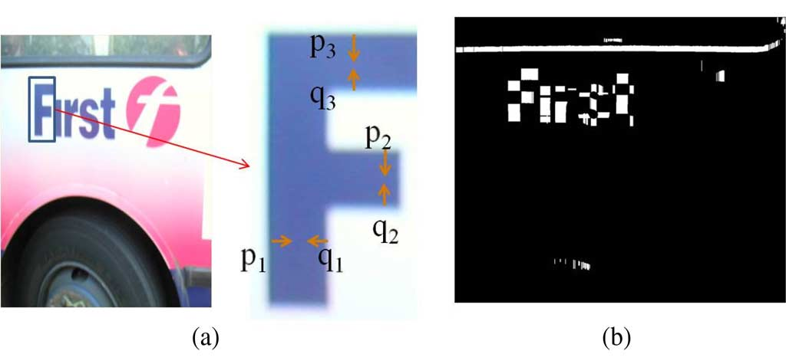
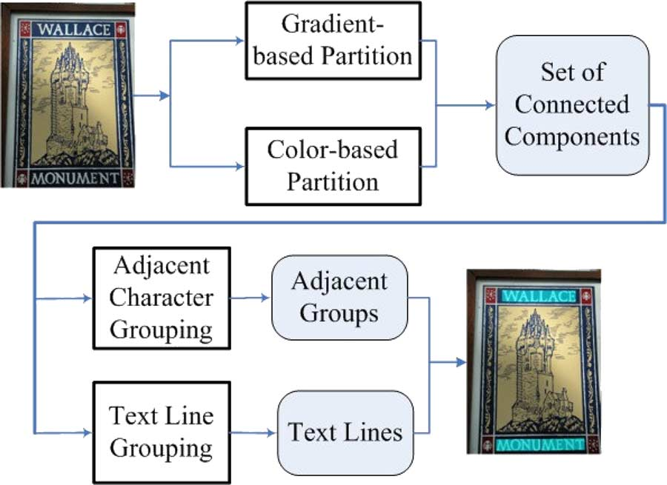
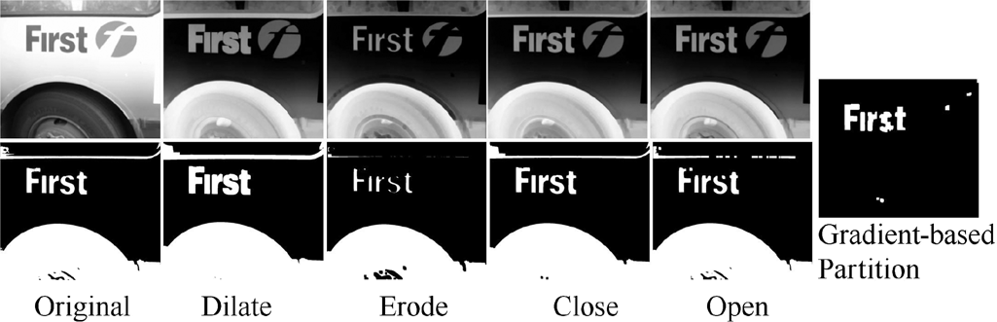
Connected Component Method example
Text String Detection From Natural Scenes by Structure-Based Partition and Grouping ,Transactions On Image processing

Slide 10
Natural image text detection Current methods
MSERs(maximally s based
  MSER is an particular case of an Extremal Region whose size remains virtually unchanged over a range of thresholds.
  The methods perform well but have problems on blurry images or characters with low contrast.
Text String Detection From Natural Scenes by structure-based partition and grouping
        IEEE Transactions on image processing 2011

