Slide 1
OCR
Defination
  Image Text Recognization
Pattern classification problem
  Image processing and analysis
  Pattern recognization
  Machine learning
  …
Usage
  Scene understanding, content-based image retrieval,assistive navigation...

Slide 2
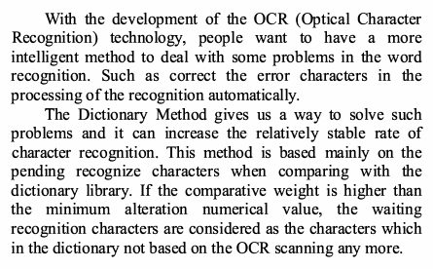

OCR
Classification
  Printed text image OCR
  Natural image OCR

