Slide 1
NodeJS
November 2013 TIP CORE UI

Slide 2
Agenda
NodeJS Overview
NodeJS Features
NodeJS Modules
Debug NodeJS
NodeJS project examples
JS Tests
JS Minify

Slide 3
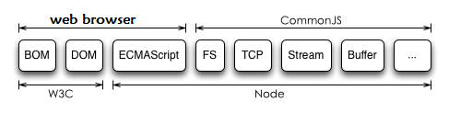
1 NodeJS overview
Download http://nodejs.org/dist/v0.10.20/node-v0.10.20-x86.msi
Official Site http://nodejs.org
Guide Book http://www.nodebeginner.org/
What is NodeJS:
A ECMAScript running environment with underlying OS related layer
A ECMAScript which don’t run on web-browser but on node
A script which can run on web-Server side (only if node is installed)

Slide 4
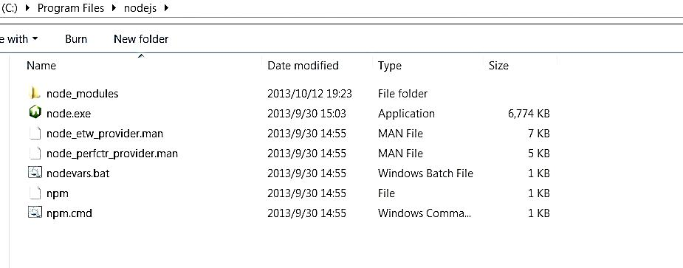

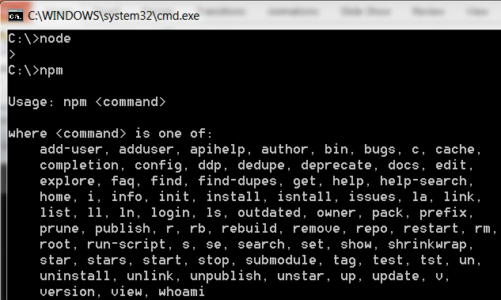
Install and use
install
use

Slide 5
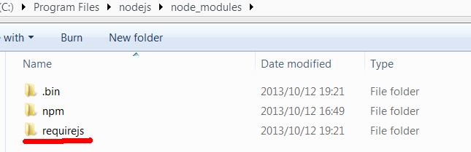
Maintain Packages using npm
$ npm ls
$ npm install [-g] package_name//-g will set the package to os path
$ npm update
Eg. Install require.js in NodeJS
Maybe you need to configure a http-proxy in IE… …
Requirejs package
NodeJS’s npm works like python’s easy_install

Slide 6
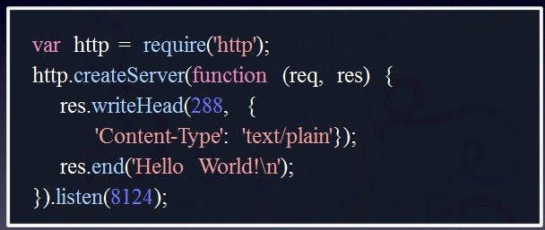
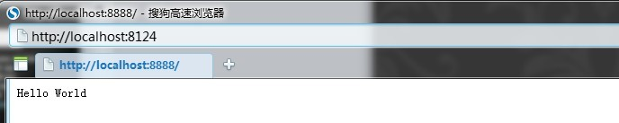
Use NodeJS
Helloworld.js
console.log(“hello world”)
server.js

Slide 7
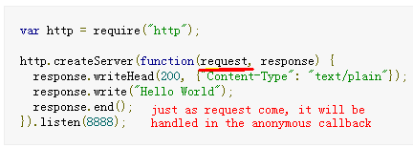
2 NodeJS Features
Non-blocking:
Asynchronous callback driven
No locks (no multi-thread)
Low system resource occupation
Traditional js: block operation
echo 'hello';
sleep(1);
echo 'world';
setTimeout(function(){ console.log('world');
}, 1000);
console.log('hello');
NodeJS:asynchronous
NodeJS aims at removing blocking operations and instead offering a pure callback-driven model

Slide 8
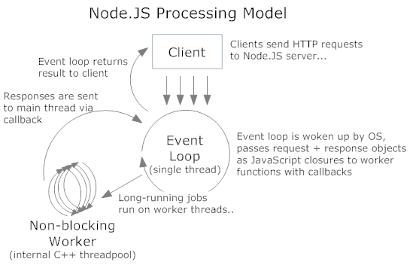
More about NodeJS’s Event-driven
With event-loop and callbacks, there is no “wait until when xx, do sth” operations , but “(when xx) do sth” operations, you just do sth at a time or state, then you go to another state, and you don’t need to block for some state to come .
The main loop thread received every request event, and distribute it to another non-blocking worker to handle it, the handle result will be sent back to main thread via callback asynchronously. There ‘s no real multi-thread, so no locks.

Slide 9
attention
Don’t write too much time-waiting synchronous code
or it will block your other codes including asynchronous code
Put them in asynchronous callbacks
attention.js
var die = false;
setTimeout(function() {
die=true
}, 100);
while(!die) { // this will block setTimeout() and below codes
}
console.log("done"); //this will never be executed

Slide 10
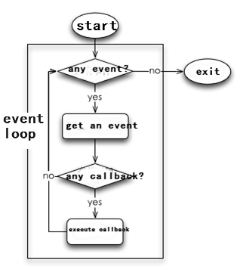
NodeJS Event-driven asynchronous callbacks summary
In tradition web-server, requests are handled one by one, result in much IO-waiting
In Node-JS, Long operation can be handled as asynchronous event’s callbacks
while one request is in its event-callback, the other can be handled :
in this way
Little time waiting in request handling
Low Latency
High CPU usage
high concurrency

Slide 11
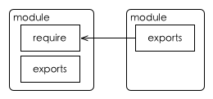
3 Use modules
With modules, we can make our code reusable, just like ‘library’
In nodejs, Every module exports some variable like ‘module.exports=…’
Every module can also use other modules like ‘require SOMEMOD’

Slide 12
3 Use modules
Define a module
Circle.js: define a module
var PI = Math.PI;
exports.area = function (r) { return PI * r * r; };
exports.circumference = function (r) { return 2 * PI * r; };
Call a module
Index.js: call module using ‘require’
var circle = require('./circle.js');
console.log( 'The area of a circle of radius 4 is ' +
circle.area(4));
Have a Test

Slide 13
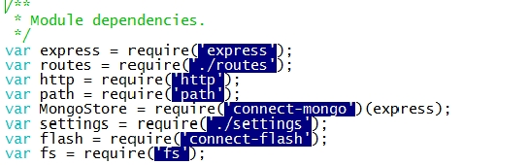
Module example
In a project, we will use modules from
nodejs
third-party
local(our project itself)
Nodejs modules
Third-party modules
local modules

Slide 14
Folders defined as a module
Sometimes, a module contains many files in a folder
folderxx
Package.json
{
"name" : "some-library",
"main" : "./lib/some-library.js"
}
package.json
a.Js
b.Js
….
Caller.js:
var s=require(“folderxx”)
…

Slide 15
More : Call & find module
How to call a module
Given absolute or relative path of the module
Given module name
How does node find a module
NodeJS will search the “node_modules” folder in ancestor directories recursively:
If not found, Node will search $HOME/.node_modules $HOME/.node_libraries $PREFIX/lib/node if $HOME or $PREFIX is set.
var circle = require('./circle.js');
console.log( 'The area of a circle of radius 4 is ' + circle.area(4));
var circle = require(‘express'); //express is the module name
Find(moduleName):
While(true)
If currentDir.hasFolder(“node_modules”)
If Scan(“./node_modules”) return pwd()
If currentDir=root return NOT_FOUND
currentDir=currentDir.getParentDir()

Slide 16
Module attention
When you export something in a js , you cannot do it asynchronously:
You can
[module.]exports=… or exports.xx=…
You cannot
setTimeout(function() {
module.exports = { a: "hello" };
}, xx);
Since ‘require’ will be done synchronously, You can
module.exports=require(‘…’)

Slide 17
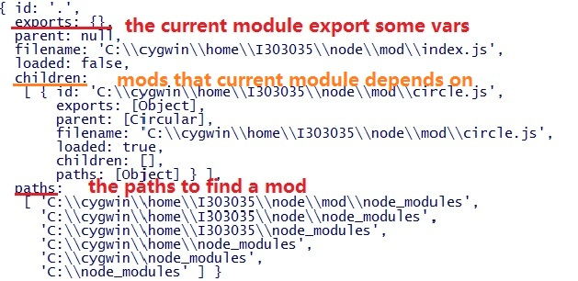
Further topics about module usage
In every JS file or module , there are two variables “module” and “exports” indicating current module and its related modules
Example:
var circle=require(“./circle.js”);
console.log(module);
console.log(exports);
Module
exports

Slide 18
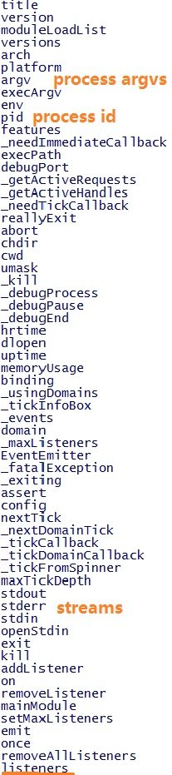
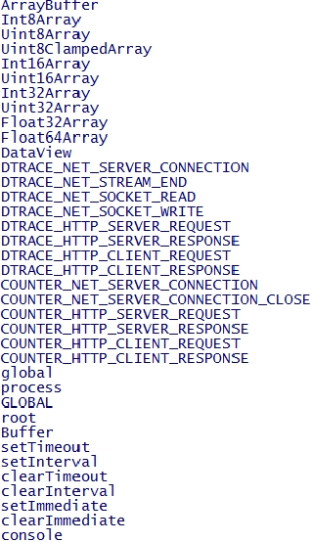
NodeJS variable scope
Variable scope: module-scope vs global-scope
When you write “var xx;”, it will be local to that module.
But when you write “xx=…”,it will be global which means it can be used in other modules.
Global Variables
Global variables are referenced by “global” namespace object
process
global
Example:
for(s in global)
{
console.log(s);
}
for(s in process)
{
console.log(s);
}

Slide 19
NodeJS internal modules
Synopsis
Assert
Buffer
Child_Process
Cluster
Console
Crypto
Debugger
DNS
Domain
Events
File System
Globals
HTTP
HTTPS
Modules
Net
OS
Path
Process
Punycode
Query Strings
Readline
REPL
Stream
String Decoder
Timers
TLS/SSL
TTY
UDP/Datagram
URL
Utilities
VM
ZLIB

Slide 20
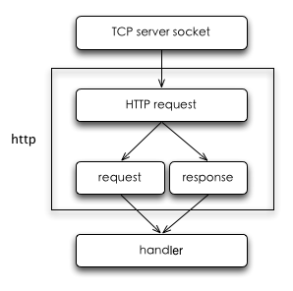
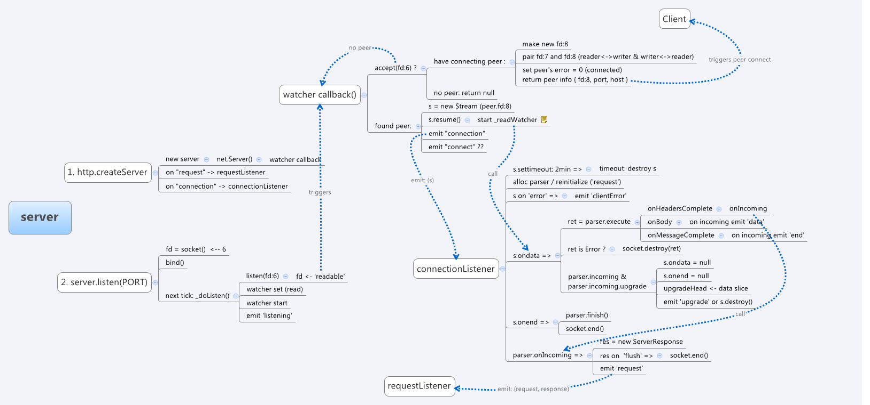
NodeJS HTTP module
HTTP Protocol structure
HTTP is a protocol working on the TCP layer
Server / client communicate using TCP socket
Node-JS’s flow chart with HTTP process as below:

Slide 21
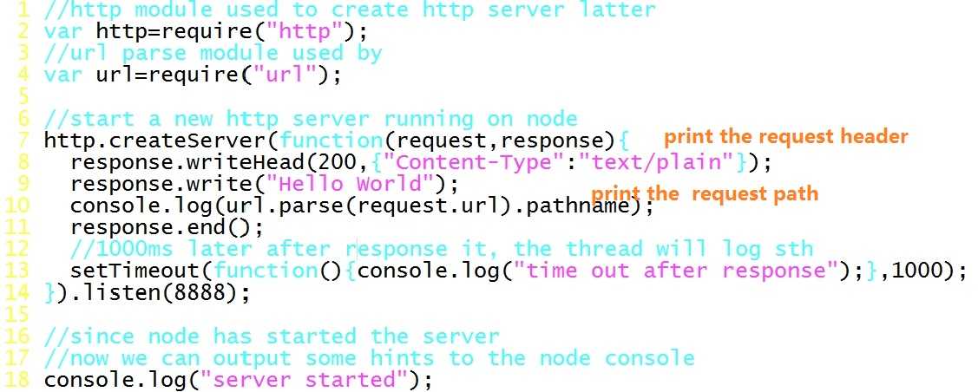
NodeJS HTTP module
Let’s monitor a http server using http module:
Index.js, calling server.js which will create a server
Server.js, listen on port 8888

Slide 22
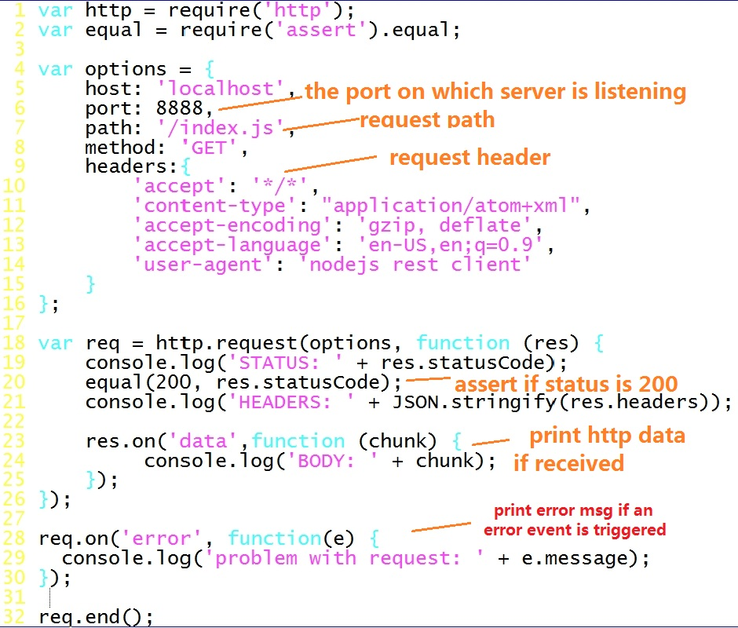
NodeJS HTTP module
We can monitor client which send a http request to IP:8888 and print the response from server

Slide 23
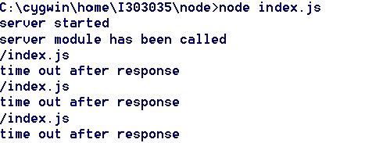
NodeJS HTTP module
DEMO Run index.js and client js

Slide 24
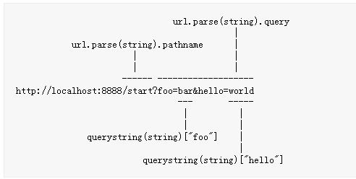
NodeJS url module
Used in web server as an URL router
‘url.parse(url-str)’ will return an object with URL’s pathname and http GET variables
When the url is “http://.../start?foo=xxx&hello=yyy”

Slide 25
NodeJS net module
Net contains net.Server net.Socket and other functions
You can use it to create your tcp socket connection
Create a tcp server
Create a tcp client
tcpserver.js
tcpclient.js
var net = require('net');
var server = net.createServer(function(c) { //'connection' listener
console.log('server connected');
c.on('end', function() {
console.log('server disconnected');
});
c.write('hello\r\n');
c.pipe(c);
});
server.listen(8124, function() { //'listening' listener
console.log('server bound');
});
var net = require('net');
var client = net.connect({port: 8124},
function() { //'connect' listener
console.log('client connected');
client.write('world!\r\n');
});
client.on('data', function(data) {//recved data
console.log(data.toString());
client.end();
});
client.on('end', function() {//end connection
console.log('client disconnected');
});
Reference:http://nodejs.org/api/net.html http://fengmk2.github.io/ppt/qcon2011/

Slide 26


NodeJS DNS module
var dns = require(‘dns’)
dns.lookup(domain, [family], callback(err,addrs))#
dns.resolve(domain, [rrtype], callback(err,addrs))#
rrtype : ‘A’ (IPV4 default), ‘AAAA’ (IPV6), ‘MX’ (mail exchange records), …

Slide 27
NodeJS FS module
Node support both synchronous and asynchronous methods
var fs = require('fs'); // $ touch /tmp/hello fs.rename('/tmp/hello', '/tmp/world', function (err) { if (err) throw err; fs.stat('/tmp/world', function (err, stats) { if (err) throw err; console.log('stats: ' + JSON.stringify(stats)); });});
var fs = require('fs'); // $ touch /tmp/helloSync fs.renameSync('/tmp/helloSync', '/tmp/worldSync'); var stats = fs.statSync('/tmp/worldSync'); console.log('statsSync:' + JSON.stringify(stats));
var readstream = fs.createReadStream(uploadfile);
readstream.on('data', function(chunk) {
console.log('write', chunk.length);
// send file to server
req.write(chunk);
});
readstream.on('end', function() {req.end();});

Slide 28

NodeJS child_process/process module
Similar to c language, you can use fork to create a child process
And use process.on(‘..’,callback) to do process communication
parent.js
var cp = require('child_process');
var n = cp.fork(__dirname + '/child.js');//fork child
n.on('message', function(m) {
console.log('PARENT got message:', m);
});
n.send({ hello: 'world' });//send msg to child process
child.js
process.on('message', function(m) {
console.log('CHILD got message:', m);
});
process.send({ foo: 'bar' });
//send msg to parent process

Slide 29
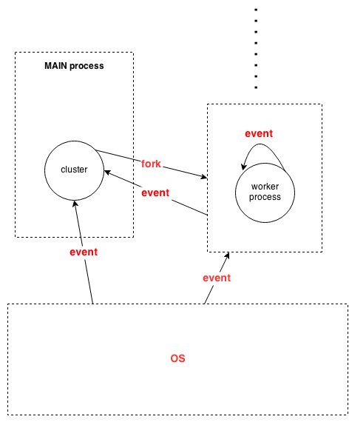
NodeJS cluster module
Cluster module is used to realize multi-thread model
in order to fully use multi-core
Cluster object
Workers[ ] workers[id] store the workers
Worker A reference to the current worker object.
Not available in master process.
Worker object
id
process
send(msg,sendhandle) disconnect()
on(“online/listening/disconnect/exit/error
/message…”,callback)
Example
When current process exit, call the callback
cluster.on('exit', function(worker, code, signal) {
console.log('worker ' + worker.process.pid + ' died'); });
// worker is current process

Slide 30
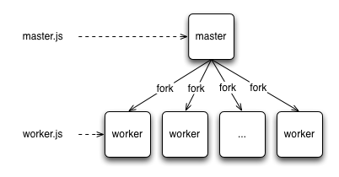
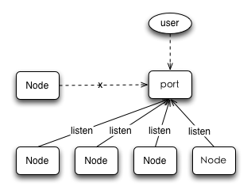
NodeJS cluster module
Cluster target:
Using multi-process to fully use multi-core CPU
All worker process share the same port:

Slide 31

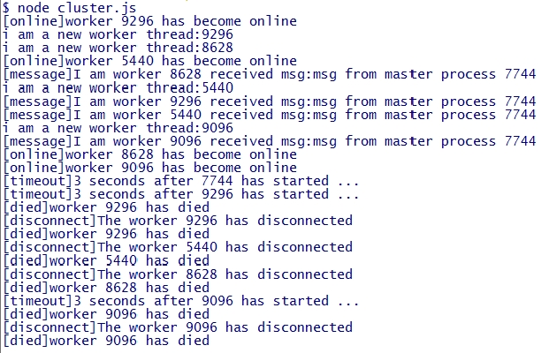
NodeJS cluster module demo
cluster.js
var cluster = require('cluster');
var http = require('http');
var numCPUs = require('os').cpus().length;
//after process 'worker' is forked
cluster.on('fork', function(worker) {
worker.send("msg from master process "+process.pid);
});
//after process 'worker' is online
cluster.on('online', function(worker) {
console.log("[online]worker "+worker.process.pid+" has become online");
});
//after process 'worker' is disconnected
cluster.on('disconnect', function(worker) {
console.log('[disconnect]The worker ' + worker.process.pid + ' has disconnected');
//since the worker process is disconnected, clear its timeout
clearTimeout(timeouts[worker.process.pid]);
});
//after process 'worker' is died
cluster.on('exit', function(worker, code, signal) {
console.log('[died]worker ' + worker.process.pid + ' has died');
});
//after current process recved a msg
process.on('message',function(msg){
console.log("[message]I am worker "+process.pid+" received msg:"+msg);
});
//after current process has started for 3 seconds
function timeout() {
console.error("[timeout]3 seconds after "+ process.pid+" has started ...");
//if current process is not master, then kill it
//process will first disconnect from cluster, then exit
if(cluster.isWorker) process.exit(0);
}
var timeouts = [];
timeouts[process.pid]=setTimeout(timeout, 3000);
if(cluster.isMaster) {
// Fork worker processes.
for (var i = 0; i < numCPUs; i++)
cluster.fork();
}
else {
console.log("i am a new worker thread:"+process.pid);
//Here workers all share the same TCP/HTTP connection
http.createServer(function(req, res) {
}).listen(8888);
}

Slide 32
External modules and tools
Modules
Node-canvas used to handle with picture
Xml2js transit xml to javascript object
Mailer used to send mail
Socket.io aims to make realtime apps possible in every browser and mobile device, blurring the differences between the different transport mechanisms.
Expressjs is a mvc-based web development framework
Geddy another mvc web-dev framework
Tools
Forever automatically restart your app after it’s down
Node-dev automatically restart your app after source changed
Nide open-source nodejs IDE
Node-inspector remote debugging tools

Slide 33
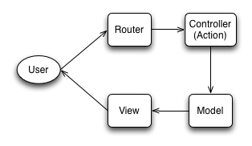
Express module
A mvc framework for nodejs web development
Express works similar to java servlet: app.get(‘..’,..)
Express supplies cookieParser/session/logger… utils for web dev
express.js
var express=require(‘express’);
var app=express();
app.set(‘views’,…);//bind views
app.set(‘view engine’,’ejs’);//choose view engine
http.createServer(app).listen(…);//use app as request listener
app.get(URL,callback(req,res){
res.render(RESNAME,{…});
});
app.post(URL,callback(req,res){
res.render(RESNAME,{…});
});
MVC

Slide 34
Socket.io module
Nodejs support Tcp socket, and Socket.io module realizes web-socket API
In web-socket, web-client and web-server each have a socket connected to the other, and push msg to the other in two directions at anytime.
With socket.io you can develop your chat/monitor program on the web. Your client(web browser side js) can send msg to server without http request. So HTTP connection is established once, and then data goes via web-socket .
client.js
server.js
var socket= new io.Socket('localhost',{
port: 8080
});
socket.connect(); //client socket conncet to ..
socket.on('message',function(data) {
console.log('Received a message from the server!',data); //recved a message
});
socket.send(message); //send a msg to server
var http= require('http'), io= require('socket.io');
//start server
var server= http.createServer(function(req, res){
res.writeHead(200,{ 'Content-Type': 'text/html' });
res.end('<h1>Hello Socket Lover!</h1>');
});
server.listen(8080);
var socket= io.listen(server);
//after connected to client socket
socket.on('connection', function(client){
client.on('message',function(event){
console.log('Received message from client!',event);
});});

Slide 35
Node connections flow chart
Client
Server
Websocket、flashsocket
Support websocket
http
websocket
flashsocket
check
cookie
Support flash
Listen to client’s different connection requests and then init the relevant server side socket
Support xhr
Receive data and handle them
Request.end();
Response.write(data);

Slide 36
4 Debug NodeJS
Use debugger tag, and node will break at that point
dbg.js
Var x = 5;
setTimeout(function () {
++x;
debugger;
function a() {
x *= 3;
debugger;
}
a();
console.log("done");
}, 1000);
debugger;
console.log("begin");
Then run debug commands
Debug Commands: run (r), cont (c), next (n), step (s), out (o), backtrace (bt), setBreakpoint (sb), clearBreakpoint (cb), watch, unwatch, watchers, repl, restart, kill, list, scripts, breakpoints, version
Eclipse debugger plugin for V8:http://code.google.com/p/chromedevtools/

Slide 37

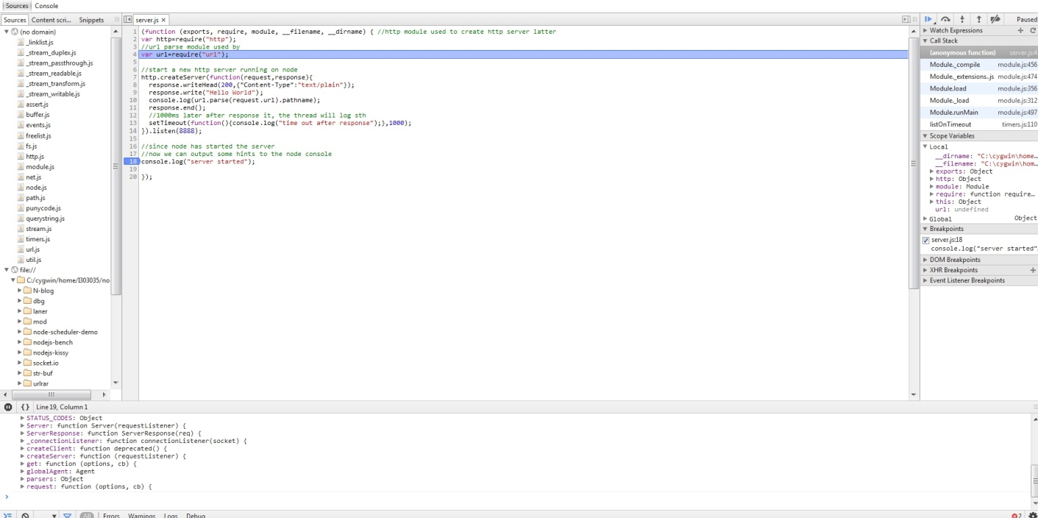
Debug NodeJS using node-inspector
Node-inspector is a debugger interface for node.js using WebKit Web Inspector.It is a remote debugging tool enabling debug nodejs on chrome.
Node-inspector supported live-edit, that is, you can change the code in the chrome debug panel. To enable this, set node-inspector/config.json
http://localhost:8080/debug?port=5858

Slide 38
Who is Using Node.js
5 NodeJS project examples
LinkedIn use node-js on its mobile app server
Yammer used node.js to build a cross domain proxy for its platform to allow developers to make AJAX calls from JavaScript hosted on their domain to our API. ( response ajax requests)
Proxlet use nodejs as a platform that could handle many concurrent requests , without having to invest a lot of time into building infrastructure.
Yahoo! Mail is now using nodejs
REFERENCE: http://bostinno.streetwise.co/2011/08/14/who-is-using-node-js-and-why-yammer-bocoup-proxlet-and-yahoo/

Slide 39
NodeJS usage summary
Web APP (Real-time and IO-heavy)
Cloud9 : Web IDE
PaintChat
Trello
Taojob
Web mid-layer service
NAE proxy
Loggly
Nodefox
Desktop:
Node-gui
termkit

Slide 40
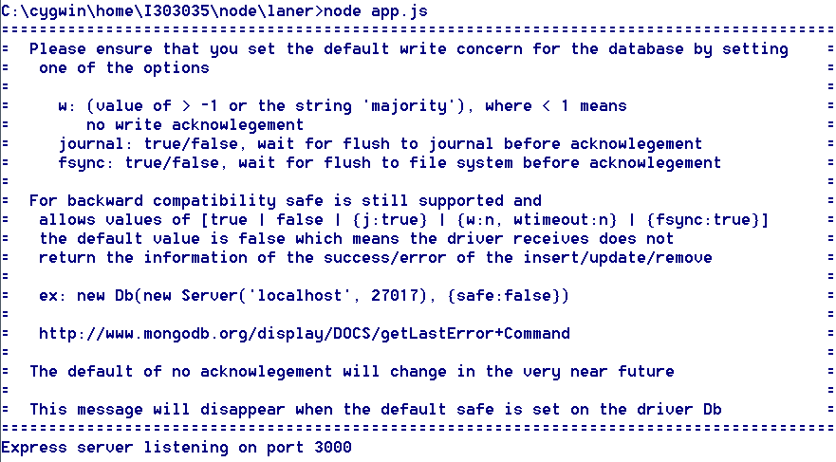
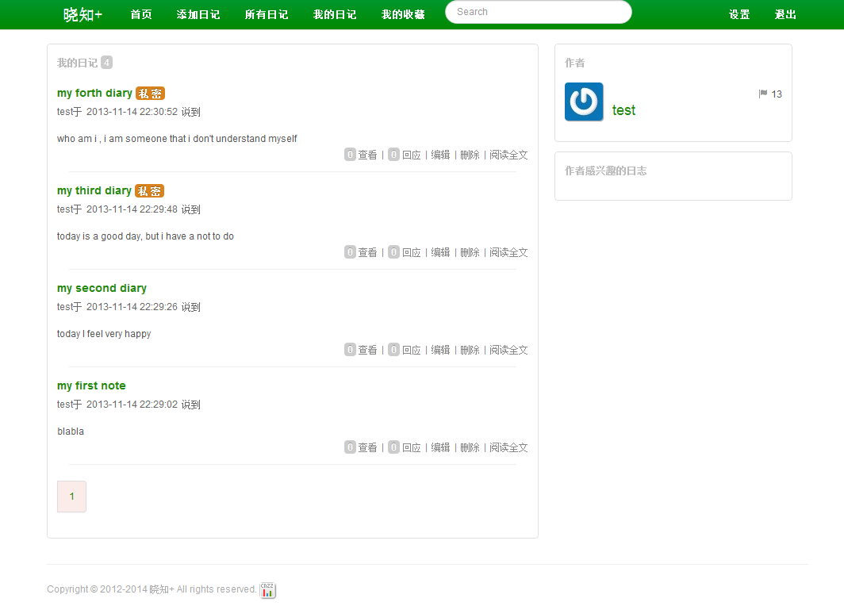
NodeJS project examples (web APP)
Demo
http://localhost:3000

Slide 41
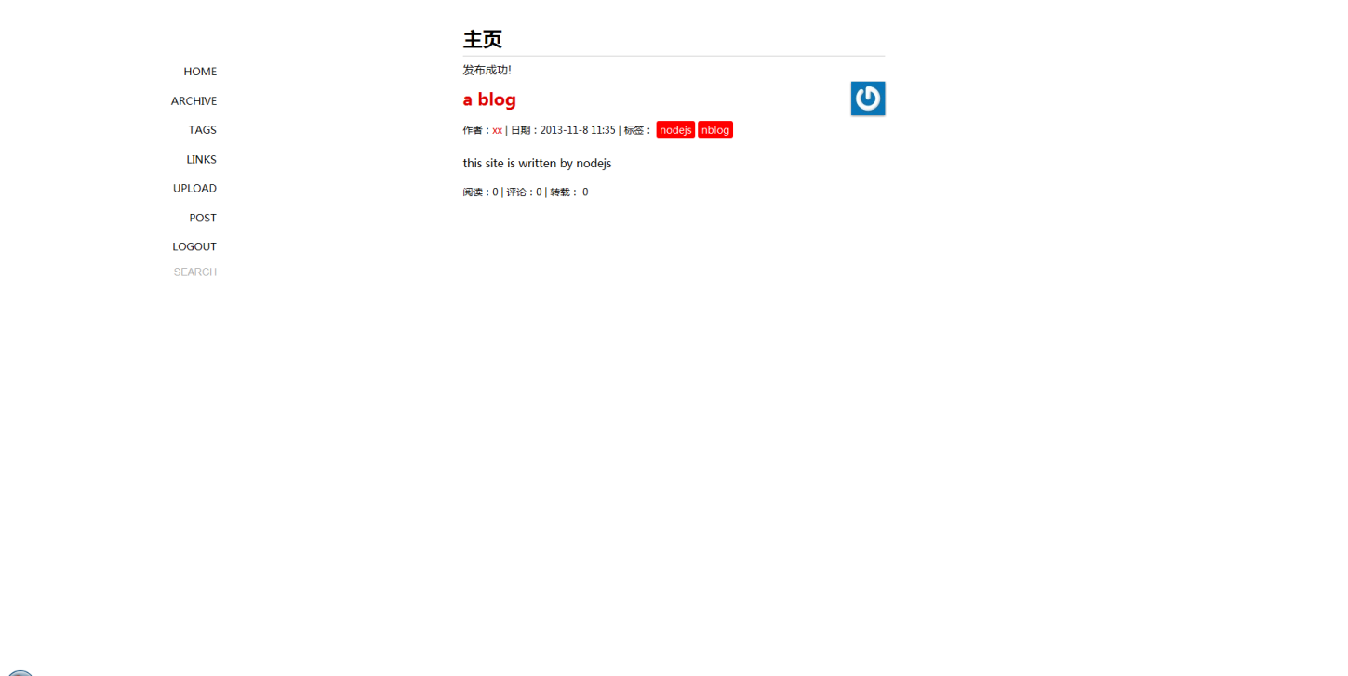
NodeJS project examples (web APP)
A blog website written in nodejs REF

Slide 42
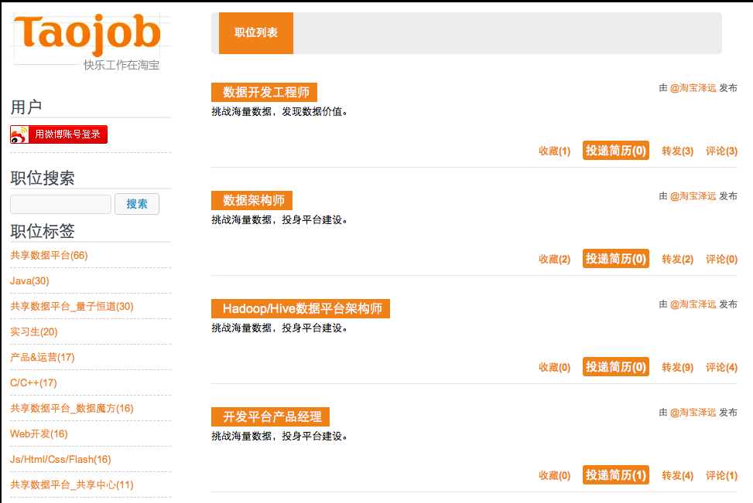
NodeJS project examples (web APP)
A blog website written in nodejs REF

Slide 43
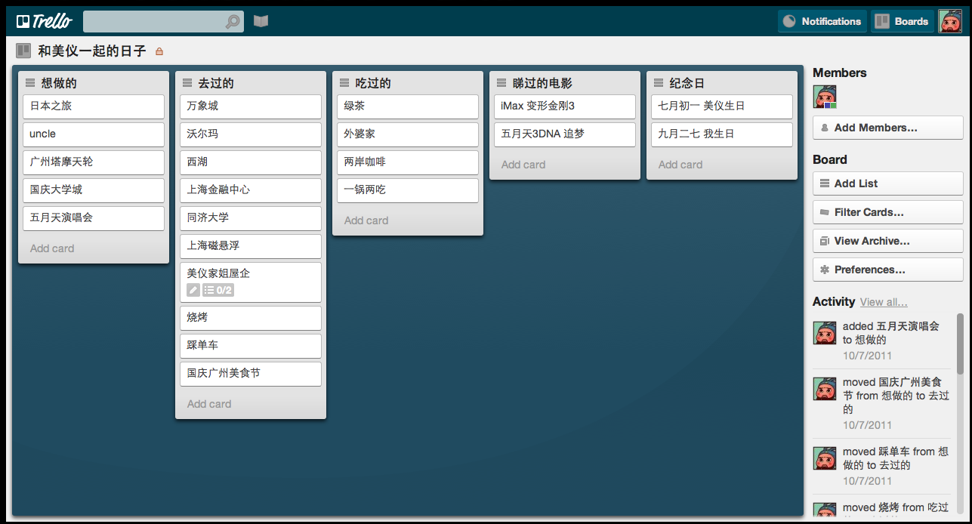
NodeJS project examples (web APP)
A blog website written in nodejs REF
A Collaborative editing tool

Slide 44
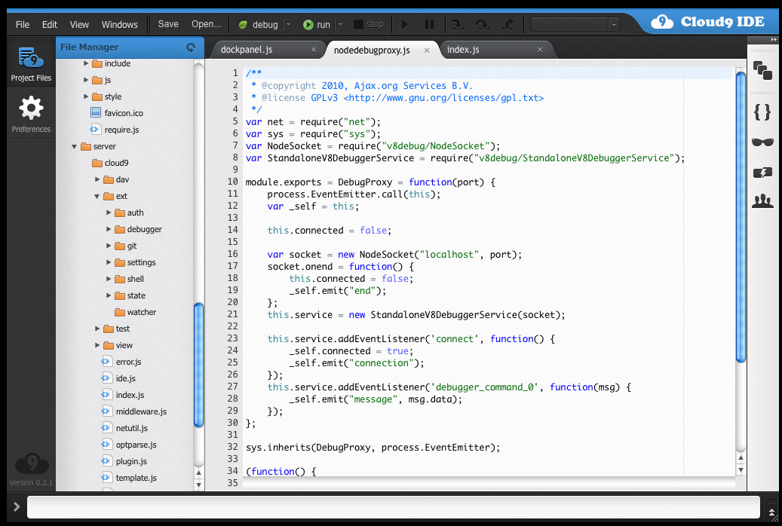
NodeJS project examples (web APP)
A blog website written in nodejs REF
Cloud9(web IDE) https://c9.io/

Slide 45
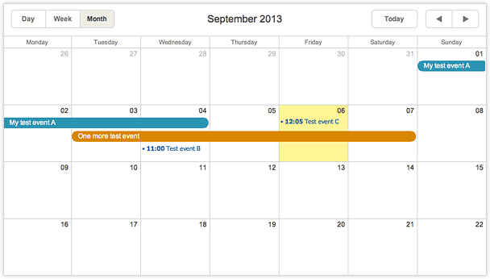
NodeJS project examples (web APP)
A calendar REF

Slide 46
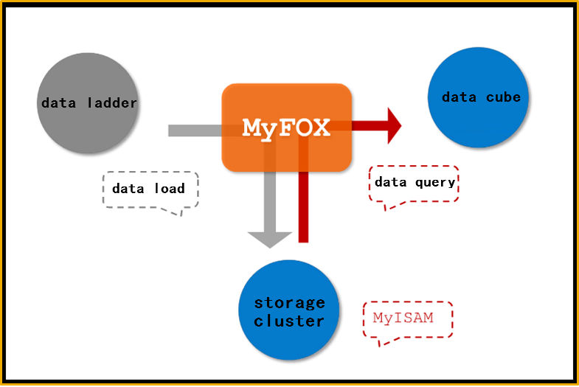
NodeJS project examples (mid-layer web data service)
Nodefox: data handling midware ,get data from mysql cluster and do statistics

Slide 47
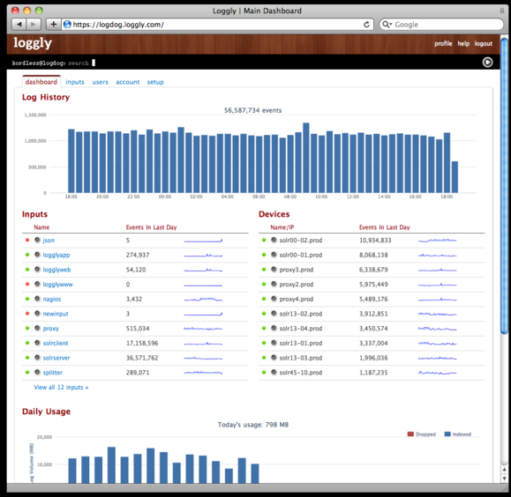
NodeJS project examples (mid-layer web data service)
Loggly: http://www.loggly.com/ a web service which collect syslog and http log

Slide 48
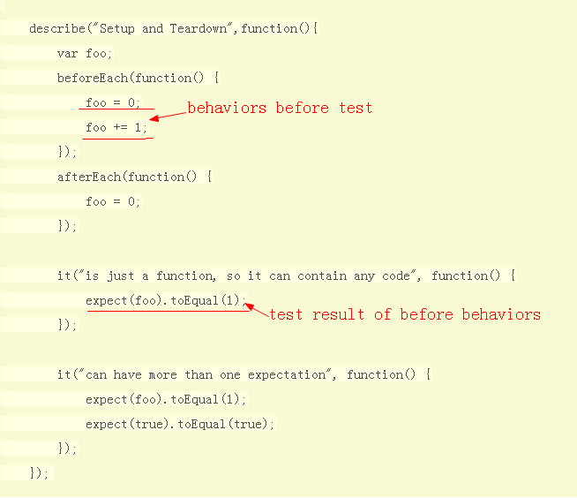
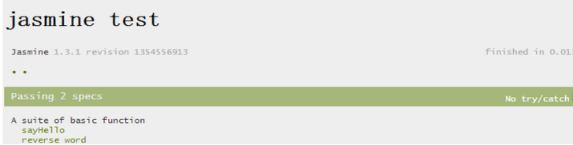
6 JS Tests
Jasmine a behavior driven test framework:
run

Slide 49
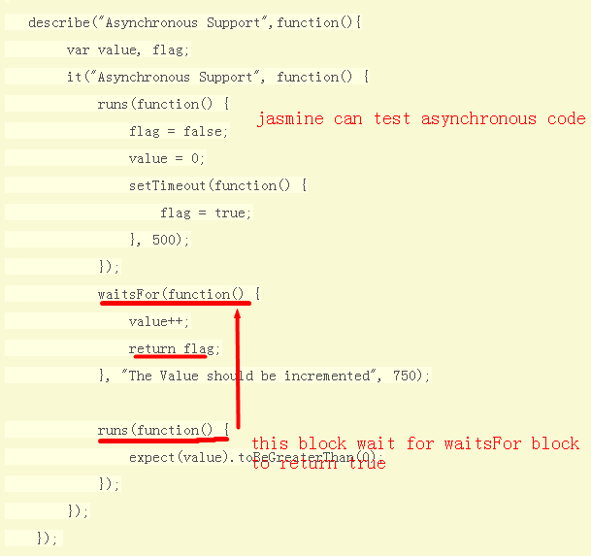
Jasmine
Jasmine can test asynchronous code
http://blog.fens.me/nodejs-jasmine-bdd/

Slide 50
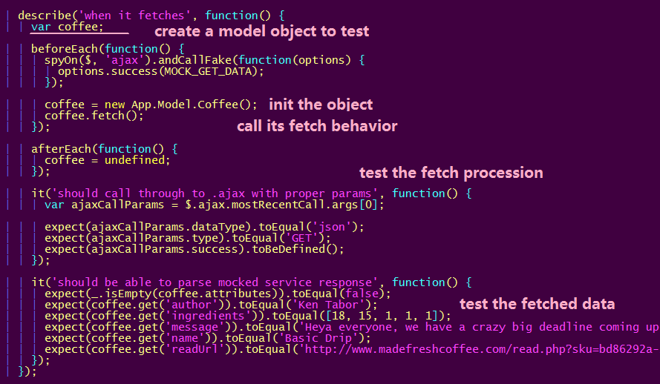
Jasmine
Use jasmine to test backbone projects: REF

Slide 51
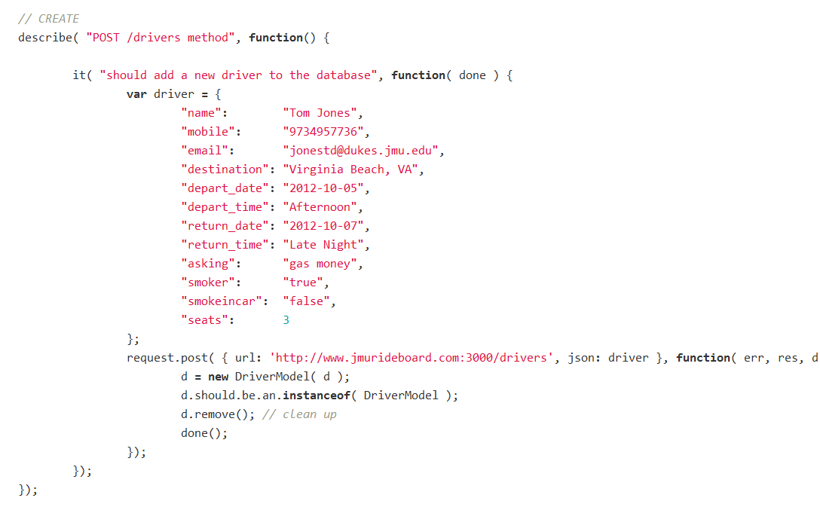
Other test examples
Test NodeJS projects using node ‘should’ module: REF
NodeJS’s Should mod is similar to jasmine

Slide 52
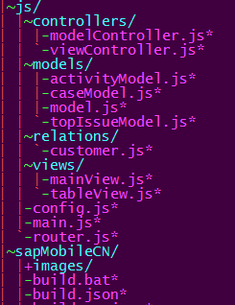
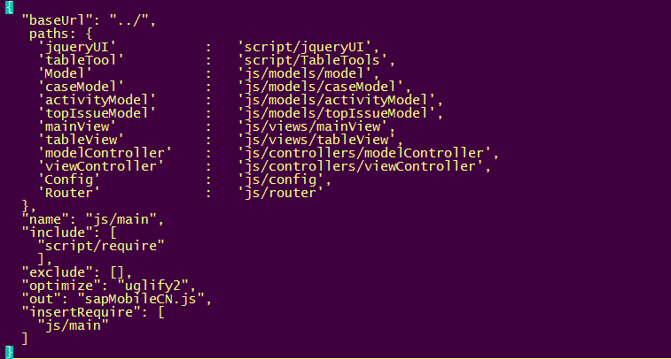
7 JS Minify
Using requireJS and NodeJS
Write a build.json, which tell r.js how to
Resolve the dependencies
node ..\script\r.js -o build.json
sapMobileCN.js
minify
Files to be
minified
Config file:Build.json

