Slide 1

& JS TESTS & JS MINIFY
Brando I303035

Slide 2
OUTLINE
NodeJS Overview
NodeJS Features
NodeJS Modules
JS Tests
JS Minify

Slide 3
1 NodeJS overview
Download http://nodejs.org/dist/v0.10.20/node-v0.10.20-x86.msi
Official Site http://nodejs.org
What is NodeJS:
A Javascript running on Client and Server sides
JS running environment
many modules

Slide 4
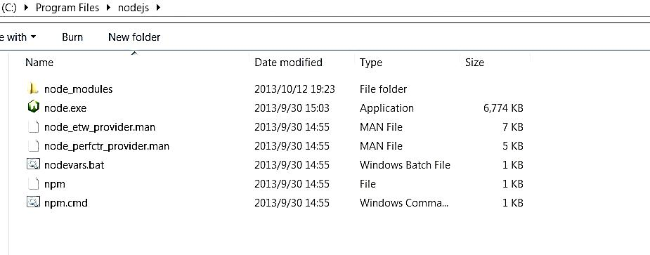

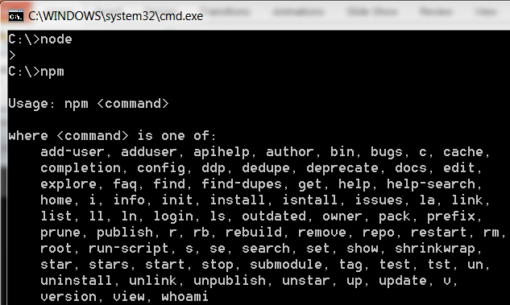
Install and use
install
use

Slide 5
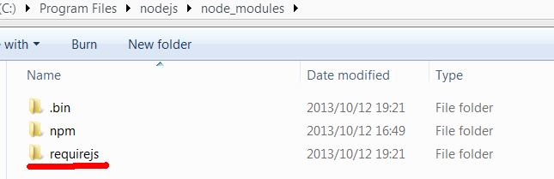
Maintain Packages using npm
$ npm ls
$ npm install [-g] package_name//-g will set the package to os path
$ npm update
Eg. Install require.js in NodeJS
Maybe you need to configure a http-proxy in IE… …
Requirejs package
NodeJS’s npm works like python’s easy_install

Slide 6
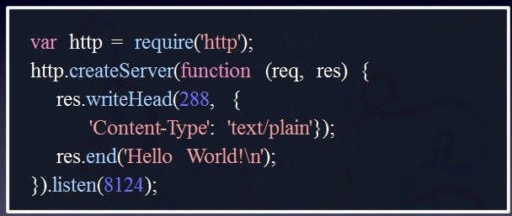
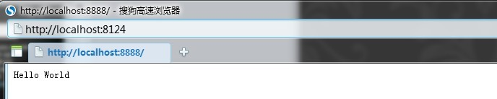
Use NodeJS
Helloworld.js
console.log(“hello world”)
server.js

Slide 7
2 NodeJS Features
Non-blocking
Single-thread
Single Nodejs thread running
No locks \thread synchronization
Low system resource occupation
Event-driven
echo 'hello';
sleep(1);
echo 'world';
setTimeout(function(){ console.log('world');
}, 1000);
console.log('hello');

Slide 8
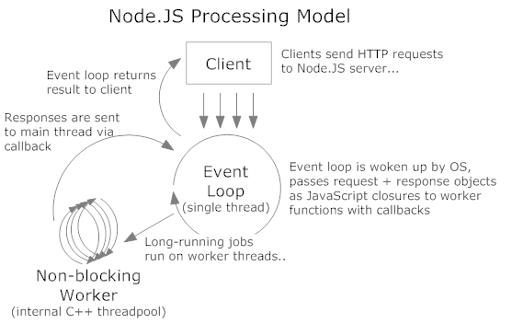
NodeJS processing model
The main loop thread received every request event, and distribute it to another non-blocking worker thread to handle it, the handle result will be sent back to main thread via callback asynchronously

Slide 9
3 Use modules
Define a module
Circle.js: define a module
var PI = Math.PI;
exports.area = function (r) { return PI * r * r; };
exports.circumference = function (r) { return 2 * PI * r; };
Call a module
Index.js: call module using ‘require’
var circle = require('./circle.js');
console.log( 'The area of a circle of radius 4 is ' +
circle.area(4));
Have a Test

Slide 10
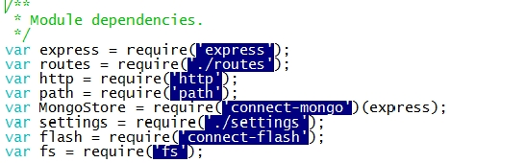
Module example
In a project, we will use modules from
nodejs
third-party
local(our project itself)
Nodejs modules
Third-party modules
local modules

Slide 11
Module attention
When you define a module in a js , you cannot do it asynchronously:
You can
[module.]exports=… or exports.xx=…
You cannot
setTimeout(function() {
module.exports = { a: "hello" };
}, xx);
Since ‘require’ will be done synchronously, so You can
module.exports=require(‘…’)

Slide 12
Folders defined as a module
folderxx
Package.json
{
"name" : "some-library",
"main" : "./lib/some-library.js"
}
package.json
a.Js
b.Js
….
Caller.js:
var s=require(“./folderxx”)
…

Slide 13
Call & find module
How to call a module
Given absolute or relative path of the module
Given module name
How does node find a module
NodeJS will search the “node_modules” folder in ancestor directories recursively:
If not found, Node will search $HOME/.node_modules $HOME/.node_libraries $PREFIX/lib/node
var circle = require('./circle.js');
console.log( 'The area of a circle of radius 4 is ' + circle.area(4));
var circle = require(‘express'); //express is the module name
Find(moduleName):
While(true)
If currentDir.hasFolder(“node_modules”)
If Scan(“./node_modules”) return pwd()
If currentDir=root return NOT_FOUND
currentDir=currentDir.getParentDir()

Slide 14
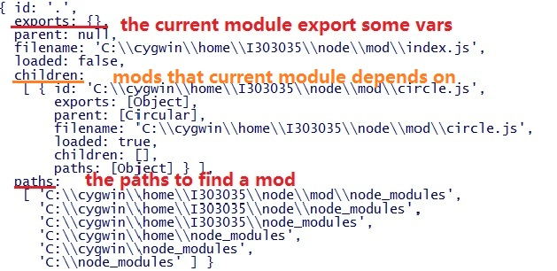
Further topics about module
In every JS file or module , there are two variables “module” and “exports” indicating current module and its related modules
Example:
var circle=require(“./circle.js”);
console.log(module);
console.log(exports);
Module
exports

Slide 15
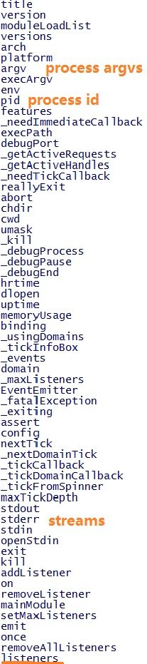
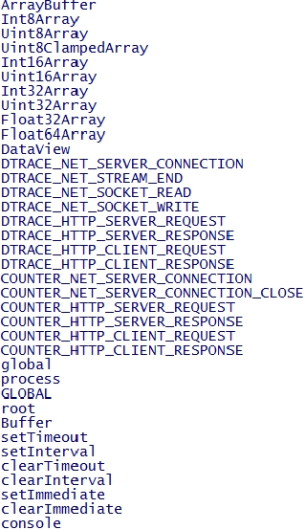
NodeJS variable scope
Variable scope: module & global
When you write “var xx;”, it will be local to that module.
Global Variables
Global variables are referenced by “global” namespace object
process
global
Example:
for(s in global)
{
console.log(s);
}
for(s in process)
{
console.log(s);
}

Slide 16
4 NodeJS modules
Synopsis
Assert
Buffer
Child_Process
Cluster
Console
Crypto
Debugger
DNS
Domain
Events
File System
Globals
HTTP
HTTPS
Modules
Net
OS
Path
Process
Punycode
Query Strings
Readline
REPL
Stream
String Decoder
Timers
TLS/SSL
TTY
UDP/Datagram
URL
Utilities
VM
ZLIB

Slide 17
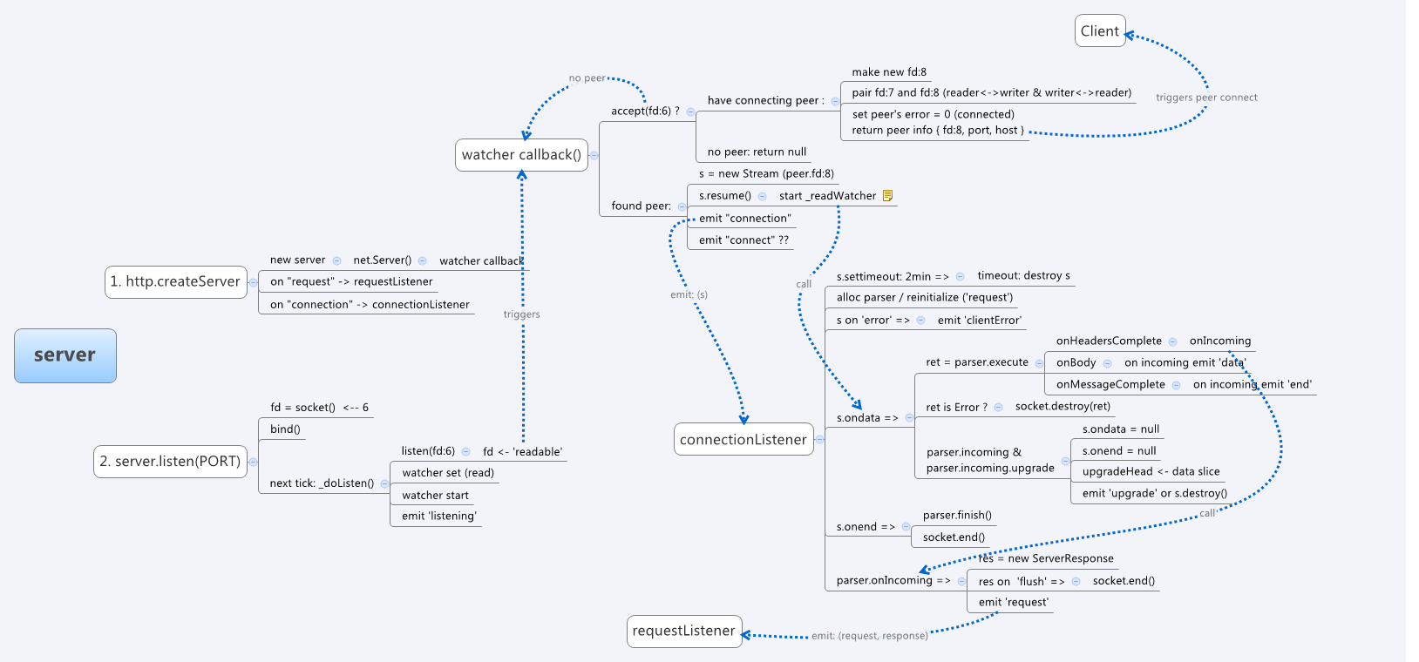
NodeJS HTTP module

Slide 18
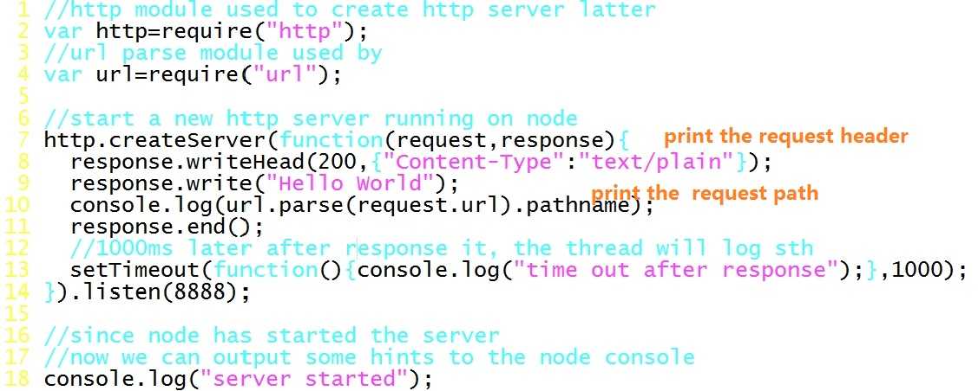
NodeJS HTTP module
Let’s monitor a http server using http module:
Index.js, calling server.js which will create a server
Server.js, listen on port 8888

Slide 19
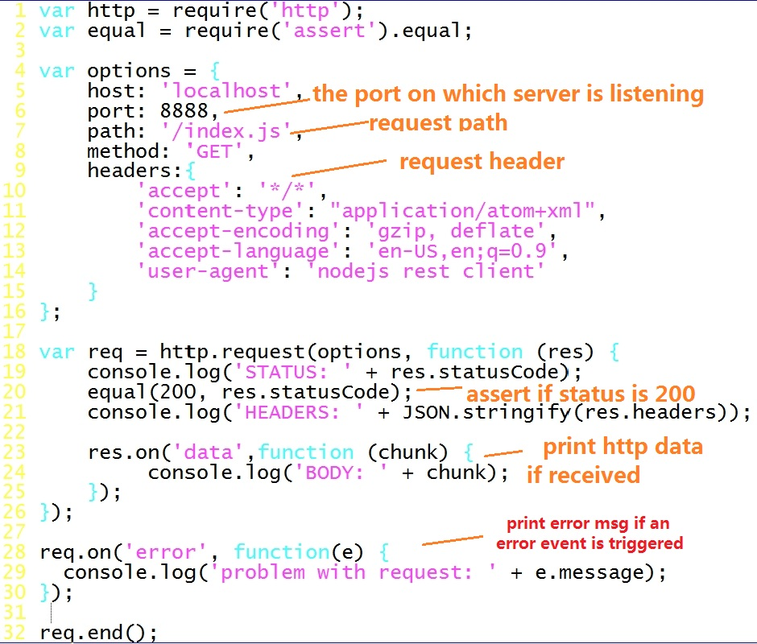
NodeJS HTTP module
We can monitor client which send a http request to IP:8888 and print the response from server

Slide 20
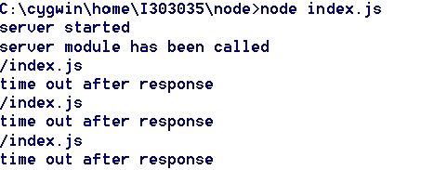
NodeJS HTTP module
Run index.js and client js

Slide 21
NodeJS net module
Net contains net.Server net.Socket and other functions
You can use it to create your tcp socket connection
Create a tcp server
Create a tcp client
tcpserver.js
tcpclient.js
var net = require('net');
var server = net.createServer(function(c) { //'connection' listener
console.log('server connected');
c.on('end', function() {
console.log('server disconnected');
});
c.write('hello\r\n');
c.pipe(c);
});
server.listen(8124, function() { //'listening' listener
console.log('server bound');
});
var net = require('net');
var client = net.connect({port: 8124},
function() { //'connect' listener
console.log('client connected');
client.write('world!\r\n');
});
client.on('data', function(data) {//recved data
console.log(data.toString());
client.end();
});
client.on('end', function() {//end connection
console.log('client disconnected');
});
Reference:http://nodejs.org/api/net.html

Slide 22


NodeJS DNS module
var dns = require(‘dns’)
dns.lookup(domain, [family], callback(err,addrs))#
dns.resolve(domain, [rrtype], callback(err,addrs))#
rrtype : ‘A’ (IPV4 default), ‘AAAA’ (IPV6), ‘MX’ (mail exchange records), …

Slide 23

NodeJS child_process/process module
Similar to c, you can use fork to create a child process
And use process.on(‘..’,callback) to do process communication
parent.js
var cp = require('child_process');
var n = cp.fork(__dirname + '/child.js');//fork child
n.on('message', function(m) {
console.log('PARENT got message:', m);
});
n.send({ hello: 'world' });//send msg to child process
child.js
process.on('message', function(m) {
console.log('CHILD got message:', m);
});
process.send({ foo: 'bar' });
//send msg to parent process

Slide 24
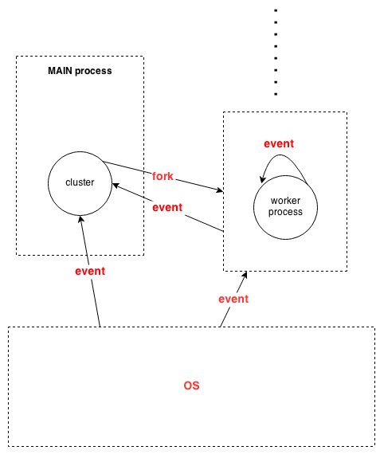
NodeJS cluster module
Cluster module is used to realize multi-process model
Cluster object
Workers[ ] workers[id] store the workers
Worker A reference to the current worker object.
Not available in master process.
Worker object
id
process
send(msg,sendhandle) disconnect()
on(“online/listening/disconnect/exit/error
/message…”,callback)
Example
When current process exit, call the callback
cluster.on('exit', function(worker, code, signal) {
console.log('worker ' + worker.process.pid + ' died'); });
// worker is current process

Slide 25

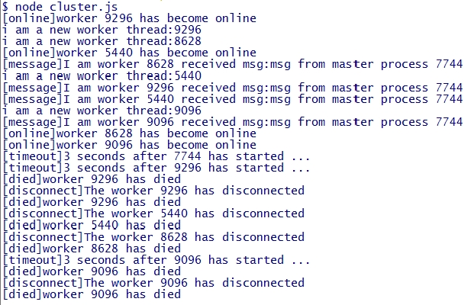
NodeJS cluster module
cluster.js
var cluster = require('cluster');
var http = require('http');
var numCPUs = require('os').cpus().length;
//after process 'worker' is forked
cluster.on('fork', function(worker) {
worker.send("msg from master process "+process.pid);
});
//after process 'worker' is online
cluster.on('online', function(worker) {
console.log("[online]worker "+worker.process.pid+" has become online");
});
//after process 'worker' is disconnected
cluster.on('disconnect', function(worker) {
console.log('[disconnect]The worker ' + worker.process.pid + ' has disconnected');
//since the worker process is disconnected, clear its timeout
clearTimeout(timeouts[worker.process.pid]);
});
//after process 'worker' is died
cluster.on('exit', function(worker, code, signal) {
console.log('[died]worker ' + worker.process.pid + ' has died');
});
//after current process recved a msg
process.on('message',function(msg){
console.log("[message]I am worker "+process.pid+" received msg:"+msg);
});
//after current process has started for 3 seconds
function timeout() {
console.error("[timeout]3 seconds after "+ process.pid+" has started ...");
//if current process is not master, then kill it
//process will first disconnect from cluster, then exit
if(cluster.isWorker) process.exit(0);
}
var timeouts = [];
timeouts[process.pid]=setTimeout(timeout, 3000);
if(cluster.isMaster) {
// Fork worker processes.
for (var i = 0; i < numCPUs; i++)
cluster.fork();
}
else {
console.log("i am a new worker thread:"+process.pid);
//Here workers all share the same TCP/HTTP connection
http.createServer(function(req, res) {
}).listen(8888);
}

Slide 26
external modules and tools
Modules
Node-canvas used to handle with picture
Xml2js transit xml to javascript object
Mailer used to send mail
Socket.io aims to make realtime apps possible in every browser and mobile device, blurring the differences between the different transport mechanisms.
Expressjs is a mvc-based web development framework
Geddy another mvc web-dev framework
Tools
Forever automatically restart your app after down
Node-dev automatically restart your app after source changed
Nide open-source nodejs IDE
Node-inspector remote debugging tools

Slide 27
Express module
Express works similar to java servlet: app.get(‘..’,..)
Express supplies cookieParser/session/logger… utils for web dev
express.js
var express=require(‘express’);
var app=express();
app.set(‘views’,…);//bind views
app.set(‘view engine’,’ejs’);//choose view engine
http.createServer(app).listen(…);//use app as request listener
app.get(URL,callback(req,res){
res.render(RESNAME,{…});
});
app.post(URL,callback(req,res){
res.render(RESNAME,{…});
});

Slide 28
Socket.io module
Socket.io realize web-socket API
In web-socket, web-client and web-server each have a socket connected to the other, and push msg to the other in two directions at anytime.
With socket.io you can develop your chat program on the web. Your client(web browser side js) can send msg to server without http request. So HTTP connection is established once, and then data goes via web-socket .
client.js
server.js
var socket= new io.Socket('localhost',{
port: 8080
});
socket.connect(); //client socket conncet to ..
socket.on('message',function(data) {
console.log('Received a message from the server!',data); //recved a message
});
socket.send(message); //send a msg to server
var http= require('http'), io= require('socket.io');
//start server
var server= http.createServer(function(req, res){
res.writeHead(200,{ 'Content-Type': 'text/html' });
res.end('<h1>Hello Socket Lover!</h1>');
});
server.listen(8080);
var socket= io.listen(server);
//after connected to client socket
socket.on('connection', function(client){
client.on('message',function(event){
console.log('Received message from client!',event);
});});

Slide 29
Debug NodeJS
Use debugger tag, and node will break at that point
dbg.js
Var x = 5;
setTimeout(function () {
++x;
debugger;
function a() {
x *= 3;
debugger;
}
a();
console.log("done");
}, 1000);
debugger;
console.log("begin");
Then run debug commands
Debug Commands: run (r), cont (c), next (n), step (s), out (o), backtrace (bt), setBreakpoint (sb), clearBreakpoint (cb), watch, unwatch, watchers, repl, restart, kill, list, scripts, breakpoints, version
Eclipse debugger plugin for V8:http://code.google.com/p/chromedevtools/

Slide 30

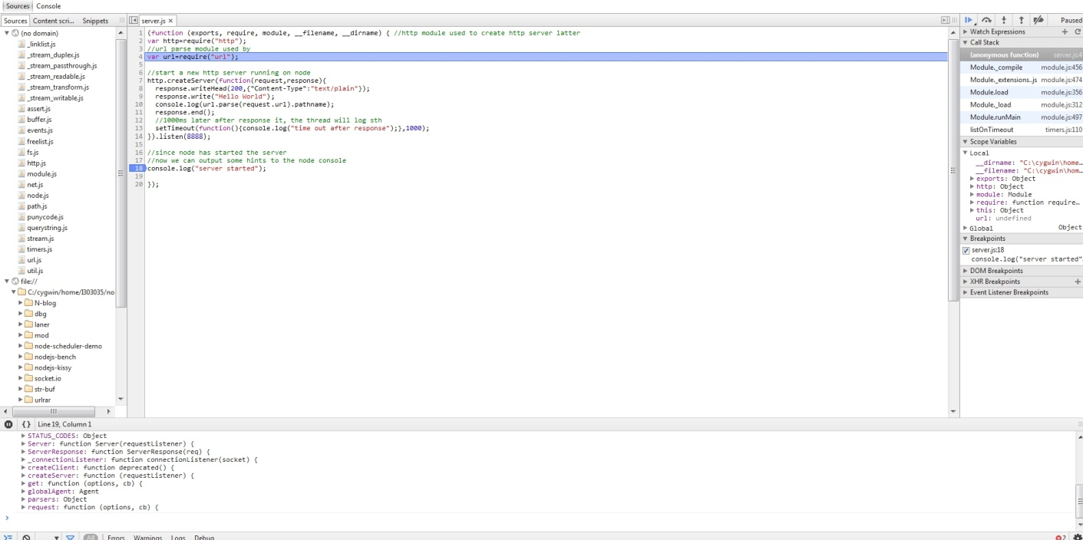
Debug NodeJS using node-inspector
Node-inspector is a debugger interface for node.js using WebKit Web Inspector.It is a remote debugging tool enabling debug nodejs on chrome.
Node-inspector supported live-edit, that is, you can change the code in the chrome debug panel. To enable this, set node-inspector/config.json
http://localhost:8080/debug?port=5858

Slide 31
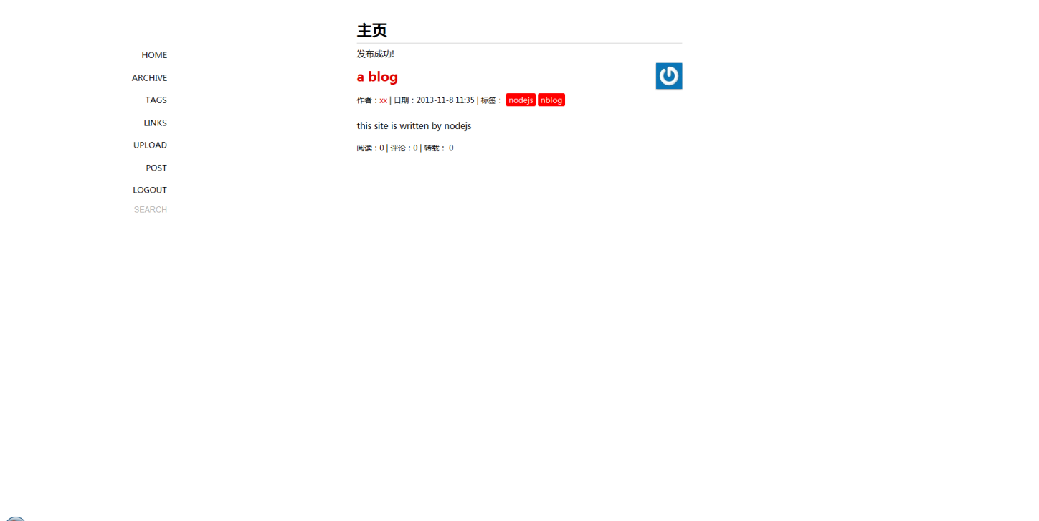
5 NodeJS project examples
what can we do using nodejs
A blog website written in nodejs REF

Slide 32

NodeJS project examples

Slide 33
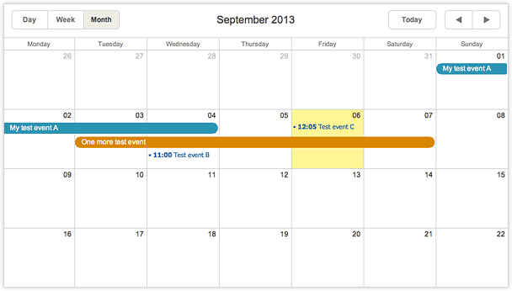
NodeJS project examples
A calendar REF

Slide 34
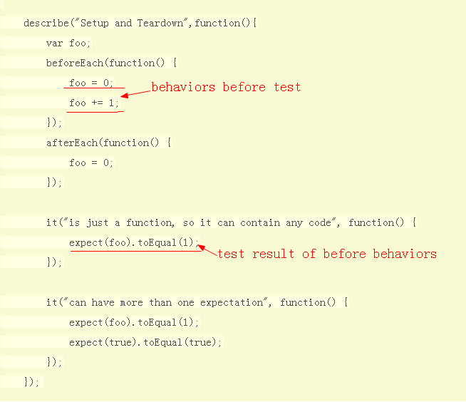
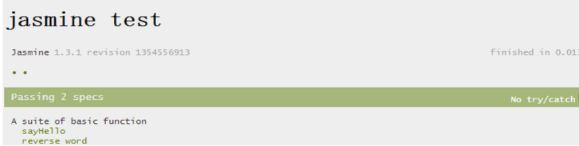
6 JS Tests
Jasmine a behavior driven test framework:
run

Slide 35
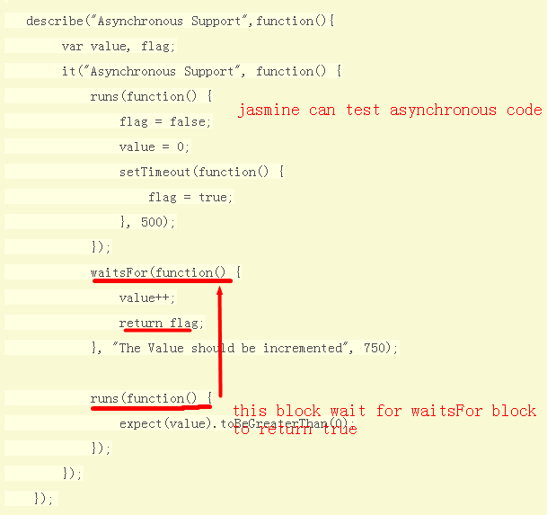
Jasmine
Jasmine can test asynchronous code
http://blog.fens.me/nodejs-jasmine-bdd/

Slide 36
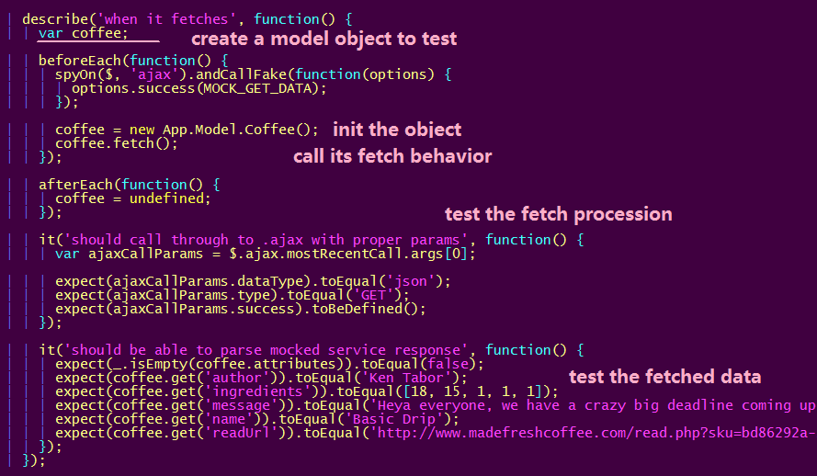
Jasmine
Use jasmine to test backbone projects: REF

Slide 37
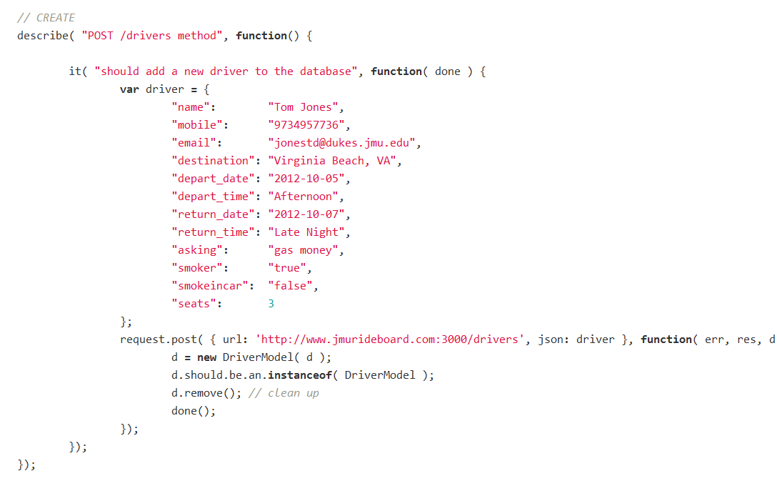
Other test examples
Test NodeJS projects using node ‘should’ module: REF
NodeJS’s Should mod is similar to jasmine

Slide 38
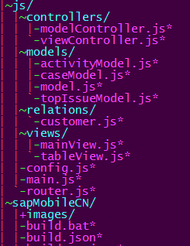
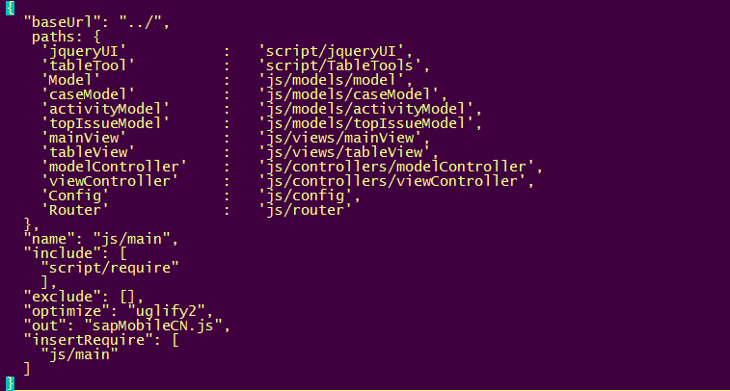
7 JS Minify
Using requireJS and NodeJS
Write a build.json, which tell r.js how to
Resolve the dependencies
node ..\script\r.js -o build.json
sapMobileCN.js
minify
Files to be
minified
Config file:Build.json

