Slide 1
Comparing Attitudes to Climate Change in the Media Using Sentiment Analysis Based on Latent Dirichlet Allocation
Ye Jiang, Xingyi Song, Jackie Harrison, Shaun Quegan and Diana Maynard

Slide 2
Motivations
Editorial decisions
Multiple opinion targets
Implicit polarity vocabulary
Investigate how different publications differ in their approach to stories about climate change
Notes:
People link extreme weather to climate change mostly because newspapers report in that way.

Slide 3
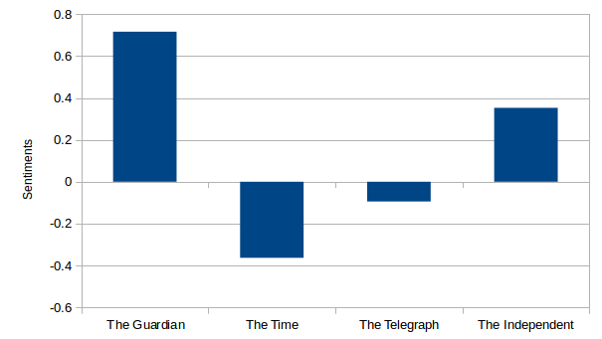
Overall Structures
The Guardian
Latent Dirichlet Allocation (LDA)
The Times
Newspapers
Preprocessing
Clustering and Regroup
Compare sentiment polarities between publications
The Independent
The Telegraph
SentiWordNet
Notes:
This research is concerned with combining Latent Dirichlet Allocation (LDA) with Sentiment analysis to investigate what are the climate change related topics and polarized sentiments in the UK broadsheet newspapers.

Slide 4
Why Newspapers?
Largest readership
Linkage between public and scientific
Influencing policy making
Shaping public perspectives
Notes:
Compare with other media types, such as Twitter, blogs. Newspaper still has the largest readership based on circulation. According to the Audit Bureau of Circulations the best-selling papers as of January 2017 are The Sun, 1.67 million, The Daily Mail, 1.51 million and the Daily Mirror, 725,000. Readership figures are usually higher than circulation figures because of the assumption that a typical copy of the newspaper is read by more than one person.
Some research found that individuals depend on news media to link extreme events such as floods or droughts to climate change, even if they are confronted with floods or droughts. Many news headlines describe climate change as sensational, alarming and harmful environmental issues.
The construction and implementation of environmental policies mainly depend on public attitudes. For instance, research found that UK news coverage of genetically modified food affects public views and policy actions on such issues. Also, some research revealed that political actors have played by far the most powerful and efficient role in shaping climate change in the public, but their framings have always been mediated through each newspaper’s preferred ideological worldview.
As scientific consensus about the risk of climate change has grown stronger, there is an increase in ideological polarization of public attitudes about climate change. For instance, framing product purchases in pro-environment terms can result in reduced intentions for purchasing the product among those likely to be skeptical of climate change.

Slide 5
Why LDA?
Narrow down the climate change issues
Regroup the documents with similar sentiment targets
Identify the sentiment targets

Slide 6


What is LDA?
It is a generative topic model that automatically discovering topics that these documents contain.
It generates the probability of a word in the document came from a certain topic.

Slide 7
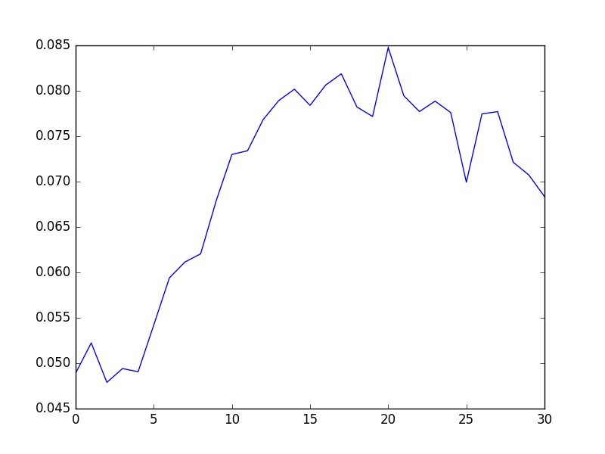
How LDA is implemented?
1. Tokenization
2. Stop-word removing
3. POS tagging
4. Remove words except nouns
5. Silhouette Coefficient (number of topics)

Slide 8
How LDA is implemented?
Topic ID
Distribution
Key Words
Topic 1 0.029 trump, agreement,…,campaign
Topic 5 0.115 world, science,…, warming
… …
Topic 11 0.797 ice, sea,…world, level
Topic 20 0.061 year, carbon, trump,….
The Guardian news article N
Topic 8 0.731 sun, water, ice, level…
Topic 1 0.159 body, professor, science,…
… …
Topic 9 0.036 decision,…, gas
Topic 17 0.003 world, aggreement…
The Times news article N
Topic 7 0.491 cent, report, year….
Topic 2 0.509 air, level, sea,…, ice
The Independent news article N
Topic 1 0.034 paris, agreement,…, energy
Topic 2 0.002 government,…, emission
… …
Topic 19 0.476 hot, disaster, earthquake..
Topic 20 0.138 china, role, agreement,…
The Telegraph news article N
Notes:
Assign each document to different numbers of topics

Slide 9
How LDA is implemented?
Topic ID
Distribution
Key Words
Topic 11 0.797 ice, sea,…world, level
The Guardian news article N
Topic 8 0.731 sun, water, ice, level…
The Times news article N
Topic 2 0.509 air, level, sea,…, ice
The Independent news article N
Topic 19 0.476 hot, disaster, earthquake..
The Telegraph news article N
Notes:
Select the topic with highest distribution in each document.

Slide 10
How LDA is implemented?
Topic ID
Distribution
Key Words
Topic 11 0.797 ice, sea,…world, level
The Guardian news article N
Topic 8 0.731 sun, water, ice, level...
The Times news article N
Topic 2 0.509 air, level, sea,…, ice
The Independent news article N
Topic 19 0.476 hot, disaster, earthquake..
The Telegraph news article N
Notes:
Select the topic with highest distribution in each document.

Slide 11
SentiWordNet
SentiWordNet¹
¹http://sentiwordnet.isti.cnr.it
Notes:
Limitations of sentiwordnet here

Slide 12
Future works
Build climate change domain-specific lexicon.
Find meaningful topics overlaps in terms of keywords.
Extend sentiment analysis to consider not just positive and negative attitudes, but also the different emotions expressed.
Balance the numbers of news articles in different publications.
Notes:
”agreement”

Slide 13
Thank you
The Guardian
Latent Dirichlet Allocation (LDA)
The Times
Newspapers
Preprocessing
Clustering and Regroup
Compare sentiment polarities between publications
The Independent
The Telegraph
SentiWordNet

