Slide 1
Hyperpartisan News Detection Using ELMo Sentence Representation Convolutional Network
Ye Jiang, Johann Petrak, Xingyi Song, Kalina Bontcheva, Diana Maynard
Notes:
Good morning, my name is ye jiang, and I am a PhD student in the University of Sheffield, today I am going to present our works in the Task 4: hyperpartisan news detection, by using ELMO sentence representation Convolutional Network.

Slide 2
Outline
SemEval 2019 Task 4: Hyperpartisan News Detection.
Phase1: Early-Bird Submission.
Phase2: Final Submission.
Phase3: Recent works.
Notes:
This presentation consists of four parts.
First, I will have a short description for this task and I will mainly demonstrate our workflows in this competition, and I will also show the proposed model in later sections. Finally, I will show some related works which we have done recently.

Slide 3
SemEval 2019 task 4
Hyperpartisan News: expresses an extremely one-sided opinion or unreasoning allegiance to one party.
Binary document level classification.
by-publisher (automatic labelled, N=750K).
by-article-train (manual labelled, N=645) and test (manual labelled, N=628, evaluation only.)
Notes:
As the last presentation has made this task very clear, I will go through this slide very briefly.
What is hyperpartisan news, it is recently defined as the news ex...
So basically, this is a binary doc level classification task, and each doc contains a label either True or False refer to the hyperpartisan category.
and this task contains two datasets, by-PUBLISHER is annotated by the news publisher automatically with a great number of 750K new articles.
By-ARTICLE is annotated by human annotators, and it split into train and test, for all participants they can only access the training set, and the test set is used for final evaluation set only.

Slide 4
Phase 1: Early-bird submission
Initial tryout: Train a model on the by-publisher, and test it on by-article.
.Train_test_split(by-publisher): training set (600K), validation set (150K), test set (645 by-article).
Model selection: light weight shallow CNN, RNN(LSTM+Attention).
Embedding: GloVe (6 billion words, 300 dimensions).
Accuracy on test set: CNN (59.41%), RNN (61.39%).
Notes:
In the very beginning, we decided to train a model on the by-PUBLISHER considering about the size of it and then test it on the by-article set.
So we split the by-publisher set into training, validation.
We used a light weight shallow CNN, and also use LSTM+attention as a alternative.
We used Glove embedding, and select the initial 400 tokens in each document as the input sequence.
And we got the accuracy, which is just better than throw a coin.

Slide 5
Phase 1: Early-bird submission
Summary of initial tryout:
The model trained on by-publisher might not be helpful when it tested on by-article.
The performance of CNN is similar to RNN model, but training speed is much faster.
Notes:
To sum up our initial experiment, we make a hypothesis that 1.
But still we are not sure this is correct or not, so we have to keep exploring the data and models.
We also confirmed that 2. so we decided to use CNN as it is much quicker without compromising the performance too much.

Slide 6
Phase 1: Early-bird submission
Second tryout: Train a model on the by-publisher/by-article, test it on by-publisher/by-article.
.Train_test_split(by-publisher): training set (600K), validation set (100K), test set (50K).
.Kfold(by-article): 10-fold cross validation.
Accuracy on by-publisher test set (50K): 70.64%.
Accuracy on by-article (averaging accuracies from10-fold): 79.53%.
Notes:
To make a comparison, Our second experiment is that train/test a model on by-publisher only and another model train/test on by-article only.
split by-PUBLISHER into train, val, test.
considering the size of by-ARTICLE is much smaller, we decided to use 10-fold CV to evaluation the model performance.
As you can see the results now are increased.

Slide 7
Phase 1: Early-bird submission
Summary of second tryout:
Accuracies on leaderboard: 76.59% (by-article test), 64.35% (by-publisher test)
The model can be improved by training/testing on by-publisher or by-article separately.
Can the model be improved by padding more initial tokens (200, 400, 1000, etc..)?
Can the contextual word embeddings could improve the model?
Notes:
At that time, we have to publish our models to the VM for the early bird submission, and we got :
Not bad, but still it has huge space for improvement.
And this result also show that train/test on the same dataset can improve model performance.
and we also bring some questions into our phase 2, final submission :

Slide 8
Phase 2: Final submission
Third tryout: Padding more initial tokens from documents.
.Kfold(by-article): 10-fold cross validation.
Accuracy on by-article (averaging accuracies from10-fold): 78.29% (200 tokens), 79.53% (400 tokens), 80.93% (800 tokens), OOM (1000 tokens).
Notes:
For the first question, we started our third tryout:
as it train on by-ARTICLE, we use 10-fold for this tryout
As you can see, the more initial tokens padded the better accuracy we got, but we still have the problems of OOM issue.
We calculate the token numbers in two dataset, and found it is impossible to cover most of the content in each document.
So We decide to use sentence representation.

Slide 9
Phase 2: Final submission
Fourth tryout: Use ELMo generate sequence input, train the model on by-publisher and test it on by-article.
Embeddings: ELMo (Original 2x4096_512_2048cnn)
.Train_test_split(by-publisher): training set (80K), validation set (20K),test set (645 by-article).
Accuracy on by-article: 56.43%
Notes:
So our fourth tryout is to use ELMO to generate the sentence representation and build a CNN on the top of it, again, we train it on by-PUBLISHER and test …
we use original size of ELMO model
and randomly select 100K from 750k as it is not fessible to generate the ELMo representation for the entire By-PUBLISHER.
And the accuracy is not good.

Slide 10
Phase 2: Final submission
Fifth tryout: Fine-tune the fourth tryout model on by-article set.
Embeddings: ELMo (Original 2x4096_512_2048cnn)
.Kfold(by-article): 10-fold cross validation.
Accuracy on by-article (averaging accuracies from10-fold): 81.89%
Notes:
We didn’t give up, what about fine-tune the model on by-article set?
We used the common strategy to fine-tune the model by freezing the weights and only re-train the last layer.
we still use the same ELMO model with 10-fold cv
Here we got much better result!

Slide 11
Phase 2: Final submission
Sixth tryout: Training on only the by-article and evaluate it.
Embeddings: ELMo (Original 2x4096_512_2048cnn)
Accuracy on by-article (averaging accuracies from10-fold): 83.87%
Notes:
So seems like fine-tuning is working on this case, we just wondering what about we directly train a new model only on by-ARTICLE and evaluate on it as well.
New record!

Slide 12
Phase 2: Final submission
Summary of the fourth, the fifth and the sixth tryouts:
This confirms results that any use of the by-publisher data only hurts the model.
Contextual word embeddings improves model accuracy.
Boosting the accuracy to 84.04% by forming an averaged ensemble model.
Notes:
To sum up our last three tryouts,
1.As you can see the results from the second, and the sixth, they are much better because there is no by-publisher data involved in the training process.
2.
3, as our model training are relatively easy and fast, we select best three from the 10 fold models and use ensemble method to boosting the accuracy to 84 at last.

Slide 13
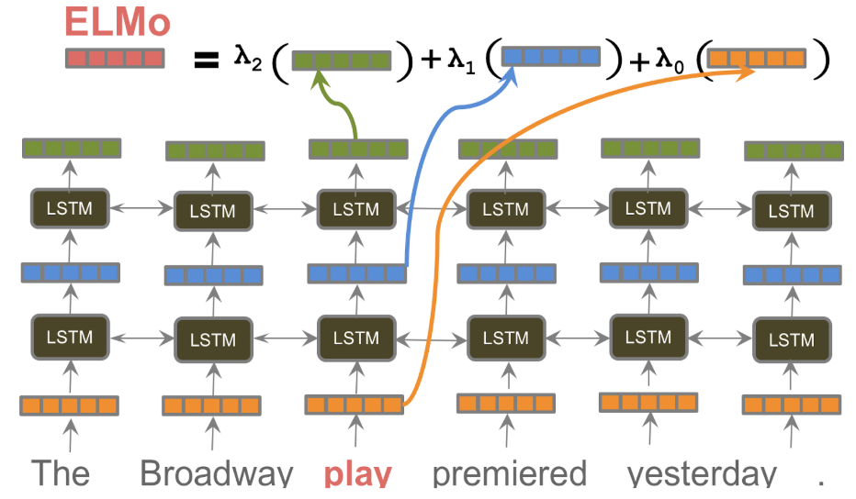
Model structure
[ , num_tokens per sentence, num _dimension]
3
Average
[num_tokens per sentence, num _dimension]
Average
[num _dimension]
ESRC sentence representation
(peters et al, NAACL 2018)
Notes:
I divided our model structure into two parts.
The first part is for generating the ELMO sentence representation, the image is from peters’ presentation (which is hold in the tutorial session on last Sunday).
ELMO actually generate 3 different features, one is from the char-level cnn contains morphological features, others two are from BiLSTM which contains the contextual information.
The output of ELMO is actually a three dimensional matrix, and we just average the first dimension to get a overall representation, and then average it again to generate sentence level representation.
Finally, each document becomes to a set of sequences as the input to our model.

Slide 14
Model structure
Output
Fully connected Layer, Sigmoid
Maxpooling
Maxpooling
Maxpooling
Maxpooling
Maxpooling
Batch Normalization
Batch Normalization
Batch Normalization
Batch Normalization
Batch Normalization
Conv Layer, k=2, ReLU
Conv Layer, k=3, ReLU
Conv Layer, k=4, ReLU
Conv Layer, k=5, ReLU
Conv Layer, k=6, ReLU
Sequence Input
….
ESRC sentence representation
ESRC sentence representation
ESRC sentence representation
Notes:
In our model I just want to highlight the batch nor, as we found there is a 2% improvement when we add BN after the RELU activation.

Slide 15
Phase 3: Recent works
Will BERT improve model accuracy again?
Can we use other approaches to train sentence representation instead of just taking the average of word embeddings?
Combine meta-data (LDA, word counts, sentiments, etc.) with sentence representation could also improve model accuracy.
Notes:
As we know the competition will never end, Here are some recent works we have done on this dataset.
1.Yes, we used the same process to generate a BERT sentence representation and train it on the same CNN model, it outperformed ELMO by 2%. But this result is only train and test on the BY-ARTICLE training set (645) ONLY, so I think it is good to know how the BERT model on the official evaluation set (628), so that would be great if the task organizer could make the rest of test data on public!
2. Yes, we have tried use Hierarchical CNN and H-RNN to generate the sentence embeddings but TBH, average still better as we think the training sample is still too small for such model, so it is easily to get overfitted.

Slide 16
thanks
Questions?
Email: yjiang18@sheffield.ac.uk
Code: https://github.com/GateNLP/semeval2019-hyperpartisan-bertha-von-suttner
Homepage: ye-jiang.github.io

