Slide 1
Facial Expression Recognition
-- Yuanqi Jin

Slide 2
My start point – to make computer human-like
We spend long time staying in front of computers
We want more feed backs from computers
It would be interesting if computers can interact with people

Slide 3
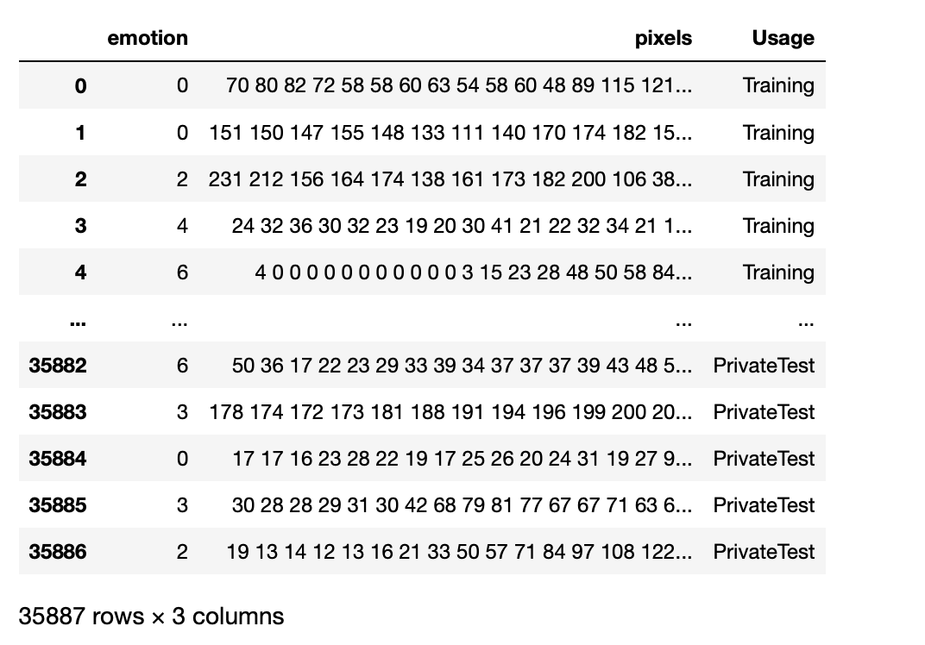
My training data 1
FERG-3D-DB (Facial Expression Research Group 3D Database) for stylized characters, including angry, disgust, fear, joy, neutral, sad, surprise. – fer2013.csv

Slide 4
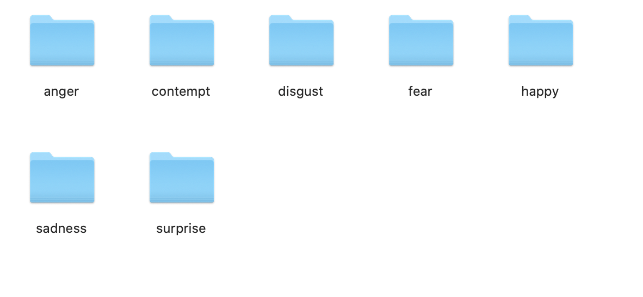
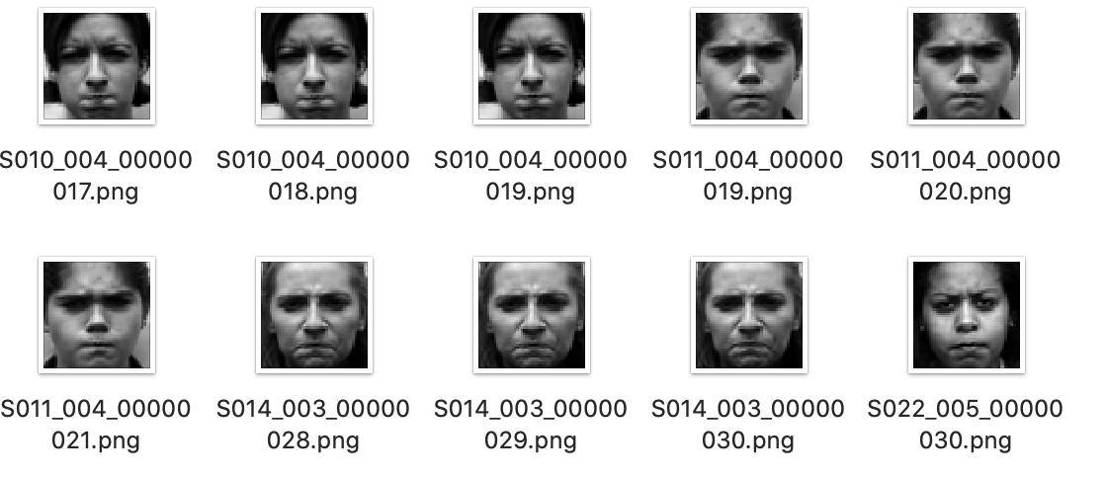
My training data 2
Extended Cohn-Kanad,e Dataset (CK+), including sadness, surprise, happiness, fear, anger, contempt and disgust. – images

Slide 5
Data Preprocessing
Fer2013.csv: Convert the string pixels into numbers and reshape them to be (48,48,1)
CK+: use opencv(cv2) to read all the images, reshape them to be (48,48,3) and label them.
Use to_categorical() function to transform Y (labels), if we have 7 emotions and the label is 5, it will be converted to [0,0,0,0,0,1,0]

Slide 6
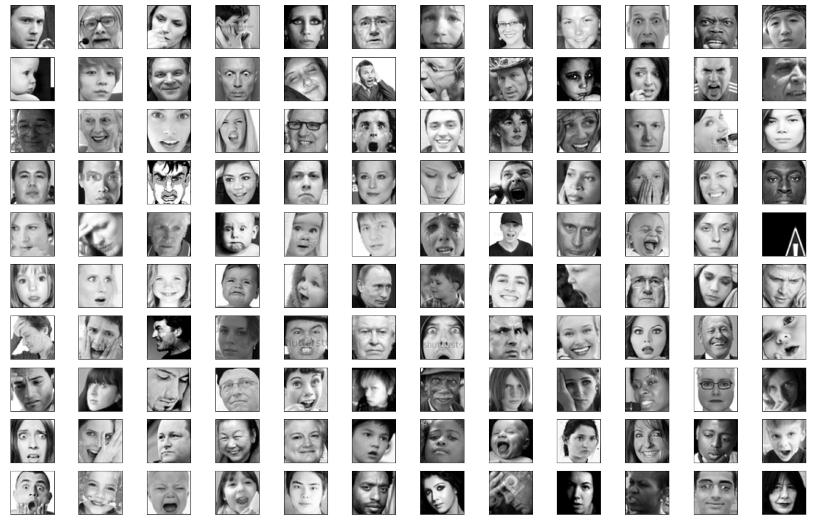
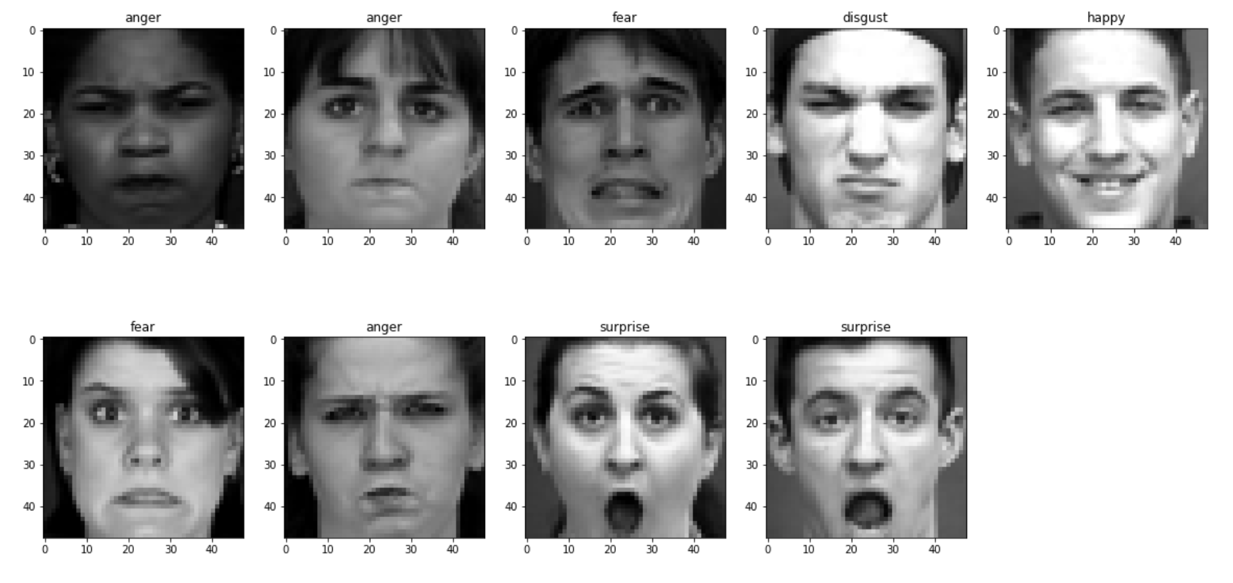
Visualization
Fer2013.csv
CK+ images

Slide 7
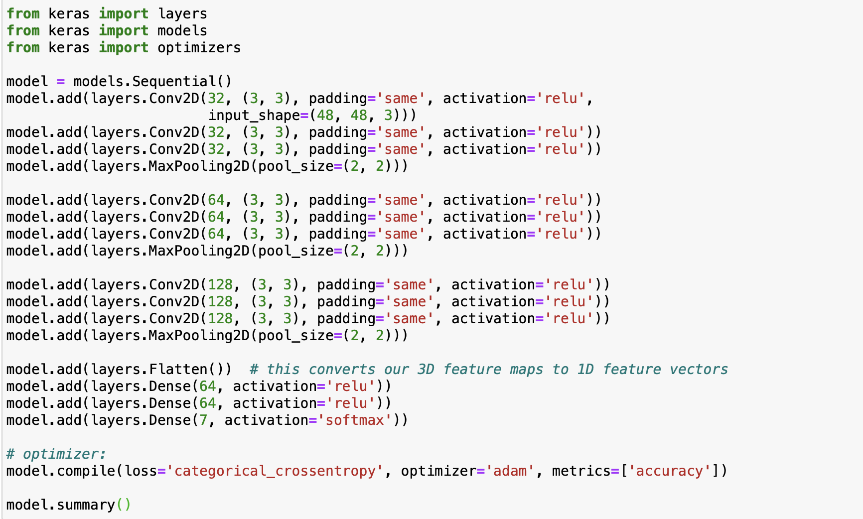
Training – Convolutional Neural Network

Slide 8
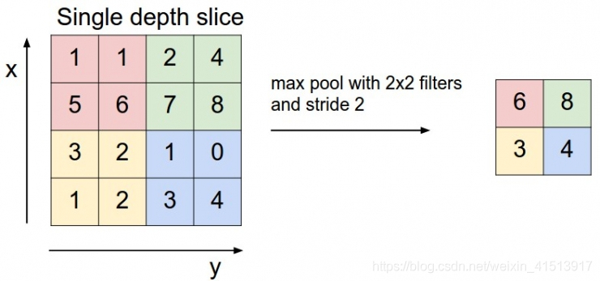
Max pooling

Slide 9
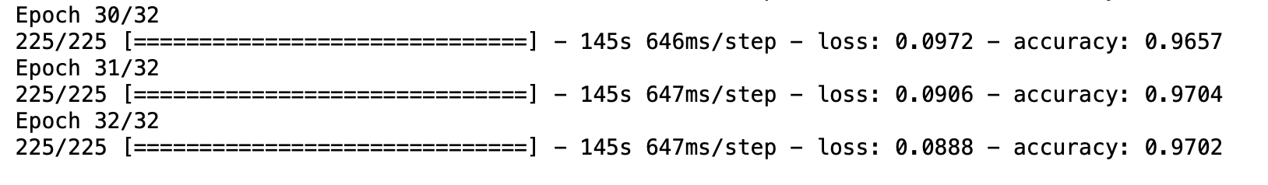
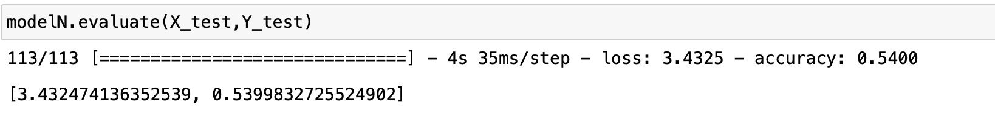
Result: fer2013.csv

Slide 10
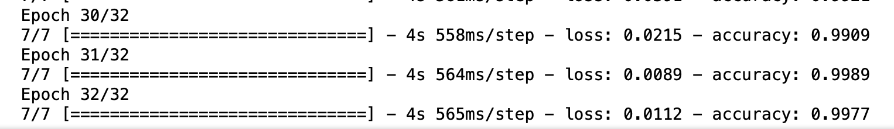
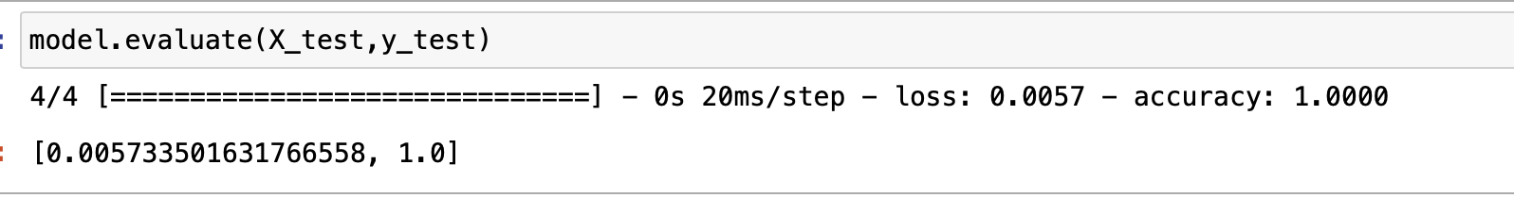
Result: CK+ images

Slide 11
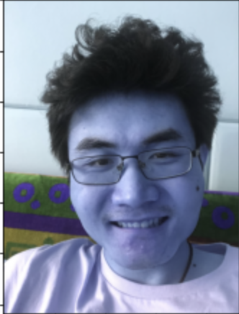
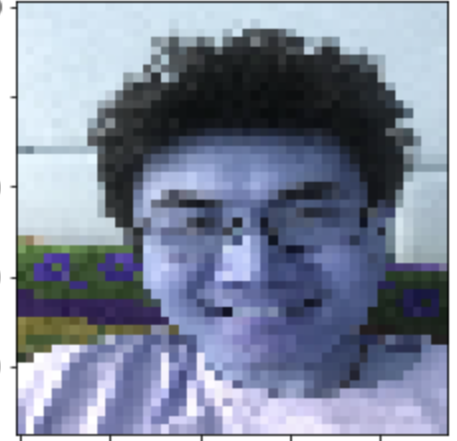
A Big Problem -- Resolution
(3088,2320,3)
(48,48,3)

Slide 12
References:
https://www.kaggle.com/ashishpatel26/tutorial-facial-expression-classification-keras
https://en.wikipedia.org/wiki/Facial_expression_databases
https://blog.csdn.net/weixin_41513917/article/details/102514739

