Slide 1
Newton’s Iteration
Presented:
Yuchen Jin

Slide 2
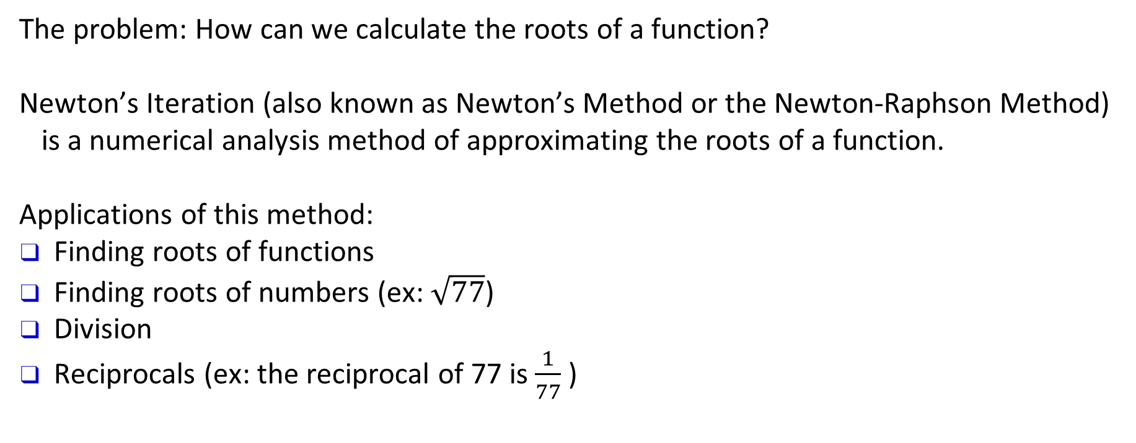
Background
The problem: How can we calculate the roots of a function?
Newton’s Iteration (also known as Newton’s Method or the Newton-Raphson Method) is a numerical analysis method of approximating the roots of a function.
Applications of this method:
Finding roots of functions
Finding roots of numbers (ex: $\sqrt{77}$)
Division
Reciprocals (ex: the reciprocal of 77 is $\frac{1}{77}$ )

Slide 3
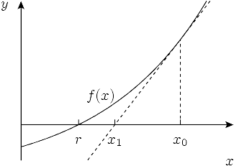
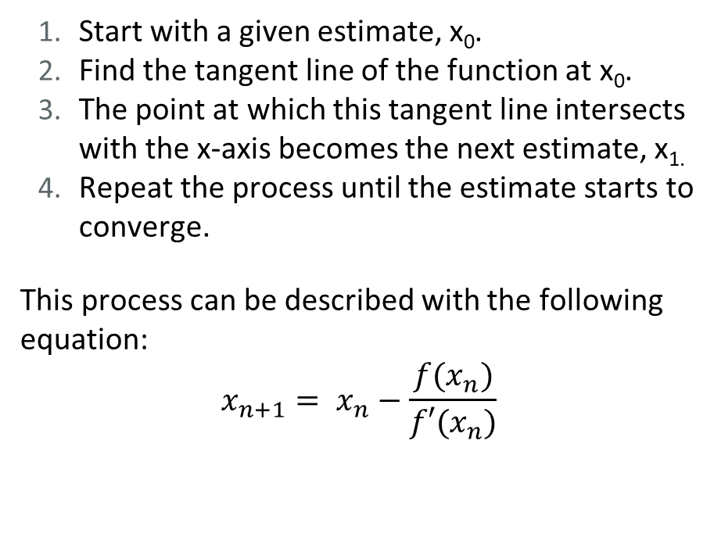
Algorithm
Start with a given estimate, x₀.
Find the tangent line of the function at x₀.
The point at which this tangent line intersects with the x-axis becomes the next estimate, x_{1.}
Repeat the process until the estimate starts to converge.
This process can be described with the following equation:
$$x_{n+1}= x_{n}−\frac{f(x_{n})}{{f′(x}_{n})}$$
(source)

Slide 4
Deriving the equation
The slope of the tangent line at (x0, f(x0) ) can be expressed as the following equation: f'(x0)=f(x0) – 0 / x0-x1, obtained by inserting the points (x0, f(x0) ) and (x1, 0 ) into the slope formula m = y2-y1 / x2-x1.
Solve the slope formula for x1:
(x0-x1) f'(x0)=f(x0) - 0
x0-x1=f(x0)f'(x1)
x1=x0-f(x0)f'(x0)
If we derive the equation for x2, we will end up with x2=x1-f(x1)f'(x1)and so on for x3,x4…. The sequence can be summarized with the Newton Iteration equation.

Slide 5
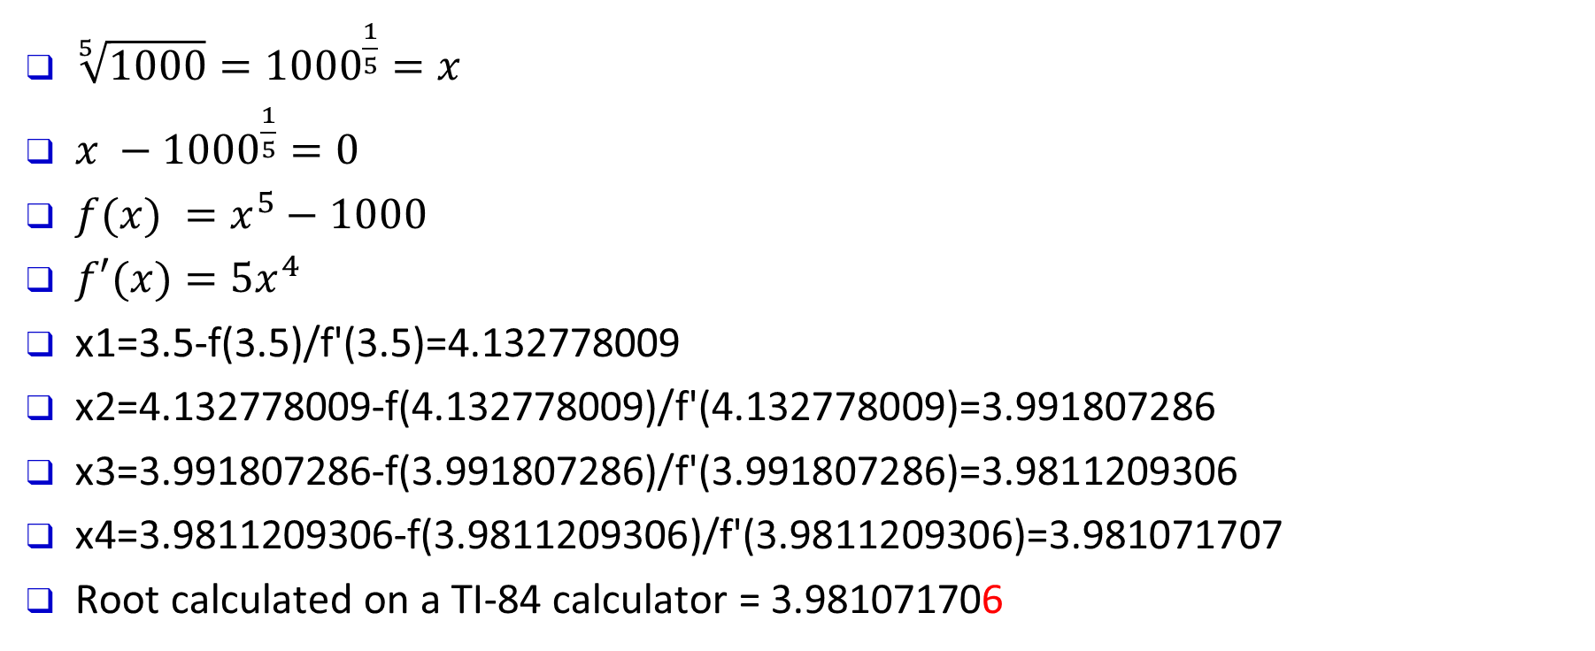
Example: Use Newton’s Iteration to solve for $\sqrt[5]{1000}.$Start with $x_{0}=3.5$ and estimate root up to $x_{4}$
$\sqrt[5]{1000}={1000}^{\frac{1}{5}}=x$
$x −{1000}^{\frac{1}{5}}=0$
$f(x) =x^{5}−1000$
$f′(x)=5x^{4}$
x1=3.5-f(3.5)/f'(3.5)=4.132778009
x2=4.132778009-f(4.132778009)/f'(4.132778009)=3.991807286
x3=3.991807286-f(3.991807286)/f'(3.991807286)=3.9811209306
x4=3.9811209306-f(3.9811209306)/f'(3.9811209306)=3.981071707
Root calculated on a TI-84 calculator = 3.981071706

Slide 6
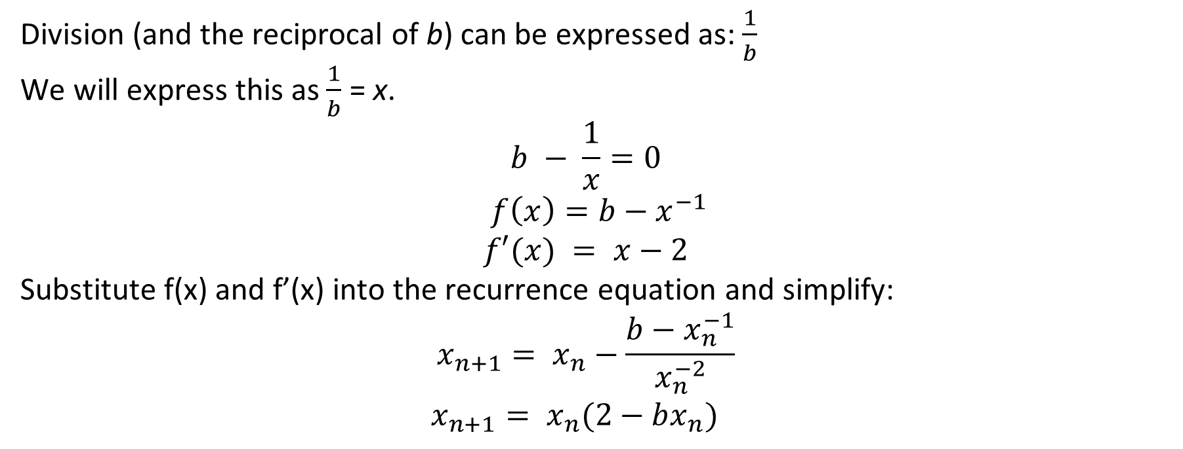
Division Using Newton’s Iteration
Division (and the reciprocal of b) can be expressed as: $\frac{1}{b}$
We will express this as $\frac{1}{b}$ = x.
$$b − \frac{1}{x}=0$$
$f\left(x\right)=b−x^{−1}$
$$f′(x) = x−2$$
Substitute f(x) and f’(x) into the recurrence equation and simplify:
$$x_{n+1}= x_{n}−\frac{b−x_{n}^{−1}}{x_{n}^{−2}}$$
$$x_{n+1}= x_{n}(2−bx_{n})$$

Slide 7
Example: Calculate 1/115 using Newton’s Iteration. Start with $x_{0}=.001$
x1=.001(2-115 • .001) =.001885
x2=.001885(2-115 • .001885)=.0033613791
x3=.0033613791(2-115 • .0033613791)=.0054233882
x4=.0054233882(2-115 • .0054233882)=.0074642653
x5=.0074642653(2-115 • .0074642653) =.0085212761
Quotient calculated on a T1-84 calculator = .0086956522

Slide 8
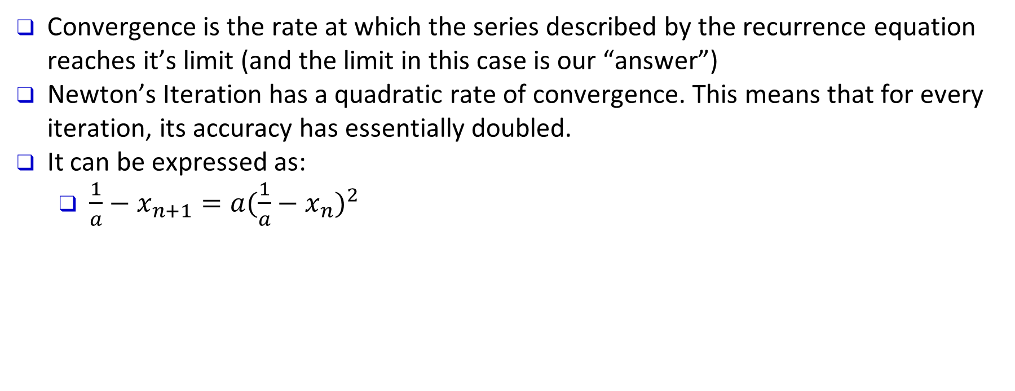
Quadratic Convergence
Convergence is the rate at which the series described by the recurrence equation reaches it’s limit (and the limit in this case is our “answer”)
Newton’s Iteration has a quadratic rate of convergence. This means that for every iteration, its accuracy has essentially doubled.
It can be expressed as:
$\frac{1}{a}−x_{n+1}=a{(\frac{1}{a}−x_{n})}^{2}$

Slide 9
Code
from scipy.misc import derivative
# basic newton iteration algorithm
def newton(func, estimate, min_error=.0001):
diff = func(estimate)/derivative(func, estimate)
while abs(diff) > min_error:
diff = func(estimate)/derivative(func, estimate)
estimate = estimate - diff
diff = func(estimate)/derivative(func, estimate)
return estimate

Slide 10
Code
# newton iteration for division
def newton_div(a, min_error=.0001):
k = 0
while 10**k < a:
k += 1
init_estimate = 1/(10**k)
estimate = init_estimate * (2 - (a * init_estimate))
diff = estimate - init_estimate
while min_error < abs(diff):
old_estimate = estimate
estimate = estimate * (2 - (a * estimate))
diff = estimate - old_estimate
return estimate

Slide 11
Time Complexity
Newton’s Iteration: O(lognF(n))
logn because of the quadratic convergence rate. Each iteration takes us halfway closer to the answer.
where F(n) is the time boundary on the operation f(x) / f’(x).

Slide 12
Thank you.
2

