Slide 1


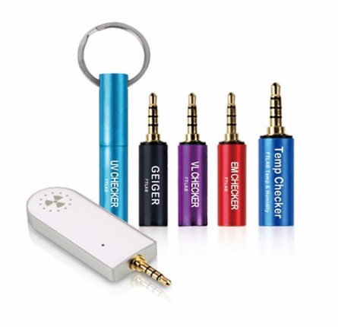
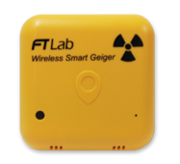
IoT 기반 무선방사능측정 기기 및 시스템
Copyright© 2000-2019 Technonia,Inc. All Rights Reserved.
This document, which contains business secrets and confidential information, is a property owned by Technonia.

