Slide 1
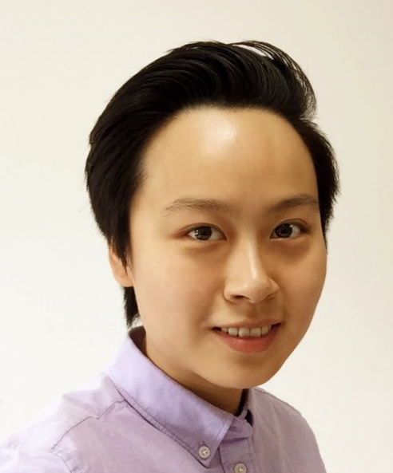
Yue JIN
ISTJ Personality
Introvert | Observant | Thinking | Judging
2013-2016
Worked as Business Analyst / Management Consultant, mostly serving clients from healthcare industry
Gradually fell in love with Data
2017
Finished Udacity Data Analyst NanoDegree
Present
Master Student in Biostatistics
University of Michigan
2013
Bachelor of Clinical Medicine
SJTU, China
2016
Started to learn programming for data visualization and machine learning
Got Stanford Machine Learning Online Certificate

Slide 2


User Side
App Side
1
Rate beers you have tried before
Set additional preference (manufacturer region, beer style, bitterness, alcohol content and etc.)
2
Recommend new beers you may like
3
Provide feedback on recommended beers after you tried them
4
Improve future recommendations according to user feedback

