Slide 1
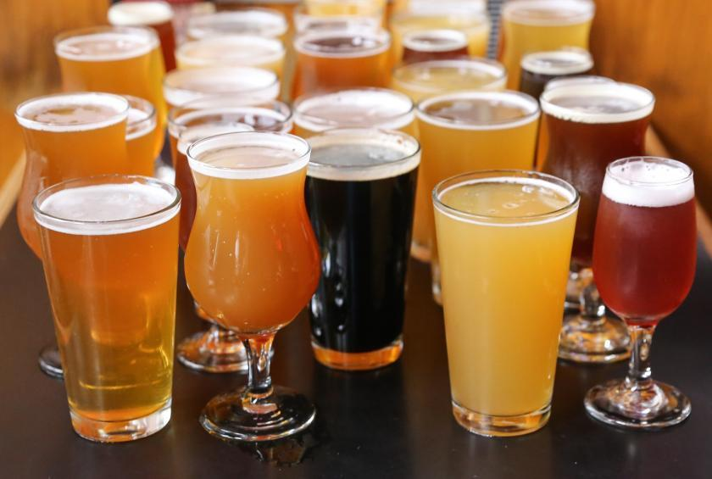
Data Incubator Finalist Presentation
Yue JIN
16 May 2018

Slide 2
About Me

Slide 3
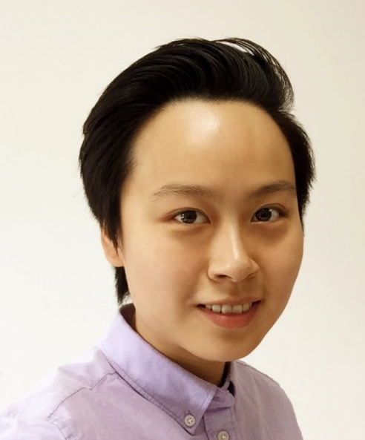
Yue JIN
ISTJ Personality
Introverted | Observant | Thinking | Judging
2013-2016
Worked as Business Analyst / Management Consultant, mostly serving clients from healthcare industry
Gradually fell in love with Data
2017
Completed Udacity Data Analyst NanoDegree
Present
Master Student in Biostatistics
University of Michigan
2013
Bachelor of Clinical Medicine
SJTU, China
2016
Started to learn programming for data visualization and machine learning
Obtained Stanford Machine Learning Online Certificate

Slide 4
Project Introduction

Slide 5


BeerRadar
A Beer Recommendation APP for Craft Beer Lovers
User Side
App Side
1
2
Rate beers you have tried before
Set additional preference (manufacturer region, beer style, bitterness, alcohol content and etc.)
Recommend new beers you may like
3
4
Provide feedback on recommended beers after you tried them
Improve future recommendations according to user feedback

Slide 6
Project Motivation
A Hobby for Me:
Personally, I love craft beer
From 2016 to Present, I tasted 152 different beers
Great Market Potential:
Huge user base: 4.71M monthly users of BeerAdvocate.com, 2.99M monthly users of Ratebeer.com, 3.07M monthly users of Untappd.com*
Business model succeeded in similar field: Recommendation algorithm + Product merchandise for wine - BrightCellar
*Source: https://craftbeerinsandiego.com/blog/ratebeerisdeadlongliveuntappd

Slide 7
Data Source
Data was scraped from BeerAdvocate.com:
104 Beer Styles
13K Breweries from around the world
200K Beer Items
7 Million+ Ratings from 300K+ Users
3 GB Total Data Size

Slide 8
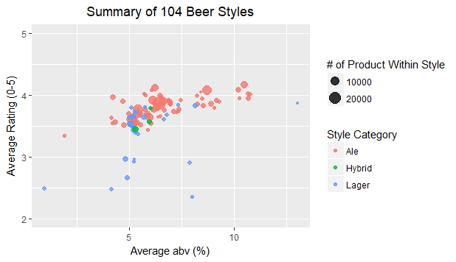
For Beer Styles… Stronger Ale is always better!

Slide 9
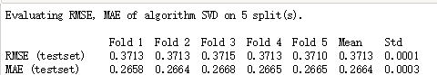
Algorithm Test Run: Mean error of 0.3/5.0
SVD matrix factorization implemented on 2.2 Million ratings from 9000 Users on 1300 Beers*
Cross validation result:
RMSE (Root Mean Square Error): 0.37/5.00
MAE (Mean Absolute Error): 0.27/5.00
Performance will be further improved:
Algorithm parameter tuning
Leverage text features extracted from textual comments
Incorporate popularity based/content based algorithms
* Subset of the full dataset, which includes ratings from users who submitted >100 ratings on beers with >1000 ratings

Slide 10

Project Timeline
Phase One: 19th April ~ 31st May
Phase Two: 1st June ~ 10th August
Data
Scraping
Data
Cleaning
Exploratory Data Analysis
Model Selection
& Training
Function Testing
Interface Design
…And Cheers!

