Slide 1

User
Service
Table
t_book
t_user
t_rentInfo
DAO
VO
VO
Database

Slide 2
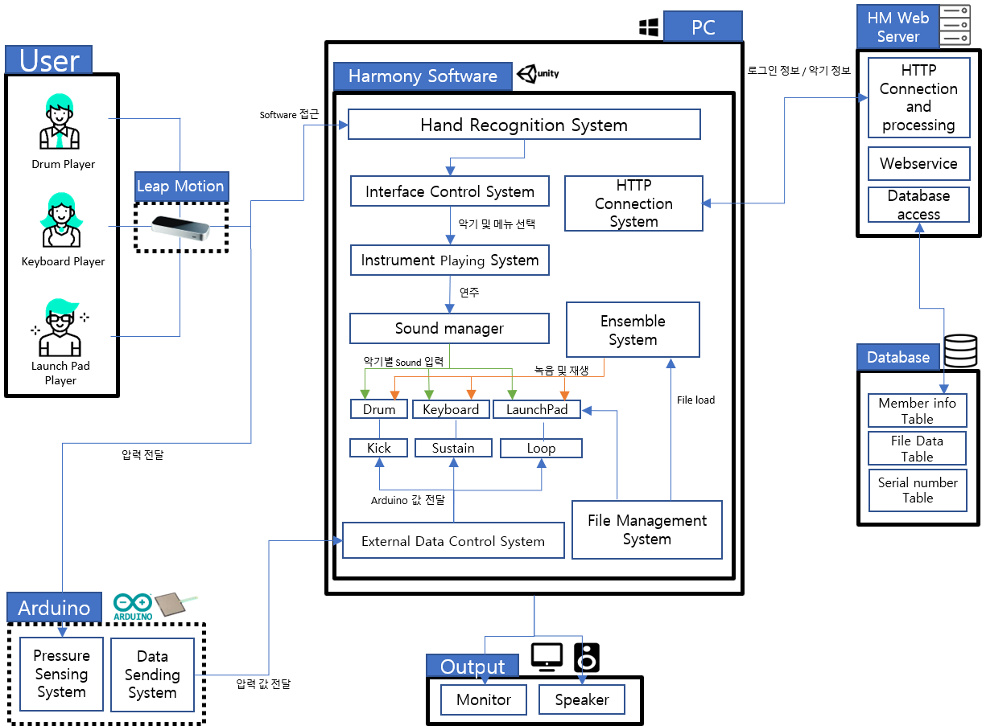

Slide 3


Book Management System
UI
VO
AddBook
BookVO
User
BookList
UserVO
MemberList
Service
DAO
메뉴 선택
Login
해당 서비스 호출
BookService
DAO 호출
BookDAO
User
Borrow
BookList
VO
VO
DeleteBook
입력값
입력값
FindMember
UserDAO
UserService
UserList
ReturnBook
SignUp
FindBook
Exit
프로그램 종료
데이터 값 출력

Slide 4

Book Management System
UI
VO
AddBook
BookVO
BookList
RentVO
User
UserVO
Database
MemberList
DAO
Service
메뉴 선택
RentList
Table
t_book
t_rentInfo
t_user
해당 서비스 호출
DAO 호출
DB 접근
User
Login
BookService
BookDAO
Borrow
VO
VO
RentService
RentDAO
DeleteBook
입력값
입력값
FindMember
UserService
UserDAO
ReturnBook
SignUp
FindBook
Exit
프로그램 종료
데이터 값 출력

