Slide 1
Isolation in Relational Databases (3)

Slide 2
Isolation in Relational Databases
Locking in Relational Databases
SQL Isolation Levels
Granular Locks
Index Locking
Multiversion Controls (MVCs)
SNAPSHOT Isolation

Slide 3
Index Locking
Index Locks
Predicate Locks
Key-Range Locks

Slide 4
Preventing Phantoms
Lock entire table - this works
T₁ executes SEL(P): (where P is a predicate), obtains long-duration S lock on table
T₂ executes INS(t): requires long-duration X lock on table
Phantom prevented
Lock the predicate P - this works but entails too much overhead
Can granular locking be used?

Slide 5
封锁的选择
Lock entire table
Lock table/pages
No Appropriate Index for P
Index idx_I exists on attribute P，but no Index Locking
Index idx_I exists on attribute P，and use Index Locking

Slide 6
Lock entire table - Example
T₁: SELECT F.Name
FROM Faculty F
WHERE F.Salary > 70000
Holds: long-duration S lock on Faculty
pages of row which salary>7000
Faculty
...,75000,...
c
a b d
T₂: INSERT INTO Faculty
VALUES (…75000, …)
Requests: long-duration X lock on Faculty
inserted row
lock conflict detected on table Faculty, T₂ is waiting......

Slide 7
① No Appropriate Index for P
Assume containment hierarchy is table/pages:
T₁ does SEL(P): obtains long-duration S lock on table
Since it must read every page to find rows satisfying P
T₂ requests INS(t): obtains long-duration IX lock on table and X lock on page into which t is to be inserted.
lock conflict detected (on table), hence (a potential) phantom is prevented
However other transaction can read parts of the table that are stored on pages other than the one on which t is stored
Notes:
提供‘表/页面’两级的多粒度封锁

Slide 8
① No Appropriate Index for P - table / pages
T₁: SELECT F.Name
FROM Faculty F
WHERE F.Salary > 70000
Holds: long-duration S lock on Faculty
because no index can be used for salary>7000, T₁ must read every page to find rows satisfying salary>7000
pages of row which salary>7000
Faculty
...,75000,...
c
a b d
T₂: INSERT INTO Faculty
VALUES (…75000, …)
Requests: long-duration IX lock on Faculty,
计划在页面c中插入新元组，需要申请表上的IX锁和页面c上的X锁
waiting ......
lock conflict detected on table Faculty, T₂ is waiting......

Slide 9
② Index I exists on attribute P but NO Index-locking
T₁ obtains long-duration IS lock on table, uses I to locate pages containing rows satisfying P, and acquires long-duration S locks on them.
T₂ obtains long-duration IX lock on table (no conflict) and X lock on page p, into which t is to be inserted.
Problem: Since p might not be locked by T₁, a phantom can result.
Notes:
注：1、在有索引可用的情况下，事务T1可以利用索引来查找满足条件的元组指针，不需要遍历整张表来执行查询。
2、事务T2在表中找到一个page p来插入新元组（如果p恰好没有被T1封锁上），然后在索引中插入该新元组对应的索引项。由于没有提供索引上的封锁机制，因而T1和T2可以并发运行，但有可能产生phantom问题。

Slide 10
② No Index Granular Locking - table / pages
T₁: SELECT F.Name
FROM Faculty F
WHERE F.Salary > 70000
unclustered
index on
Salary
Request & Holds:
IS lock on Faculty
S lock on page a, b, d
e
Faculty
c
a b d
T₂: INSERT INTO Faculty
VALUES (…75000, …)
inserted row
Request & Holds:
IX lock on Faculty,
X lock on page c
no lock conflict, but
a phantom can result. !

Slide 11
③ Index Locking
Solution: lock pages of the index in addition
Example: I is an unclustered B⁺ tree.
T₁ (SEL(P)) obtains:
long-duration IS lock on table,
long-duration S locks on the pages containing rows satisfying P, and
long-duration S locks on the leaf index pages containing entries satisfying P
T₂ (INS(t)) requests:
long-duration IX lock on table (granted),
long-duration X locks on the page into which t is to be inserted (might be granted), and
long-duration X lock on the leaf index page into which the index entry for t will be stored (lock conflict if t satisfies P)
The phantom is prevented!

Slide 12
③ Index Locking - Example
T₁: SELECT F.Name
FROM Faculty F
WHERE F.Salary > 70000
Holds: IS lock on Faculty,
S lock on a, b, d, S lock on e
unclustered
index on
Salary
e
Faculty
c
a b d
T₂: INSERT INTO Faculty
VALUES (…75000, …)
Requests: IX lock on Faculty,
X lock on c, X lock on e
inserted row
lock conflict detected on index page e, phantom is prevented !

Slide 13
Index Locking
B⁺ tree
index entries locking and key-range locking
locking index pages

Slide 14
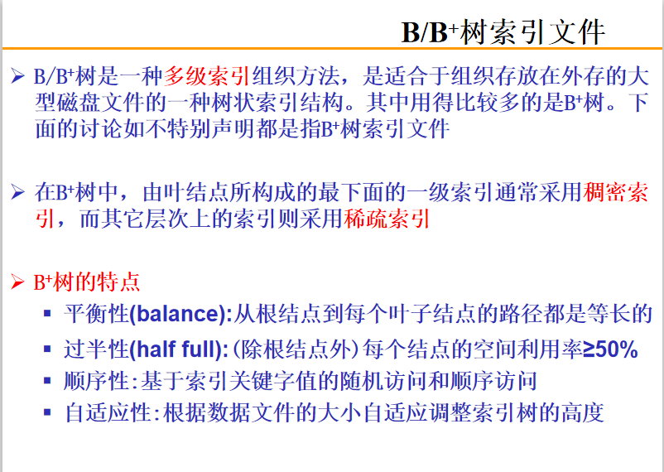
Notes:
稠密索引：表中的每一条元组，在索引中都有对应的索引项；稀疏索引，索引项指向的是表中的page
在B+树中，所有的叶子结点，构成表上的一个顺序稠密索引。

Slide 15
B⁺ tree
the order of tree (树的'阶'数)
the order of tree is the maximum number of children
N-ary B⁺-tree ( N-阶B⁺树 )
Node Type | Children Type | Min number of key value | Max number of key value
root node (the only node in the tree) | None | 1 | N − 1
root node | internal node or leaf node | 1 | N − 1
internal node | internal node or leaf node | ⎣ (N−1) / 2 ⎦ | N − 1
leaf node | None | ⎣ N / 2 ⎦ | N − 1
Notes:
树的'阶'数：有两种定义方式（1）是指每一个结点能够拥有的子结点的最大数目；（2）是指每一个结点中能够存放的关键字的最大数目。在本文中采用第（1）种定义方式。
备注: ⎣ x ⎦ 表示‘向下取整’，返回 ‘小于等于x的最大整数’； ⎡ x ⎤ 表示‘向上取整’，返回 ‘大于等于 x 的最小整数’
1、如果这棵树只有一个结点（the only node in the tree)，那么该结点既是根结点也是叶子结点，其中的指针不是子树指针而是关键字对应的元组指针；
2、在内部结点和叶子结点中，关键字数目的下界有所不同，主要是因为内部结点和叶子结点的分裂处理算法不一样。
3、关于‘树的阶数’的定义，有些地方指‘在一个结点中存放的关键字的最小数目’，有点地方指‘一个结点可以拥有的子结点的最小数目’（即结点中子树指针的最小数目），本文使用的是后一种定义。

Slide 16

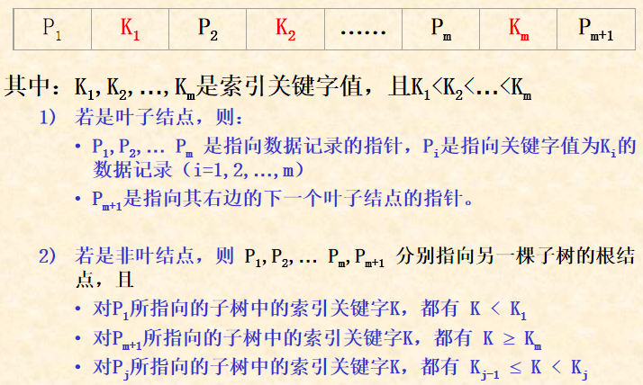
node of N-ary B⁺-tree
each node have m key values and (m+1) pointer, and K₁<K₂<…<K_{m} （1 ≤ m < N）

Slide 17
Index, Predicate & Key-Range Locks
If a WHERE clause:
refers to a predicate name = mary and if there is an index on name,
then an index lock on index entries for name = mary
is like a predicate lock on that predicate
If a WHERE clause refers to a
predicate such as 50000< salary < 70000 and if there is an index on salary,
then a key-range index lock can be used to get the
equivalent of a predicate lock on 50000<salary<70000

Slide 18
Key-Range Locking
Instead of locking index pages, index entries at the leaf level are locked (Each such lock is interpreted as a lock on a range )
Suppose the entries in the index are k₁,k₂,... and k₁<k₂<k₃<...<k_{n}
（省略了其中的子结点指针）
k₁ | k₂ | k₃ | ...... | k_{n}
lock on index entry | lock on key-range
k_{s} (1≤s<n) | key ∈ [ k_{s}, k_{s+1} )
k_{n} | key ≥ k_{n}
a new lock | key < k₁
Notes:
在一个含有 n 个关键字的叶子结点中，将关键字的定义域划分为 n+1 个区间 (key range)
1）设置一个虚拟的索引项 (index entry) 代表‘小于 k₁ 的所有关键字'
2）关键字 k_{s}（1≤s<n）对应的索引项代表 区间 [ k_{s}, k_{s+1} )
3）关键字 k_{n} 对应的索引项代表 ‘大于等于 k_{n} 的所有关键字'
封锁一个索引项（index entry lock）就相当于封锁其对应的索引关键字区间（key range lock）

Slide 19
Key-Range Locking (cont)
Suppose the domain of an attribute is A…Z and suppose at some time the entries in the index are
C | G | P | R | X
For example to lock the interval H<key<T, we would lock all entries from G to R because H∈[G, P) and T∈[R, X)
H
H < key < T
T
key
C
G
P
R
X

Slide 20
Key-Range Locking (cont)
Recall the index entries are:
C | G | P | R | X
For example
the interval of key | lock index entries
H < key < T | lock G, P and R
key ≥ U | lock R and X
key < E | lock [A, C) and C
key < E
H < key < T
key ≥ U
key
U
H
T
U
C
G
P
R
X

Slide 21
Key-Range Locking (cont)
To insert a new key J in the index, search index entry J and return entry G because J∈[G,P)
C | G | P | R | X
J | P | R | X
Lock G thus locking the interval [G P)
Insert J thus splitting the interval into [G J) [J P)
Lock J thus locking [J P)
Release the lock on G
Lock [G,P)
key
C
G
J
P
R
X
Lock [J,P)
Notes:
当需要在一个叶子结点中插入一个新关键字 J 对应的索引项时，其 key range locking 的处理过程如本页PPT所示。
在这里，因为需要做‘插入’操作，所以在申请 key-range 上的封锁时，所申请的锁类型应该是具有排他性的 ‘写封锁’！

Slide 22
Key-Range Locking (cont)
To insert a new key J in the index
C | G | P | R | X
Lock G thus locking the interval [G P)
Insert J thus splitting the interval into [G J) [J P)
Lock J thus locking [J P)
Release the lock on G
If a SELECT statement had a lock on G as part of a key-range, then the first step ① of the insert protocol could not be done
Thus phantoms are prevented and the key-range lock is equivalent to a predicate lock
Notes:
如果另外一个事务已经持有索引项G上的‘读封锁’，那么在本处理流程的第①步，当前事务在申请 G 上的‘写它锁’时就会被拒绝，因而防止了‘幻读’错误。

Slide 23
Index Locking
locking index pages
short term locks / long term locks
lock coupling
Read Locks on a B-Tree Index page
Write Locks on a B-Tree Index page

Slide 24
Locking a B⁺-Tree Index
Many operations need to access an index structure concurrently
This would be a bottleneck if conventional two-phase locking mechanisms were used
Understanding index semantics, we can develop a more efficient locking algorithm
Goal is to maintain isolation among different operations, concurrently accessing the index
The short term locks on the index are called latches
The long term locks on leaf entries we have been discussing are still obtained

Slide 25
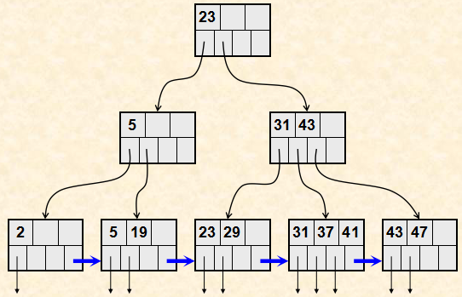
Example of B⁺-Tree Index

Slide 26
Read Locks on a B⁺-Tree Index Page
Obtain a read lock on the root, and work down the tree locking each entry as it is reached
When a new entry is locked, the lock on the previous entry (its parent) can be released
This operation will never revisit the parent
No write operation of a concurrent transaction can pass this operation as it goes down the tree
Called lock coupling or crabbing
Notes:
ReadLock 仅仅用于查询（即以‘只读’方式访问索引树的各个结点），请参考B+树上查找算法的执行流程。一般流程如下（详见下一页的流程图）
输入：随机查找关键字K
1、从根结点开始 ，自顶向下搜索到某个叶子结点；
2、在每一个结点中，根据其中保存的关键字值，将整个关键字的值域划分为若干个‘取值区间’
3、如果当前结点不是叶子结点，则判断关键字K属于哪一个取值区间，从而决定下一个要访问的索引结点（index page）。
当然，我们从当前结点（被称为’结点P'）找到的是‘下一个将要被访问的索引结点（被称为‘结点C'）的结点指针’（结点P和结点C互为‘父子’关系）
在根据找到的结点指针访问‘下一个’结点C之前，我们先要申请结点C上的ReadLock
在获得结点C上的ReadLock封锁后，当前事务就获得了对于结点C的访问权限，并且之后不需要再回溯访问其父结点P
所以，当前事务在获得子结点C上的ReadLock后，就可以立即释放其父结点P上的ReadLock
这样的封锁使用方式并不符合‘两阶段封锁’协议的要求，但适合于数据库中的 B+ 索引的访问特点
因此，为了提高效率，在B+树结点上的ReadLock的申请和释放都是这样成对出现的，这被称为‘锁耦合’（lock coupling）
4、如果当前结点是叶子结点，就搜索当前页面中是不是有关键字K。
1）如果在当前叶子结点中没有关键字K，则表明K对应的元组不存在，则以失败方式返回并释放当前叶子结点上的ReadLock; （如果是范围查找，则需要顺序扫描当前叶子结点中是否有其他符合条件的关键字，具体请参见B+树上范围查找算法）
2）如果存在，则以ReadLock方式封锁K对应的索引项（key-rangle lock），释放当前结点上的ReadLock，返回查找成功；

Slide 27
request for ReadLock (search key K)
N := root of B⁺ tree
申请结点 N 上的 ReadLock
N is a leaf node?
no
yes
在结点N中寻找关键字K对应的子结点M
在结点N中寻找关键字K
是否存在 K ?
no
申请结点M上的ReadLock
yes
释放结点N上的ReadLock
N := M
申请 K上的 ReadLock
(key-range lock for search)
lock coupling
释放结点N上的ReadLock
Notes:
给定一个关键字K，利用索引树查找其对应的元组是否存在，在索引树上的锁申请与锁释放的处理流程（详细解释请见上一页PPT的注释）

Slide 28
Write Locks on a B⁺-Tree Index
Obtain a write lock on the root, and work down the tree locking each entry as it is reached
When new entry N is locked, if that entry is not full, the locks on all its parents can be released
An insert operation might have to go back up the tree, revisiting and perhaps splitting some nodes
Even if that occurs, because N is not full, it will not have to split N and therefore will not have to go further up the tree
Thus it can release locks further up in the tree.

Slide 29
request for WriteLock (insert key K)
N := root of B⁺ tree
申请结点N上的 WriteLock
if ( 结点 N not full )
then (释放 N 的所有祖先结点上的 WriteLock)
N is a leaf node ?
no
yes
寻找N的子结点M
申请结点M上的 WriteLock
N := M
在结点N中插入关键字 K
(key-range lock for insert)
释放结点N上的 WriteLock

Slide 30
Granular and Index Locking Summary
Algorithm has property that a lock conflict that prevents phantoms will occur:
In the index, when an index is used
At the table level, when no index is used
Even if there is no index, write operations need not get an X lock on whole table, only an IX lock, which allows more concurrency

Slide 31
UPDATE Statement
An UPDATE can be treated as if it were a DELETE followed by an INSERT
If an index attribute is changed, the index entry for the tuple must be moved to a new position
The transaction must obtain write locks on both the old and new index pages

Slide 32
Lock Escalation
To avoid acquiring many fine grain locks on a table, a DBMS can set a lock escalation threshold.
If more than the threshold number of tuple (or page) locks are acquired, the DBMS automatically trades them in for a table lock but …
Beware of deadlock

Slide 33
Performance Hints
Use lowest correct isolation level
Embedding constraints in schema might permit the use of an even lower level
Constraint violation due to interleaving detected at commit time (an optimistic approach)
No user interaction after a lock has been acquired
Use indexes and denormalization to support frequently executed transactions
Avoid deadlocks by controlling the order in which locks are acquired

