Slide 1
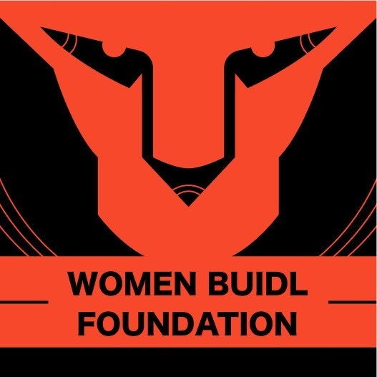
Women Buidl Foundation
Empowering women in web 3 coding!

Slide 2
Vision & Mission
Code is the language of shaping a new world. Women must have a voice in this transformation. Join us, build a new world, starting with learning coding.
We are Women Buidl Foundation (WBF), aiming to facilitate increased female involvement in shaping the Web3 ecosystem. Our goal is to collaboratively establish training camps and knowledge repositories tailored for women, utilizing a decentralized consensus foundation to build a closely-knit community of female builders.

Slide 3
What we have
Scenario 1: Women's Coding Camp
Scenario 2: Building DAO Space
Scenario 3: Job/Project Connect
Scenario 4: Mentorship Program
Scenario 5: Angel Capital

Slide 4

Development Roadmap
1-Year Plan: Conduct coding camps, attract sponsorships.
2-Year Plan: Expand coding camps, deepen partnerships, establish branches.
5-Year Plan: Expand to Asia, international events, impact broader vulnerable groups.
Future Prospects
A) Global Reach: Expand globally, empower women in Web3.
B) Beyond Women: Extend impact to broader vulnerable groups.

Slide 5
Core Functions (Website)
Function 1: Project Showcase
Provide industry updates, tech articles, and exclusive insights.
Function 2: Fundraising
Accept cryptocurrency donations for foundation support.
Function 3: Member Services
Online platform for event registration, forums, and information queries.

Slide 6
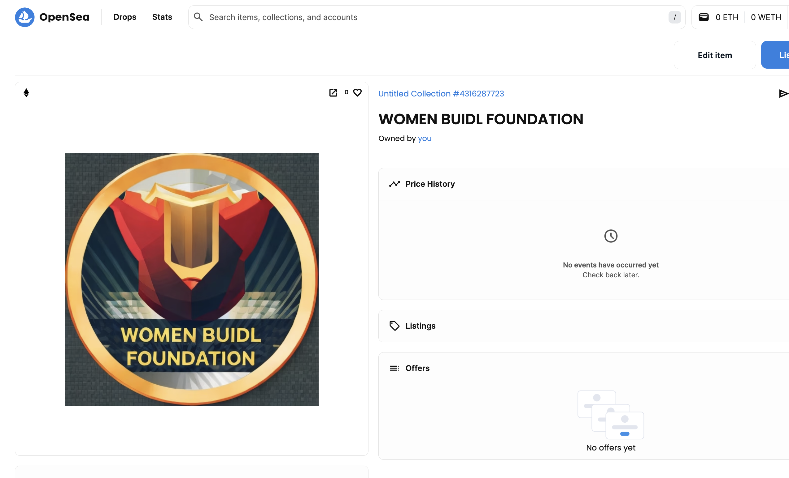
WBF Token
Ethereum + Polygon
ERC20, ERC721 Token

Slide 7
Project Team
Supported by:
MaXX、Qiū Qiū、Wendy
Contributed by:
Yijing: visual design and optimization, content and idea creation.
Jill: website prototype ideation, long-term development planning, and content creation.

Slide 8
Contact Us
Email: contact@wbf.io
Social Media: Weibo, WeChat, XHS, X, Ins
Notion:https://womenbuidl.notion.site

